Slide 1

September 3, 2020
SWAN Quarterly Meeting

Slide 2
Agenda
Welcome & Business
Introduction of new library directors
Tactical Plan Review
Parallel Discovery Platform Project: Aspen Discovery
EBSCO Group Purchase: Early Use & Next Steps
Cataloging & Acquisitions
Data Security & System Reliability
SWAN100: Welcoming Glenside, Roselle, and Warrenville
Next meeting: December 3, 2020

Slide 3
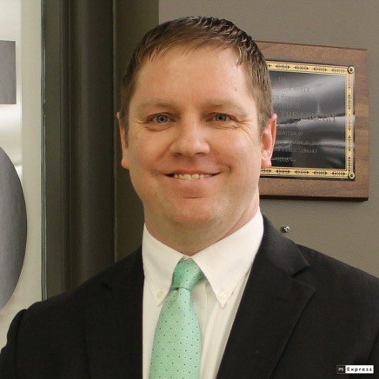
Board Appointment
Jesse Blazek
Library Director at Palos Heights Public Library
Robin Wagner at South Holland Public Library retirement

Slide 4

From Pandemic to Progress
This Photo by Unknown Author is licensed under CC BY-NC

Slide 5
2019 Tactical Plan completed goals
Objective 1: Develop a Shared and Accurate Diagnosis of Member Dissatisfaction Around the Existing ILS and OPAC (Staff Interface and Online Catalog)
Form Operational Think Tank, AKA Clarity Task Force
Create a Curriculum of Training for Library Staff
Conduct ILS Processing Inefficiencies Evaluation
Create More Online Documentation
Assess the Discovery Platform for SWAN & Provide Recommendation
Objective 2: Deliver on the Solutions that Can Be Readily Implemented, While Focusing on Long Term Solutions
Complete Infrastructure Migration
Membership Implementation Schedule
Offer Library Patrons Mobile Application through BLUEcloud Mobile
Create New OCLC Holdings Update Process for SWAN: OHM
Study & Offer E-Content Consortia Purchases
Evaluate BLUEcloud Staff Interface
Perform an Assessment of BLUEcloud Acquisitions
Automated Delivery In-Transit Label
Negotiate Extension of SirsiDynix Agreement
Negotiate Long Term Agreements with EBSCO & OCLC
Determine Community Driven Software Initiatives within FY21 Operations Budget
Objective 3: Reconstitute as a Mission Driven 501c3 with Clear Representative Governance Practices
Evaluate Organization Legal Entity
Revise SWAN Budget Structure
Objective 4: Increase Presence of Patron Experience
Develop & Deploy Online Patron Registration
Develop & Incorporate Patron Help into Public Catalog
Objective 5: Strengthen the Collective Identity
Pilot Online Membership Forums
Plan SWAN Expo 2019 Event
Clarify Role of SWAN Advisory & User Groups

Slide 6
2020 Tactical Plan Highlights
April – June 2020
Implement parallel discovery platform
Develop audio-visual (AV) Item Type recommendations for SWAN100
Establish uniform parameters for fine free
Continue BLUEcloud Staff interface pilot & targeted deployment
Continuing work
Standardize the management of holds for New Items (Clarity Recommendation)
Pilot BLUEcloud Acquisitions + Baker & Taylor rental
July – September 2020
Support & Promote EBSCO group-purchase
Add three libraries to SWAN– “SWAN100 Project”
Build “your library statistics” monthly report
Read full Tactical Plan on SWAN support site
About > Mission, History, Objectives > Strategic Objectives > Tactical Plan
https://support.swanlibraries.net/tactical-plan

Slide 7
Parallel Discovery Platform Project:
Aspen Discovery
Tara Wood, SWAN User Experience Manager

Slide 8
Background
Clarity Task Force identified our discovery platform as a source of dissatisfaction in the membership, especially around relevancy
Aspen was the highest-scoring platform in the Discovery Platform Evaluation, conducted with DUX February 2019 – March 2020
Exploratory research and testing with Aspen began in mid-May 2020, in partnership with ByWater Solutions
https://support.swanlibraries.net/aspen
Notes:
Discovery Platform started with a survey of about 60+ platforms, an evaluation on priority features identified by DUX, and we came down to only two platforms that could potentially better meet our needs: Bibliocommons and Aspen
We were actually all set to go forward on testing in March, but the pandemic happened and we had to put the project on hold
Aspen is an open source platform, but ByWater is providing support and development. This means in the future there is the potential for us to contribute code to the project

Slide 9

Milestones
Milestone | Target Start | Target Complete | Done?
Aspen Test System Installation | May 2020 | June 2020
Create Personas & User Stories | May 2020 | June 2020
Search Query Set | May 2020 | June 2020
Expert Review & Configuration | June 2020 | TBD
Usability Testing – Library Staff | May 2020 | TBD
Usability Testing – Library Patrons | Dependent on test system configuration | TBD
Recommendation to SWAN Board |  | Q4 2020
Phase 2 - Pilot Phase | Dependent on Board discussion & decision
Notes:
We’ve set up 1 consortial catalog and 4 library instances we selected based on testing needs. St. Charles – has all the resources. Oak Park – branches. Elmwood Park – representative in terms of size and collections for the majority of our libraries. National – academic library.

Slide 10
Features
Grouped records (FRBR)
Improved relevancy
Theme and branding features
Public service features
Combined results
Bonus features

Slide 11
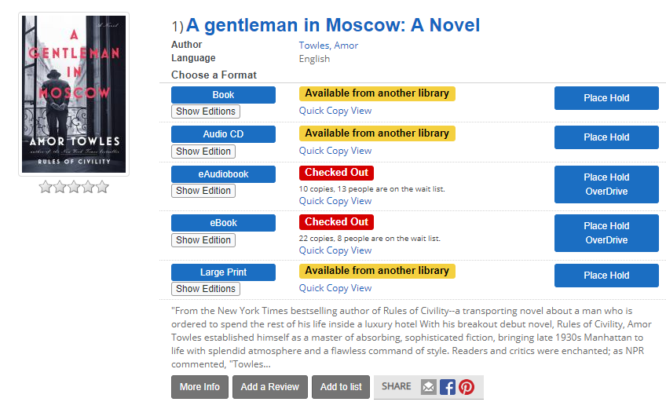
Grouped Records (FRBR)
Notes:
Record grouping was a major priority, since it would immediately resolve many of our relevancy issues.
Groups all formats of a work together, so its easier for the patron to find what they are looking for.
No longer need to worry about paperback version surfacing over hardcover with more copies. Finding large print is much easier.
An awesome bonus is that the grouped record inherits the best features from the individual records.
Overdrive record now has all the careful cataloging from our ILS records applied to it. You can use facets with eBooks that you can’t in Enterprise, like Fiction/Non-fiction. And there’s also some hold calculations in there – if you don’t care what edition of the Pride & Prejudice book you get, you can just get the first available edition whether its hardcover, paperback, etc. or drill down to place a hold on a specific edition.

Slide 12
Relevancy – Known Item Searches
In the July 2020 meeting, DUX and cataloging advisory compared keyword searches in Aspen and Enterprise
Used a set of patron personas to develop keywords
Recorded the position of known items in the results (e.g. 2nd result)
Recorded the number of relevant results in a topic search (e.g. 10/25)
Relevancy scores for known item searches (position in results)
Measure | Enterprise | Aspen
Mean | 11.5 | 1.9
Median | 2 | 1
Below 1st | 66.7% | 39.4%
Below 5th | 25% | 6.1%
Below 10th | 19.4% | 0%

Slide 13

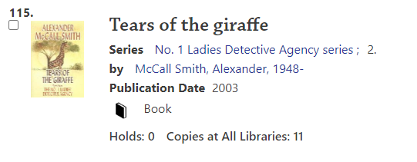
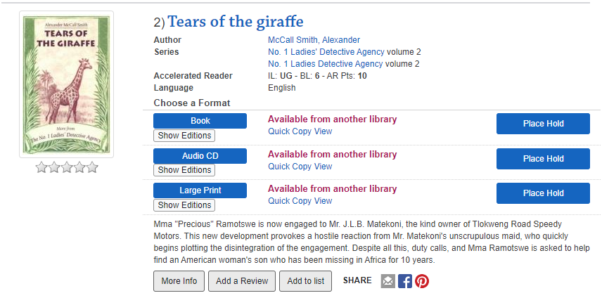
Series = "ladies detective agency"
Enterprise
Aspen
115
2
Keywords: "ladies detective agency", format book, looking for the 2nd book in the series

Slide 14
Relevancy – Topic/Author Searches
Measured precision by ranking the top 5 results in the search
Relevant
Near
Misplaced
Irrelevant
...and feeding through a fancy spreadsheet formula
Precision scores for topic searches
Measure | Enterprise | Aspen
Strict (Rs) | 52% | 67%
Loose (Rs, Ns) | 62% | 74%
Permissive (Rs,Ns, Ms) | 82% | 87%

Slide 15
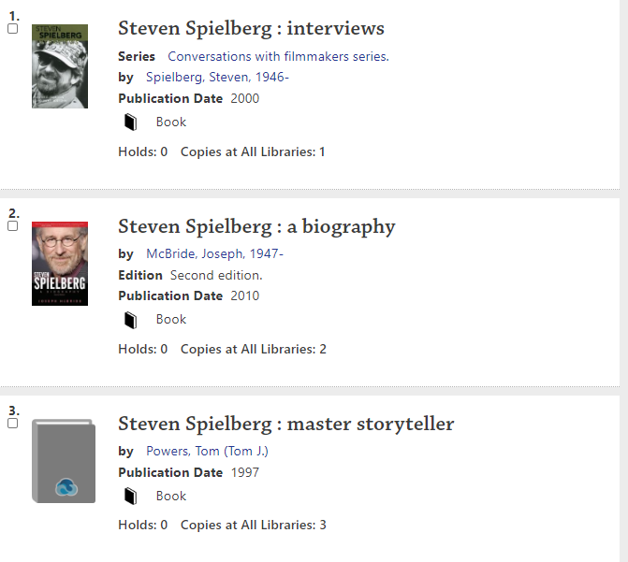
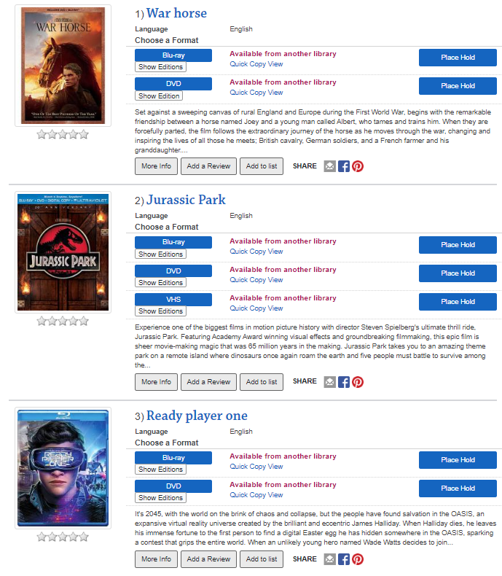
Author/Director = "steven spielberg"
Enterprise
Aspen
0 movies in top 5
5 movies in top 5

Slide 16
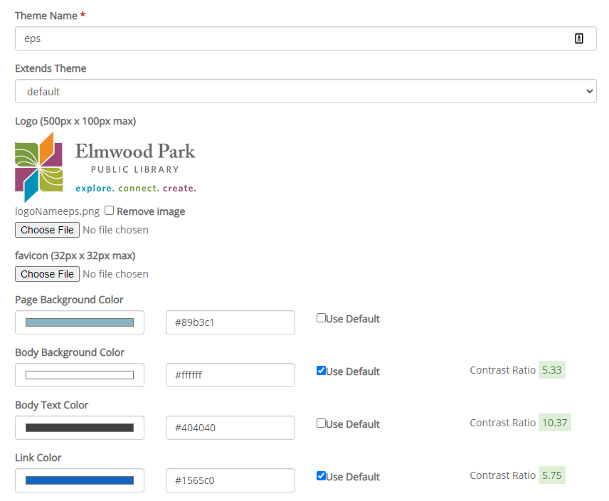
Theme and Branding
Customizable theme and branding for the library
Placards
Website indexing
Notes:
While Enterprise had theme-ing options, you had to be able to write your own CSS and stylesheets, and there was no permissions system to ensure all your hard work couldn’t get accidentally deleted or overridden by another library’s changes.
Two things we’re working on now is making the permissions system more robust, to make sure just your library can access your stuff, and fine-tuning the website search integration.

Slide 17
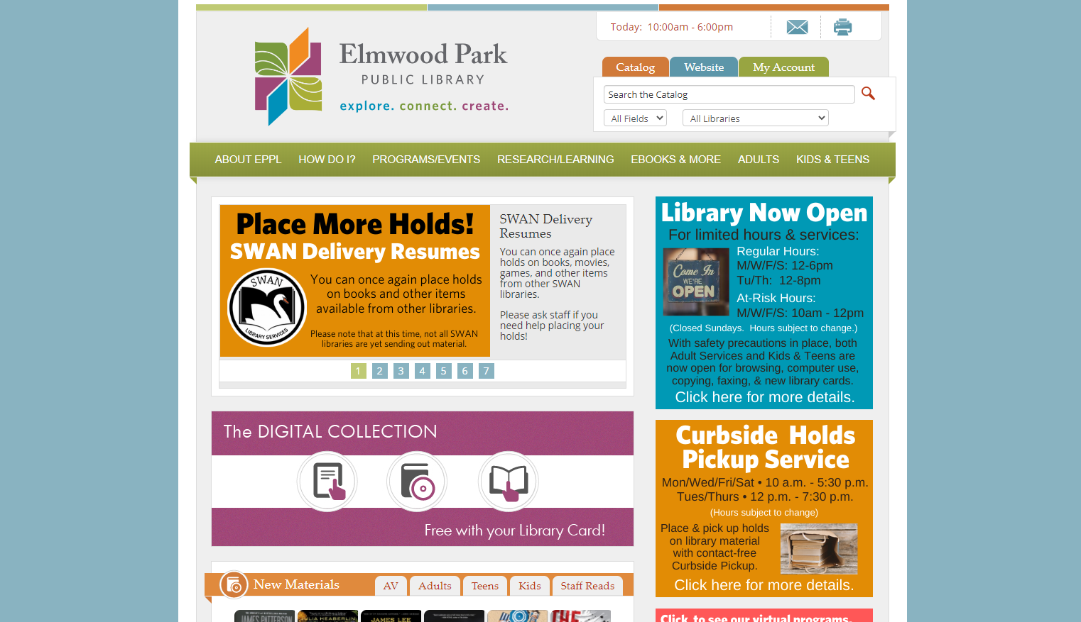
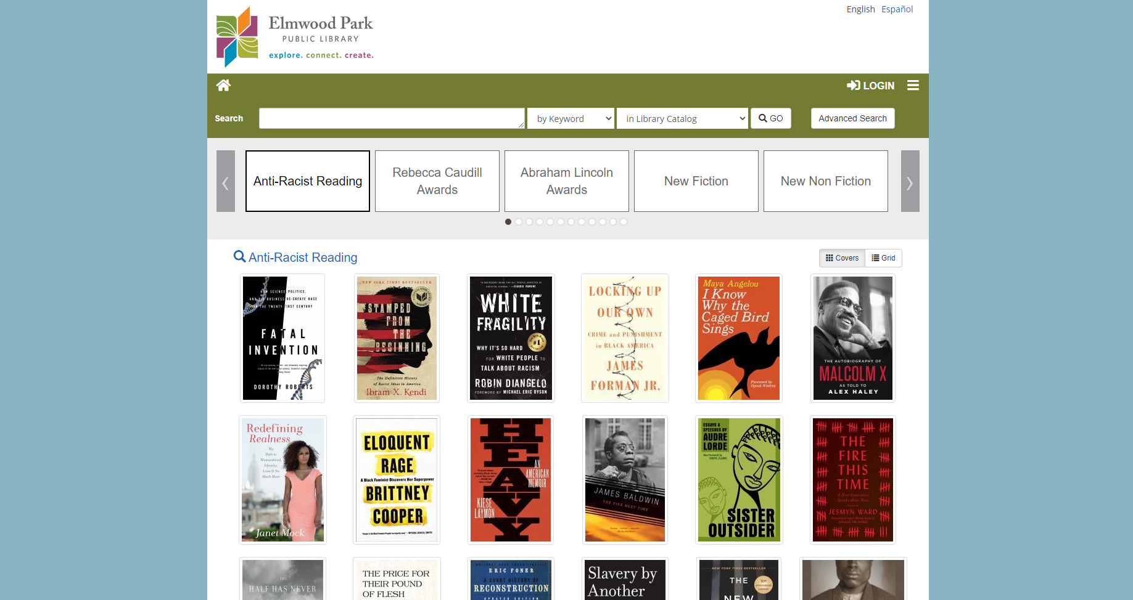
Elmwood Park
Notes:
You can see the ability to customize your catalog to look similar to your website.
Something to note: Aspen has accessibility validation features to help you make sure the colors you choose are accessible to patrons.

Slide 18
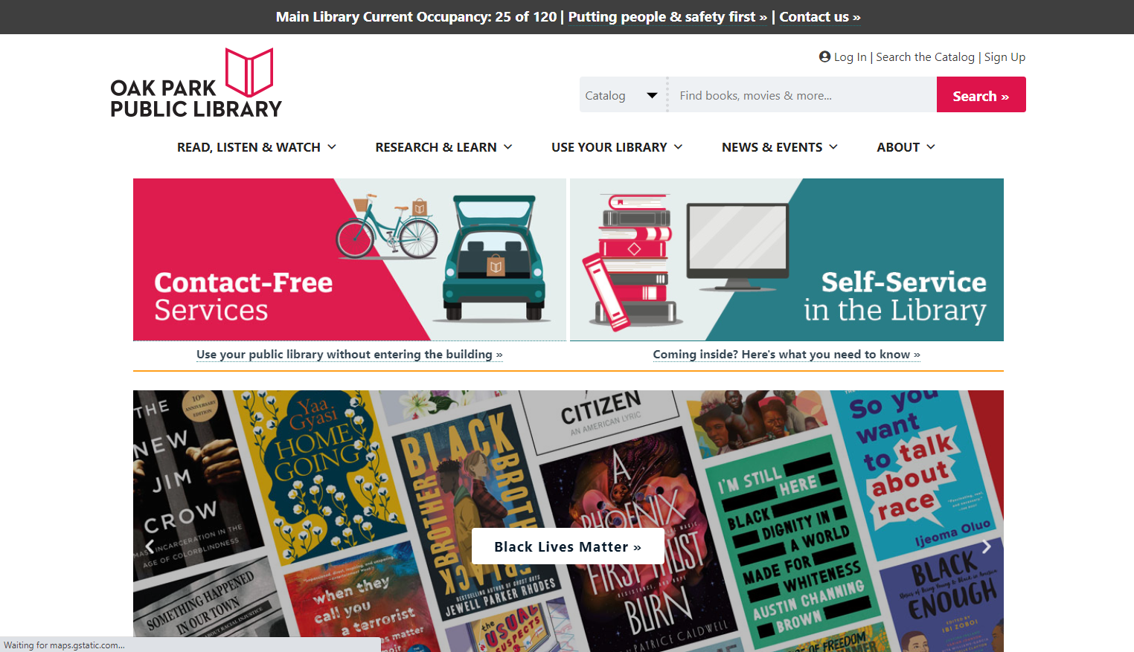
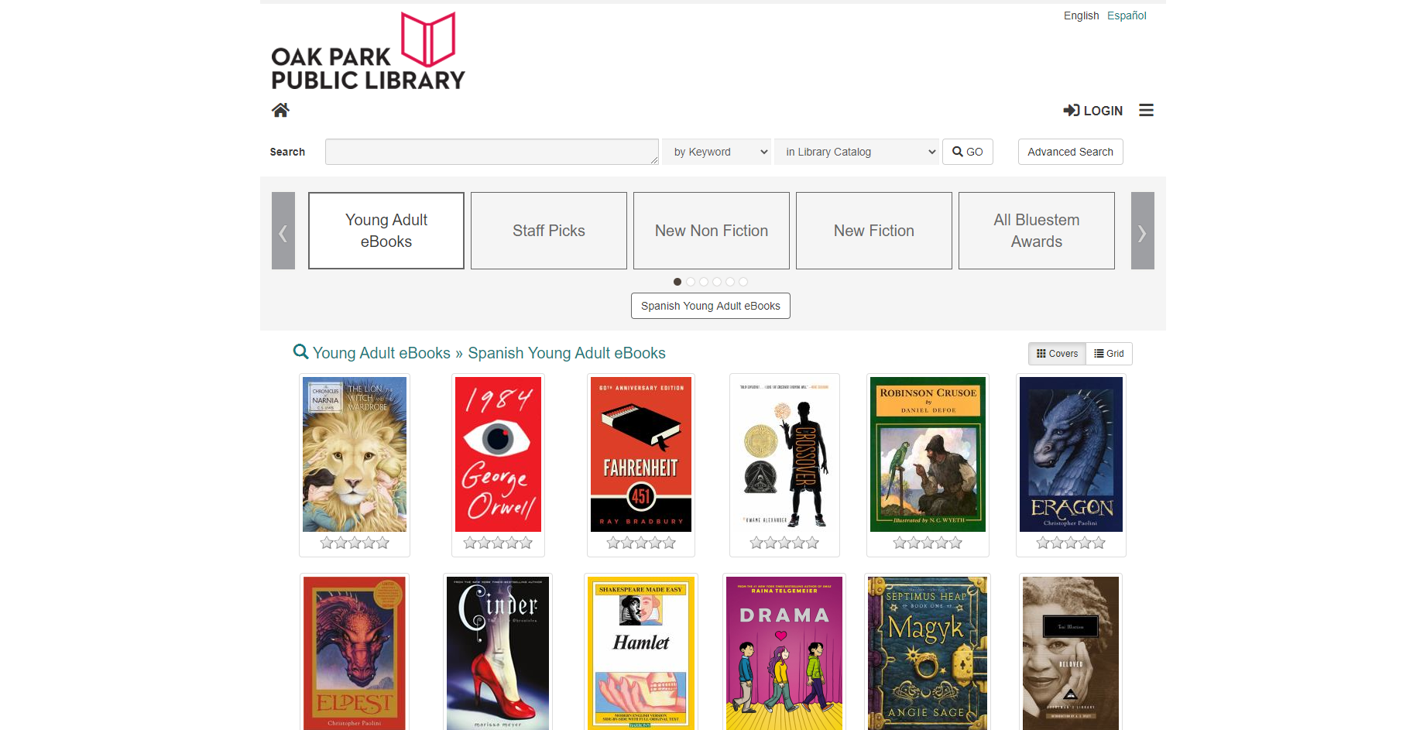
Oak Park

Slide 19
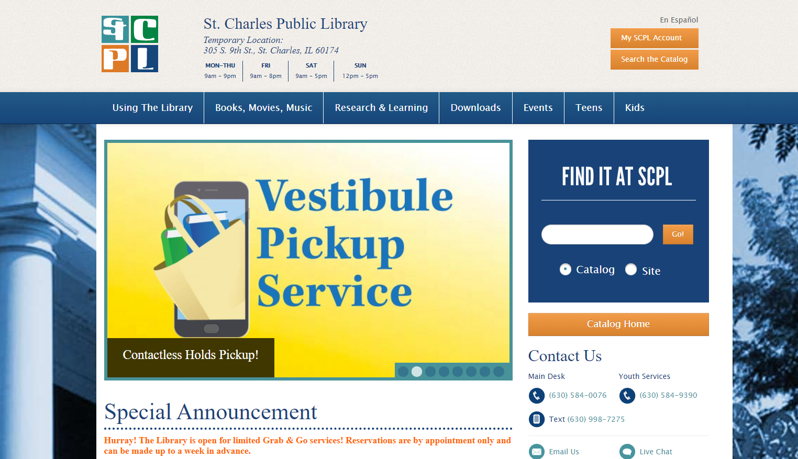
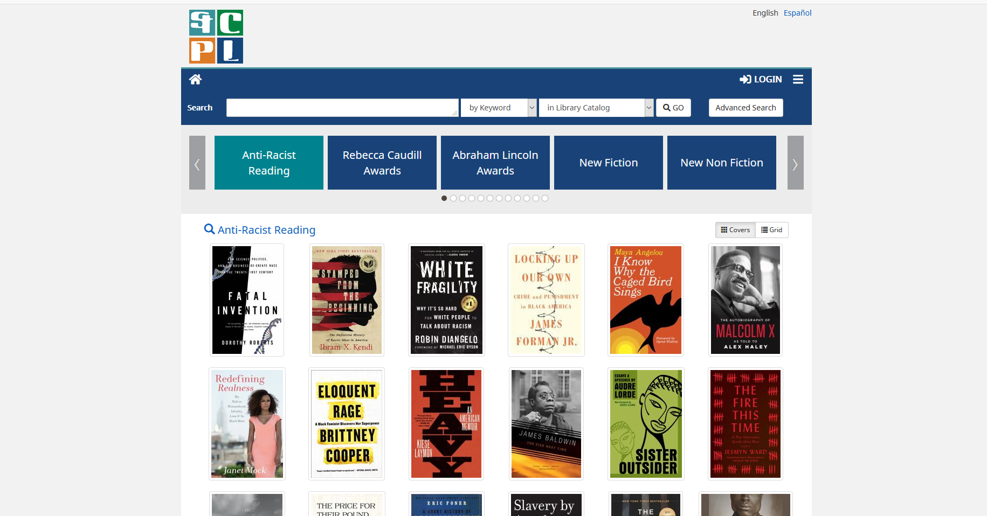
St. Charles

Slide 20
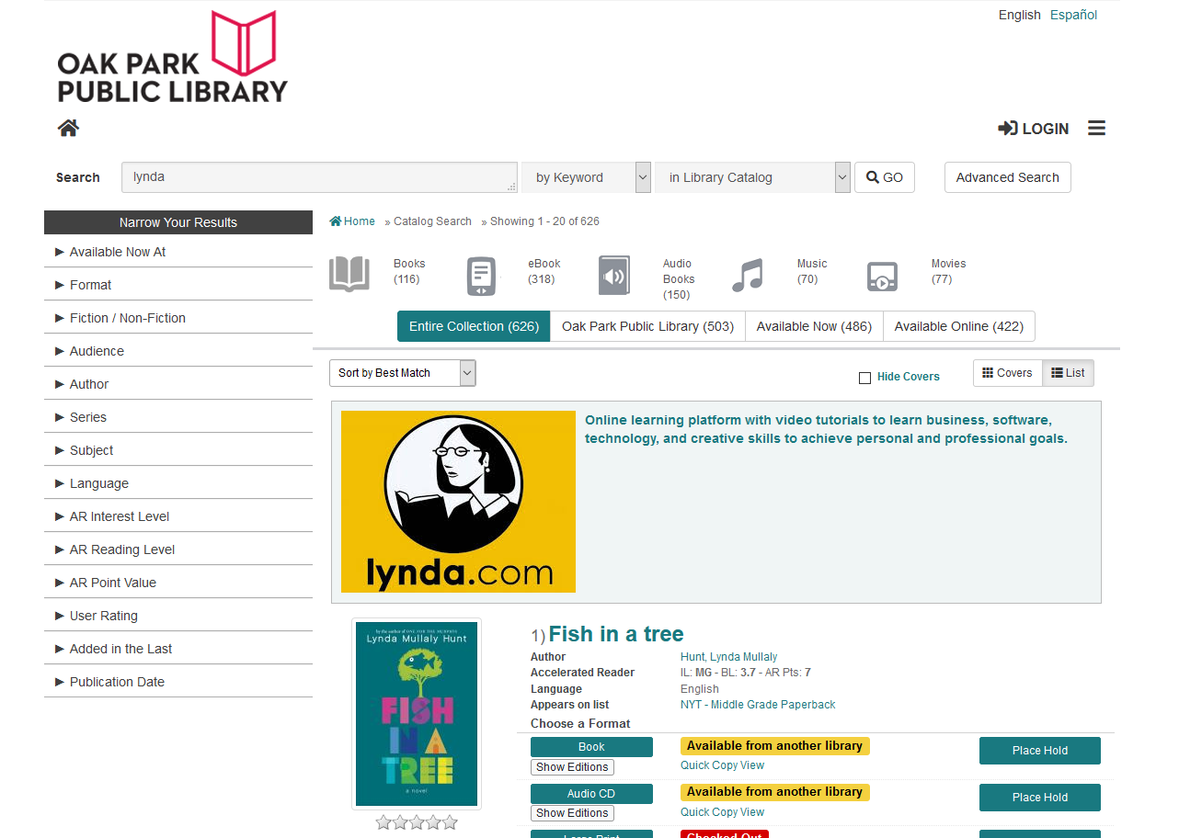
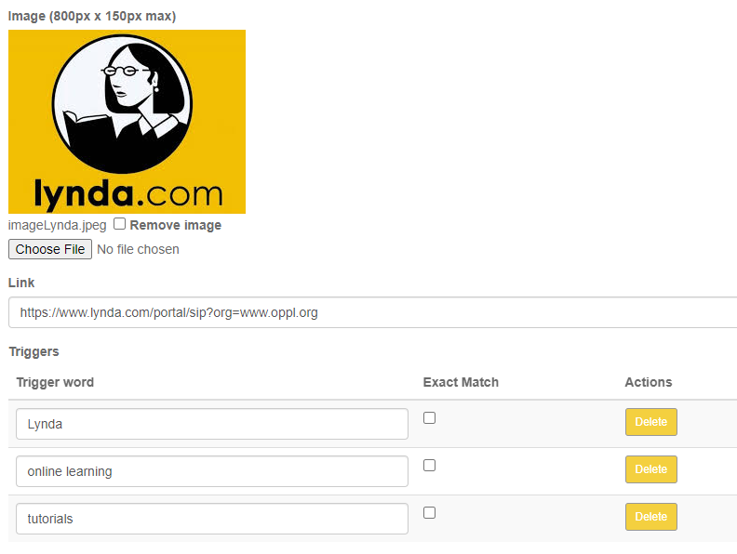
Placards

Slide 21
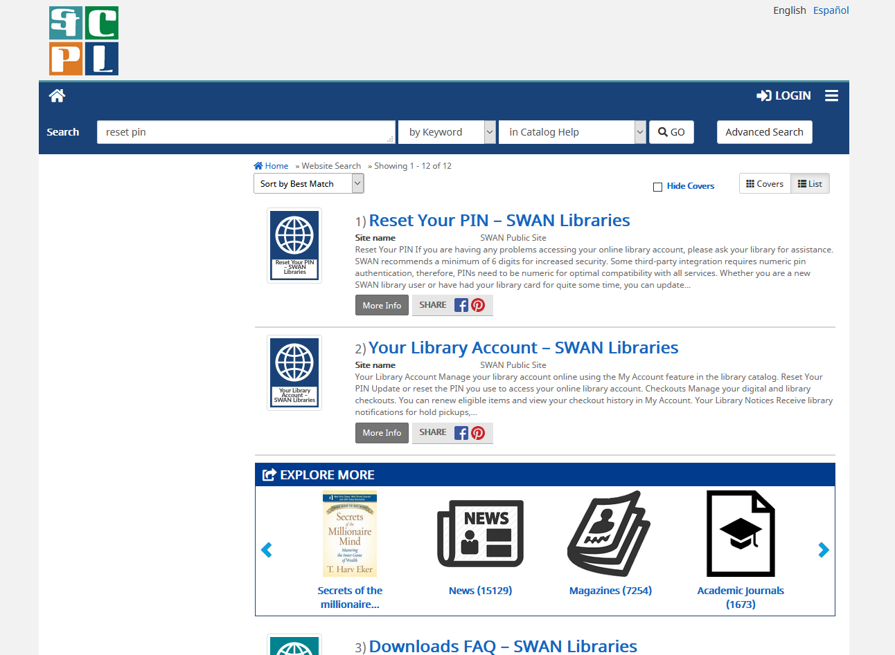
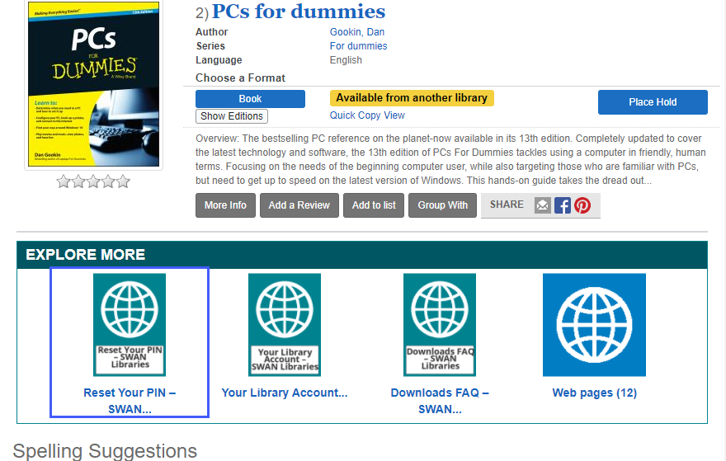
Website Indexing

Slide 22
Public Service Features
Spotlights
Browse categories
Searchable lists
Masquerade mode

Slide 23
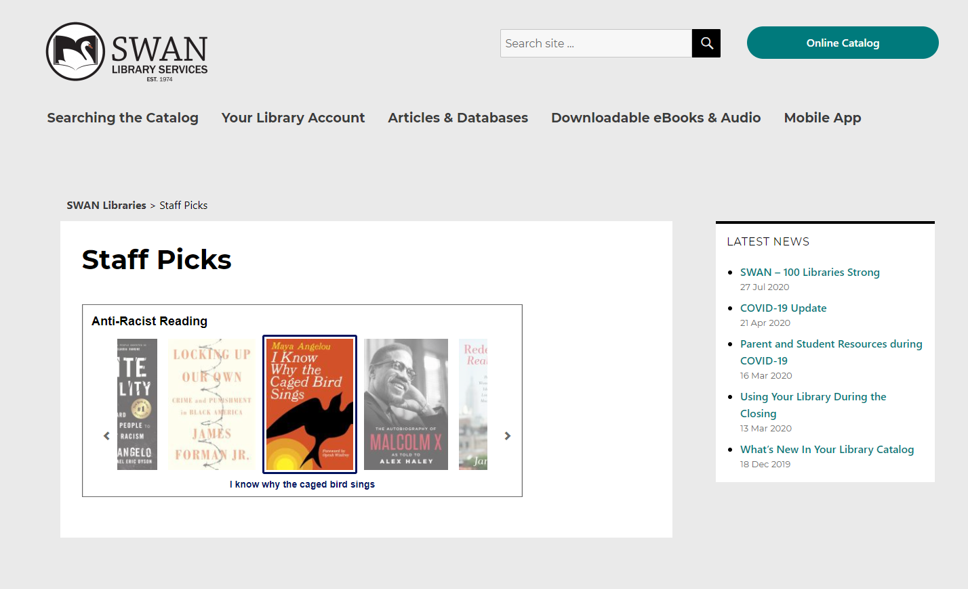
Spotlights
Embed staff lists or searches into your website.
Notes:
This is similar to the feature available in Library Aware that many of our libraries use.

Slide 24
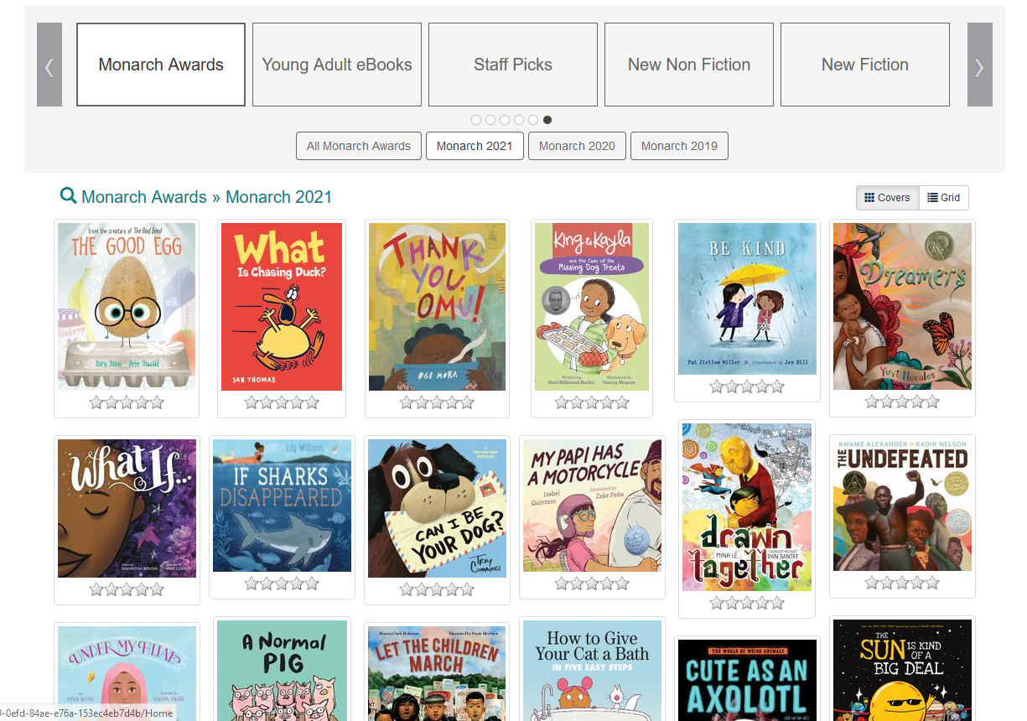
Browse Categories
Add featured lists or searches to your catalog home page

Slide 25
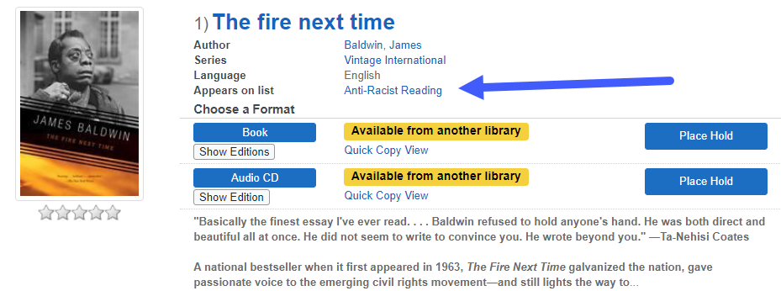
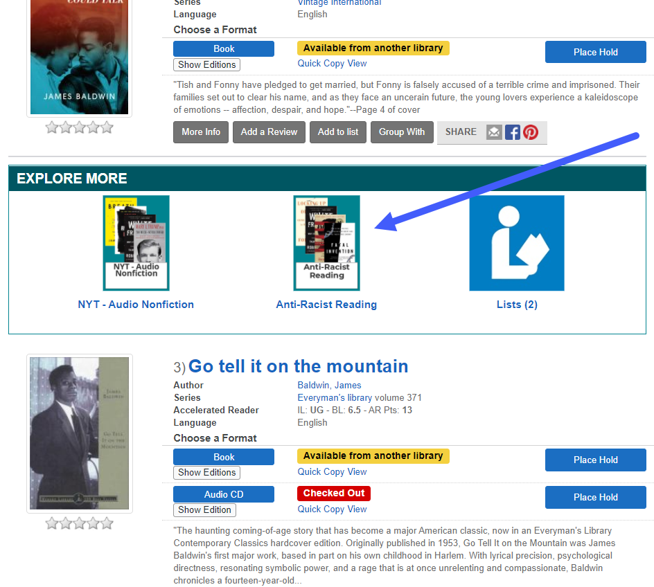
Searchable Lists
Lists appear in multiple places in search results
Notes:
Lists

Slide 26
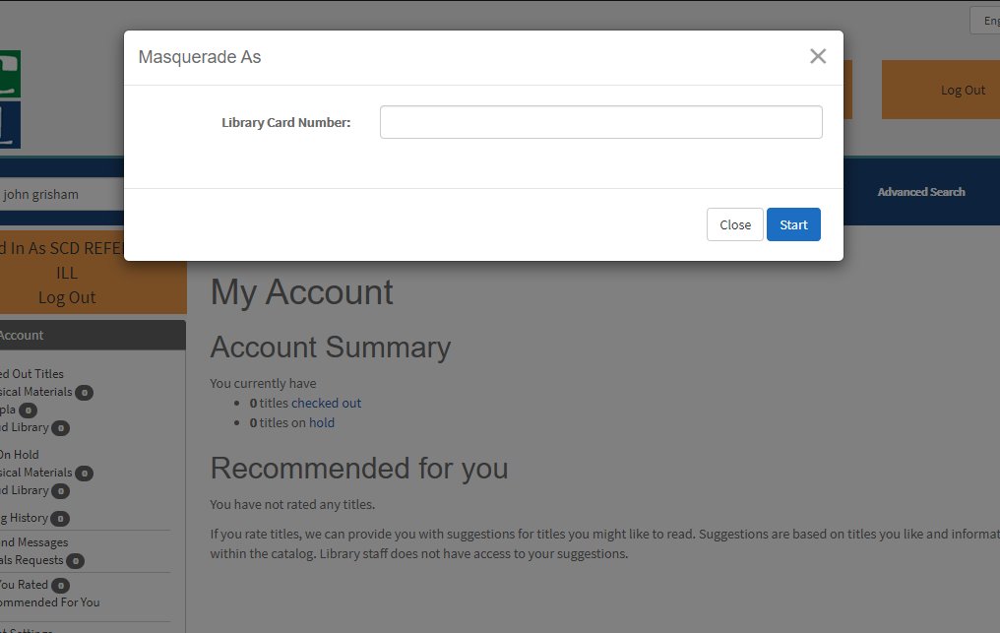
Masquerade Mode
Staff can log in to patron accounts to assist them with just a barcode
Notes:
We’ve set this up to work with the REFILL accounts
This could potentially eliminate the need to use workflows for some desk staff, depending on their role.
This has been a long requested feature for Enterprise, and something we were even looking into building ourselves.

Slide 27
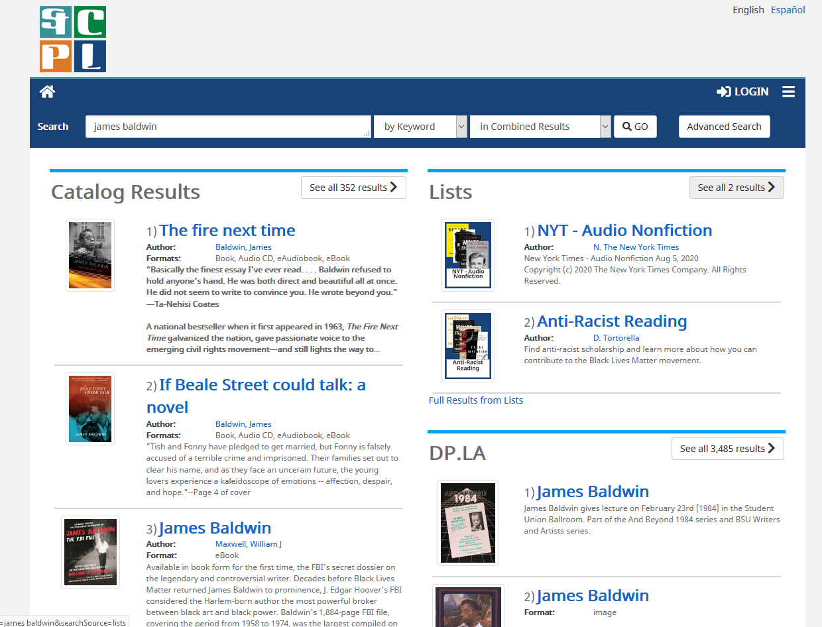
Combined Results
Notes:
Combined results are a “bento search” feature – this might be helpful for power users searching an obscure topic, or for library staff helping patrons with research

Slide 28
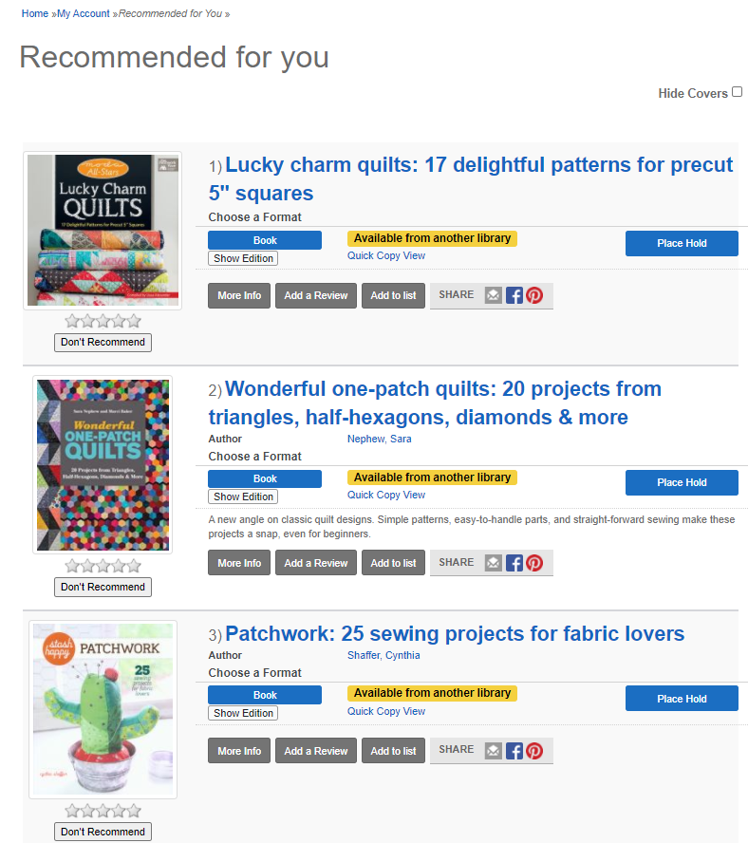
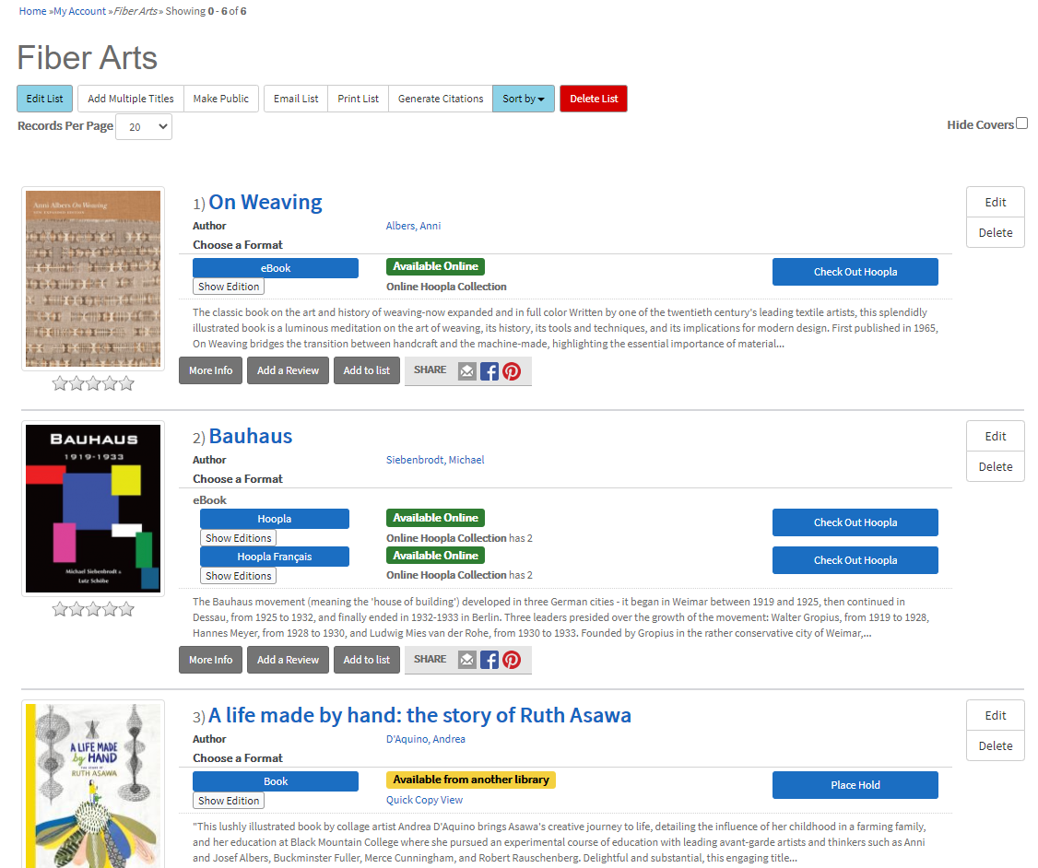
Reviews, Lists, and Recommendations
Notes:
Patrons can review items, and they’ll receive recommendations based on their reviews. They can also create their own lists that have the same grouped records as you see in search, and the order of the lists are drag-and-drop to help them sort

Slide 29
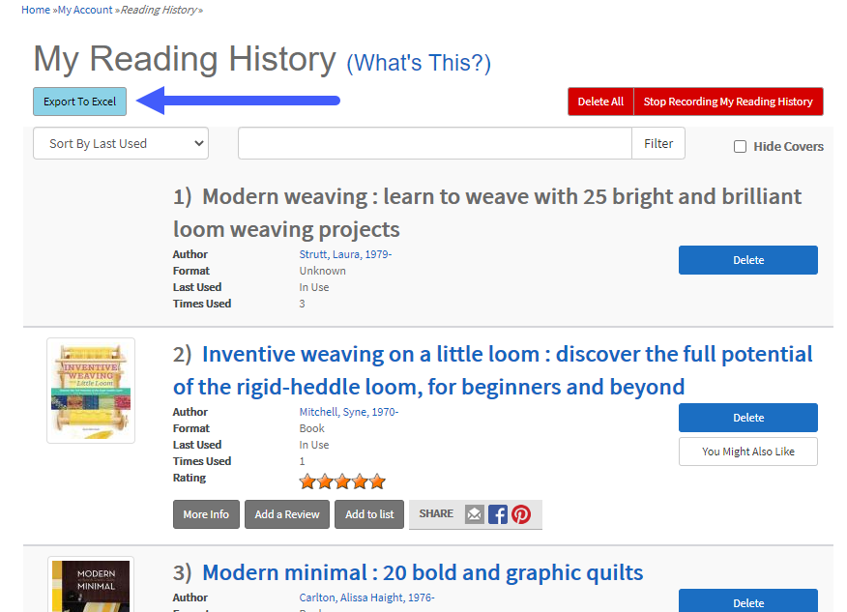
Export

Slide 30
Aspen: What's Next?
Test links:
catalogbeta.swanlibraries.net
opsbeta.swanlibraries.net
scdbeta.swanlibraries.net
epsbeta.swanlibraries.net
nudbeta.swanlibraries.net
Also checkout:
Arlington Public Library (VA)
AspenCat (CO)
Anne Arundel (MD)
Testing and development
  Availability issues
  Serials and format issues
  Performance and load testing
  Accessibility improvements
Usability testing with patrons and library staff
Pilot project with 5-7 libraries
https://support.swanlibraries.net/aspen

Slide 31
EBSCO & E-Resources Goals
Robin Hofstetter, SWAN Electronic Resources Consultant

Slide 32


EBSCO SWAN Group Purchase Update
Partnership with RAILS for 2021-2022 to continue with the same package.
New price details coming by December 2020.
SWAN statistics training on COUNTER 5 Reports for EBSCO databases on October 7, 2020 from 1:00-2:00 PM.

Slide 33
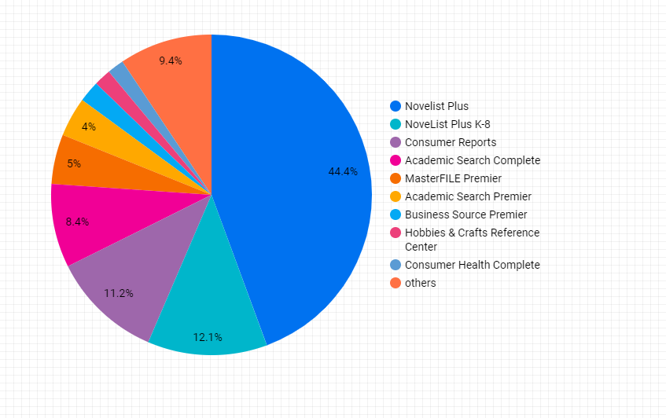
EBSCO Statistics
Early stats show popular databases for July 2020
Find stats on the SWAN-Wide Monthly Statistics Page
https://support.swanlibraries.net/documentation/64729

Slide 34
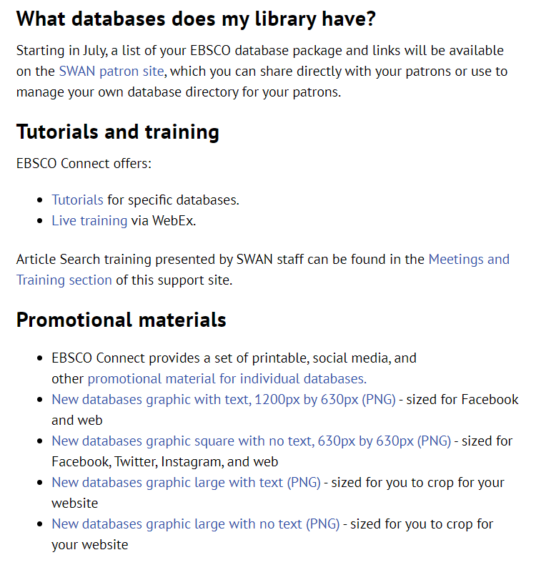
EBSCO Resources on the SWAN Support Site
Documentation > E-Resources > SWAN EBSCO Databases
https://support.swanlibraries.net/documentation/70949
Tutorials and training from EBSCO Connect listed by interface
Promotional materials including graphics

Slide 35
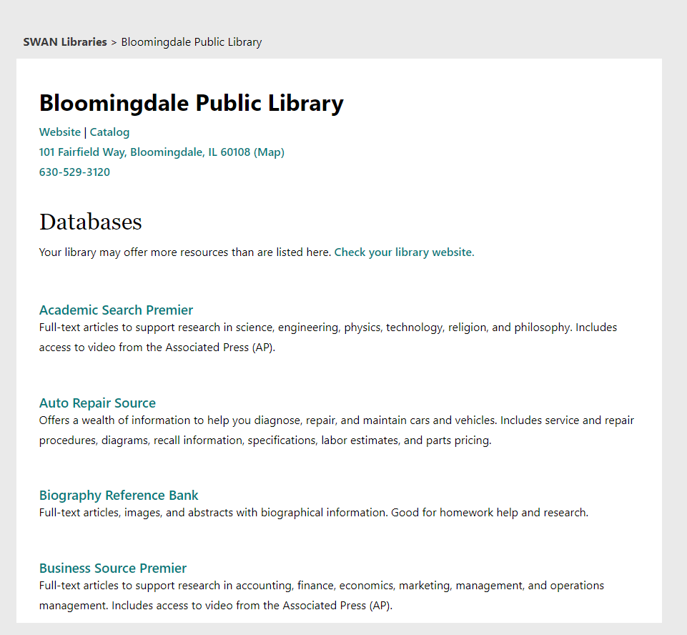
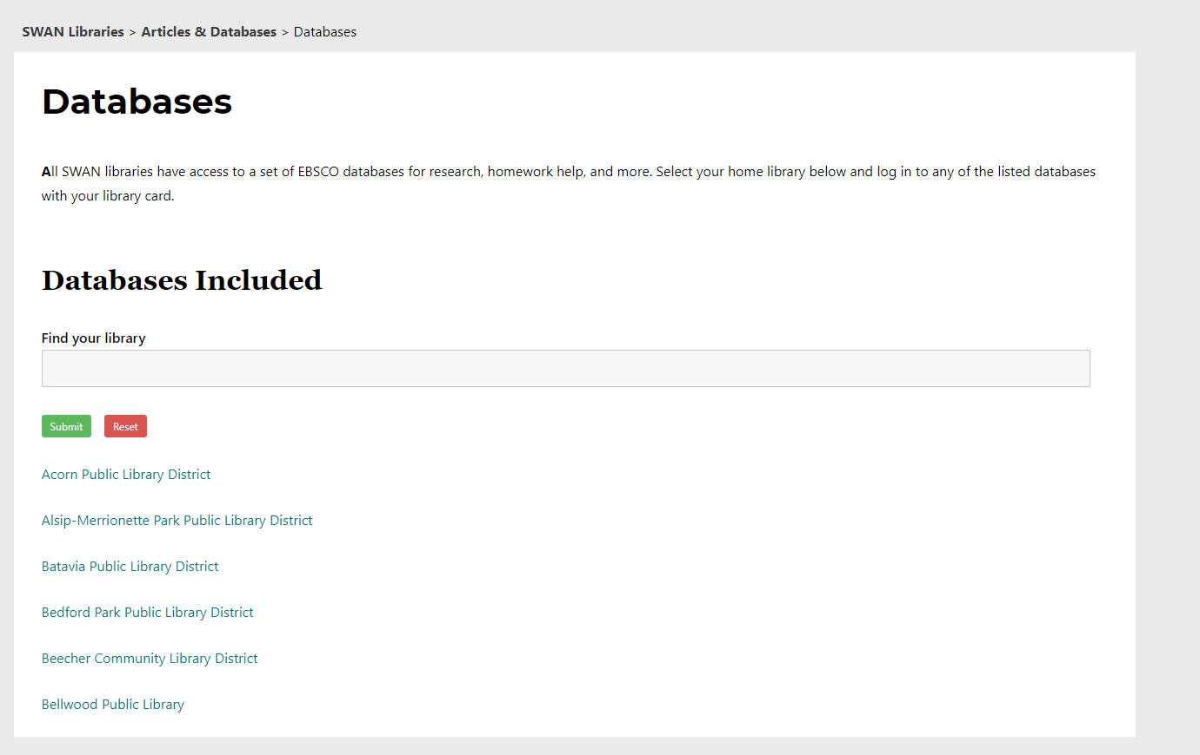
EBSCO Resources on the Patron Site
SWAN Patron site > Articles & Databases > Databases
https://swanlibraries.net/articles-databases/databases/

Slide 36





EBSCO for Schools
Students in school with public library cards can use the EBSCO databases either remotely or at the school.

Slide 37
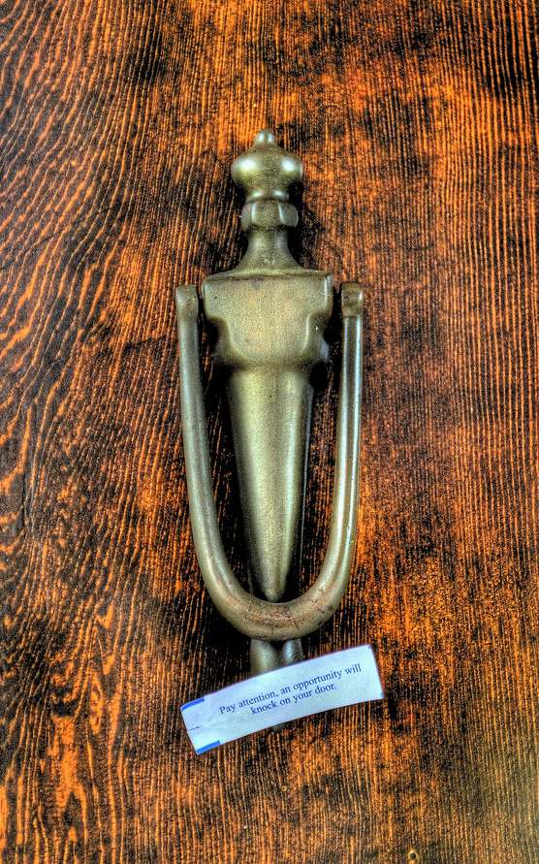


What next?
Vendors knocking on our door
ProQuest
  Ancestry
  Chicago Tribune
https://www.flickr.com/photos/kim_carpenter_nj/6663183829

Slide 38
Cataloging & Acquisition Goals
Scott Brandwein, SWAN Bibliographic Services Manager

Slide 39
Baker & Taylor Rental Collection (R&D)
Baker &Taylor
Symphony ILS
BLUEcloud Acquisitions
Goal: B&T configuration and processing expertise to assist member libraries
Consistency in recommendations for carts/holding codes
Guidelines for processing procedures
Goal: Extend holdability for new items through open SWS collection
Titles will be selected from high demand holds
Sent to members in ILL to fulfill holds
Experiment with floating collections
Goal: Test functionality and gain expertise in BLUEcloud Acquisitions
Collection managed through BLUEcloud Acquisitions
Develop expertise and documentation

Slide 40
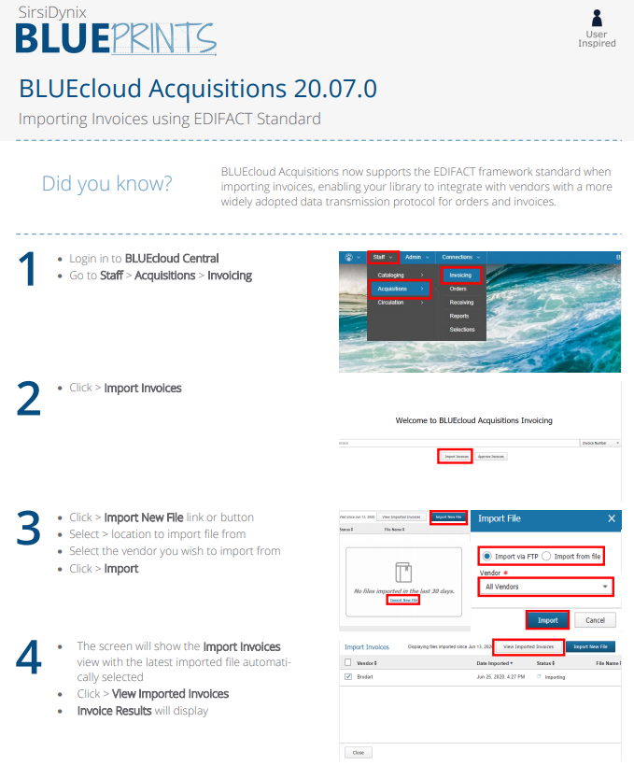
BLUEcloud Acquisitions
Fall 2020
SWAN Headquarters testing in production (B&T Rental)
New Libraries will be using BLUEcloud Acquisitions (Glenside, Roselle, Warrenville)
2021
Phased migration of existing Acq SWAN libraries to BLUEcloud Acquisitions
Invitation for other non-Acq libraries to use

Slide 41
Do you know what OHM is and that SWAN built it?
OCLC Holdings Manager
Replaces OSMOSIS (TMQ) 20 year process for Illinois libraries
Updates OCLC holdings in WorldCat through api set/unset holdings, based on comparison of consortium’s bibliographic catalog
Bibliographic Expertise/Design: Scott Brandwein
Developer: Rudy Host
Processed:
SWAN
CCS
PrairieCat
Up next:
RSA
Pinnacle
SHARE (IHLS)

Slide 42
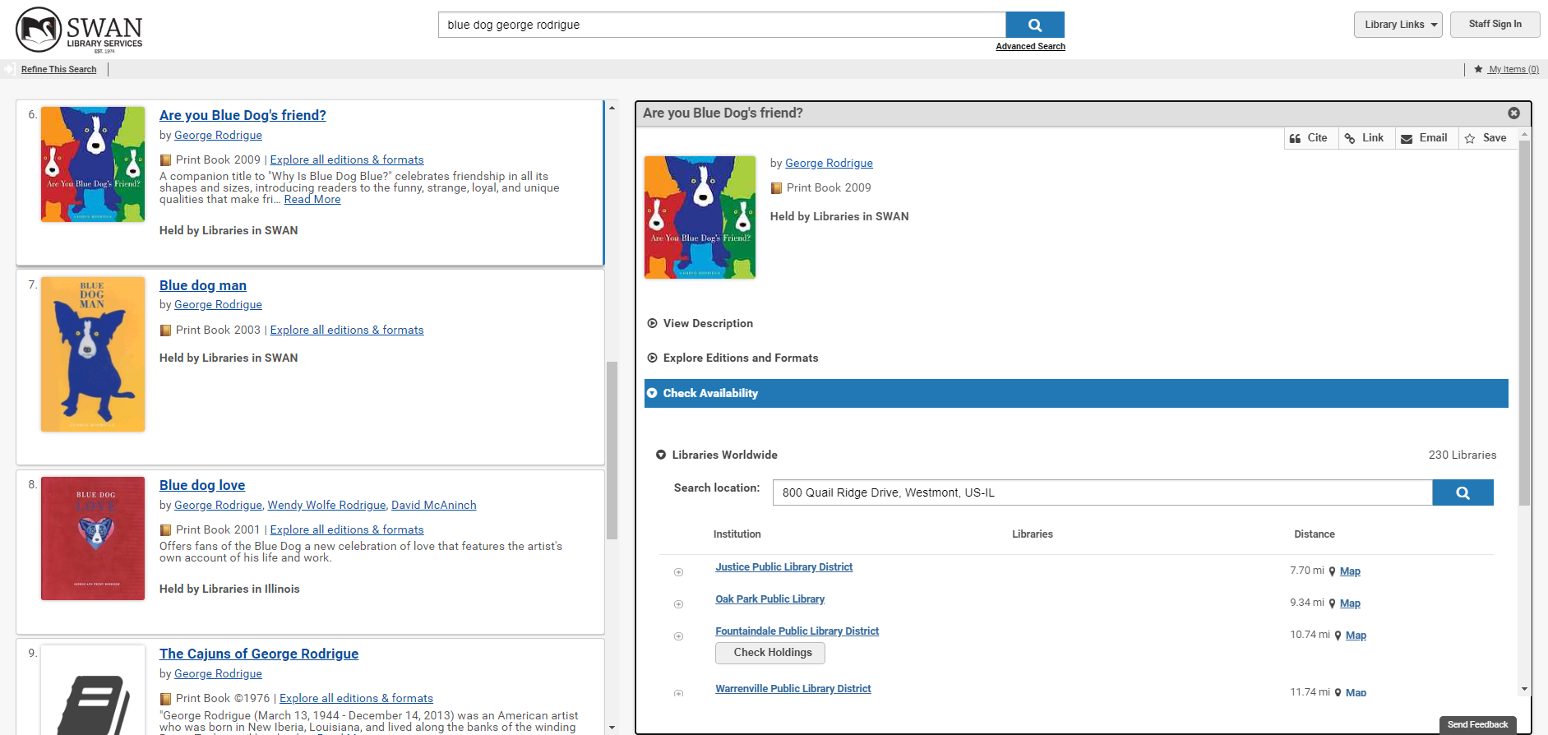
WorldCat Holdings

Slide 43
Data Security Goals
Steven Schlewitt, SWAN IT & Systems Support Manager

Slide 44
SWAN Securities Initiative
Identifying and evaluating security/privacy vulnerabilities
Within our libraries
Within the ILS
Internal to SWAN
Interfacing with 3rd party vendors
Advocating security and privacy within our libraries
Use a PIN on self-checkout
Limit handling and storing of patron data
Protect personally identifiable information
For more examples, watch the SWANx Web Series – Security & Patron Privacy Tips
Advocating security and privacy with our vendors
Ensuring 3rd parties are transmitting data and authenticating in a secure manner, following current standards and acceptable protocols
Ensuring our development follows industry standards
Use of SSL certificates to ensure proper form encryption
Reducing the "hops" of PII (Personally Identifiable Information)
Encrypting transmission of this data

Slide 45
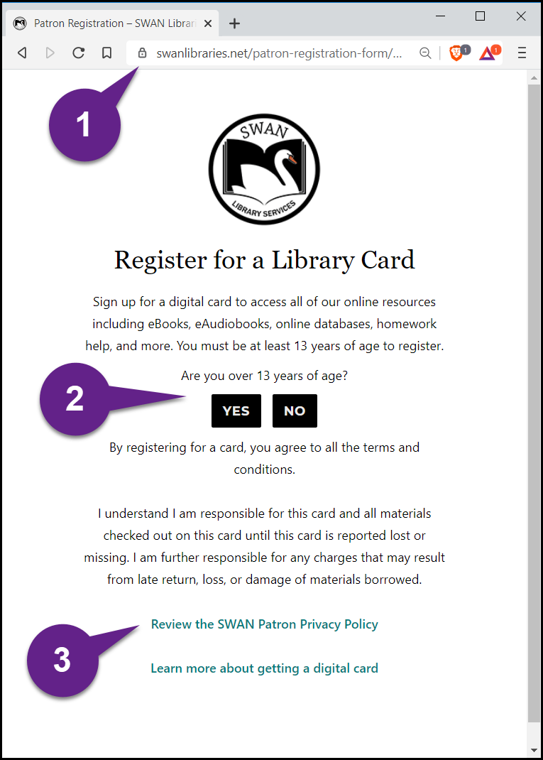
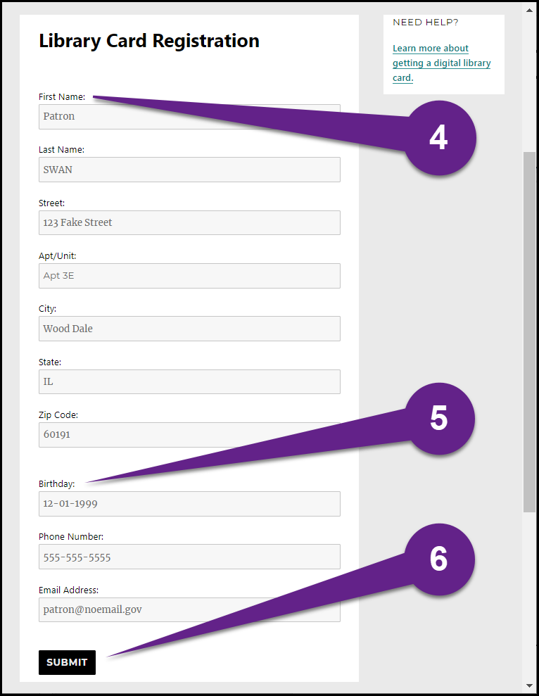
Example: Online Patron Registration
1. SSL encrypted sites ensure patron data is securely entered and transmitted
2. Age verification for Children's Online Privacy Protection Rule (COPPA) compliance
3. Privacy policy for further web compliance
4. Duplicate patron checking, based on name and birth date
5. Birth date does not permit underaged user entry, following COPPA
6. Submission transmits directly to Symphony server, avoiding mishandling of data

Slide 46








Reducing the Hops
Patron
Library Website
(Non-HTTPS)
Registration Info
Data Collection Service
???
Notification Email
Library Staff
SWAN Servers
Patron
SWAN Website
(HTTPS)
Registration Info
SWAN Servers
Library Staff
Notes:
Rudy

Slide 47
SWAN Securities Initiative
Associated Projects:
  Sunsetting of external SIP2 connectivity by end of 2021, transition vendors to:
    TLS-wrapped SIP2 OR
    Web Services OR
    OpenAthens
  Exploration of TLS-wrapped (encrypted) internal WorkFlows and SIP2 connections
  SonicWall End of Life (EOL) hardware upgrades for SWAN-managed libraries
    Prices range from $500 (smaller installations) to $2,000 (high-end installations)
    We will reach out to affected libraries directly to plan/budget
These vendors have already made the switch!
  Demco
  Kanopy
  CenTec
  Midwest Tape
  Plymouth Rocket
  Patron Point
  MeeScan (TLS-SIP2)
  Library Market (TLS-SIP2)

Slide 48
Disaster Recovery / ILS Platform Reliability
Associated Projects:
  Scheduled Disaster Recovery tests
  Review of security/data breach plan
  Scheduling of Annual Rebuild
    Completed February 23rd
    Additional rebuild for SWAN100 in December (more info coming soon!)
  Audit/Review of Symphony and User Access policies
  Annual/monthly record purging and cleanup

Slide 49
SWAN100 Project
Dawne Tortorella, SWAN Assistant Director

Slide 50
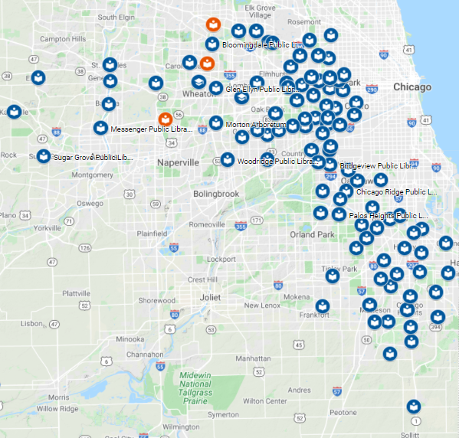
SWAN 100 Strong
GSD - Glenside Public Library District
Tom Bartenfelder, Director
ROD- Roselle Public Library District
Samantha Johnson, Director
WVD - Warrenville Public Library District
Sandy Whitmer, Director

Slide 51
SWAN100 Migration Timeline
New Libraries:
Data testing, training Sept-November
Join SWAN
Offline (New)
Go Live
Load Policies
Test Data
Tech Freeze (New)
Prod Bib Load
Reindex (Off-Line – ALL)
Patron/Circ Load
June 2, 2020
August 5, 2020
August 28, 2020
Dec 9, 2020
Dec 7-8, 2020
Dec 6, 2020
Dec 5-6, 2020
Nov 30-Dec 6, 2020
Nov 23, 2020
New policies will be visible in production. Welcome GSD, ROD, WVD to the family!
Date for full re-indexing is not finalized. The rebuild will require all libraries to be in off-line during this process.

Slide 52
Changes/Impact
Immediate - Now
During Migration (Dec)
Post Migration
Policies are appearing in Symphony (GSD, ROD, WVD)
Model policies for item type consolidation (e.g. video)
Added to SWAN group in OCLC (ILL requests deflected)
Off-line during bibliographic database re-indexing (targeted for: Dec 5-6)
Assistance from SWAN member library staff as real-life experts (rely on expertise of user/advisory groups)
First production use of BLUEcloud Acquisitions – will help development training, documentation, and procedures
By Jan 2021, full resource sharing
Consistent use of transit labels

Slide 53
Announcements & Questions
Notes:
Starting with these releases, SWAN will be conducting member updates to share added features/functionality, and timeline/impact with the membership. We will announce these sessions via SWANcom, News posts, and on L2.

