Slide 1
SWAN Quarterly Meeting
June 3, 2021

Slide 2
Agenda
Welcome & Business
Introduction of new library directors
Approval of the March 4, 2021, Quarterly meeting minutes
Board election results
ARPA funding
User record purge
Aspen
Diversity, Equity, and Inclusion in Metadata
Next meeting: September 2, 2021

Slide 3
SWAN Board Election
Ted Bodewes, SWAN Board President
Thomas Ford Memorial Library, Western Springs, IL

Slide 4
Election conclusion
3-year terms
  Charity Gallardo, Executive Director, La Grange Public Library
  Tim Jarzemsky, Library Director, Bloomingdale Public Library
Thank you!
  Dorothy Koll, Director, Acorn Public Library District
  Jorge Perez, Director, River Grove Public Library District
  Laura Maye Van Cleve, Library Director, Richton Park Public Library District
  Colleen Waltman, Library Director, Homewood Public Library District
  Anna Wassenaar, Director, Blue Island Public Library

Slide 5
ARPA Funding
Diane Foote, Executive Director Illinois Library Association
Aaron Skog, SWAN Executive Director

Slide 6
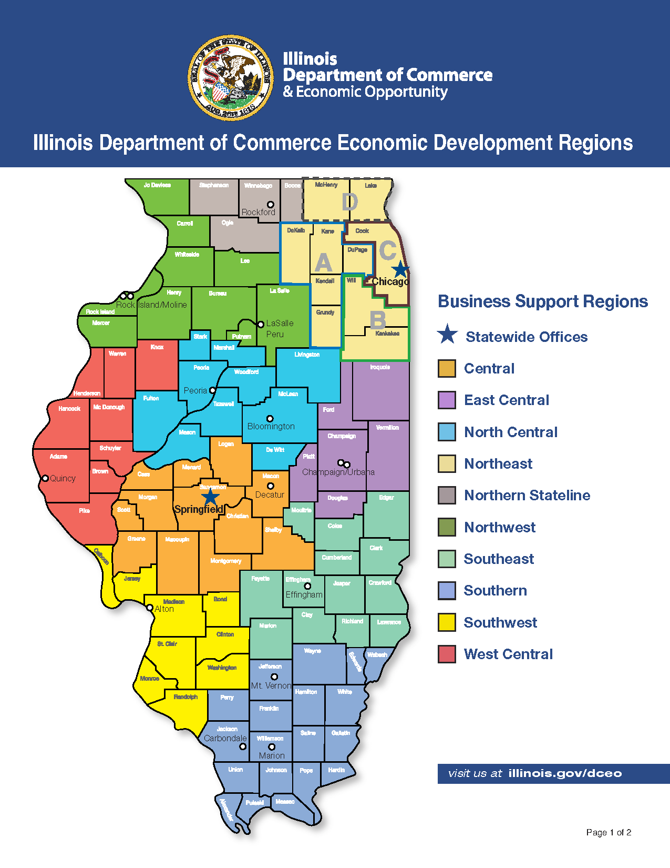
ARPA: American Rescue Plan Act 2021
IMLS/Illinois State Library
NEH/Illinois Humanities Council
NEA/Illinois Arts Council Agency
FCC: Emergency Connectivity Fund
  Equipment, laptops
State & Local Government/DCEO
  Illinois cities, counties, districts
Education Stabilization Fund
Higher Education
ILA’s index:
https://www.ila.org/advocacy/covid-19-resources/arpa-funding-for-illinois-libraries

Slide 7
SWAN Hosted Events
Monday, June 7, 2021 1pm - 2pm
Kane County Group Meeting
Monday, June 7, 2021 2:30pm - 3:30pm
DuPage County Group Meeting
Wednesday, June 9, 2021 1pm - 2pm
Cook County South Group Meeting:
Wednesday, June 9, 2021 2:30pm - 3:30pm
Cook County North Group Meeting
Thursday, June 10, 2021 1pm - 2pm
Will County Group Meeting
Goal
Build some good ideas
Seek appropriate funding
Build on local relationships, regional coordination

Slide 8
User Record Purge Update & Discussion
Dawne Tortorella, SWAN Assistant Director

Slide 9
Overview of user record purge proposal
Steps
Goals
Patron record purge for public libraries
Begin operational monthly processing of inactive accounts
Perform National Change of Address (NCOA) update
Add new geo-location update via NCOA
Move towards a criteria for inactive user removal monthly basis vs annual
Model approach used with bibliographic database
Define thresholds for fines/fees on user records for removal
Help libraries target patrons with fees/fines for immediate follow-up

Slide 10
Analysis of user records in SWAN
Based on initial record purge criteria, approximately 35% of patrons on record have not been active in over 3 years
Very old user records with fines/fees
Benefits to removing inactive users
  Reduce user record management
  IPLAR 3-years guidance
  Carried data security risk
  Overhead in patron batch processes (e.g., running any operational reports that read user records)
Description | Count
3+ years inactive, $0 bills | 27,031
BADADDRESS from NCOA 2018 $0 bills | 30,978
A. BADADRESS/MAILRETD with bills | 13,917
B. 3+ years inactive, <= $10 in bills | 51,935
C. 10+ years inactive, between $10.01 and $200.00 in bills | 33,738
D. 10+ years inactive, in collection status | 4,466
Totals (estimated as of 4/18/2021) | 162,065

Slide 11

Patron Record Purge & Bill Clean-up
What we heard:
Be more conservative in selection criteria
Provide reports to assist libraries in ongoing record review
Move to an ongoing process by Fall 2021
See:
News Post 5/17
SWAN Community Forums
June Quarterly Discussion
Target dates:
Begin August 2021 with monthly clean-up
NCOA – Fall, 2021

Slide 12
Feedback & Concerns
Inconsistency in setting of Last Activity Date
Inactivity timeline of 3 years – too soon
  Lost year or more of activity due to pandemic
  Several building plans limited access before or after pandemic closures
Removal of bills
  Criteria used to determine
  Who is authorized to remove
  Incomplete audit trail for migrated bills
Handling of juvenile records and bills
  Aged to adulthood – not responsible for prior bills
  Responsible party transferred to patron, from previous guardian
Increased liability in storing inactive patron information, especially sensitive personally identifiable information (PII)

Slide 13
Criteria Adjustments for Discussion
Concern | Adjustment
Last Activity Date (LAD) is before Expiration Date | Update LAD to “today” to reset prior to removal criteria review
OpenAthens and other services do not appear to be setting Last Activity Date consistently | Use Athens 1-year archive of barcodes to capture active barcodes in past year; update LAD to “today” to reset prior to removal criteria review
Bill removal criteria | Consider opt-out for libraries Ability for library to archive records for pursuance Discussion of $100 vs $200 threshold for > 10+yrs
Last Activity of 3 yrs seems aggressive given lost year or more due to pandemic | Start with 10+ year removal Work toward 5+ year removal by 1/1/2023
Edit of user address information does not update Last Activity Date | Symphony 3.7.1 settings can make this possible

Slide 14
Update Last Activity Date (June 2021)
Capture all users who authenticated through OpenAthens in past year (by barcode)
  In June 2020, additional privacy settings in Athens prevented LAD updates
  Working with EBSCO to automate LAD update on access
Update Last Activity Date to reflect activity
Using 3 libraries (CSD, TFS, WDD) 541 total patrons had authenticated through OpenAthens in past year.
36 of 541 or 6.6% of those users had LAD < 6/30/2020
NOTE: Resources accessed through SIP2 (OverDrive, hoopla, etc) get LAD updated upon access

Slide 15
Start with consensus
Remove bills for inactive accounts > 10 years (less than $100 or $200)
  Immediately remove these accounts
  Re-registration required with new signature/responsibility agreement with public library
Remove remaining BADADDRESS from 2018 NCOA
  Libraries have had 2 ½ years to contact and update these records
Remove inactive accounts > 10 years
Questions:
How do libraries follow-up on these outstanding bills?
If there is no follow-up, is there a reason to keep these patrons in the system?
If we allow a library to opt-out of this removal, when/how should we revisit?

Slide 16
Analysis of 2021 revised record clean-up
In 2021, focus on clean-up/removal of patrons 10+ years inactive
Description | Count
10+ years inactive (before 1/1/2011) | 53,647
BADADDRESS from NCOA 2018 | 62,270
Potential 10+ years inactive (1/1/2011-12/31/2011) | 89
Totals (estimated as of 6/2/2021) | 116,006

Slide 17
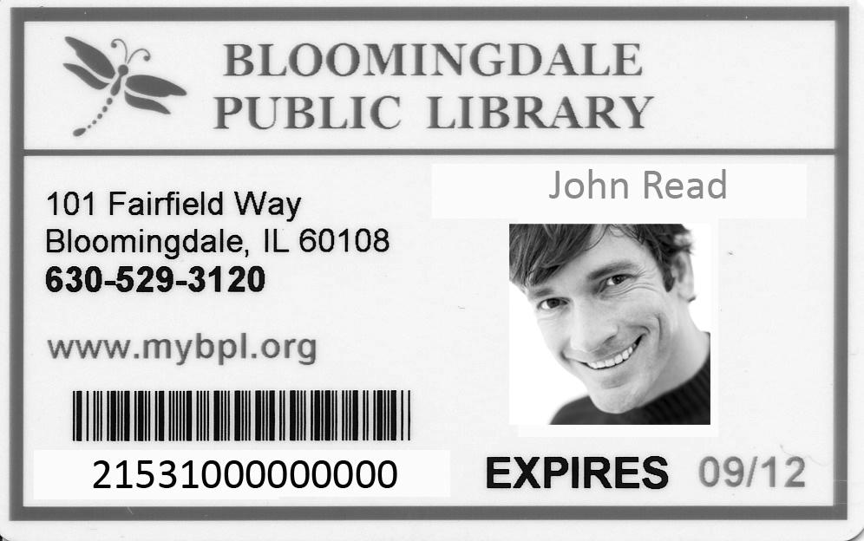
Why record clean-up/removal is necessary
Privacy – access to personal information
Security – increased liability in storing personal information (potential point of contact, 3rd party partners)
Efficiency/Service – inactive records come with processing overhead and increased likelihood of duplicates
Protecting personal information is critical public service
Protect patron privacy, require library cards or scannable barcode on device for checkout and self-check.

Slide 18

Move Toward Automation
Aug, 2021 – remove users inactive 10+ years
Jan, 2022 – remove users inactive 7+ years
Jan, 2023 – remove users inactive 5+ years

Slide 19
Weekly Monthly processing of inactive accounts
Starting July Aug 2021 perform weekly monthly patron maintenance/record removal of inactive accounts 3+ 10+ years.
Move from annual process to ongoing patron management of inactive accounts.
Provide reports and assistance in automating notification of patrons turning 18.
Benefits:
Eliminate dramatic patron record count changes – keep consistent counts.
Reduce personal information stored on inactive users.
Focus on proactive communication, outreach, and resolution of billing.
Notes:
Dawne

Slide 20
Timeline Targets
Jun-Jul 2021
Aug 2021
Sep 2021
Oct 2021
Jan 2022
Jan 2023
Update Last Activity Date
Review/remove bills
Allow library to review/update patron records
Move to 7+ years inactive criteria for selection
Start monthly removal of record 10+ yrs inactive
Start monthly reporting of records to remove
NCOA all remaining & geo-code active in last year records
Move to 5+ years inactive criteria for selection
Notes:
Vickie

Slide 21



Next Steps
Jun 30, 2021
Update LAD for OpenAthens
Jul 31, 2021
Jul 31, 2021
Review reports, LAD < 1/1/2011
Jul-Aug, 2021
Symphony 3.7.1 Upgrade
Pay bills with SWANPURGE, based on criteria
Update records, if necessary
Aug 2021
Begin monthly automatic removal, 10+ yrs inactive
Notes:
Dawne

Slide 22
Parallel Discovery Platform Project:
Aspen Discovery
Tara Wood, SWAN User Experience Manager

Slide 23
Performance Improvements in Aspen
Recent efforts have focused on performance & stability:
Added MARC record and e-resource indexes for all 100 catalogs – which drastically increased memory usage and index times
Decreased index size & run times by half
Added several checks to ensure if we have memory issues in the future, partial exports will not be processed

Slide 24
Aspen Pilot Research Summary
Read the full report: https://support.swanlibraries.net/aspen-pilot#report
Collects all research on Aspen, including:
Relevancy analysis
Usability testing with staff and patrons (6 total)
Survey results
Accessibility analysis

Slide 25
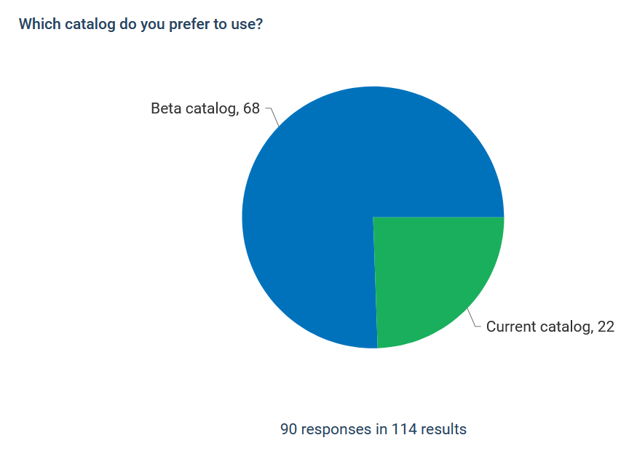
Survey Feedback
Responses from patrons completing online survey from pilot beta catalogs
Notes:
We want to highlight just a few things from the beta launch survey we ran.

Slide 26
Survey Feedback – Grouped Formats
“Right away, I know if it’s available, where it’s available, type of book, i.e. Kindle, CD, on the shelf, etc. I can check it out right there. It’s great!.”
I was not so visually overwhelmed as I was in the previous catalog. Also, I I liked how you could pick the format of material easily. The older version catalog was very difficult to pick the format. Also, I could easily identify if the book I was looking for was on the shelf, or from another library. Much more visually appealing!
I like how the beta catalog shows all of the different formats of a book in one place (ebook, physical, audiobook), compared to the current catalog, where each format is a separate entry. I also like the homepage on the beta catalog, with more suggestions in different categories.
Notes:
All comments about formats and grouped formats were positive.

Slide 27
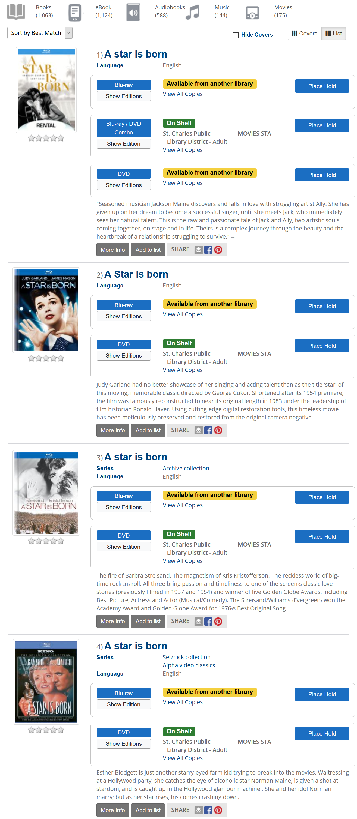
Notes:
Grouping has vastly improved since we started – movie remakes were especially hard to get to group just right. Scott identified several tweaks to the grouping logic that has helped tremendously and we have another round of tweaks to add before the wider rollout.

Slide 28

Development Progress
All go-live development priorities are complete, with the exception of ProPay integration (online fines payment)
When ProPay integration is complete, we will be looking at a wider rollout

Slide 29
Rollout Plans
2-3 cohorts
  8 weeks for training and preparation
  Bi-weekly office hours
  4 all-staff trainings
  5 admin trainings
Tentative dates
  August – September 2021
  October – November 2021
  January – February 2022
Pilots can go live as early as July 7th (with no online fines payment)
After fines payment integration, can start wider rollout.
Notes:
We had feedback from DUX that staff would prefer for the all-staff trainings to be recorded. Then staff can view recordings on their own time, and come to the bi-weekly office hours with any questions.

Slide 30
Rollout Plans
See: https://support.swanlibraries.net/documentation/82481
Start thinking about staff that should have admin logins and training.
Reference/ILL: Best for staff assisting patrons to place holds.
OPAC Public & Tech Services: Best for staff creating reader's advisory features for your catalog.
OPAC Cataloging: Only available to cataloging libraries.
OPAC Administrator: Best for your website or marketing staff to customize your catalog look-and-feel, hours, and other settings.
If you have limited staff, you may only need the Reference/ILL and OPAC Administrator permissions
Staff Roles

Slide 31
Diversity, Equity, and Inclusion in Metadata
Aaron Skog, SWAN Executive Director

Slide 32
Diversity, Equity, and Inclusion in Metadata
Task force to evaluate our catalog and ensure terms describing groups of people are modern, respectful, and granular.
Goals:
Evaluate LC subject headings and set up automated updating of problematic and outdated terms
Consider optional supplementary subject vocabularies to improve access to resources concerning groups not currently represented
Provide recommendations on improving visibility of diversity resources and Own Voices collections
Collect resources on performing diversity audits for interested members
Notes:
Based on some membership request, some other institutions, and some patron requests
Started as a desire to make sure the language we are using in the catalog that refers to groups of people is respectful and modern
LC subject heading “illegal aliens” is a more well-known example, where Congress failed to change that term, to something more respectful and commonly used
Some terms become outdated and no longer useful in searching
9 members and the Bib Services team
Identifying some terms that are problematic
Completely automated, updated in the evenings, so catalogers will not be impacted
Something on the task force watch list is “Homosaurus” to help give the catalog more depth as an optional tool for catalogers
Improving the visibility of DEI collections
We are only on the first bullet point of this list: ethnicities, medical conditions, religions, LBGTQ plus
Once there are more concrete results, we will show everyone what has been accomplished

Slide 33
Announcements & Questions
Ted Bodewes, SWAN Board President
Thomas Ford Memorial Library, Western Springs, IL

