Slide 1
SWAN Quarterly Meeting
September 2, 2021

Slide 2
Agenda
Call to Order and Welcome
Public Comment
Introduction of New Library Directors
Introduction Item – Live voting platform demonstration
Action Item – Approval of the June 3, 2021 Quarterly meeting minutes
Discussion Item – Information security risk assessment
Action Item – Amend fiscal year 2022 budget
Information Item—Aspen Discovery
Information Item—Diversity, Equity, & Inclusion in metadata
Information Item – Summary of regional library director meetings & pandemic needs
Announcements and Questions
Next meeting: December 2, 2021

Slide 3
Live Vote Demonstration
Aaron Skog, Executive Director
Dawne Tortorella, Assistant Director

Slide 4
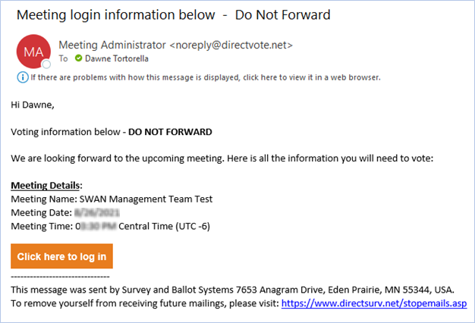
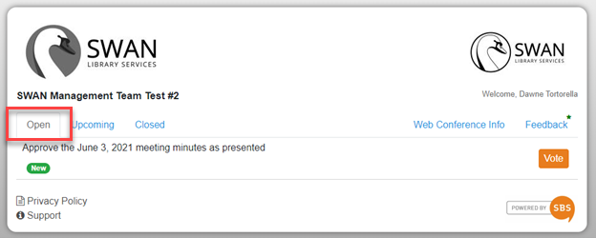
Live Voting

Slide 5
Voting
Practice vote
Approve Minutes

Slide 6
Information Security Risk Assessment
Steven Schlewitt, SWAN IT & Systems Support Manager
Notes:
Security is inherent in all of SWAN’s services. Whether you’ve noticed or not, SWAN has quietly, and sometimes not so quietly ensured security is a consideration with every project and system, from our VPN connections to TLS-encrypted websites and granular permissions

Slide 7
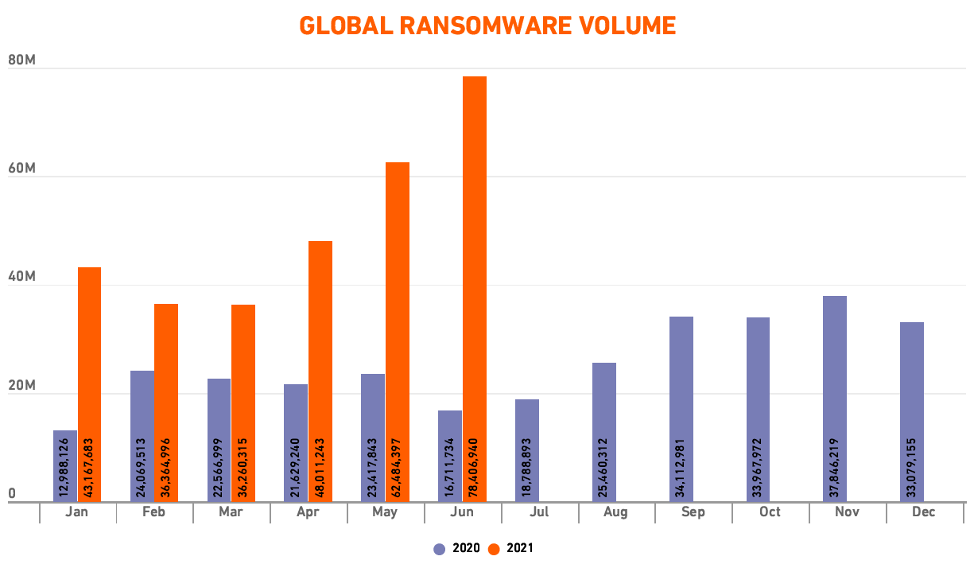
Ransomware, By the Numbers
SonicWall Cyber Threat Report 2021
Notes:
Ransomware, phishing, and hacking attempts are on the rise year-after-year.
Threats are no longer limited to malware.
Attacks are far more sophisticated - it boils down to exploitable vulnerabilities, whether it’s an unpatched system, weak password, or over-trusting person.
This graph illustrates nearly 80 million documented ransomware attempts in June 2021 alone.
Several SWAN libraries have reported attacks.
Not just big businesses being targeted
Source:
SonicWall Cyber Threat Report 2021
https://www.sonicwall.com/medialibrary/en/white-paper/mid-year-2021-cyber-threat-report.pdf

Slide 8
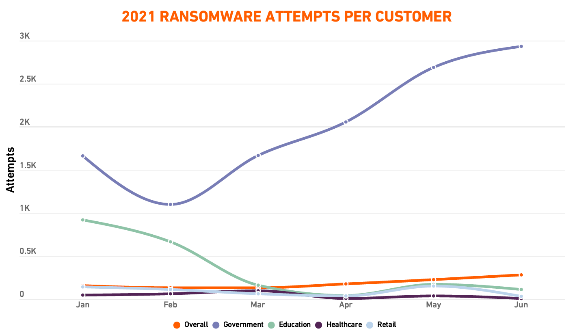
Ransomware, By the Numbers
SonicWall Cyber Threat Report 2021
Notes:
Managed service providers, healthcare, education and government entities are common targets.
Hackers are seeking valuable, personally identifiable information (PII).
Boston Public Library Cyberattack on Wednesday 8/25
https://www.nbcboston.com/news/local/boston-public-library-hit-by-cyberattack/2477795/
Source:
SonicWall Cyber Threat Report 2021
https://www.sonicwall.com/medialibrary/en/white-paper/mid-year-2021-cyber-threat-report.pdf

Slide 9
Patron Privacy
Patron marketing tools
3rd party data collection and analytics
Retained legacy patron data
Online registration
3rd party vendor authentication
Collection of student data
Collected personally identifiable data
Membership-wide access to patron data
Globally-accessible ILS tools
Collection of minor (patrons under 13) data
Notes:
A sample of SWAN’s challenges regarding patron privacy.
Security and patron privacy go hand-in-hand
The more data we collect, retain, and share, the more secure all of these functions must be
ILS data represents a wealth of personally identifiable information that could be exploited.
This all influences the need to secure our system to the best of our abilities to protect patron data.

Slide 10

Provides contracted business services including cyber security and technology consultation
  Locations across the country
  Serves 15,000 clients worldwide
Serves many SWAN libraries through contracted IT services
  Familiar with SWAN’s services and infrastructure
Offers expertise from wealth of certified IT experts
Notes:
Many organizations now seek 3rd party services to perform risk assessments, system penetration testing, and to establish standards.
Sikich is a well-established Enterprise organization providing these services worldwide, most notably with a familiarity of our libraries.
Sikich has provided us with a proposal for a security risk assessment. Scheduling can begin immediately.

Slide 11
SWAN’s Goals for a Security Assessment
Determine applicable security threats and their potential impact to SWAN.
Adopt an industry-recognized framework when approaching security, configuration, and policy.
Ensure compliance with applicable legal frameworks such as COPPA (Children’s Online Privacy Protection Act) and SOPPA (Student Online Personal Protection Act).
Pass on knowledge to membership with recommendations on assessing and managing vulnerabilities.
Notes:
Determine applicable security risks and their potential impact to SWAN.
Weigh those risks and mitigate/create a mitigation plan.
Translate this analysis into a plan for disaster recovery.
Determine vulnerability gaps in SWAN’s system configuration.
Create a process for repeating this cycle moving forward.
Adopt an industry-recognized framework when approaching security, configuration, and policy.
Suggested: NIST 800-171
Evaluate how SWAN matches up to these standards and resolve compliance issues.
Enact policies that drive how we interact with 3rd party vendors, configure servers, protect sensitive data, and secure credentials.
Ensure compliance with applicable legal frameworks such as COPPA (Children’s Online Privacy Protection Act) and SOPPA (Student Online Personal Protection Act).
Create policies to ensure compliance.
Pass on knowledge to our libraries
Note: This project is exclusive to SWAN policies, systems, and networks. Library staff may be consulted, but the assessment and mitigation does not involve local library networks or systems and stops at your firewall.

Slide 12
Phase 1: Identify Risks to the Organization & Controls
SWAN has ~1 million email addresses in the database
SWAN
Several SWAN libraries have acknowledged ransomware attacks
SWAN integrates and authenticates with over 80 3rd party vendors
SWAN maintains personally identifiable data (PII)
SWAN database is harvested by external analytics systems
SWAN is subject to COPPA and SOPPA laws
Average cost of ransom paid in 2020 is $1.1 million
Global
Threats
304.7 million ransomware attacks (up 151% from 2020)
2.5 trillion intrusion attempts
2.5 billion malware attacks
2.1 million encrypted threats
Average total cost of a data breach in 2021 is $4.24 million
Notes:
Sikich has broken down the process into four phases.
A sample of SWAN’s internal risks alongside increasing global technology threats.
Identify the risks and then categorize using controls identified.
Sources:
SonicWall Cyber Threat Report 2021
https://www.sonicwall.com/medialibrary/en/white-paper/mid-year-2021-cyber-threat-report.pdf
IBM Cost of a Data Breach Report 2021
https://www.ibm.com/security/data-breach

Slide 13
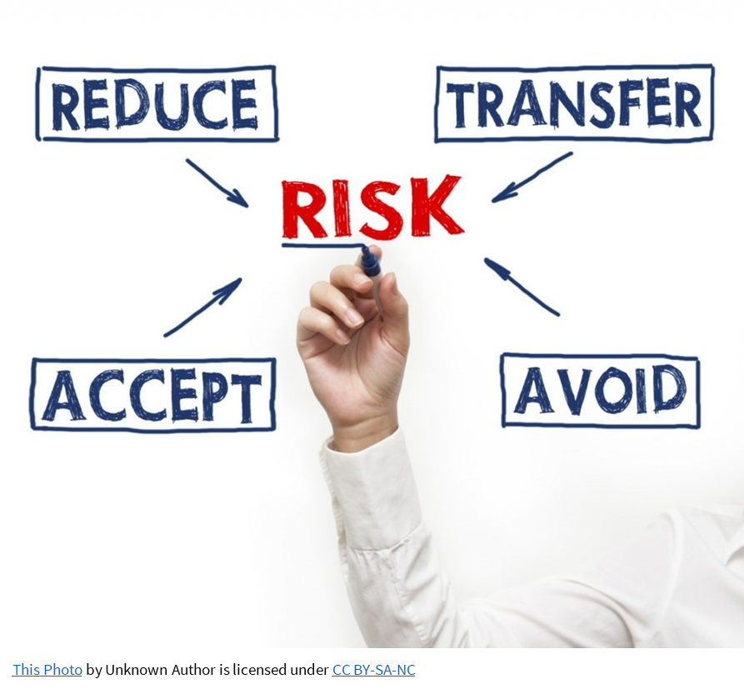
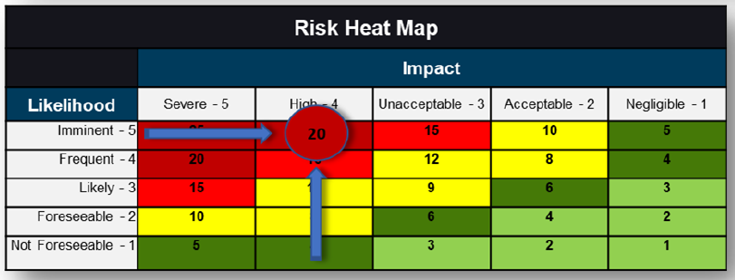
Phase 2: Analyze and Weigh Risk Impact
Benchmarked against National Institute of Standards and Technology (NIST) Special Publication (SP) 800-171
Notes:
Standard recommended by Sikich is NIST SP 800-171
- Requirements for protecting the confidentiality of controlled unclassified information
- Non-federal information systems and organizations
- Indicate the inherent risk of maintaining that information

Slide 14
Phase 3: Treatment / Plan of Action & Milestones
Examples:
Recommendations | Treatment | Priority | Services Impacted | Start Date | Completion By
Multi-Factor Authentication | Implement immediately | Medium | A, B applications | Q3 2021 | Q4 2021
Secured vendor authentication | Implement immediately | High | A, B, C vendors | Q3 2021 | Q3 2022
Stronger password requirements | Implement immediately | Medium | A, B applications | Q3 2021 | Q3 2021
Proactive monitoring tools | Plan to implement | Low |  | Q1 2022 | Q2 2022
Notes:
Based on the priorities established in Phase 2
Create a roadmap for how to tackle significant threats

Slide 15
Phase 4: Ongoing Risk Management
Evaluate Plan of Action & Milestones
Continued Consultation with Sikich Virtual Chief Information Security Officer
Continued risk register identification, updates, and reporting
Sharing recommendations & training for our libraries

Slide 16
Timeline Targets
July – Sept 2021
Oct 2021 (Phase 1)
Nov - Dec 2021 (Phase 2)
Jan 2021 (Phase 3)
Feb - Mar 2022 (Phase 4)
TBD 2021
Receive/review Sikich proposal
Quarterly Membership presentation
Budget approval
Risk Analysis
Risk Management
Standards Development
Risk Identification
Risk Treatment

Slide 17
Seeking approval of funds
SWAN Cash Reserves - June 30, 2021 | $2,060,444.23
Sikich Proposal | ($37,000.00)
SWAN Cash Reserves balance | $2,023,444.23
Percentage of reserves vs SWAN Operating Expenses | 50%
Cost $37,000
Amend current SWAN budget Consulting
No change to current membership fees
Use SWAN reserve fund

Slide 18
Seeking approval of funds
Budget amendment requires 2/3 affirmative vote of all members present
RESOLVED, THE SWAN FISCAL YEAR 2022 BUDGET LINE #5830 CONSULTING WILL BE INCREASED FROM $1,000 TO $38,000 FOR INFORMATION SECURITY RISK ASSESSMENT TO BE COMPLETED BY JUNE 30,
2022.
Need resolution moved & seconded
Discussion of proposed budget amendment resolution
Conduct live vote

Slide 19
Parallel Discovery Platform Project:
Aspen Discovery
Tara Wood, SWAN User Experience Manager

Slide 20

Cohort 1
Schedule
Date​ | What​
August 30th, 2021​ | Kickoff Meeting​
Every other Monday, 10 a.m.​ | Aspen office hours​
September 7th, 2021 11 a.m.​ | Aspen Admin Training: Themes & Library Settings​
September 14th, 2021 11 a.m.​ | Aspen Admin Training: Browse categories, Spotlights, & Adding Covers​
September 21st, 2021 11 a.m.​ | Aspen Admin Training: Placards & System Messages​
October 5th, 2021 11 a.m.​ | Aspen Admin Training: Record Grouping​
October 12th, 2021 11 a.m.​ | Aspen Admin Training: Purchase Suggestions​
October 18th-29th, 2021​ | Go live​

Slide 21
Cohort 2
Schedule
Date​ | What​
January 10th, 2022 | Kickoff Meeting​
Every other Monday, 10 a.m.​ starting January 24th | Aspen office hours​
Tuesdays, January 18th – March 1st, 2022 | Aspen Admin Trainings
March 7th – 18th, 2022 | Go live​ Enterprise decision

Slide 22

Development Progress
Additional performance improvements
ProPay integration
  Not live yet – pending additional configuration and testing
Checkout history import and syncing with Symphony
Updates to holds for lockers and drive-up windows
Better permissions for admins
Record grouping enhancements based on uniform title

Slide 23
Development Cycle
Releases are around every two weeks.
SWAN now has a test server to test new releases before moving to production.
At the start of each release cycle, SWAN identifies the top priorities for that release.
  You can view Enhancement Requests
  Current priorities were developed with the pilot libraries, and going forward we will work with DUX.
SWAN meets weekly with ByWater developers to review requests.

Slide 24
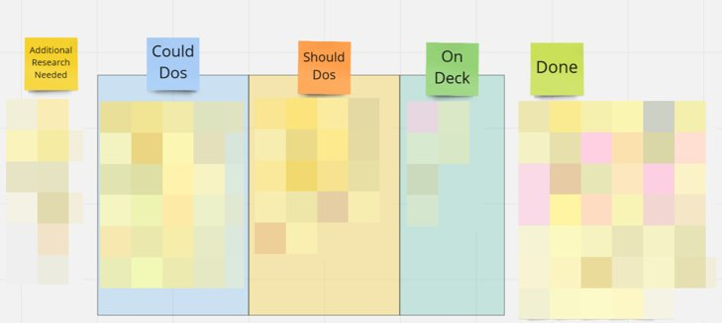
Development Priorities
We will continue to collect enhancement requests and prioritize these in bi-monthly DUX meetings.

Slide 25
Diversity, Equity, and Inclusion in Metadata
Scott Brandwein, Bibliographic Services Manager

Slide 26
Diversity, Equity, and Inclusion in Metadata
Task force to evaluate our catalog and ensure terms describing groups of people are modern, respectful, and granular.
Goals:
Evaluate LC subject headings and set up automated updating of problematic and outdated terms
Consider optional supplementary subject vocabularies to improve access to resources concerning groups not currently represented
Provide recommendations on improving visibility of diversity resources and Own Voices collections
Collect resources on performing diversity audits for interested members
Notes:
Based on some membership request, some other institutions, and some patron requests
Started as a desire to make sure the language we are using in the catalog that refers to groups of people is respectful and modern
LC subject heading “illegal aliens” is a more well-known example, where Congress failed to change that term, to something more respectful and commonly used
Some terms become outdated and no longer useful in searching
9 members and the Bib Services team
Identifying some terms that are problematic
Completely automated, updated in the evenings, so catalogers will not be impacted
Something on the task force watch list is “Homosaurus” to help give the catalog more depth as an optional tool for catalogers
Improving the visibility of DEI collections
We are only on the first bullet point of this list: ethnicities, medical conditions, religions, LBGTQ plus
Once there are more concrete results, we will show everyone what has been accomplished

Slide 27
Subject heading example
We replaced the term "illegal aliens" with "undocumented immigrants."
650 _0 Children of illegal aliens.​
​
650 _7 Children of undocumented immigrants. $2 localdei​
903 __ $i Term deprecated in SWAN catalog: $a Illegal aliens. $2 legacyterm
Previous term is preserved.
We are also working on supplementing terms:
650 _0 Sexual minorities in media.​
​650 _7 LGBTQ people in media. $2 localdei
Notes:
Based on some membership request, some other institutions, and some patron requests
Started as a desire to make sure the language we are using in the catalog that refers to groups of people is respectful and modern
LC subject heading “illegal aliens” is a more well-known example, where Congress failed to change that term, to something more respectful and commonly used
Some terms become outdated and no longer useful in searching
9 members and the Bib Services team
Identifying some terms that are problematic
Completely automated, updated in the evenings, so catalogers will not be impacted
Something on the task force watch list is “Homosaurus” to help give the catalog more depth as an optional tool for catalogers
Improving the visibility of DEI collections
We are only on the first bullet point of this list: ethnicities, medical conditions, religions, LBGTQ plus
Once there are more concrete results, we will show everyone what has been accomplished

Slide 28
Summary of regional meetings
Aaron Skog, SWAN Executive Director

Slide 29
Summary regional meetings discussing American Rescue Plan Act (ARPA) funding
SWAN hosted discussions in June with
5 meetings, 15 libraries attended
Summary of need
Improve community access to broadband
Address mobile technology needs
Support flexible programming & events
Support expanded collection development
Support for flexible & evolving space needs
Support for evolving staff, improving skills, & revising organization roles
Possible solutions/ideas
Circulate a shared collection of hotspots for all 100 libraries or a library group(s) within SWAN
Acquire mobile laptop equipment for libraries
Universal access card
Centralized ordering of book collections
Provide human resources help for libraries to retool employee positions
Mobile workforce redesign
Notes:
Aaron

Slide 30
Illinois State Library Grants: application closed 8/15
Expanding Digital Inclusion: Transforming Library Services
Focuses on devices and technologies that circulate to meet the needs of an identified target audience in response to and recovery from the pandemic.
Academic, public, school and special libraries are encouraged to reach patrons with enhanced digital inclusion efforts focused on circulating internet hotspots, laptops, and other devices to help patrons recover from the pandemic.
This offering is NOT for books or electronic subscriptions.
Requests ranging from $5,000 to $30,000 per library building or branch location will be considered, with one application accepted per agency.
Applications are due August 15, 2021
Bouncing Back from the Pandemic: Developing Resources for the Local Workforce
Provides funds from the American Rescue Plan Act of 2021 (ARPA) to support libraries in providing essential resources and services to those seeking employment.
Libraries may also establish and design workforce recovery programming and services that will impact the intended target audience.
To assist libraries in providing resources to their local workforce, public library and academic library agencies may apply for $5,000 to $50,000 to expand the library’s current technology, equipment, and related materials.
Applications are due August 15, 2021
On the Road to Recovery: Transforming Library Spaces
Offering provides emergency relief and support to academic, public, school and special libraries as library spaces are modified in response to and recovery from the pandemic.
This offering focuses on restoring the library’s capacity to operate and creating clean, safe spaces in the library for patrons during and after reopening.
The goal is to prioritize health and safety while taking progressive steps that best fit individual reopening plans and restore regular library operations.
Requests ranging from $5,000 to $25,000 per library building or branch location will be considered, with one application accepted per agency.
Applications are due August 15, 2021
Notes:
Aaron

Slide 31
Statistics
Statistics are included monthly in SWAN Board Operations Report

Slide 32
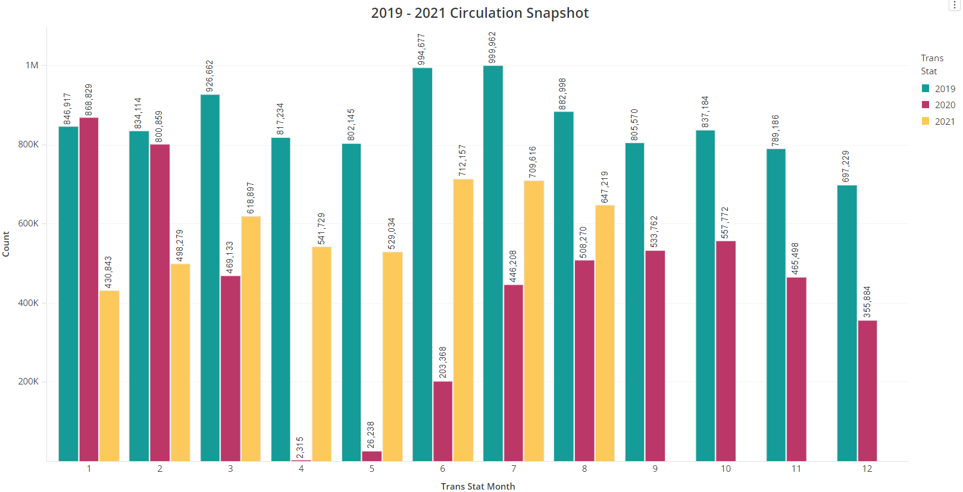



Slide 33
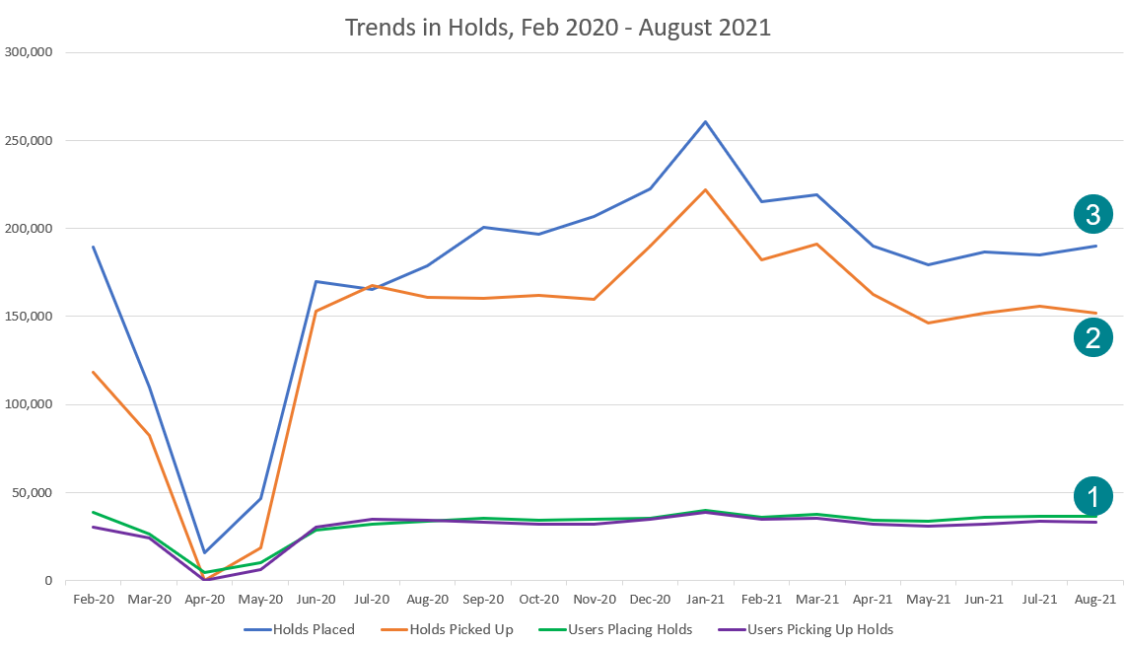
About same number of patrons placing/picking up hold as pre-pandemic
Rate of pick-up is higher during pandemic
Number of holds placed leveling off to pre-pandemic number

Slide 34
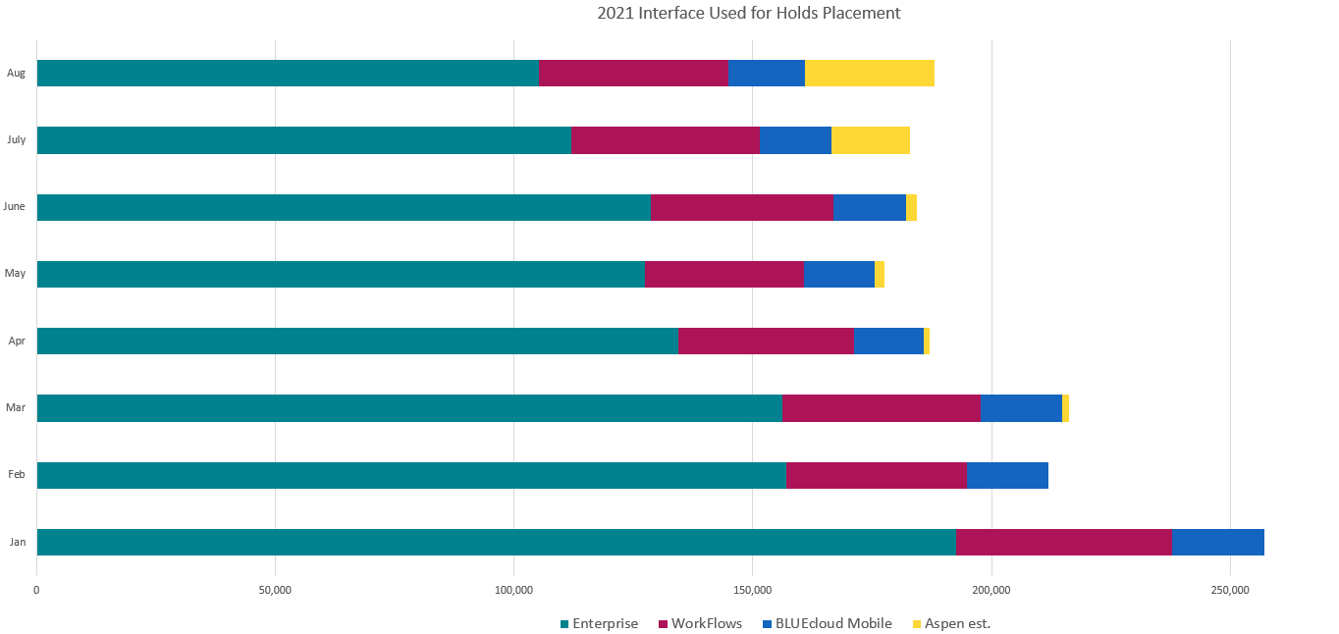
Holds placed by interface 2021
August 2021, more holds placed via Aspen than BLUEcloud Mobile.
Approximately 25% of Enterprise.

Slide 35
Announcements & Questions
Ted Bodewes, SWAN Board President
Thomas Ford Memorial Library, Western Springs, IL

