Slide 1
SWAN Quarterly Meeting
December 2, 2021

Slide 2
Agenda
Call to Order and Welcome
Public Comment
Introduction of New Library Directors
Introduction Item – Live voting platform demonstration
Action Item – Approval of the September 1, 2021 Quarterly meeting minutes
Information Item – Annual presentation on SWAN strategic plan
Information Item—Library engagement platforms overview
Information Item—EBSCO subscription group-purchase usage
Information Item – Future planning and interest in digitization projects/grants
Announcements and Questions
Next meeting: March 3, 2022

Slide 3
Live Vote Demonstration
Aaron Skog, Executive Director
Dawne Tortorella, Assistant Director

Slide 4
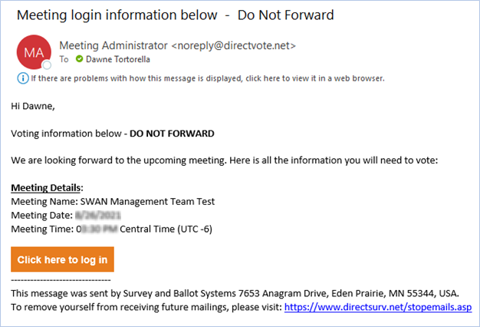
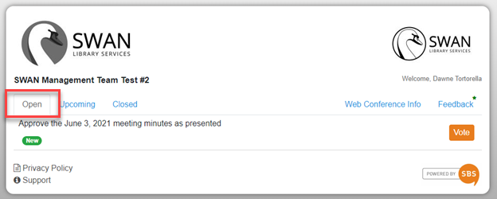
Live Voting

Slide 5
Voting
Practice vote
Approve Minutes

Slide 6
Our strategic initiatives
Aaron Skog, SWAN Executive Director

Slide 7
Completed 2021 goals
Migrate RAILS hosted servers to SWAN infrastructure
Replace SWAN automated voice notification
Develop AV item type recommendations for SWAN100
SWAN100: addition of 3 libraries to SWAN
Recommendation of new catalog: Aspen Discovery
Implementation of Aspen Discovery
Scheduled monthly “Your library statistics”report
Initiative for online self-paced training
BLUE Acquisitions in production with 3 libraries
Rental collection with Baker & Taylor rentals to supplement high demand holds
Implemented Book Club Reservation system pilot – now open to all libraries

Slide 8
BLUEcloud Acquisitions in Production
From success of BLUEcloud Acquisitions pilot in 2019, 3 new libraries joining SWAN in December 2020 went live in BLUEcloud Acquisitions
SWAN team and production use libraries worked with SirsiDynix to address duplicate issues in loading records (largely resolved in Fall 2021)

Slide 9
Baker & Taylor Rental
Baker & Taylor rentals provided a controlled test of introducing needed copies to meet high demand within the consortium
SWAN now has a contract with Baker & Taylor for rental copies. The first order of rental items were placed in August 2020
Items selected were based on high demand holds and are immediately holdable for any patrons
These items were continuously shared, with opportunities for testing roaming collections
When circulation demand ceased, the items were returned to Baker & Taylor
Based on thresholds for item retention, some copies were retained permanently and added to shared book club kits managed by member libraries

Slide 10
Goals for 2022
Expanded BLUEcloud Staff pilot: Circulation Advisory
Beanstack subscription: offered & shared with common reading initiative
Group-purchase for rental copies of popular books & movies
SWAN eXpo resumes in-person August 2022
Research mobile app usage & options: BLUEcloud Mobile & Aspen app
Risk assessment and security initiative

Slide 11
Library engagement platforms
Aaron Skog
SWAN Executive Director

Slide 12
Overview – What are library engagement platforms?
What is engagement?
Patron activity
Organizing patrons into groups, “segments” or “clusters”
Email campaigns
  New library users
  Preferred topics
  Topics based on usage/activity
Platforms
Patron Point
OrangeBoy Savannah
SirsiDynix CEP
OCLC WISE

Slide 13
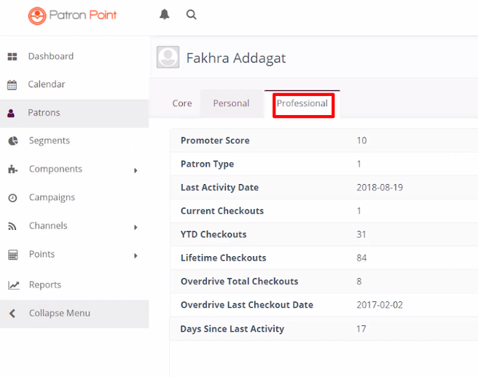
Engagement platform features
Web-based administration
Templates for email marketing, targeted at specific patron groups, i.e., segments
ILS integration means some initial harvest of users & ongoing API connection
Data integration with other vendors possible (OverDrive)
Webpage code integrated into library website
Patron Point – patron activity detail

Slide 14
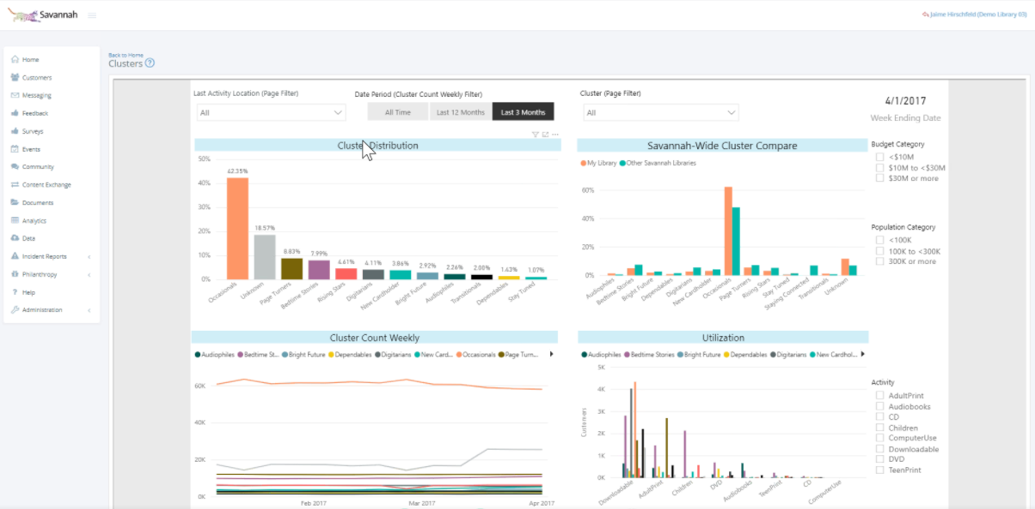
Engagement platforms & libraries
Oak Park Public Library
Tinley Park Public Library
Lansing Public Library
OrangeBoy Savannah “Clusters” dashboard

Slide 15
Engagement platforms
Strengths
Weaknesses
Targeted email marketing
New library card sign-ups
Email promotion events, follow-up campaigns, library usage & interests
Writing back to the ILS
Not a replacement for routine email notices
  Platforms not advanced with updating the ILS notification “counters”
  Borrowed material vs. library patrons vs. reciprocal users

Slide 16
Library & SWAN considerations
Please involve SWAN early in the selection of your platform
Data harvests & API connections take some planning, testing
Secure data transfer is required of SWAN member libraries
“Walk, don’t run” approach based on library staff interviews
If there is widespread interest, SWAN could continue research into a specific engagement platform subscription
  Centralized data harvests & managed segments
  Support for library marketing staff on data crosswalk

Slide 17
Usage of EBSCO subscription
Robin Hofstetter, SWAN Electronic Resources Consultant
Aaron Skog, SWAN Executive Director

Slide 18
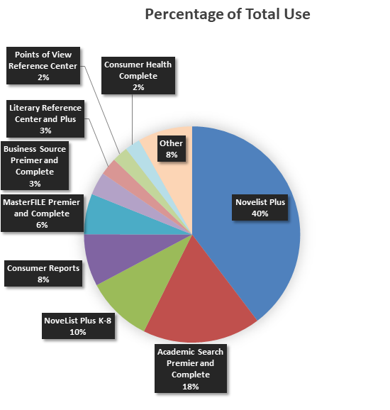
EBSCO database usage
Niche databases all together get about as much use as Consumer Reports
Academic Search is the second most-used database – patrons are doing research
"Big deal" allows SWAN libraries to serve more interests, for the same cost as Novelist & Consumer Reports

Slide 19
EBSCO year-3 renewal
Conversations starting with RAILS & EBSCO
  EBSCO wants opted out libraries requesting to rejoin must do so at full RAILS package B price (based on library service area population)
  SWAN EBSCO group purchase pricing uses 4 library discount tiers (based on library tax revenue)
  Year-3 total price includes 3 new libraries
  Possible 3% increase with the 84-participating year-2 libraries (worst case)
Next Steps:
SWAN shared year-3 pricing prior to Tuesday, February 2, 2022 COW meeting
Opt-out deadline Friday, February 18, 2022

Slide 20
Digital Archives Landscape Survey
Gauging member interest and opportunities for grants from the Illinois State Library

Slide 21
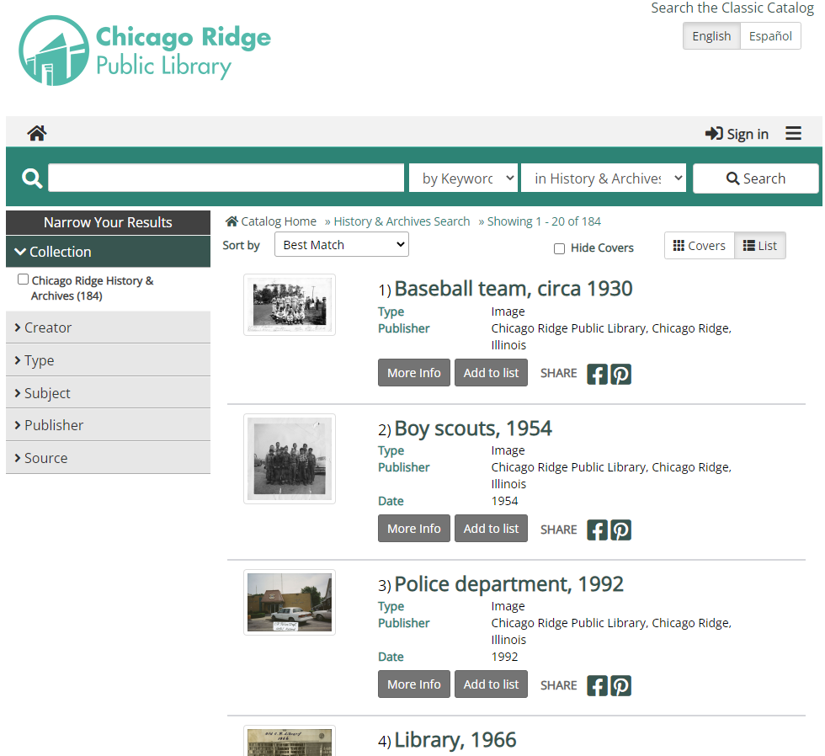
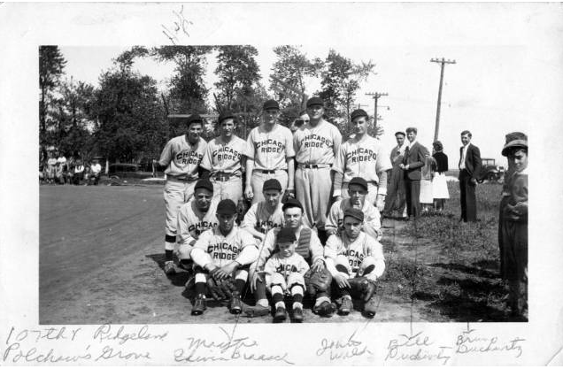
Complete the survey
Did you know Aspen can surface local digital collections?
Do you currently have collections in the Illinois Digital Archives?
Are you interested in digitizing local collections and working together to secure grant funding from the Illinois State Library?
Are you interested in community-driven archives programming?

Slide 22
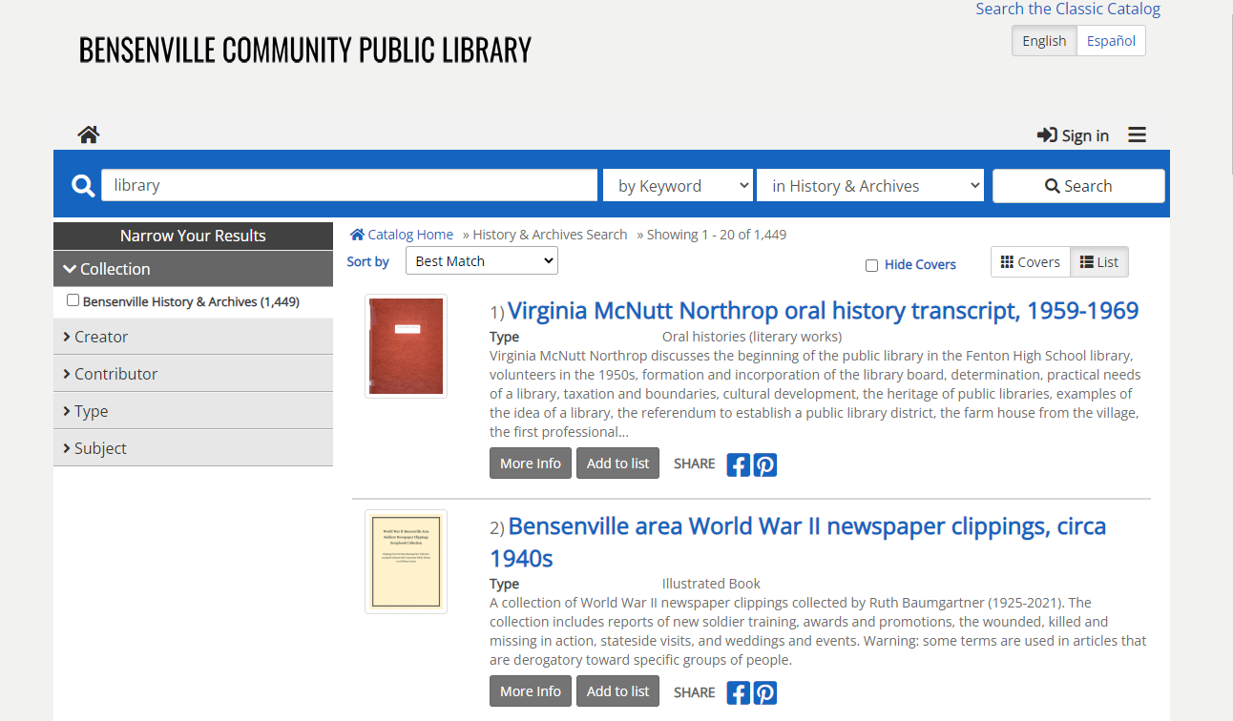
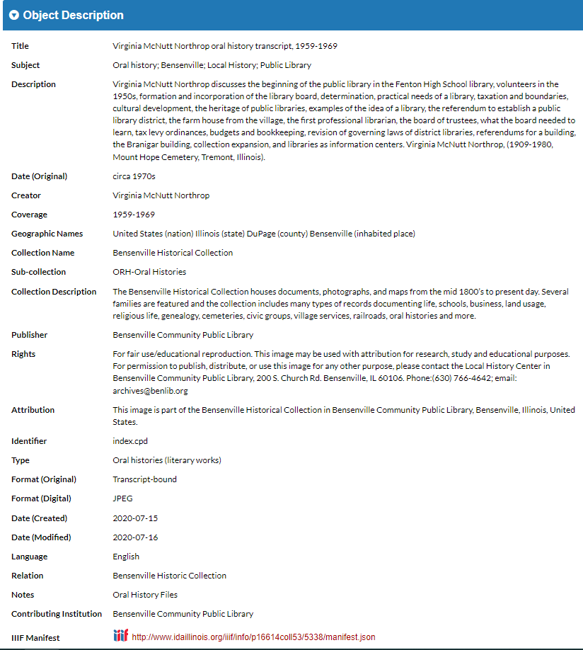

Slide 23
Statistics
Statistics are included monthly in SWAN Board Operations Report

Slide 24
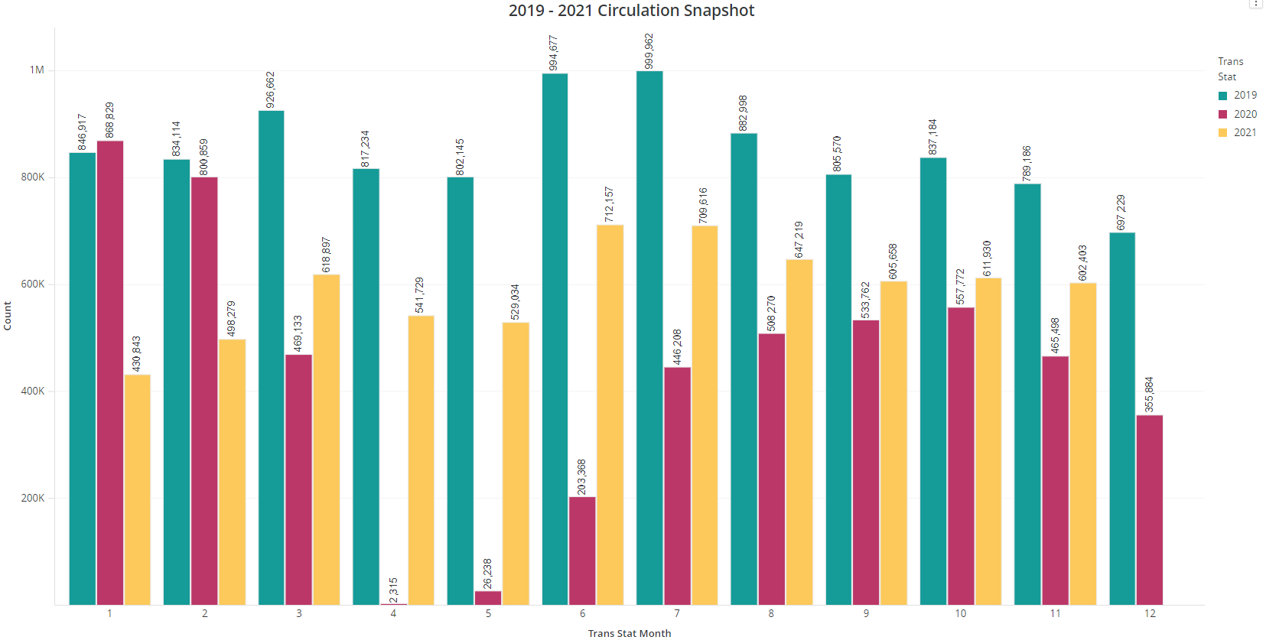


Circulation 2019 vs 2021 show similar cyclical pattern and narrowing gap in percentage difference
Feb – 59.7%
Nov – 75.9%

Slide 25
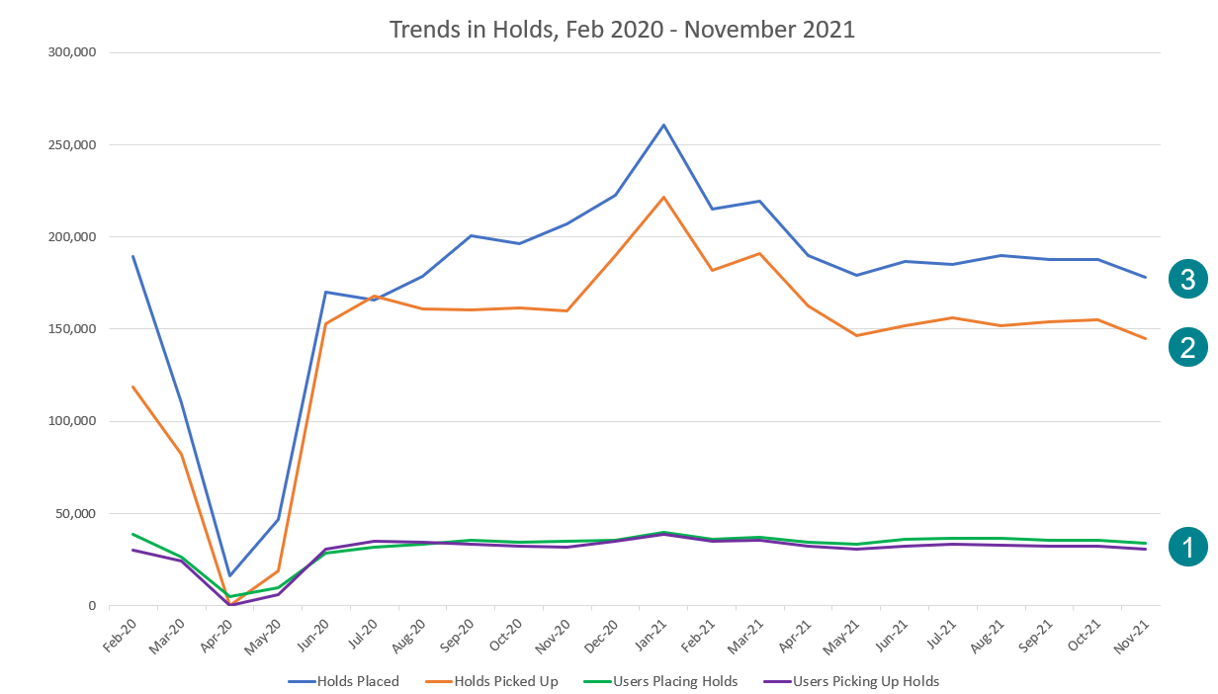
About same number of patrons placing/picking up hold as pre-pandemic
Rate of pick-up is higher during pandemic
Number of holds placed leveling off to pre-pandemic number, and more consistent since April

Slide 26
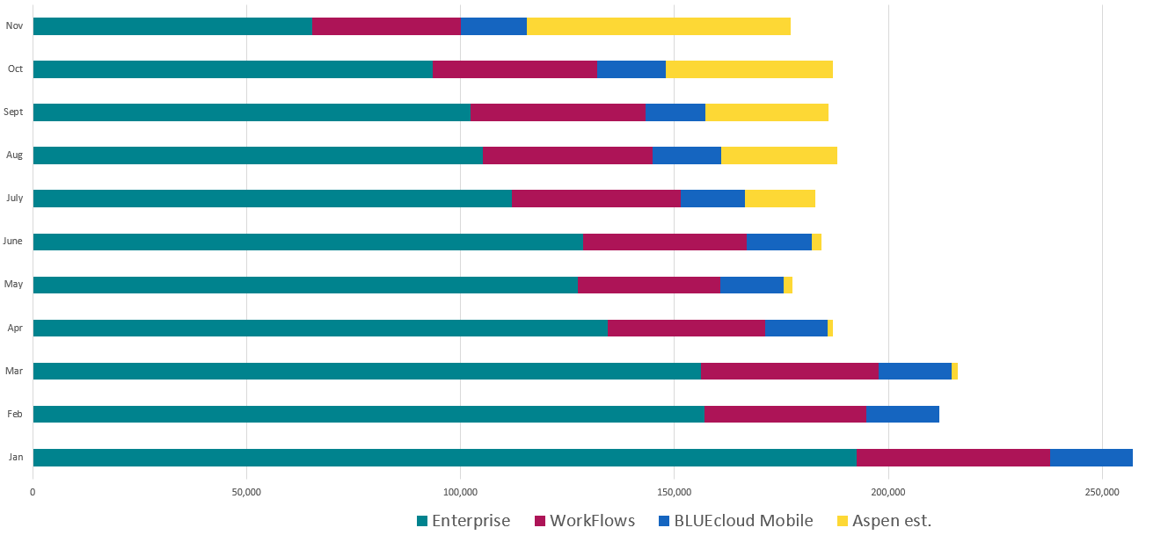
Holds placed by interface 2021
November 2021:
35% of holds placed in Aspen
37% of holds placed in Enterprise
9% placed via mobile app

Slide 27
Announcements & Questions
Ted Bodewes, SWAN Board President
Thomas Ford Memorial Library, Western Springs, IL

