Slide 1
SWAN Fiscal Year 2023 Budget
February 1, 2022
Committee of the Whole Meeting

Slide 2
SWAN Budget Overview
Fiscal Year 2023: July 1, 2022 through June 30, 2023

Slide 3
Timeline
Board review Nov, Dec, Jan
Budget documents posted for COW
COW February 1, 2022 presentation & feedback gathered
SWAN board meeting February 18, 2022
Online vote for approval March 3, 2022

Slide 4
2022 priorities
Strategic plan & tactical plan
Aspen Discovery
Security initiative
BLUEcloud Staff
  Acquisitions
  Cataloging
  Circulation
Preparation & research
Find More Illinois analysis
  Inadequate solution
  19% hit rate compared to OCLC
  Savings 0.9% to SWAN
SirsiDynix annual subscription
  Negotiated 0% increase
OCLC annual subscription
  Lowered cost in FY22

Slide 5
Budget Highlights
100 Libraries strong
No library add-ons in FY23
Aspen Discovery catalog support, SirsiDynix Enterprise subscription ends
Preparing for the BLUEcloud Circulation & automation of delivery transit labels
Security initiative consulting expenses
SWAN Expo August 19, 2022
Revenue
  Lower interest income
  Lower RAILS funding from prior years
Expenses
  Overall, 1.2% increase
    Additional e-commerce/PayPal expense pass-thru
    Printer group purchase pass-thru
  Removed Enterprise expense
  Added KitKeeper & Book Club Kits
  Reduced expenses due to pandemic

Slide 6
Aspen & Enterprise expenses
5430 & 5440 Expenses | Current | FY2023
SirsiDynix Enterprise, SaaS Annual Subscription | $41,185 | $0
SirsiDynix Portfolio, SaaS Annual Subscription - Up to 10K assets | $15,000 | $0
SirsiDynix Enterprise SaaS Test System, Annual Subscription | $2,550 | $0
Aspen hosting server expense | $6,000 | $30,000
Aspen support with ByWater Solutions expense | $85,000 | $85,000
 | $149,735 | $115,000

Slide 7
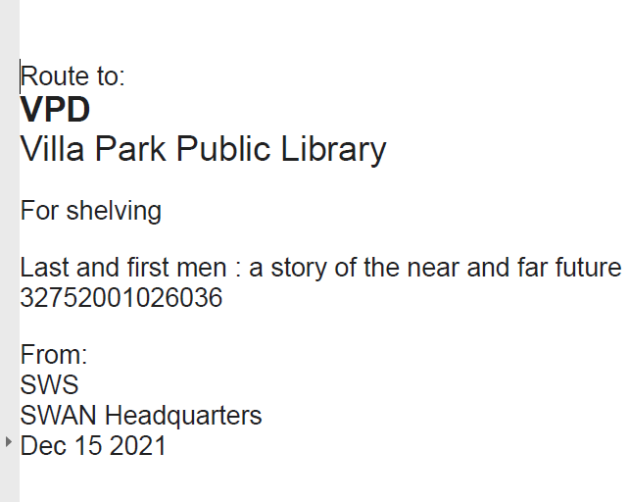
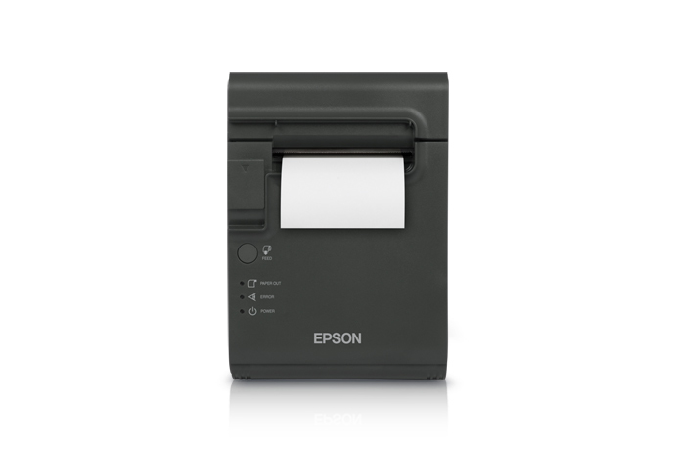
Restick printer purchase
BLUEcloud Circulation generates transit/delivery labels
100 printers $34,000 reserve purchase: 1 printer per library
Additional group-purchase for delivery printers:
  Revenue #4190 Member Group Purchase Receipts $10,200
  Expense #5690 Group Purchases – Hardware $10,200

Slide 8
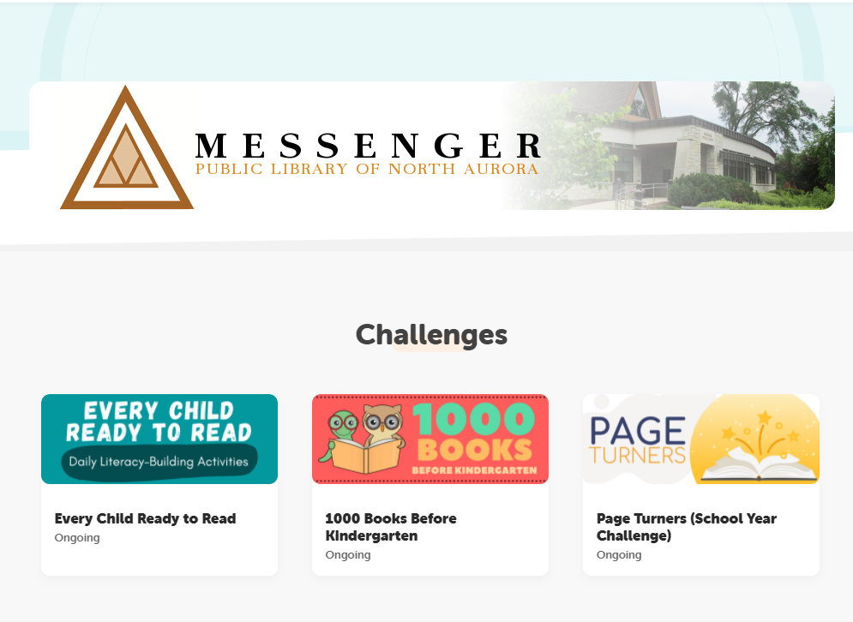
Beanstack Reading subscription
Subscription for any library, July 1, 2022 – June 30, 2023
$5,000 expense
SWAN shared subscription with single branding, reading challenges
SWAN’s NEA grant submission in Sept 2021 was not awarded (notified January 2022)
48 libraries currently using Beanstack

Slide 9
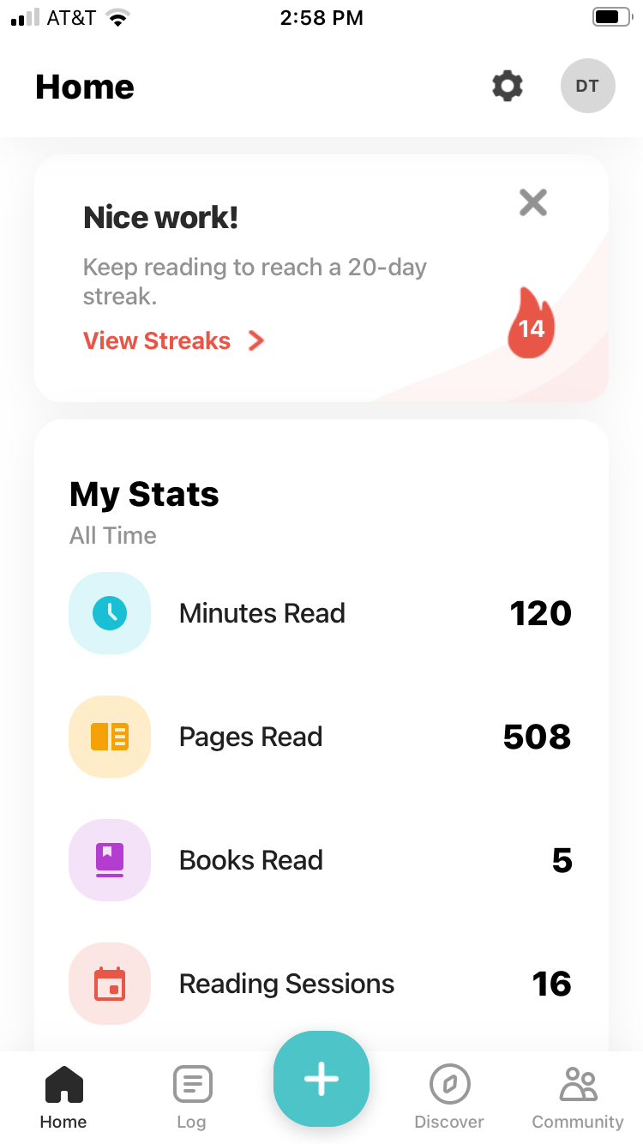
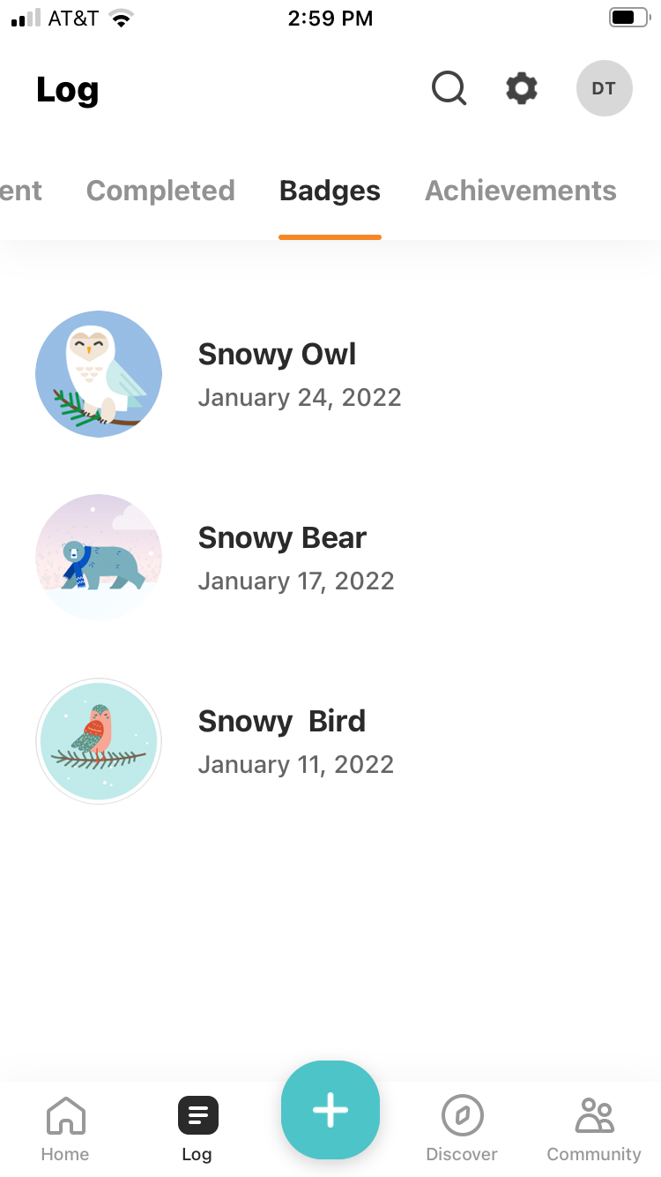
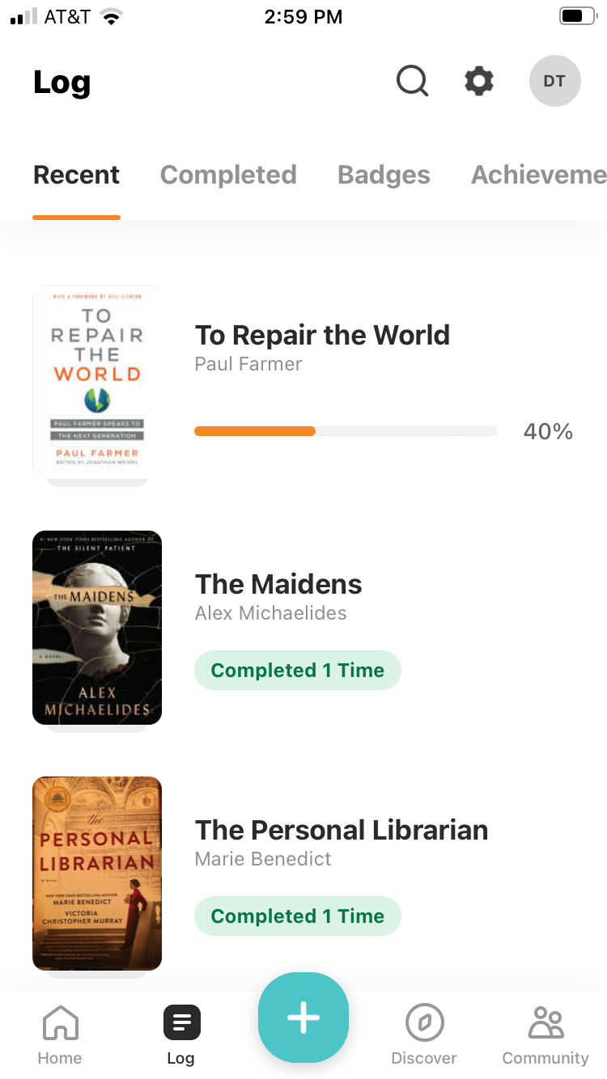
Beanstack Reading subscription
Search for libraries – connect to your library
Web-based or mobile app
Tracks reading progress (any reading)
Badges and achievements
Reviews
Upload book, magazine, reading material covers

Slide 10
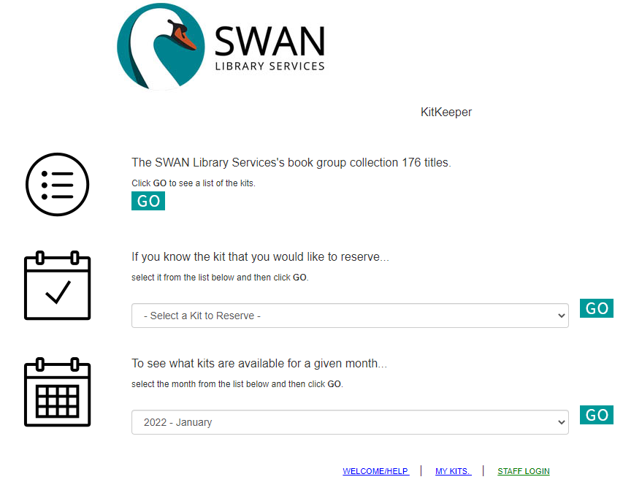
Book club support & Popular materials
KitKeeper out of pilot – any library can join
Geneva and Downers Grove are sharing 176 kits with SWAN libraries
Baker & Taylor Rental – targeting high demand holds
Rental copies circulated an average of 4.79 times
Once returned and hold queue exhausted, books returned
2022 – expanding test to include floating collections to minimize transit time

Slide 11
SWAN Reserves
SWAN Reserves Plan: Updated for FY23 Budget
Capital Expenditures (anything over $5,000) | FY22 | FY23 | FY24 | FY25 | FY26
 | July 2021-June 2022 | July 2022-June 2023 | July 2023-June 2024 | July 2023-June 2025 | July 2023-June 2026
Prior Year Balance: End of fiscal year, final audit, see "Unrestricted" on Balance Sheet | $2,241,167 | $2,107,667 | $2,073,667 | $2,073,667 | $2,073,667
Reserves collected & Impact Fee | $0 | $0 | $0 | $0
Server replacement: no longer required with cloud-based Infrastructure-as-a-Service* | $0 | $0 | $0 | $0
Firewall replacement: no longer required with cloud-based Intrastructure-as-a-Service | $0 | $0 | $0 | $0
Printer purchase |  | ($34,000)
Aspen Discovery Project | ($85,000)
Baker & Taylor Project | ($5,000)
Security audit | ($43,500)
Funds for EMV commerce devices (chip & PIN)
Funds for SWAN staff computer replacement
Future ILS Migration Budget ($465,740)
Total | $2,107,667 | $2,073,667 | $2,073,667 | $2,073,667 | $2,073,667
Maintain 4 months operating in reserve (policy) | ($1,380,842) | ($1,449,884) | ($1,522,378) | ($1,598,497) | ($1,678,422)
Over/(Under) Reserve Policy | $726,825 | $623,783 | $551,289 | $475,170 | $395,245
Operating Budget (5% increases each year after FY21) | $4,142,526 | $4,349,652 | $4,567,134.92 | $4,795,491.66 | $5,035,266.24
Months operating in reserve | 6.11 | 5.72 | 5.45 | 5.19 | 4.94

Slide 12
Revenue
Membership Fees, Grant Revenue, Investment & Interest
Pass through: Group-purchase, Reimbursements for Losses,
RAILS LLSAP grant revenue reduced $39,327 in FY22, with small $4,690 increase for FY23 at $527,381 total
Interest income remains low
Membership fee budget line increases 2.5% (varies per public library)
Annual conference fees (offset the food & beverage expenses at rental MVCC)
NEW: Added #4240 E-commerce transactions budget line (offset by #5940 expense)
EBSCO group purchase fees (offset by #5990 expense)

Slide 13
Expenses
Salaries & Wages
Personnel Benefits
4th year no increase in budget
Positions eliminated via attrition, retirement, & elimination
New position planned, on hold
Based on FY21 actual expenses, reduction $26,600 health, dental, life, & STD/LTD benefits insurance
Changed from BCBS to Aetna on January 1, 2021
Open enrollment completed January 1, 2022

Slide 14
Expenses
Buildings & Grounds
Professional Development
Small -1% decrease
Facility lease
Eliminated flood insurance for RAILS data center
Reduced utilities expense
Reinstated conference travel
Pre-pandemic was $11,000 but for FY23 $6,000

Slide 15
Membership Development
Information & Technology Services
Supports SWAN Expo
  Moraine Valley Community College Business & Conference Center
  Space reserved, can cancel without penalty
Increased staff travel to libraries
No expenses associated with in-person membership events
Transition of SWAN websites hosted by RAILS to SWAN infrastructure completed June 2021
  Increase for Azure expense #5430
  Increase infrastructure usage with Aspen Discovery
SirsiDynix decrease (Enterprise)
OCLC increase 3% (anticipated)
EBSCO increase 3% (anticipated)

Slide 16
Expenses
General Office, Hardware & Equipment, Insurance
Contractual Services
Group purchase hardware – Epson restick printers $34,000
  offset by SWAN reserve fund #4600
Continuing legal, accounting services
No libraries joining = no contractual expenses RAILS Catalog Grant
SWAN Expo MVCC expense $12,000
Increase for Unique Management Services for migration of phone notification service (SirsiDynix Voice Automation retired)

Slide 17
Expenses
Library Materials & Content
Interest & Fees
Baker & Taylor expense for book rental pilot
EBSCO database package group-purchase year-3 renewal 3% increase + add-on 3 libraries
NEW: Budget line #5940 E-commerce payment transactions added with revenue offset
Bank fees, merchant account ProPay fees flat
Annual conference merchant account fees for credit card processing $300

Slide 18
Revenue: Membership Fees
Separate formula for academic, school, special, and public libraries
Public library formula based on county tax data (Cook, DuPage, Kane, Will)
  Self-reported bond payments, debt service obligations deducted from total tax data
  Completion of debt service payments may increase fees (ex: Downers Grove)
  Details on how SWAN membership fees are calculated
  https://support.swanlibraries.net/about/budget
State funding via RAILS LLSAP is applied as a reduction in membership fees for 95 public libraries

Slide 19
EBSCO database subscription year-3 renewal group-purchase
Robin Hofstetter, SWAN Electronic Resources Consultant

Slide 20
EBSCO database group-purchase
Year-3 renewal with 84 participating libraries
Pricing posted & in Committee of the Whole meeting packet
Opt-out period ends Friday, February 18th 11:59 p.m.
Libraries opted out will remain out of the year-3 deal
Go to Support > Help > Request Forms > Opt-out EBSCO database group purchase
https://support.swanlibraries.net/forms/80756

Slide 21
Feedback

Slide 22
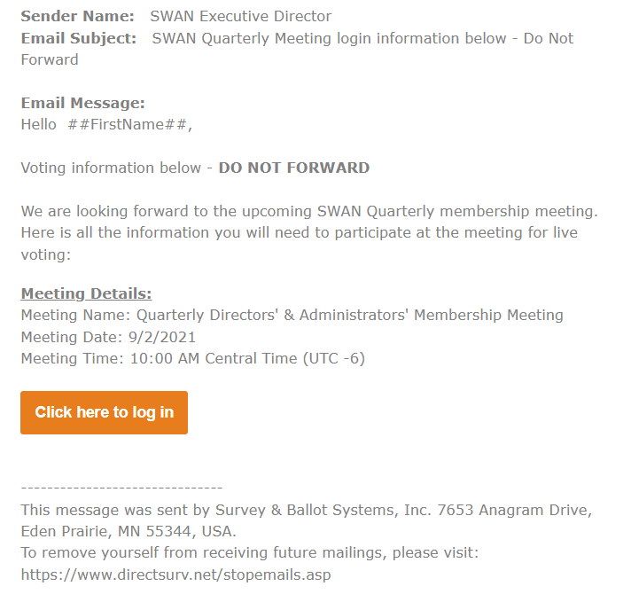
Live voting
The week prior to the March 3, 2022
Email with login information
SWANcom notifying ballot sent
Ballot will open at 10 a.m. March 3, 2022 when the meeting begins

Slide 23
Questions & Answers
Feedback from you
Board meeting February 18th
Final budget packet February 28th
March 3, 2022 Directors’ & Administrators’ Quarterly meeting
Electronic live vote at meeting

