Slide 1
SWAN Quarterly Meeting
March 3, 2022

Slide 2
Agenda
Call to Order and Welcome
Public Comment
Introduction of New Library Directors
Introduction Item – Live voting platform demonstration
Action Item – Approval of the December 2, 2021 Quarterly meeting minutes (live vote)
Action Item – Approval of the fiscal year 2023 budget & membership fees (live vote)
Action Item – Approval of amending the fiscal year 2022 budget for Aspen fines payment integration (live vote)
Discussion Item—Planned downtime for Sunday, April 17, 2022 (poll)
Information Item— SWAN analysis of rental collection pilot with Baker & Taylor
Information Item—Aspen Discovery progress report & final steps remaining
Announcements and Questions
Next meeting: June 2, 2022

Slide 3
Live Vote Demonstration
Aaron Skog, Executive Director
Dawne Tortorella, Assistant Director

Slide 4
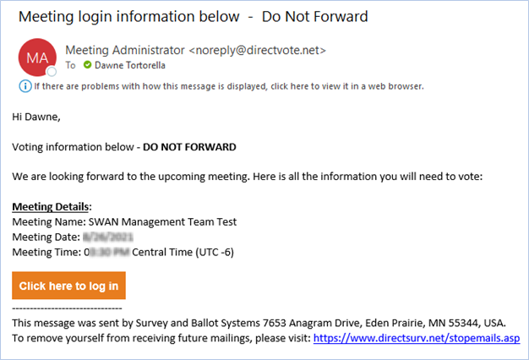
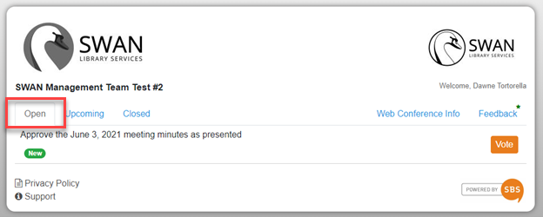
Live Voting

Slide 5
Voting
Practice vote
Approve Minutes

Slide 6
Budget & Membership Fees

Slide 7
Budget Highlights
100 Libraries strong
No library add-ons in FY23
Aspen Discovery catalog support, SirsiDynix Enterprise subscription ends
Preparing for the BLUEcloud Circulation & automation of delivery transit labels
Security initiative consulting expenses
SWAN Expo August 19, 2022
Revenue
  Lower interest income
  Lower RAILS funding from prior years
Expenses
  Overall, 1.2% increase
    Additional e-commerce/PayPal expense pass-thru
    Printer group purchase pass-thru
  Removed Enterprise expense
  Added KitKeeper & Book Club Kits
  Reduced expenses due to pandemic

Slide 8
2022 priorities
Strategic plan & tactical plan
Aspen Discovery
Security initiative
BLUEcloud Staff
  Acquisitions
  Cataloging
  Circulation
Preparation & research
Find More Illinois analysis
  Inadequate solution
  19% hit rate compared to OCLC
  Savings 0.9% to SWAN
SirsiDynix annual subscription
  Negotiated 0% increase
OCLC annual subscription
  Lowered cost in FY22

Slide 9
Budget: Aspen Discovery
FY23 Aspen expenses increase for server hosting
SirsiDynix expenses are lowered by $58,735
Net savings $34,735
5430 & 5440 Expenses | Current | FY2023
SirsiDynix Enterprise, SaaS Annual Subscription | $41,185 | $0
SirsiDynix Portfolio, SaaS Annual Subscription - Up to 10K assets | $15,000 | $0
SirsiDynix Enterprise SaaS Test System, Annual Subscription | $2,550 | $0
Aspen hosting server expense | $6,000 | $30,000
Aspen support with ByWater Solutions expense | $85,000 | $85,000
 | $149,735 | $115,000

Slide 10
Budget: Security Initiative
Current budget (underway)
FY23 budget expense
#5830 Consulting $38,000
Added expense for Sikich to conduct information security audit with SWAN
#5830 Consulting $19,200
Mitigation efforts for security audit findings
Virtual Chief of Information Security (vCISO) service
Creation & implementation of policies

Slide 11
Budget: BLUEcloud: Acquisitions, Cataloging, Circulation
Included in SirsiDynix agreement
No additional cost
BLUEcloud Acquisitions
BLUEcloud Cataloging
BLUEcloud Circulation
Cataloging Pilot
Circulation Pilot with SWAN Circulation Advisory
Acquisitions live with 3 libraries
Watch for BLUEcloud Update announcements
February release

Slide 12
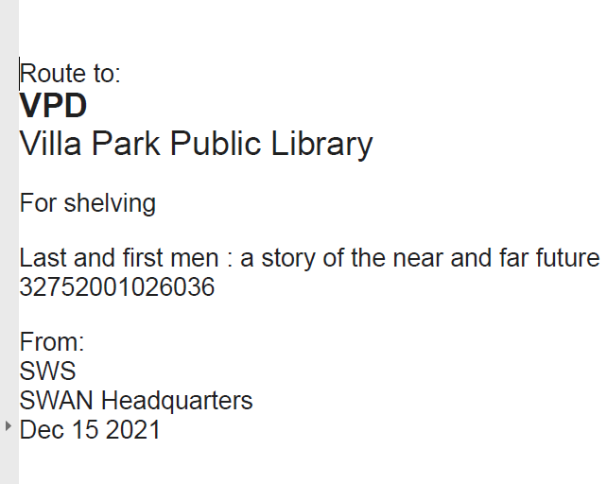
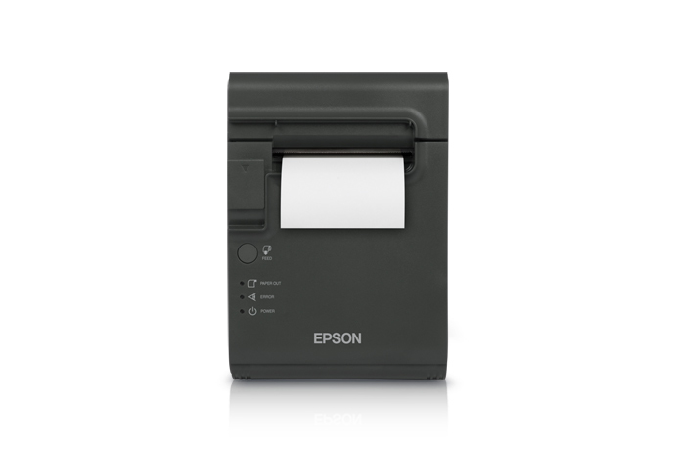
Budget: Restick printer purchase
BLUEcloud Circulation generates transit/delivery labels
100 printers $34,000 reserve purchase: 1 printer per library
Additional group-purchase for delivery printers:
  Revenue #4190 Member Group Purchase Receipts $10,200
  Expense #5690 Group Purchases – Hardware $10,200

Slide 13
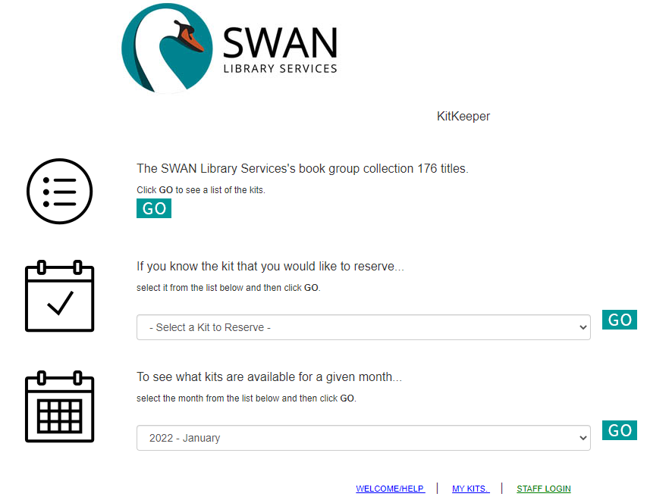
Budget: Book club support & Popular materials
KitKeeper out of pilot – any library can join
Geneva and Downers Grove are sharing 176 kits with SWAN libraries
Baker & Taylor Rental – targeting high demand holds
Rental copies circulated an average of 4.79 times
Once returned and hold queue exhausted, books returned
2022 – expanding test to include floating collections to minimize transit time

Slide 14
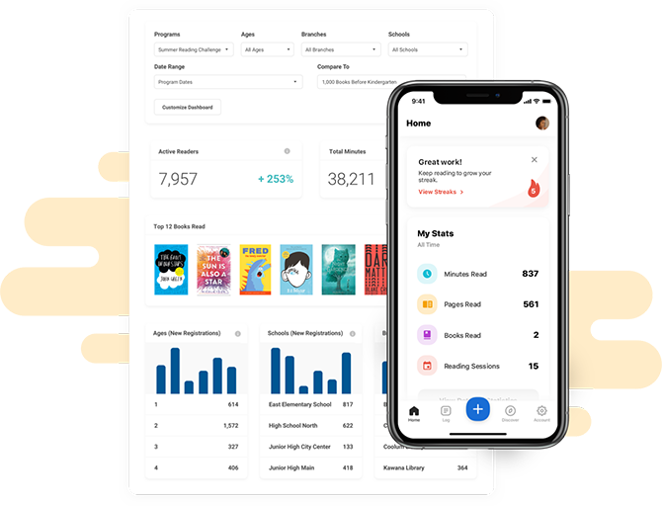
Budget: Reading Platform - Beanstack
Provides reading platform for small libraries and their patrons who do not have budget or staff time to support
Provides opportunity to share marketing and training resources throughout SWAN
Support year-long reading and student outreach
Supplements, does not replace existing library-branded reading platforms or programs
Will be available for patron use by mid-May to accommodate summer reading

Slide 15
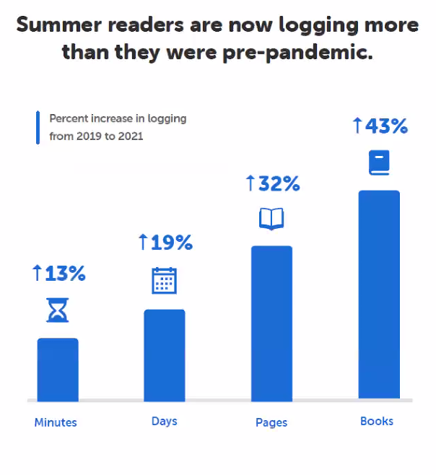
Why Beanstack?
ALA Publishing – eLearningSolutions
Use the 2021 Summer Reading Report to Adapt for Summer 2022 (Feb. 22, 2022)
Webinar archive, including chat log
Webcast slides
Currently 48 of our 95 public libraries use Beanstack
Does not require integration with patron database, retaining patron privacy and limiting access to personal identifiable information
Year-round reading programs/templates
Monthly reading challenges
Strong community of users
Continuous development
Compliance with accessibility standards

Slide 16
Budget: EBSCO database group-purchase
Year-3 renewal with 84 participating libraries
Pricing finalized at 2% increase & updated in meeting packet
Opt-out period ended Friday, February 18th 11:59 p.m.
No additional libraries opted out year-3
Invoices for full year subscription will be sent July 2022 (same as year-2)

Slide 17
Budget: SWAN Reserves
SWAN Reserves Plan: Updated for FY23 Budget
Capital Expenditures (anything over $5,000) | FY22 | FY23 | FY24 | FY25 | FY26
 | July 2021-June 2022 | July 2022-June 2023 | July 2023-June 2024 | July 2023-June 2025 | July 2023-June 2026
Prior Year Balance: End of fiscal year, final audit, see "Unrestricted" on Balance Sheet | $2,241,167 | $2,107,667 | $2,073,667 | $2,073,667 | $2,073,667
Reserves collected & Impact Fee | $0 | $0 | $0 | $0
Server replacement: no longer required with cloud-based Infrastructure-as-a-Service* | $0 | $0 | $0 | $0
Firewall replacement: no longer required with cloud-based Intrastructure-as-a-Service | $0 | $0 | $0 | $0
Printer purchase |  | ($34,000)
Aspen Discovery Project | ($85,000)
Baker & Taylor Project | ($5,000)
Security audit | ($43,500)
Funds for EMV commerce devices (chip & PIN)
Funds for SWAN staff computer replacement
Future ILS Migration Budget ($465,740)
Total | $2,107,667 | $2,073,667 | $2,073,667 | $2,073,667 | $2,073,667
Maintain 4 months operating in reserve (policy) | ($1,380,842) | ($1,449,884) | ($1,522,378) | ($1,598,497) | ($1,678,422)
Over/(Under) Reserve Policy | $726,825 | $623,783 | $551,289 | $475,170 | $395,245
Operating Budget (5% increases each year after FY21) | $4,142,526 | $4,349,652 | $4,567,134.92 | $4,795,491.66 | $5,035,266.24
Months operating in reserve | 6.11 | 5.72 | 5.45 | 5.19 | 4.94

Slide 18
Motion to Approve the Budget
Motion to approve the fiscal year 2023 budget:
Resolved, the fiscal year 2023 budget, membership fees, and EBSCO group purchase fees are hereby approved as presented.

Slide 19
Motion to Amend Current FY22 Budget
Rationale
Proposed motion
Memo in meeting packet
New revenue & expense activity
March – June 2022 online payments within Aspen
RESOLVED, THE SWAN FISCAL YEAR 2022 BUDGET LINE #4240 E-COMMERCE TRANSACTIONS WILL BE ADDED AT $11,666 AND THE BUDGET LINE #5940 E-COMMERCE PAYMENT TRANSACTIONS WILL BE ADDED AT $11,666.

Slide 20
System maintenance
Steven Schlewitt, IT & System Support Manager

Slide 21

Annual Symphony
Database Rebuild
Sunday, APRIL 17th
Sunday, April 17th, 2022 (Easter Sunday)
  Downtime of WorkFlows and other services required throughout
  Process will begin Saturday night after libraries close
WorkFlows Offline required for open libraries on the 17th
Watch for the news post!
Impacted Services:
  Enterprise & Aspen Catalog
  *Intermittent* My Account functions (holds, payments, lists, etc)
  *Intermittent* Inaccuracies of Item location and availability
  Symphony WorkFlows
  *Intermittent* External SIP2 & Web Services integrations (including external vendor subscriptions, digital materials access)
  Internal SIP2 integrations for library self-checkout, AMH, and PC reservation
  WorkFlows - Offline mode must be used for all checkouts
  BLUEcloud Applications
  BLUEcloud Analytics April 16/17th transactions - harvest will be delayed an extra day
  BLUEcloud Mobile, MobileCirc, BLUEcloud Circ and Cataloging will be unavailable
Notes:
Steven

Slide 22
Poll: Sunday, April 17th
Is your library open on Easter Sunday?

Slide 23
Analysis of Rental Pilot with Baker & Taylor
Scott Brandwein, Bibliographic Services Manager
Dawne Tortorella, Assistant Director
Aaron Skog, SWAN Executive Director

Slide 24
Rental Collection Analysis
Vendor: Baker & Taylor
$5,000 budget
Yearly quota of 276 credits (credits based on list price; most = 1 credit)
SWAN holds ~150 titles at a time
SWAN owned items had the highest ratio of circulation per item owned of all library agencies in 2021. (not surprising)
5.06:1 ratio
Overall, SWAN items in rental collection circulated 5+ times in 2021.
August 2020-December 2021

Slide 25
Project structure
Objectives
Increase knowledge of vendor processing options to provide better member support
Development expertise in BLUEcloud Acquisitions selector lists and processing
Augment consortium-wide holdable titles (no hold restrictions)
Process
Selection titles based on high demand holds
Order with pre-processing
Receive items, immediately transit
Items returned to vendor when no longer circulating

Slide 26
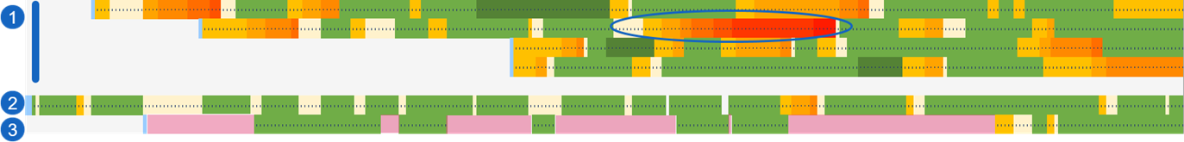
Circulation & transit analysis (The Four Winds example)
Yellow-red: In Transit Pale yellow: on hold shelf
Pink: on shelf Green: checked out
SWAN rental copies
Downers Grove copy
Single copy at a small SWAN library (few patrons place holds)
Highlighted section represents a time period of 52 days where this item bounced in transit to 7 libraries.
Shows saturation level of copies to holds reached.

Slide 27
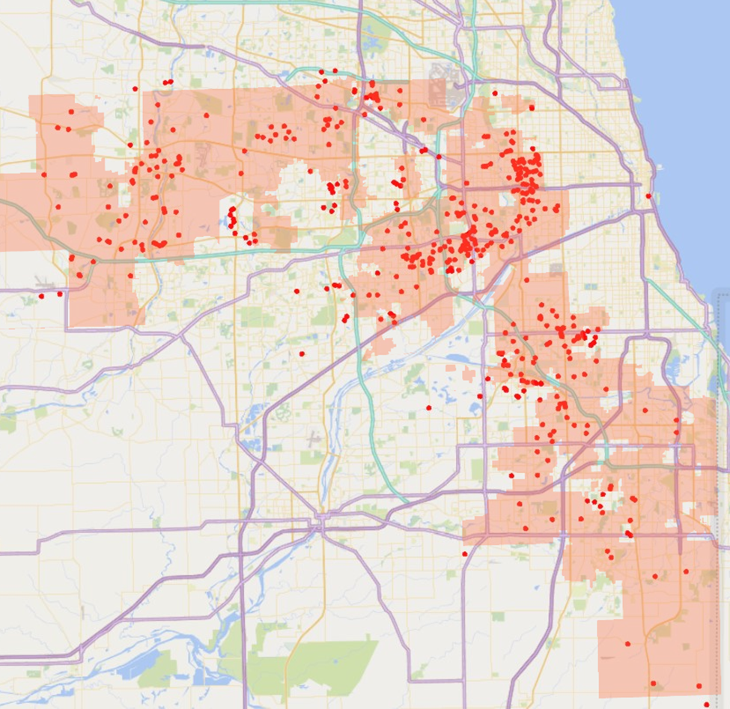
Who received these rental copies?
Benefits
Distributed throughout the SWAN service area
Patterns help identify volume and timing of demand-based fulfillment
Minimal staff time required to process items upon receipt – getting them into patron hands quickly

Slide 28

Next steps: Possibilities
Silver Lining:
Pilot confirmed that demand management within SWAN - how holds can be placed and filled - is working well and manages a diverse set of local policies.
Future research & ideas for exploration
Volume vs targeted single titles – flood the consortium with the “next hot title”
Floating collections – instead of transit back to SWAN, remain “local” on Display or Quick Picks shelf
Shared selection lists – make it easier to pick titles through centralized access to lists & pre-processing instructions, defined by library

Slide 29
Aspen Progress Report

Slide 30
Key Dates
8 Mar.
Aspen Soft Launch
26 Apr.
catalog.swanlibraries.net redirects to Aspen
30 Apr.
Enterprise contract ends

Slide 31
Updating Links
Libraries should update all links to Enterprise by April 26th
swanlibs.ent.sirsi.net URLs will NOT redirect – if not updated, will break April 30th
SWAN will monitor Enterprise traffic and reach out to individual libraries in early April

Slide 32
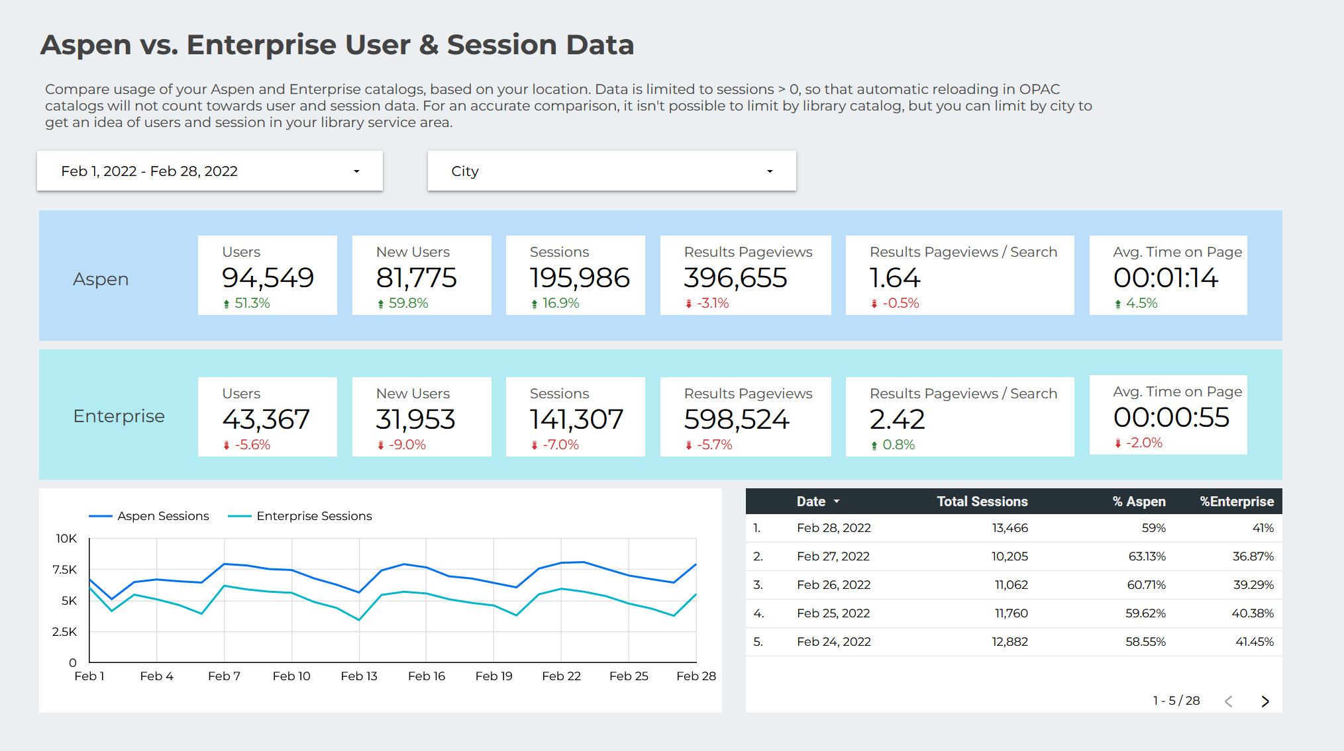
Aspen vs. Enterprise Usage
Over half of users and sessions are in Aspen already.

Slide 33
Board Election 2022

Slide 34
Board election timetable
Election Process Announced | March 3, 2022 (Quarterly)
Online Self-Nominations Accepted | April 4 – 29, 2022
Names of Candidates Released | May 2, 2022
Electronic Ballot | May 9 – May 31, 2022
Results Announced | June 1, 2022
Elected Candidates invited to June SWAN Board Meeting | June 17, 2022
Candidates’ Terms Begin | July 1, 2022
July Board Meeting | July 15, 2022

Slide 35
Announcements & Questions
Ted Bodewes, SWAN Board President
Thomas Ford Memorial Library, Western Springs, IL

