Slide 1
SWAN Fireside Chat
May 31, 2022
Notes:
Steven

Slide 2
Agenda
SWAN Expo 2022 – August 19th
Notice Update
  SMS Text Message Errors/Timeline
  Reviewing Notices – decision tree
Information Technology & Systems Support
  Hardware Recommendations
  Public Web Browser – update key
  Support ticket overview
  Moving to Zoom (August 2022)
Aspen Tip of the Month
  Aspen Hold Notes
E-Resources
  Comics Plus
  EBSCO Database Selections
Member Engagement
  User Group Recap
  Online Learning Update
  Beanstack Launch
  “Libraries Empower Connections”
Upcoming Meetings & Training

Slide 3

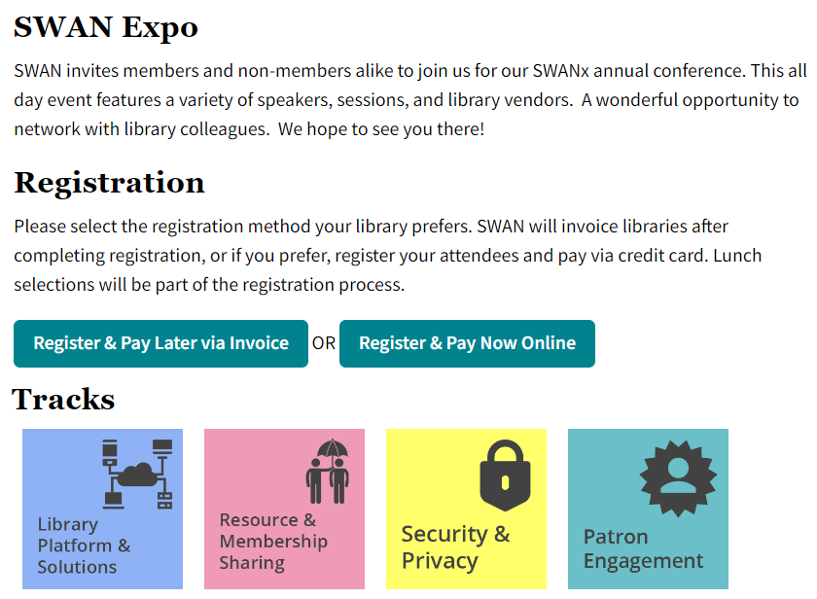
SWAN Expo 2022 – August 19, 2022
Update on member user groups
Highlighting use of the SWAN library services platform
Network with colleagues
Cost: $30, includes lunch
Space limited to 300
Raffle
No vendor tables

Slide 4
Update on registration
79 registered attendees
16 libraries
Approximately 20 staff members from SWAN libraries participating in sessions
Lunch options:
Turkey breast and swiss cheese wrap
Grilled veggie wrap
Santa Fe Salad w/grilled chicken
Greek Salad

Slide 5
Notices
A recap on SMS text message errors, notification logic
Notes:
Scott

Slide 6
SMS Text Message Delivery Failure
5/11 – 5/17 – text message sent through SirsiDynix SMS message system failed
5/18 – SMS text messages suspended, moved to email
Special message sent to alert patrons of failure (targeted to hold pick-up lost messages)
Hold pick-up by dates extended for this group of patrons
5/20 – SMS Text messaging restored

Slide 7
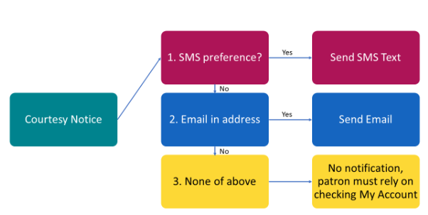
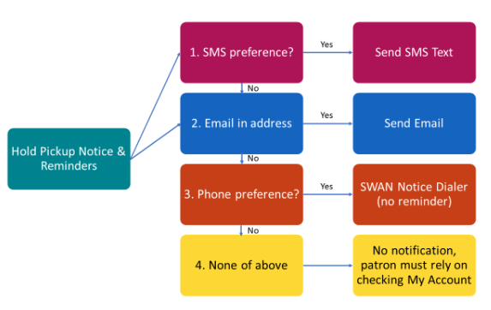
Notification Logic Review
https://support.swanlibraries.net/documentation/64674
Hold Pickup Notices
Courtesy Notices

Slide 8
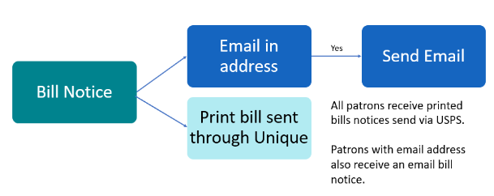
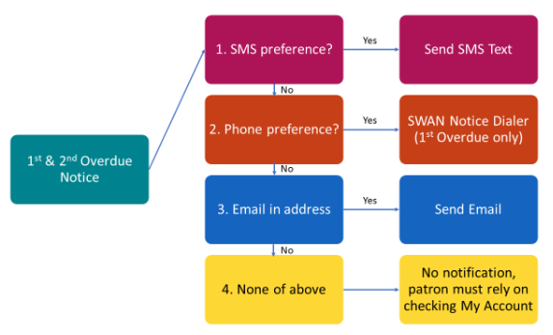
Notification Logic Review
Overdue Notices
Bill Notices

Slide 9
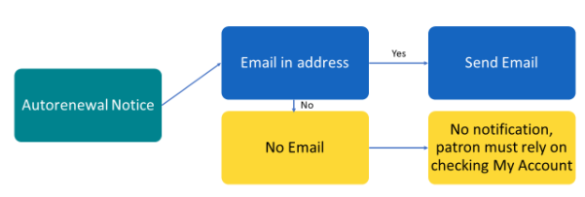

Notification Logic Review
Autorenewal Notices
Email is always our backup method when other communication channels fail.

Slide 10
Information Technology & Systems Support

Slide 11
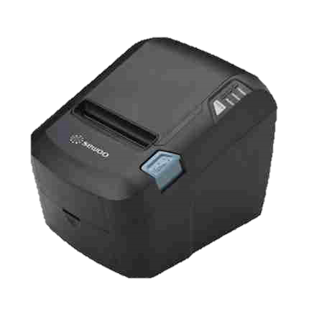
SWAN Hardware Recommendations
New receipt printer recommendations
Team One offering SWAN member library discount
SEWOO SLK-T32EBCGLLII – Standard receipt printer ($225)
SEWOO SLK-TE212IIW-L – Receipt printer with Wi-Fi ($310)
Both compatible with standard and MAXStick paper
Epson – Still supported, but harder to find
Notes:
Ian
Seewoo models from TeamOne email
Updating support site page

Slide 12

Public Web Browser – License Key Update
New Public Web Browser (PWB) license key is available
RAILS provides PWB license free of charge
Visit RAILS site under Services>Deals & Discounts (L2 required)
New license is valid until June 6, 2023 and may be applied immediately
No more end of year license expiration!
Notes:
Ian
RAILS provides key for free – requires L2 login to view link
Breadcrumbs
Note that PWB now renews in June rather than December (no more holiday renewal!)

Slide 13
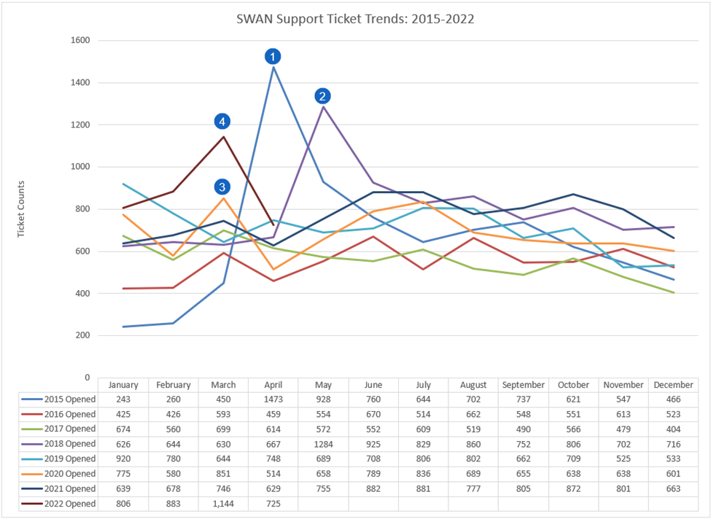
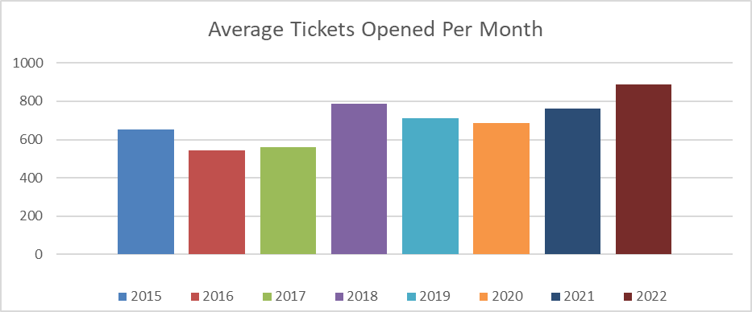
Support Ticket Overview
April 2015 - Migration from Innovative to SirsiDynix
May 2018 - Migration of N19 Libraries
March 2020 - Closures due to COVID-19
March 2022 – Aspen catalog final phase deployment

Slide 14
Support Ticket – April 2022 Recap

Slide 15

Moving to Zoom – August 2022
Starting August 2022 – all SWAN meetings will transition to Zoom instead of GoToMeeting
Check L2 listings and SWAN support site for updated meeting links
Will have new links in place by mid-June
NOTE: Recorded meetings in Zoom will include participant video displays. This is a change from GoToMeeting which will be announced to members as we move to Zoom recordings.

Slide 16

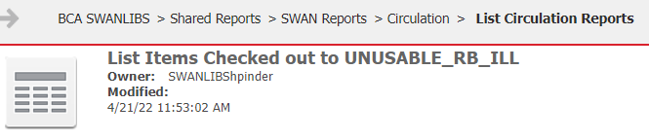

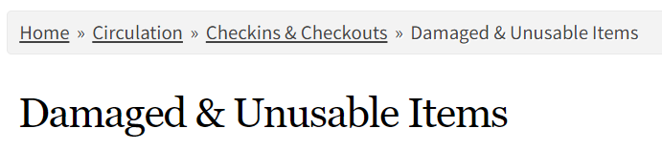

House Cleaning: UNUSABLE_RB_ILL Checkouts
Currently 500+ (438 as of 5/26) checkouts to the Unusable User
Review your items and reach out to the Checkout Library to explore resolution:
  Return to Circulation
  Seek reimbursement
  Discard from collection
Notes:
Helen
https://na1-microstrategy.bc.sirsidynix.net/bcanalytics/asp/Main.aspx?evt=4001&src=Main.aspx.4001&visMode=0&reportViewMode=1&reportID=AD7A728911ECC19B61BB0080EFA5C9FC&Server=BCA-MICROSTRAT2-1&Project=BCA%20SWANLIBS&Port=0&share=1
https://support.swanlibraries.net/documentation/64708

Slide 17
Aspen
Notes:
Tara

Slide 18
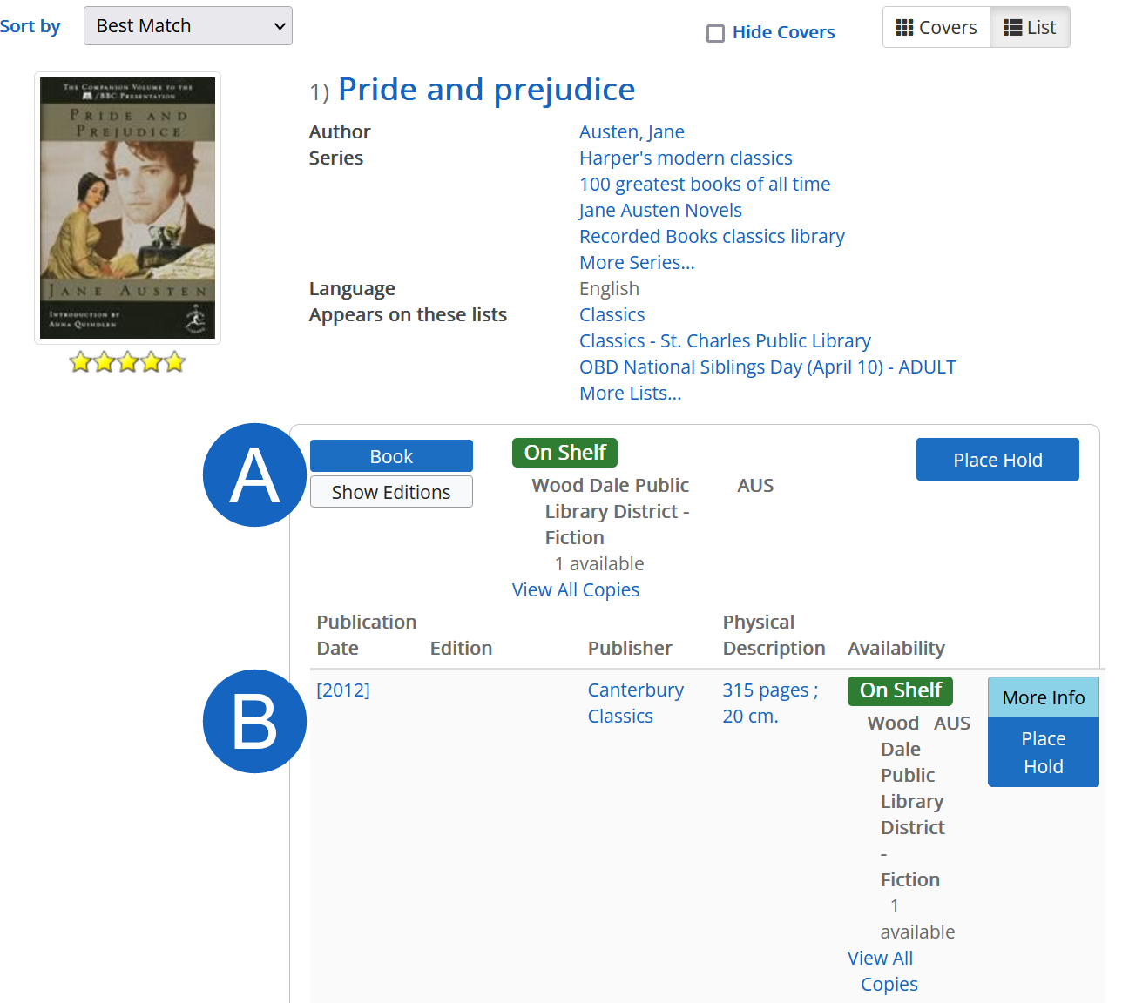
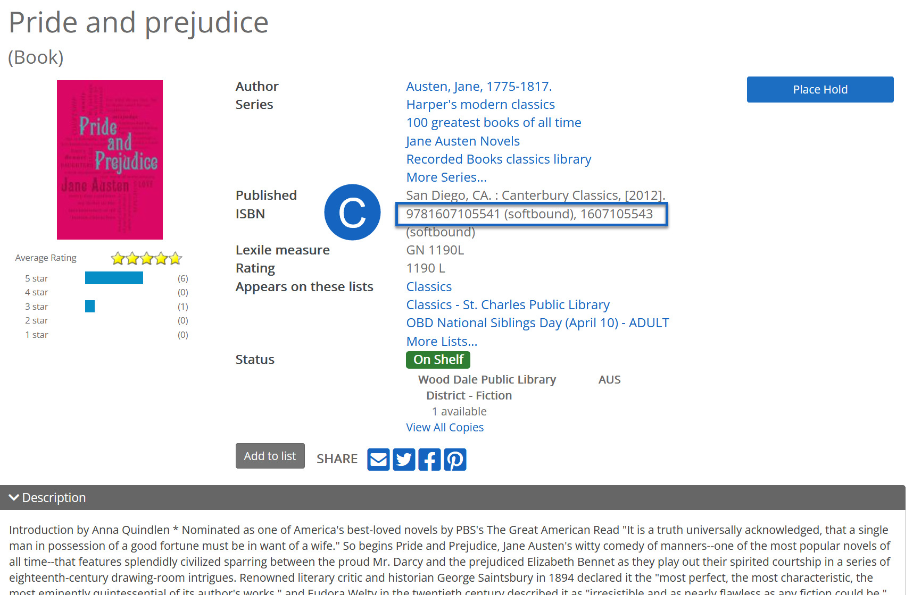
Aspen Tip of the Month
Copying ISBNs and standard numbers
Notes:
Search results display grouped records, which could have dozens of standard numbers attached. To grab an ISBN, just click into an individual record, and ISBN is at the top of the page.
Tara

Slide 19
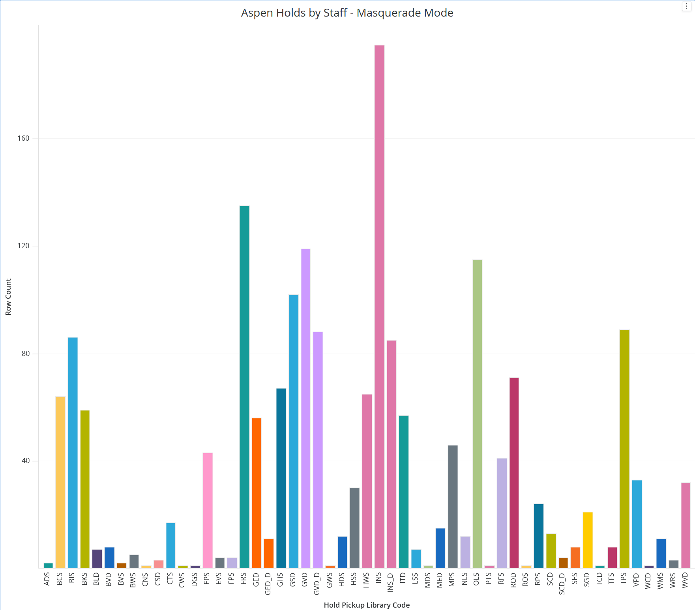
Aspen Hold Notes
"Aspen" = patron through Aspen
"Aspen masquerade" = staff through Aspen
BLUEcloud Analytics dossier for your library's usage:
Shared Reports > SWAN Reports > Holds > Aspen Hold Analysis
Notes:
In Workflows, you may see notes for "Aspen" and "Aspen masquerade." This means the hold was placed by the patron in Aspen, or by staff through masquerade mode.
Tara

Slide 20
E-Resources

Slide 21
Comics Plus
SWAN Discounts page https://support.swanlibraries.net/documentation/90261
42.5% discount for all public libraries
May 1, 2022 – June 30, 2023
Sign up as late as June 15th
SWAN handles billing and authentication
You will sign a customer onboarding form
Notes:
Robin

Slide 22
EBSCO Database Renewal
Thank you for submitting your selection forms! If you forgot, we will be in touch.
June 3rd – SWAN sends selections to RAILS and EBSCO
June 30th – Links to new selections available
More information on the group purchase:
https://support.swanlibraries.net/documentation/70949
Notes:
Robin

Slide 23
Member Engagement

Slide 24
User Groups: Recap
Acquisitions & Cataloging 5/12
Book repair
DEI Metadata Committee
Foreign language fields
Chronology using year & ISS
Discovery & User Experience 5/26
Holds logic (Aspen hold notes)
Aspen development
Design challenge for future project requests (ISBNs, Purchase suggestions, Aspen admin tools – lists, spotlights, browse categories)

Slide 25
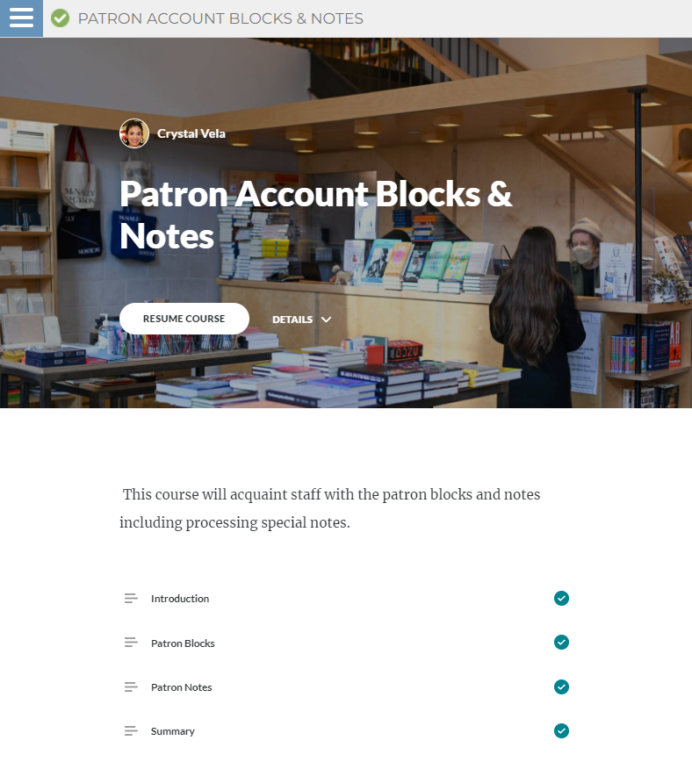
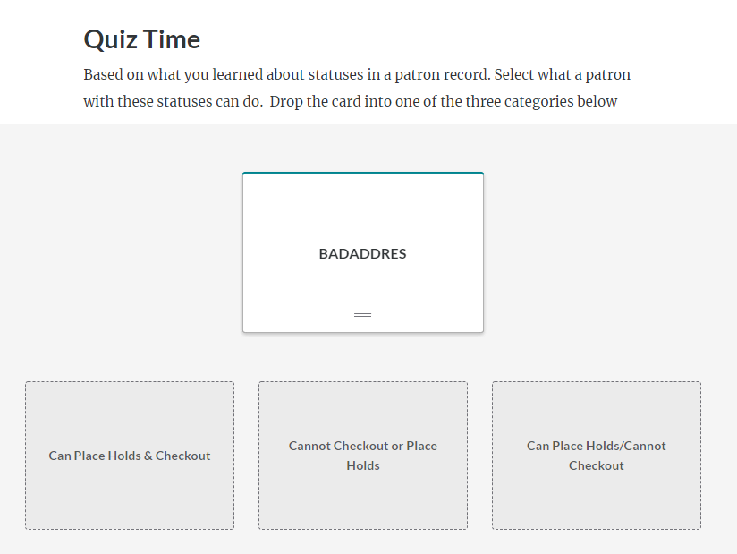
Online Learning Update – New Course
PS104: Patron Account Blocks & Notes

Slide 26
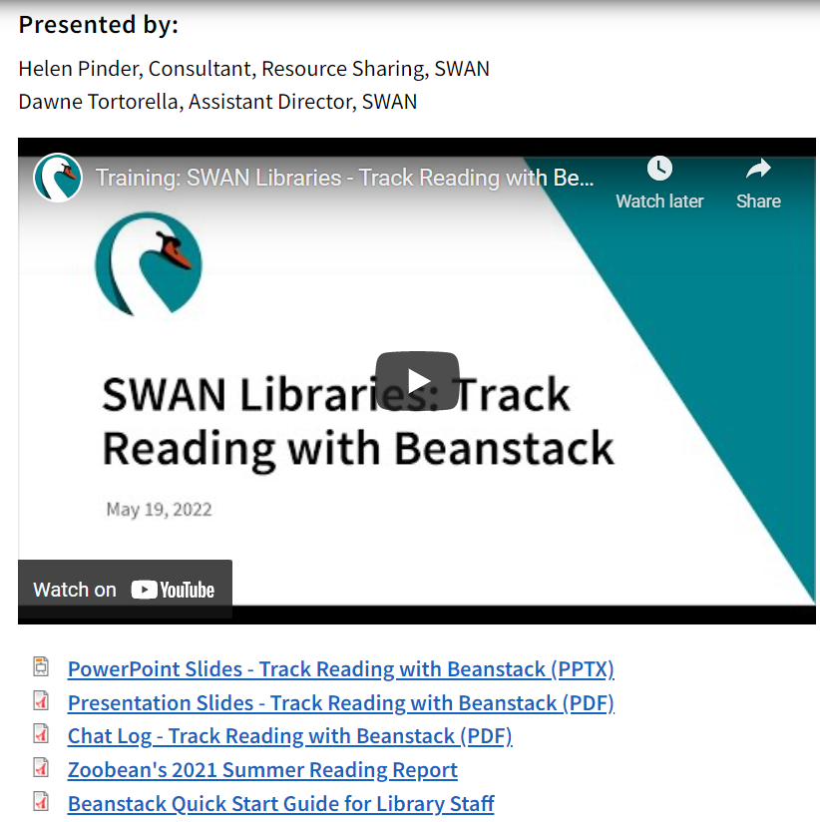
Beanstack Launch
https://support.swanlibraries.net/training/91041

Slide 27
Why Beanstack?
More than 50% of SWAN public libraries using Beanstack
Opportunity for libraries with smaller budget and staff to offer a reading software platform for patrons
Share expertise between colleagues
Not intended to replace existing reading program, but
  We did hear from libraries concerned about losing their previous platform (Wandoo Reader discontinued as of May 31, 2022)
  Readers can register on multiple beanstacks, if desired
No authentication required, so anyone can join
Libraries requested readiness by Summer Reading 2022

Slide 28

Two ways to register as a reader/family
Web Browser
  https://swanlibraries.beanstack.org
Beanstack app
  Download the app from the Apple or
  Google stores
  Search for SWAN Library Services

Slide 29


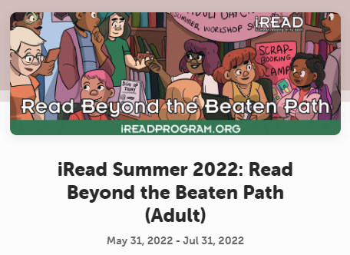
Summer Reading 2022
Based on iRead 2022 themes
4 Grade levels
Badges and challenges grade specific
Readers will only see those challenges they qualify for based on grade level entered at registration

Slide 30
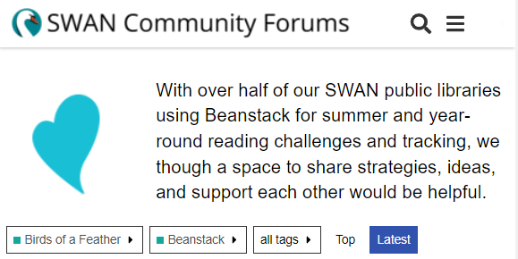
Next Steps & Questions
Sign up as a reader if you’d like to join
If your library already uses Beanstack, share your expertise and ideas in our SWAN Community Forums
  Let us know your Beanstack main contact for sharing any registrations for your library
Want staff access? Submit a help ticket
  Look around the Beanstack Help Center
  https://zoobean.zendesk.com/hc/en-us

Slide 31
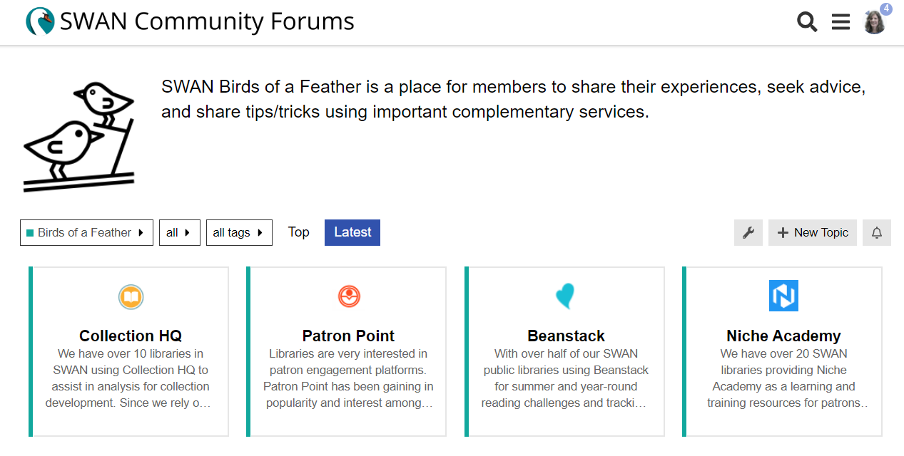
Birds of a Feather
A place for members to share expertise and help colleagues using common 3rd party services. What else should we add here?
Notes:
Dawne

Slide 32
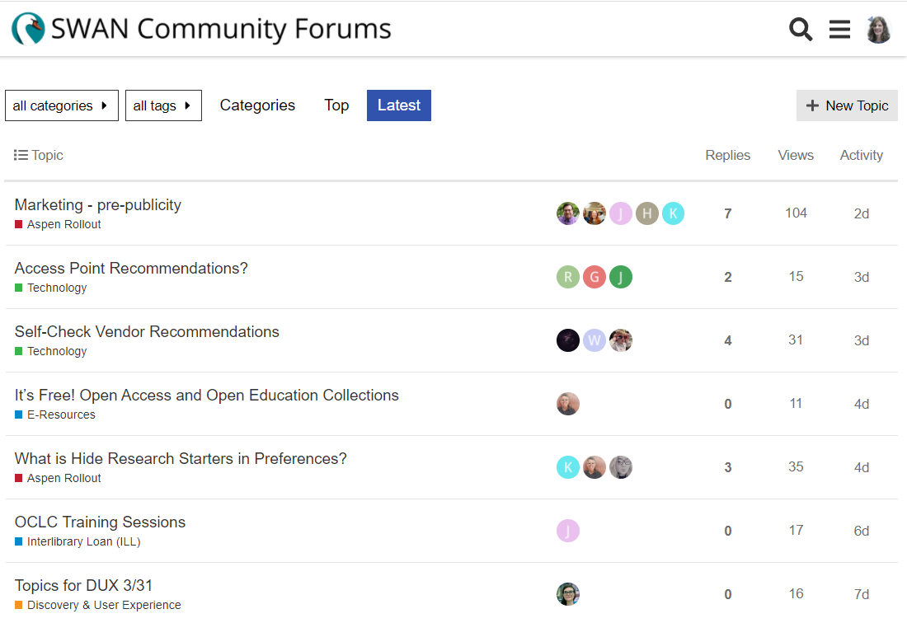
Join the SWAN Community Forums
https://support.swanlibraries.net/members/forums
Submit a help ticket if you don’t already have an account
Colleagues helping colleagues
Sharing expertise and creative solutions
See what people are talking about
Notes:
Dawne

Slide 33
Libraries Empower Communities
Brainstorming group met
Seeking Director and event/program coordinator input – survey
Will share survey results to date at Quarterly on June 2nd
SWAN News
https://support.swanlibraries.net/news/2022-05/91099
Brainstorming & Planning Group
Jeanine Vaughn, Glen Ellyn Public Library
Sue Eckhardt, Calumet City Public Library
Jasmina Lapo, St. Charles Public Library
MaryKellie Marquez, Warrenville Public Library District
Natalie Starosta, North Riverside Public Library
Helen Pinder, SWAN
Crystal Vela, SWAN
Notes:
Dawne

Slide 34
Other Upcoming Meetings
See SWAN’s events on L2
SWAN Quarterly – 6/2
SWAN Board Meeting – 6/17
Monthly Office Hours
  Aspen – 6/6
  Circ/ILL/Outreach –6/1
  Directors Coffee Hour – 6/3
  BLUEcloud Analytics – 6/8
  Circulation & Hold Map – 6/15
  BLUEcloud Staff – 6/22
OCLC Training on L2
  WorldShare ILL - Borrowing –6/21
  OCLC: WorldShare ILL – Lending – 6/23
User Groups:
  ILL Users – 6/1
  Circulation users – 6/15
  E-Resource Advisory – 6/23
Trainings
  Getting Started with Accessibility Testing – 6/9
Office hours are free-form, without an agenda. Bring your questions, ideas you’d like to share, and request demonstrations of how to perform functions/tasks.
Notes:
Scott

Slide 35
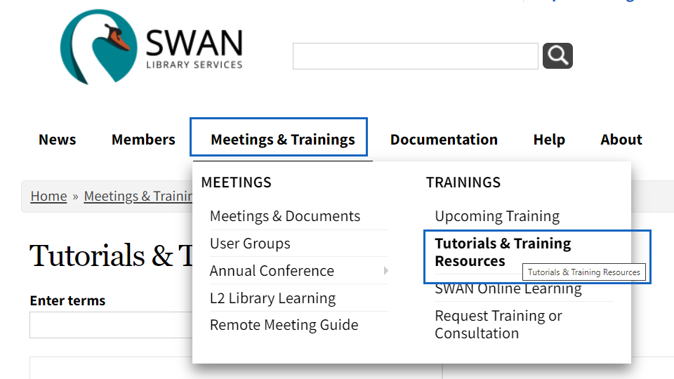
Recent webinar recordings available
It’s Free! Open Access & Open Education Collections
ILL Boot Camp: Providing electronic copes to libraries (and patrons)
Using geocode data to map activity
Let’s Talk Billing: avoiding common billing mistakes

Slide 36

Thank you!
Next Fireside Chat:
June 28, 11:00 AM - Noon
Register at GoToWebinar:
https://librarylearning.org/event/2022-06-28/swan-members-fireside-chat
Notes:
Scott

