Slide 1
SWAN Quarterly Meeting
September 1, 2022

Slide 2
Agenda
Call to Order and Welcome
Public Comment
Approval of June 2, 2022 minutes
EBSCO usage statistics review
MessageBee proposal
Data visualization of library usage in GIS maps
Director’s orientation
Announcements & Questions

Slide 3
EBSCO usage statistics
Tara Wood, SWAN

Slide 4
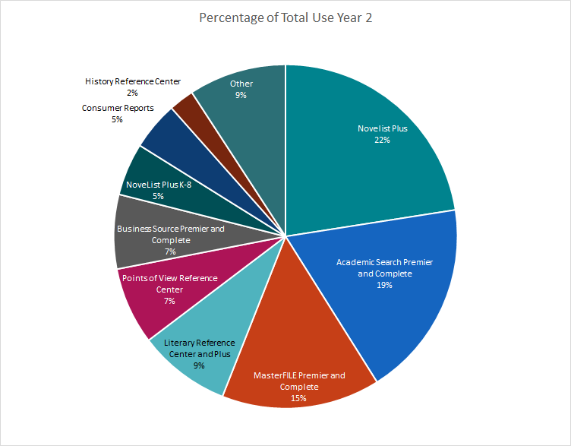
EBSCO Database Usage
Database usage saw a 54% increase in Year 2
Use of research and niche databases is growing
  Literary Reference Center = 407% increase
"Big deal" allows access to more databases for about the cost of Novelist, Consumer Reports

Slide 5
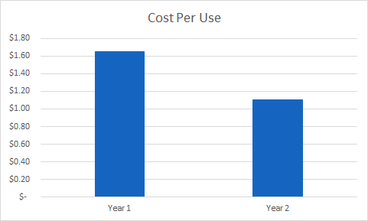
EBSCO Database Cost-Per-Use
Cost per use is down
Year 1 = 95 libraries
Year 2 = 84 libraries

Slide 6
EBSCO Year 4 Renewal
Conversations with RAILS & EBSCO will start in the coming months
In Year 3, EBSCO proposed opted out libraries requesting to rejoin must do so at the full RAILS package B price.
Anticipate pricing will be available by February 2023

Slide 7
MessageBee for SWAN
Aaron Skog, SWAN

Slide 8
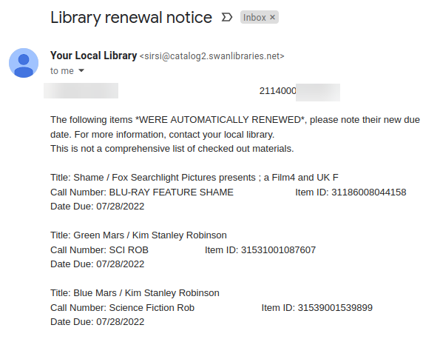
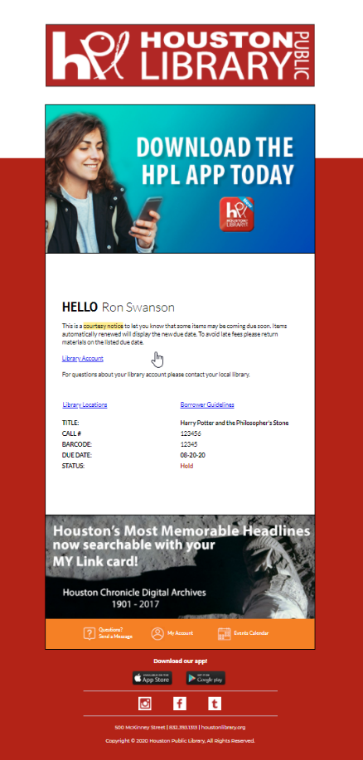
MessageBee emails notices
Current email notice
MessageBee email

Slide 9
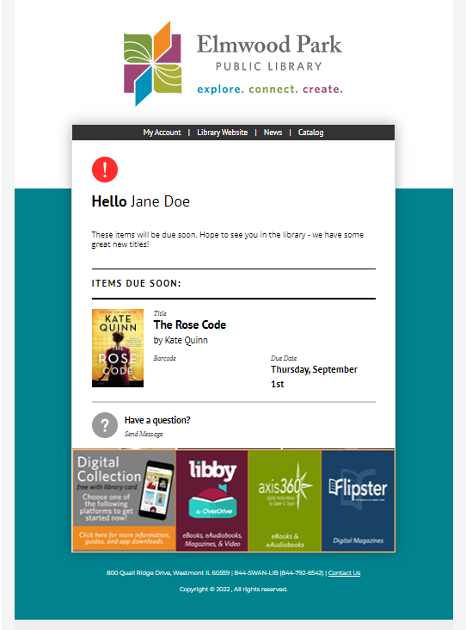
MessageBee integrates cover artwork
“Before the intervention, about 59 percent of individuals receiving the standard courtesy notice — which were non personalized, with blunt language — returned their book on time. Behaviorally informed courtesy notices with enhanced information about checked-out items, including the book titles and images of book covers, increased timely return by almost 10 percent. BPL has made changes to reflect their findings, including a photo of the book jacket on overdue notices, with more engaging outreach and translations in four different languages.”
-- Brooklyn Public Library

Slide 10
Brooklyn PL– Using Behavioral Science
Planning prompts
  Your nearest drop box is at Central Library and you can return books there 24/7! What day this week can you do this?
Promote prosocial behavior and positive social norms
  Please return your books on time so families like yours can enjoy those books next.
  -or-
  90% of patrons at this branch return their books on time.
By adjusting courtesy reminder to 3 days before due date (previously 1 day), promoting positive language, and including book cover images:
Timely returns increased by almost 10%

Slide 11
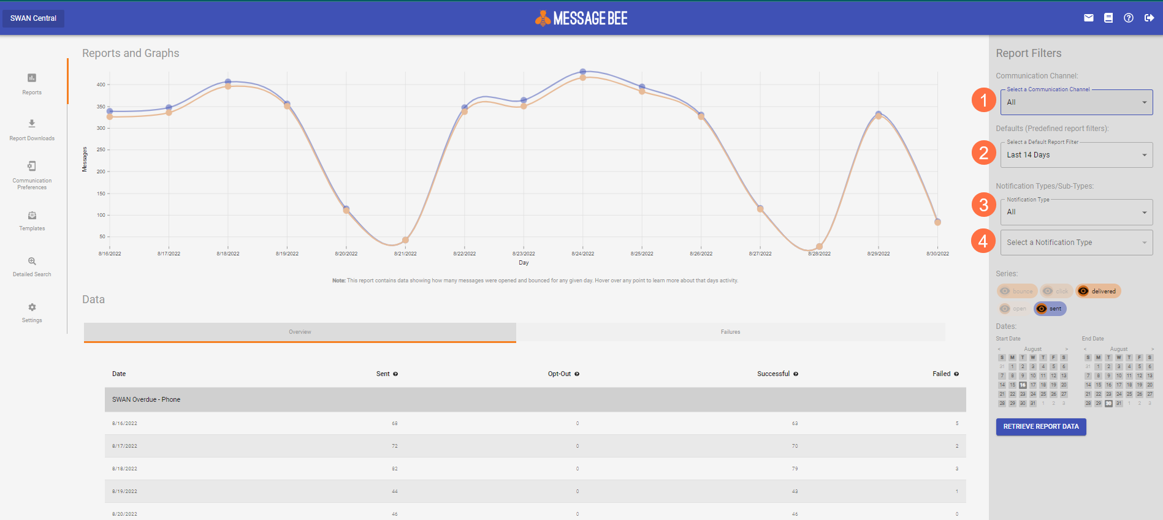
MessageBee Portal
Channel – Email, Voice, Text
Time period
Notification Type (hold, courtesy, overdue)
Notification Sub-Type (voice, email, text)

Slide 12
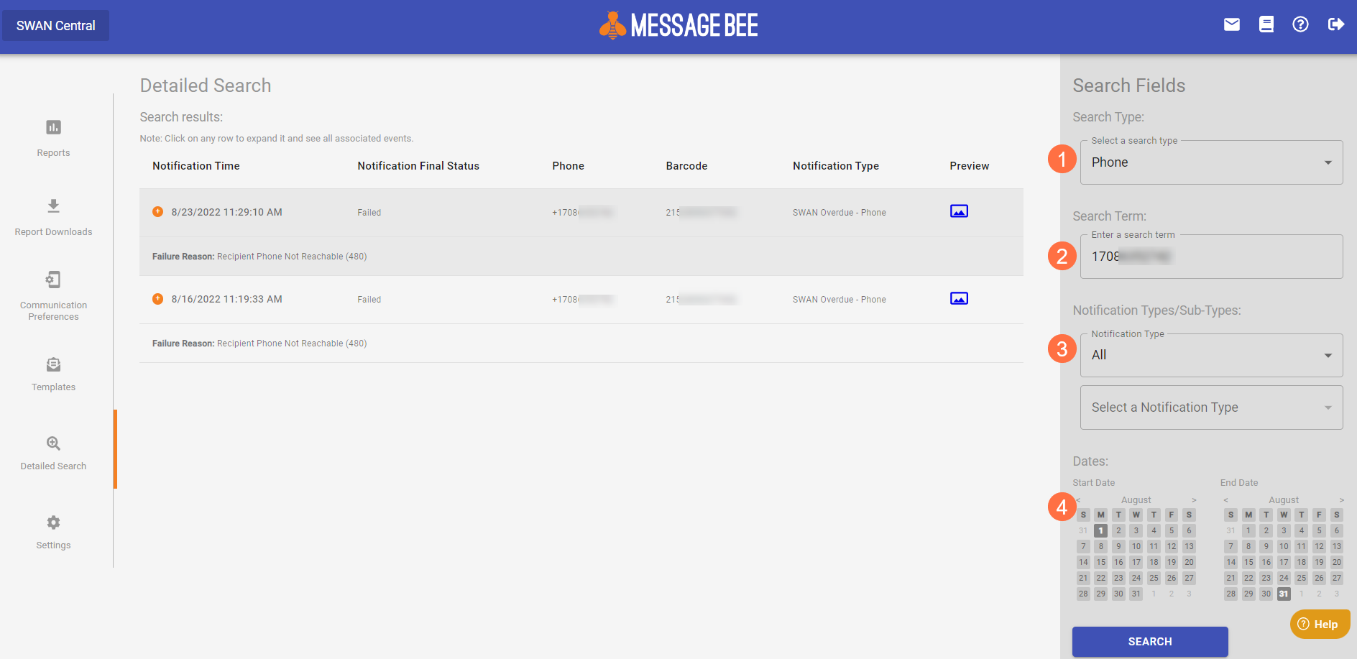
Tracking Delivery
Search by Email, Phone #, or Barcode
Search terms
Notification Type (hold, courtesy, overdue)
Time span

Slide 13



MessageBee text messaging
Current
MessageBee
Libraries receive daily email from SirsiDynix with Excel attachment (contains barcode and phone number of patrons)
Reported within MessageBee portal
Cumulative archive of notifications, searchable

Slide 14
Bounced Emails
Current
MessageBee
SWAN staff generate daily reports emailed to libraries to the library’s SWAN email account (called aliased account)
SWAN provided instructions to follow at the library
Library can take action, or no action, on report list
Library staff can log into the own MessageBee portal at any time as assigned duties
View the status of emails within a date range
Unsuccessful reasons listed
Library can take action, or no action, on these unsuccessful notices

Slide 15
Voice call notifications
Currently
MessageBee
SWAN has been using MessageBee voice notification since July 2021
Single portal SWAN staff use to track usage, generate reports
Goal is to have all library’s voice notifications appear in their library’s MessageBee portal
When completed, each SWAN library will see email, text, and phone notices under a single web interface

Slide 16
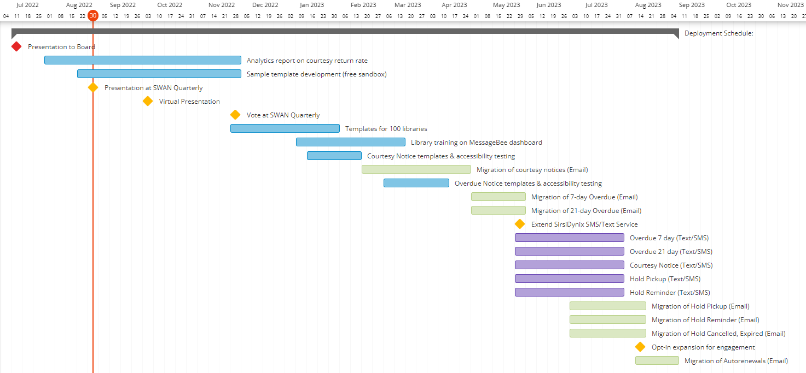
Project timeline

Slide 17
Notification costs
One-time Setup Costs | $ 10,000
FY23 Budget Total MessageBee Operating Cost | $ 27,257
#5860 Notification & Collection Additional Expense for FY23 | $ 37,257
FY24 #5860 MessageBee Expenses (HTML Notices/SMS&Text) | $ 76,686
SirsiDynix SMS/Text service subscription cancelled | $ (13,000)
MessageBee Additional Annual Costs | $ 63,686

Slide 18
Proposed approval process
Presentation to Board
SWAN Quarterly Presentation to Membership
Virtual Presentation/Demo
Vote at SWAN Quarterly
July, 2022
September 1, 2022
September 2022
December 1, 2022
COW meeting
October 4, 2022

Slide 19
Data visualization in GIS maps
Aaron Skog, SWAN & Dawne Tortorella, SWAN

Slide 20
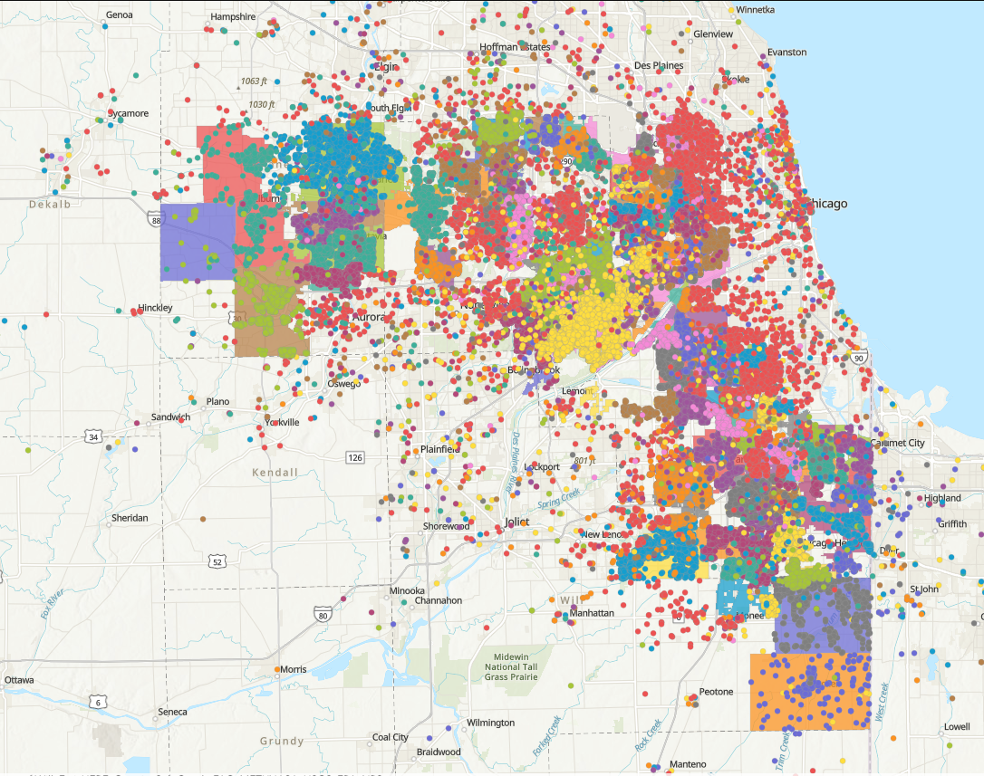
Patrons Active in Past 3 Months

Slide 21
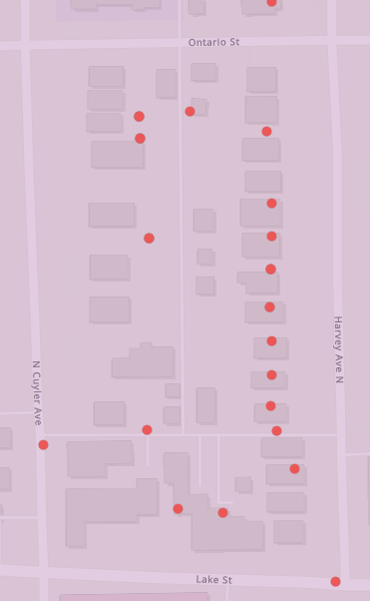
Monthly Data Extracts
Patrons Active in Past 3 Months
  Goal is to provide time progression of active patrons
Item Checkouts
  Libraries will be able to see where their material was checked out
Patron Checkouts
  Libraries will be able to see where their patrons checked out material

Slide 22
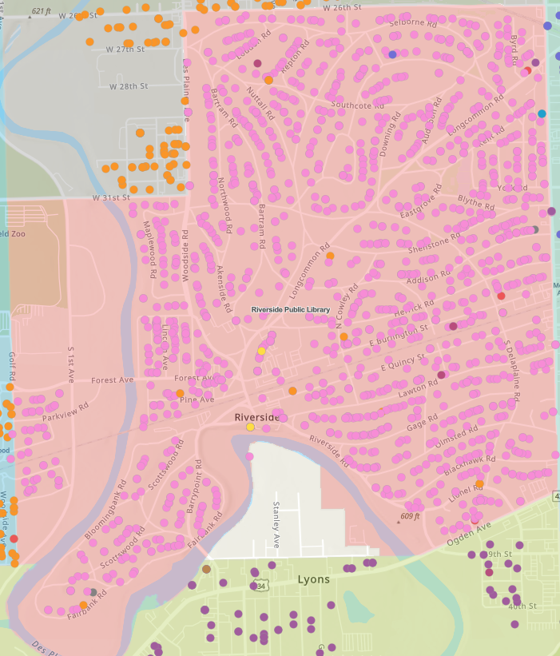
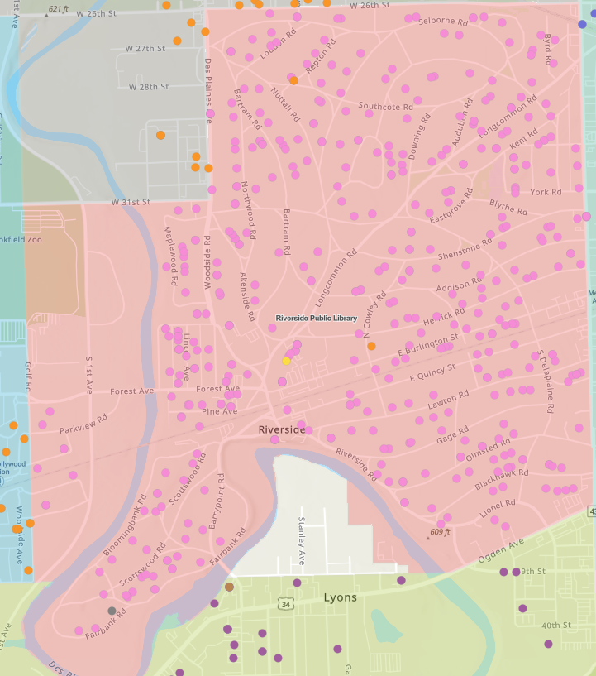
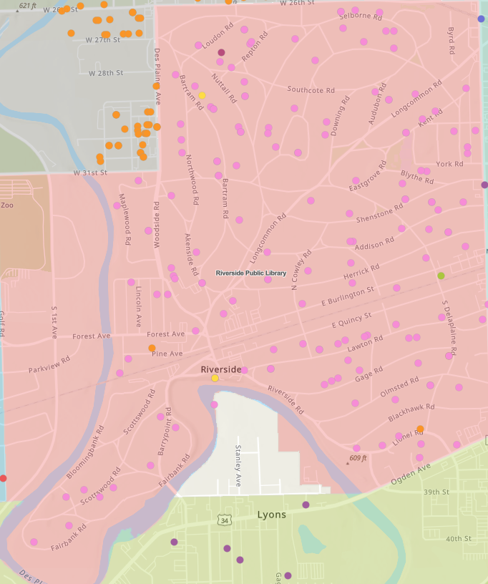
Comparison of Population
All patrons active – 3 months
60 and over
10 and under

Slide 23
Directors’ Orientation
Aaron Skog, SWAN

Slide 24

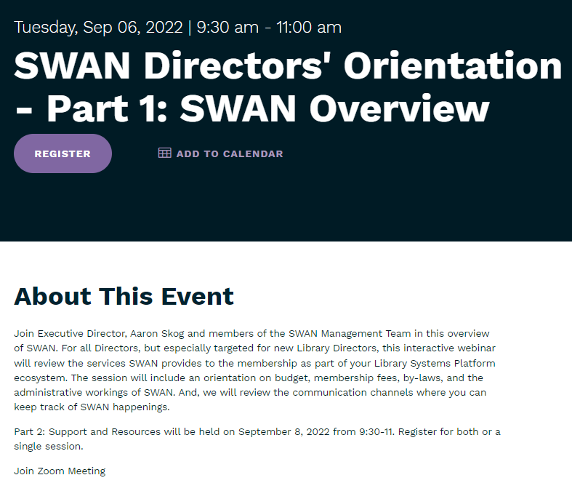
Director Orientation
September 6, 2022 – Overview of SWAN
September 8, 2022 – Support and resources
Register on L2
Targeted to new Directors, but helpful for all
Sessions will be recorded and presented at least annually

Slide 25
Announcements & Questions
Jennifer Cottrill, SWAN Board Vice-President
Library Director Midlothian Public Library

