Slide 1
SWAN Committee of the Whole
October 4, 2022

Slide 2
Agenda
MessageBee proposal
Announcements & Questions

Slide 3
MessageBee for SWAN
Aaron Skog, SWAN
Crystal Vela, SWAN
Michael Szarmach, SWAN
Rob Klaus, Unique Management

Slide 4

MessageBee
Messaging Service provided by Unique
SWAN currently uses it for phone notification and is proposing the use for HTML and SMS notices
Patron notices would be under “one roof” in MessageBee Portal
Approval process (in progress)
  If approved, it will be for all SWAN libraries
Proposal for membership vote in December

Slide 5



Research: What’s out there?
Waterloo Public Library
  Using SD HTML templates
CCS consortia
Brooklyn Public Library (BPL)

Slide 6
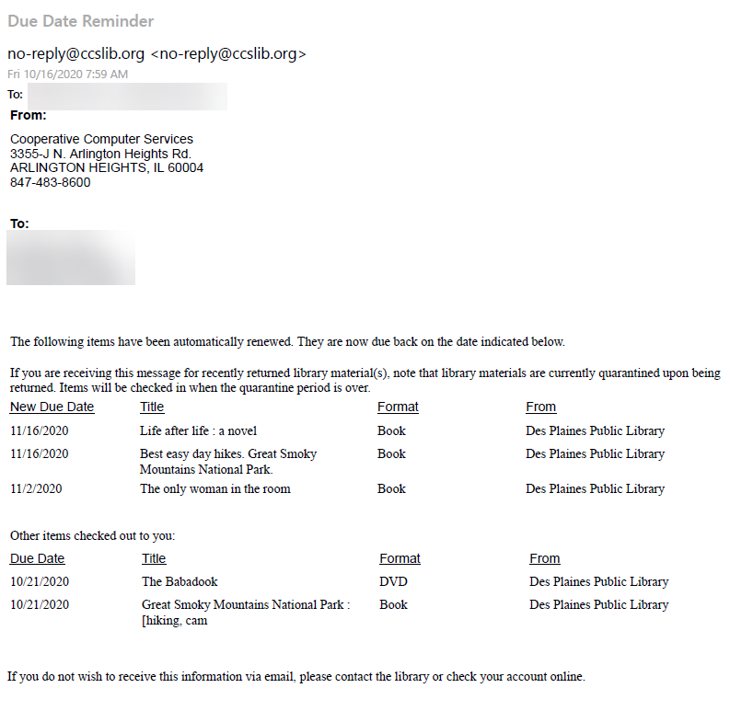
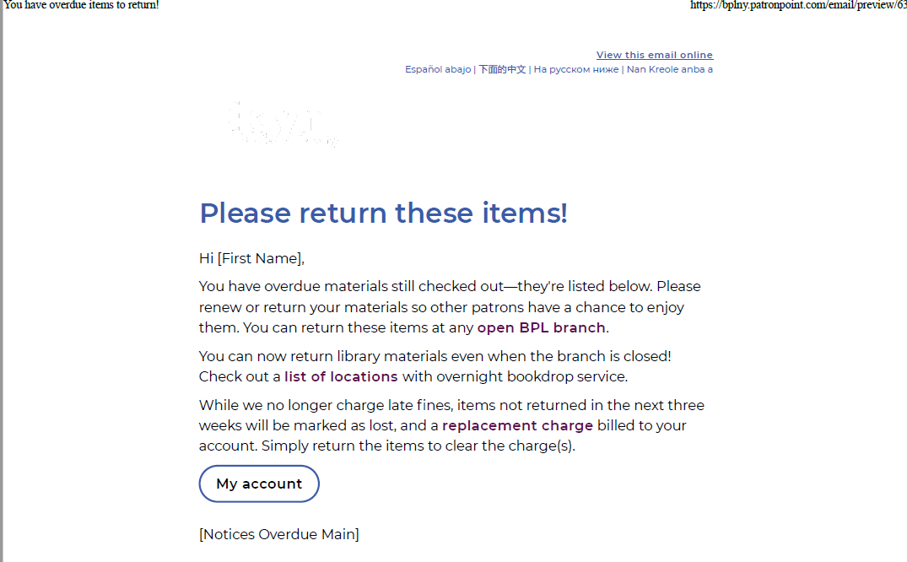
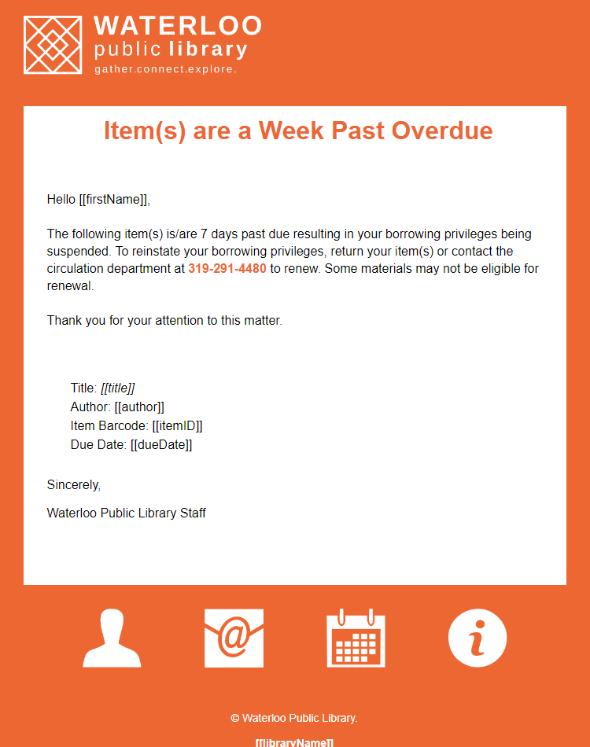
Notice Examples

Slide 7
Brooklyn PL– Using Behavioral Science
Planning prompts
  Your nearest drop box is at Central Library and you can return books there 24/7! What day this week can you do this?
Promote prosocial behavior and positive social norms
  Please return your books on time so families like yours can enjoy those books next.
  -or-
  90% of patrons at this branch return their books on time.
By adjusting courtesy reminder to 3 days before due date (previously 1 day), promoting positive language, and including book cover images:
Timely returns increased by almost 10%

Slide 8
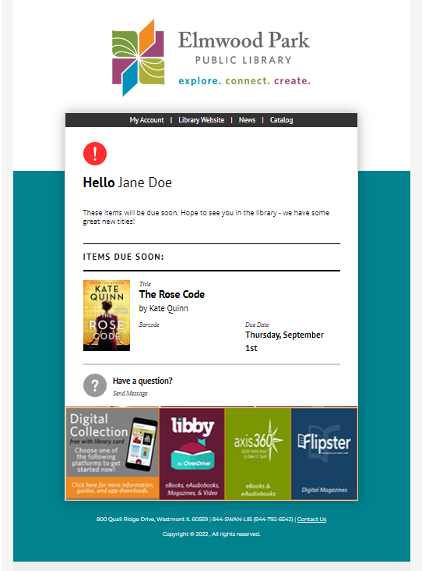
MessageBee integrates cover artwork
“Before the intervention, about 59 percent of individuals receiving the standard courtesy notice — which were non personalized, with blunt language — returned their book on time. Behaviorally informed courtesy notices with enhanced information about checked-out items, including the book titles and images of book covers, increased timely return by almost 10 percent. BPL has made changes to reflect their findings, including a photo of the book jacket on overdue notices, with more engaging outreach and translations in four different languages.”
-- Brooklyn Public Library

Slide 9
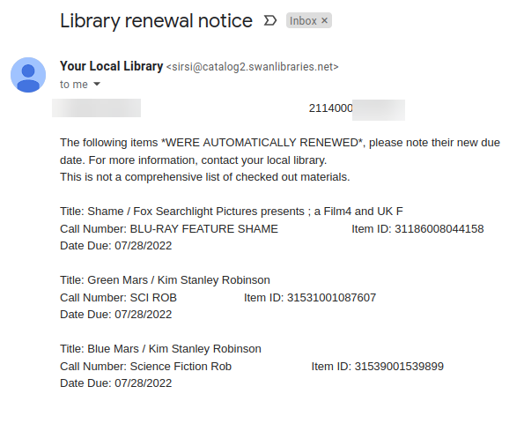
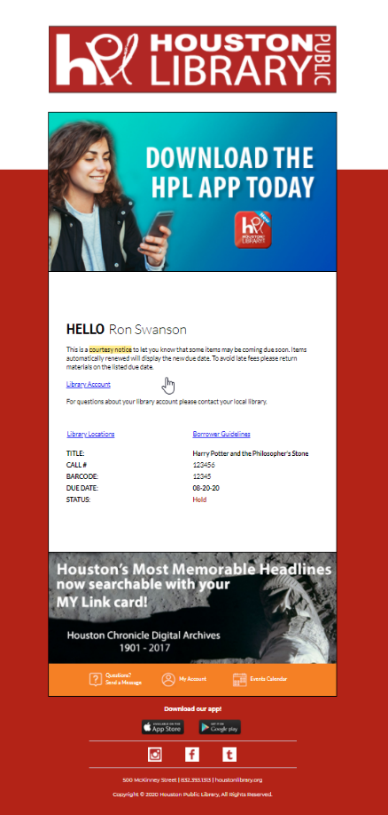
MessageBee emails notices
Current email notice
MessageBee email

Slide 10
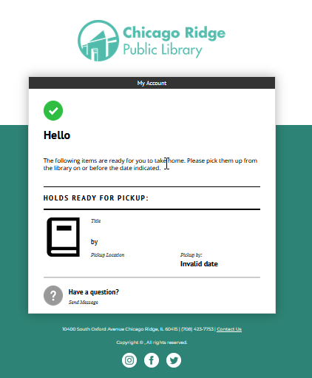
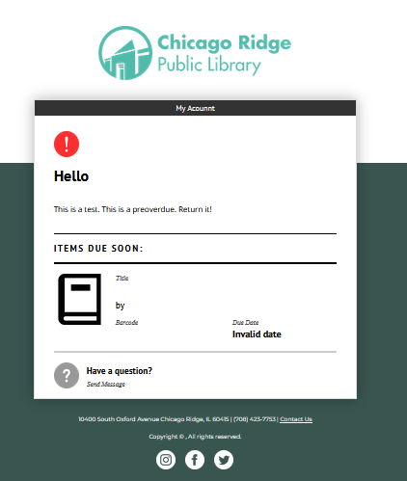
MessageBee email Notices continued

Slide 11
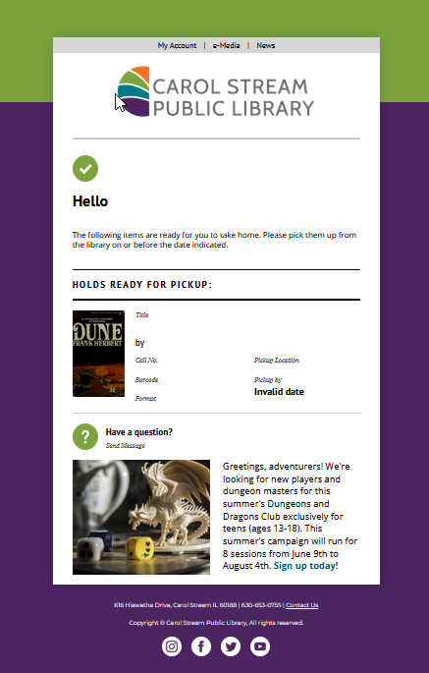
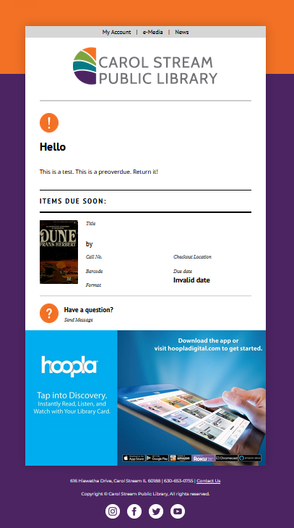
MessageBee email Notices continued

Slide 12









2
Unique works with SWAN to bake the bread – template matching logo and color scheme
Library picks your favorite toppings for the menu bar
Library can add some special flavor/messaging
SWAN/Symphony provides the meat – the transactions drive the communication and template selection
Library adds seasonal topics that can be time sensitive
Library provides the base condiment for consistency
1
3
4
5
6

Slide 13
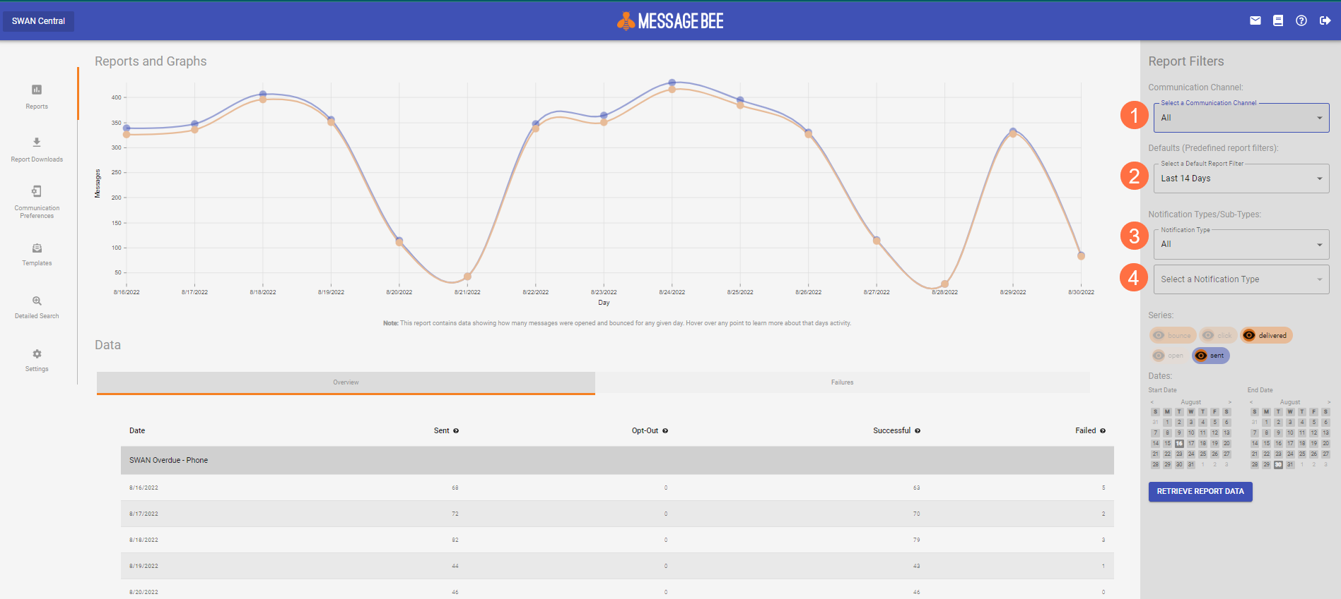
MessageBee Portal
Channel – Email, Voice, Text
Time period
Notification Type (hold, courtesy, overdue)
Notification Sub-Type (voice, email, text)

Slide 14
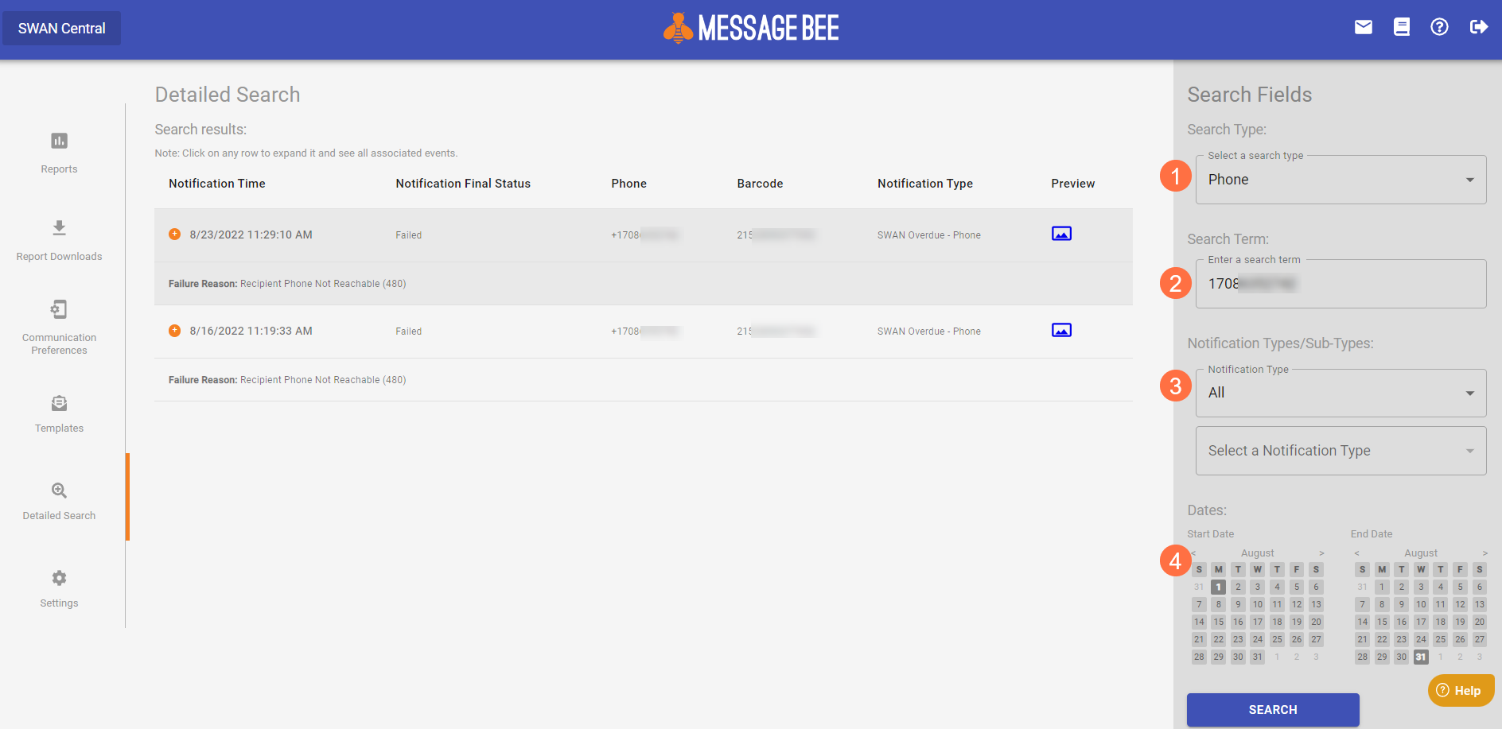
Tracking Delivery
Search by Email, Phone #, or Barcode
Search terms
Notification Type (hold, courtesy, overdue)
Time span

Slide 15



MessageBee text messaging
Current
MessageBee
Libraries receive daily email from SirsiDynix with Excel attachment (contains barcode and phone number of patrons)
Reported within MessageBee portal
Cumulative archive of notifications, searchable

Slide 16
Bounced Emails
Current
MessageBee
SWAN staff generate daily reports emailed to libraries to the library’s SWAN email account (called aliased account)
SWAN provided instructions to follow at the library
Library can take action, or no action, on report list
Library staff can log into the own MessageBee portal at any time as assigned duties
View the status of emails within a date range
Unsuccessful reasons listed
Library can take action, or no action, on these unsuccessful notices

Slide 17
Voice call notifications
Currently
MessageBee
SWAN has been using MessageBee voice notification since July 2021
Single portal SWAN staff use to track usage, generate reports
Goal is to have all library’s voice notifications appear in their library’s MessageBee portal
When completed, each SWAN library will see email, text, and phone notices under a single web interface

Slide 18
Project timeline

Slide 19
Notification costs
One-time Setup Costs | $ 10,000
FY23 Budget Total MessageBee Operating Cost | $ 27,257
#5860 Notification & Collection Additional Expense for FY23 | $ 37,257
FY24 #5860 MessageBee Expenses (HTML Notices/SMS&Text) | $ 76,686
SirsiDynix SMS/Text service subscription cancelled | $ (13,000)
MessageBee Additional Annual Costs | $ 63,686

Slide 20
Proposed approval process
Presentation to Board
SWAN Quarterly Presentation to Membership
Vote at SWAN Quarterly
July, 2022
September 1, 2022
December 1, 2022
COW meeting & Presentation
October 4, 2022

Slide 21
Announcements & Questions
Ted Bodewes, SWAN Board President
Thomas Ford Memorial Library

