Slide 1
SWAN Quarterly Meeting
December 1, 2022

Slide 2
Agenda
Call to Order and Welcome
Public Comment
Introduction of new library directors
Approval of September 1, 2022 minutes
MessageBee proposal review
Amend the FY23 budget
Addison Public Library membership
Next year’s FY24 budget update
Data visualization with GIS maps presentation
Holds time to fill & Aspen presentation
Announcements & Questions

Slide 3
MessageBee for SWAN
Aaron Skog, SWAN

Slide 4

MessageBee
Messaging Service provided by Unique
SWAN currently uses it for phone notification and is proposing the use for HTML and SMS notices
Patron notices would be under “one roof” in MessageBee Portal
If approved, it will be for all SWAN libraries
Proposal for membership vote December 1, 2022

Slide 5
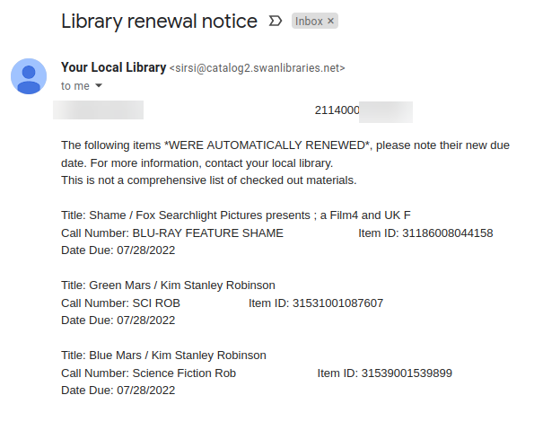
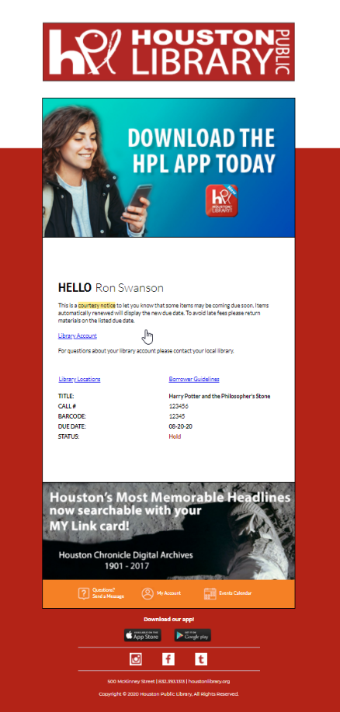
MessageBee email notices
Current email notice
MessageBee email

Slide 6
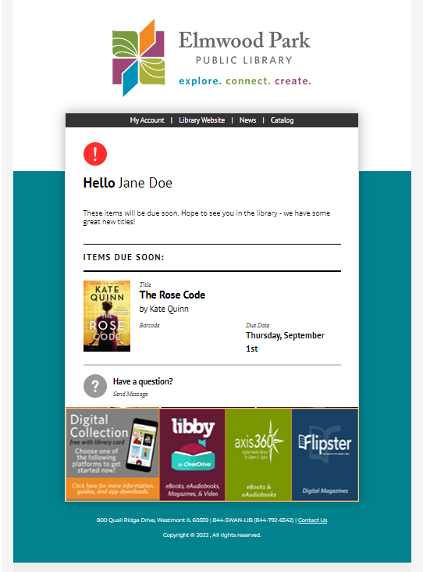
MessageBee integrates cover artwork
“Before the intervention, about 59 percent of individuals receiving the standard courtesy notice — which were non personalized, with blunt language — returned their book on time. Behaviorally informed courtesy notices with enhanced information about checked-out items, including the book titles and images of book covers, increased timely return by almost 10 percent. BPL has made changes to reflect their findings, including a photo of the book jacket on overdue notices, with more engaging outreach and translations in four different languages.”
-- Brooklyn Public Library

Slide 7
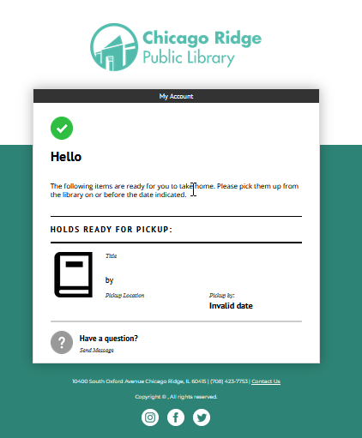
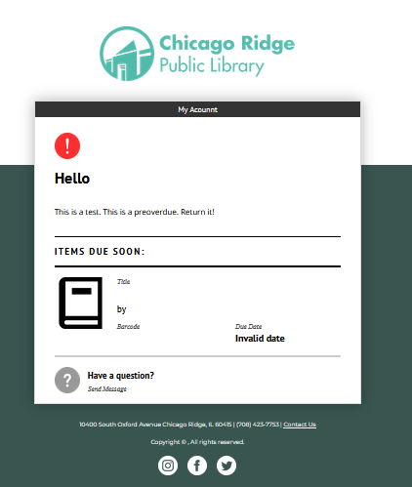
MessageBee email Notices continued

Slide 8
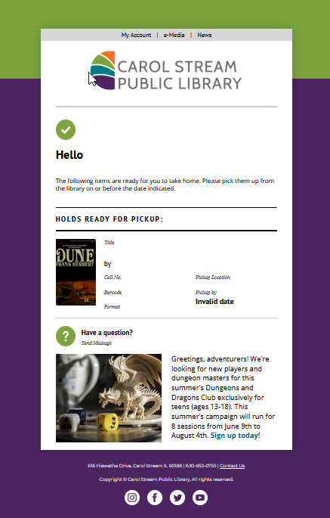
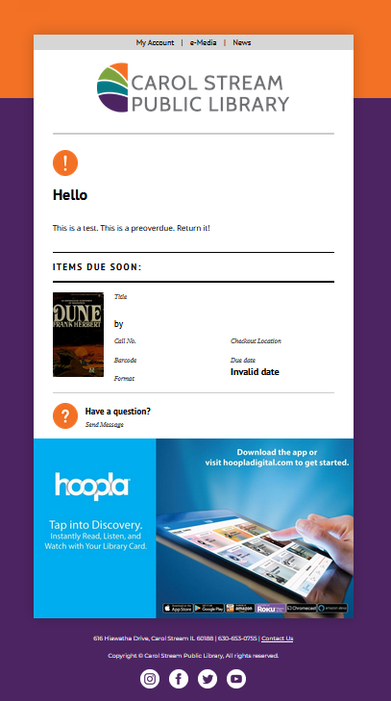
MessageBee email Notices continued

Slide 9









2
Unique works with SWAN to bake the bread – template matching logo and color scheme
Library picks your favorite toppings for the menu bar
Library can add some special flavor/messaging
SWAN/Symphony provides the meat – the transactions drive the communication and template selection
Library adds seasonal topics that can be time sensitive
Library provides the base bun for consistency
1
3
4
5
6

Slide 10
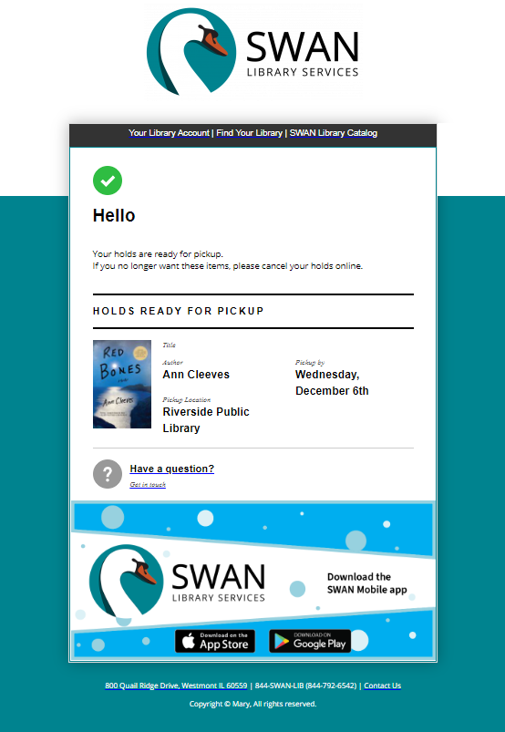
Initial templates will include library logo at top
To start, a link to your library catalog and website will be configured (up to 4 editable links allowed)
Default messaging configured, editable by library.
THE MEAT – not editable, comes from Symphony
Initially no image or promotional banner at bottom, library can add
Footer info will contain library address, phone, and Contact Us link. (If you have social media links on your website, we will gather those for inclusion)
1
2
3
4
5
6

Slide 11
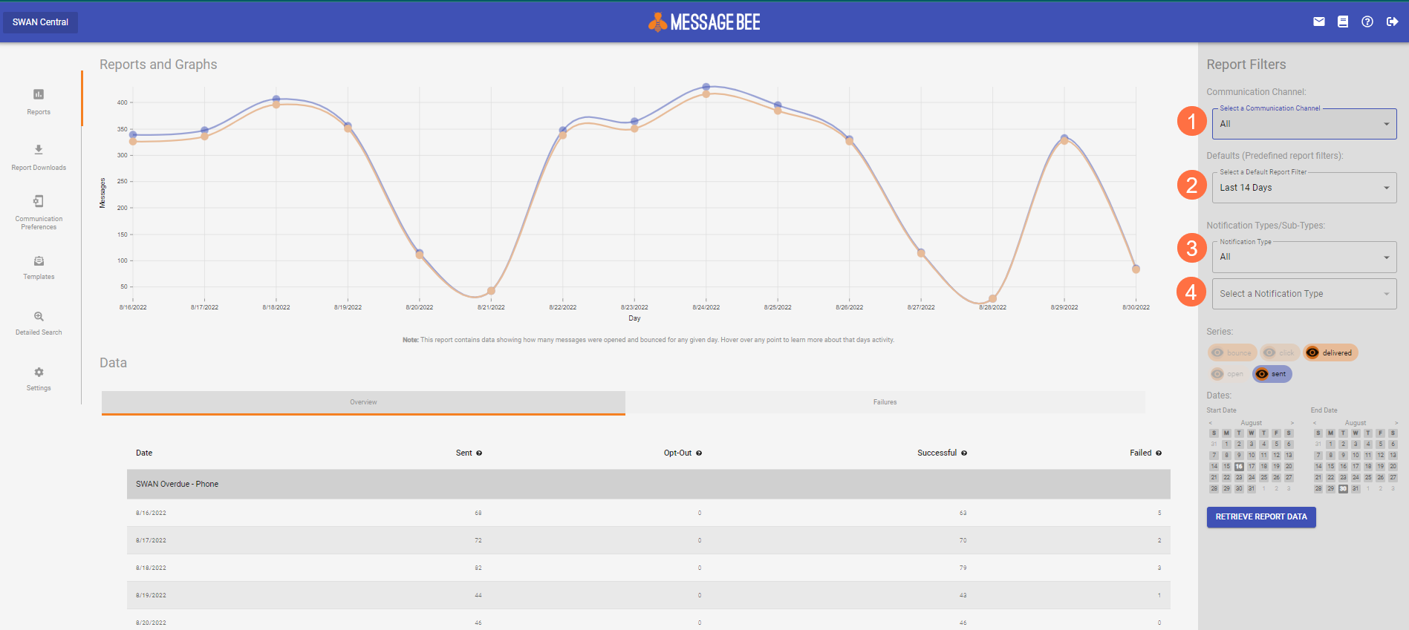
MessageBee Portal
Channel – Email, Voice, Text
Time period
Notification Type (hold, courtesy, overdue)
Notification Sub-Type (voice, email, text)

Slide 12
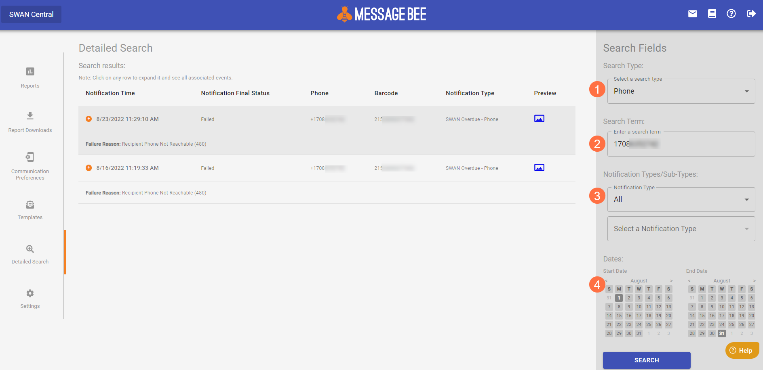
Tracking Delivery
Search by Email, Phone #, or Barcode
Search terms
Notification Type (hold, courtesy, overdue)
Time span

Slide 13



MessageBee text messaging
Current
MessageBee
Libraries receive daily email from SirsiDynix with Excel attachment (contains barcode and phone number of patrons)
Reported within MessageBee portal
Cumulative archive of notifications, searchable

Slide 14
Bounced Emails
Current
MessageBee
SWAN staff generate daily reports emailed to libraries to the library’s SWAN email account (called aliased account)
SWAN provided instructions to follow at the library
Library can take action, or no action, on report list
Library staff can log into the own MessageBee portal at any time as assigned duties
View the status of emails within a date range
Unsuccessful reasons listed
Library can take action, or no action, on these unsuccessful notices

Slide 15
Voice call notifications
Currently
MessageBee
SWAN has been using MessageBee voice notification since July 2021
Single portal SWAN staff use to track usage, generate reports
Goal is to have all library’s voice notifications appear in their library’s MessageBee portal
When completed, each SWAN library will see email, text, and phone notices under a single web interface

Slide 16
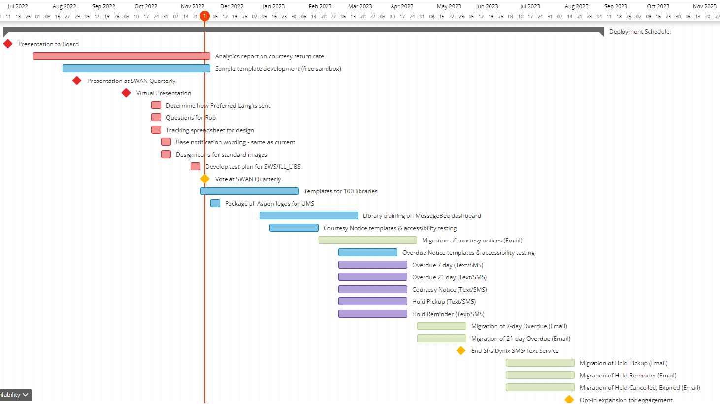
Project timeline

Slide 17
Notification costs
One-time Setup Costs | $ 10,000
FY23 Budget Total MessageBee Operating Cost | $ 27,257
#5860 Notification & Collection Additional Expense for FY23 | $ 37,257
FY24 #5860 MessageBee Expenses (HTML Notices/SMS&Text) | $ 76,686
SirsiDynix SMS/Text service subscription cancelled | $ (13,000)
MessageBee Additional Annual Costs | $ 63,686

Slide 18
Proposed approval process
Presentation to Board
SWAN Quarterly Presentation to Membership
Vote at SWAN Quarterly
July 2022
September 1, 2022
December 1, 2022
COW meeting & Presentation
October 4, 2022

Slide 19
Amend current FY23 budget

Slide 20
Amend FY23 budget with roll call
#5860 Notifications & Collections | $16,900
MessageBee one-time setup costs | $10,000
MessageBee operating cost through June 30, 2023 | $27,257
Total budget for Notifications & Collections | $54,157
Proposed budget vote
Resolved, the SWAN fiscal year 2023 budget line #5860 Notification & Collection will be increased from $16,900 to $54,157 for the implementation of Unique Management Services MessageBee to be completed by June 30, 2023.

Slide 21
Addison Public Library
Aaron Skog, SWAN

Slide 22
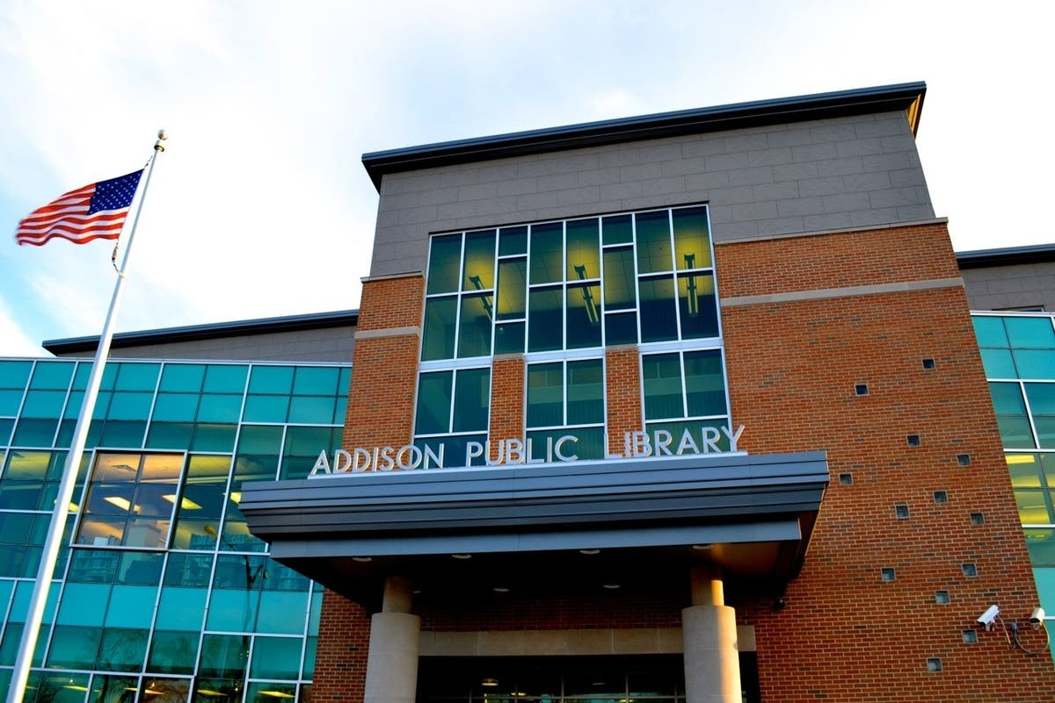
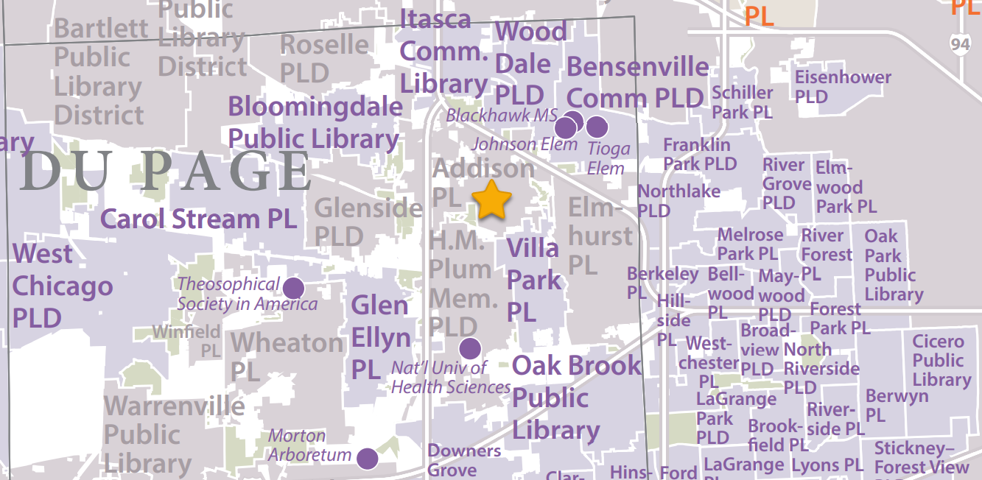
Addison Public Library
Library service pop 36,000
Membership fee est. $70,367
  5th highest in SWAN
Initial meeting took place October 2022
SWAN received a letter of intent to join (incl. in meeting packet)

Slide 23
Addison Public Library interest in joining SWAN
Provide cost estimate to interested library
Answer the library’s questions about features, membership, etc.
Inform the SWAN Board
Inform the SWAN Membership
Provide interested library the SWAN agreement, set date for library trustee approval
Write recommendation & profile on library, discuss at membership meeting
SWAN Membership votes for admission (1 month): 67 affirmative votes for approval required
SWAN staff profile library data, extract and import data, provide library training, and design marketing material (6-8 months)
Library circulation & catalog go-live on SWAN

Slide 24
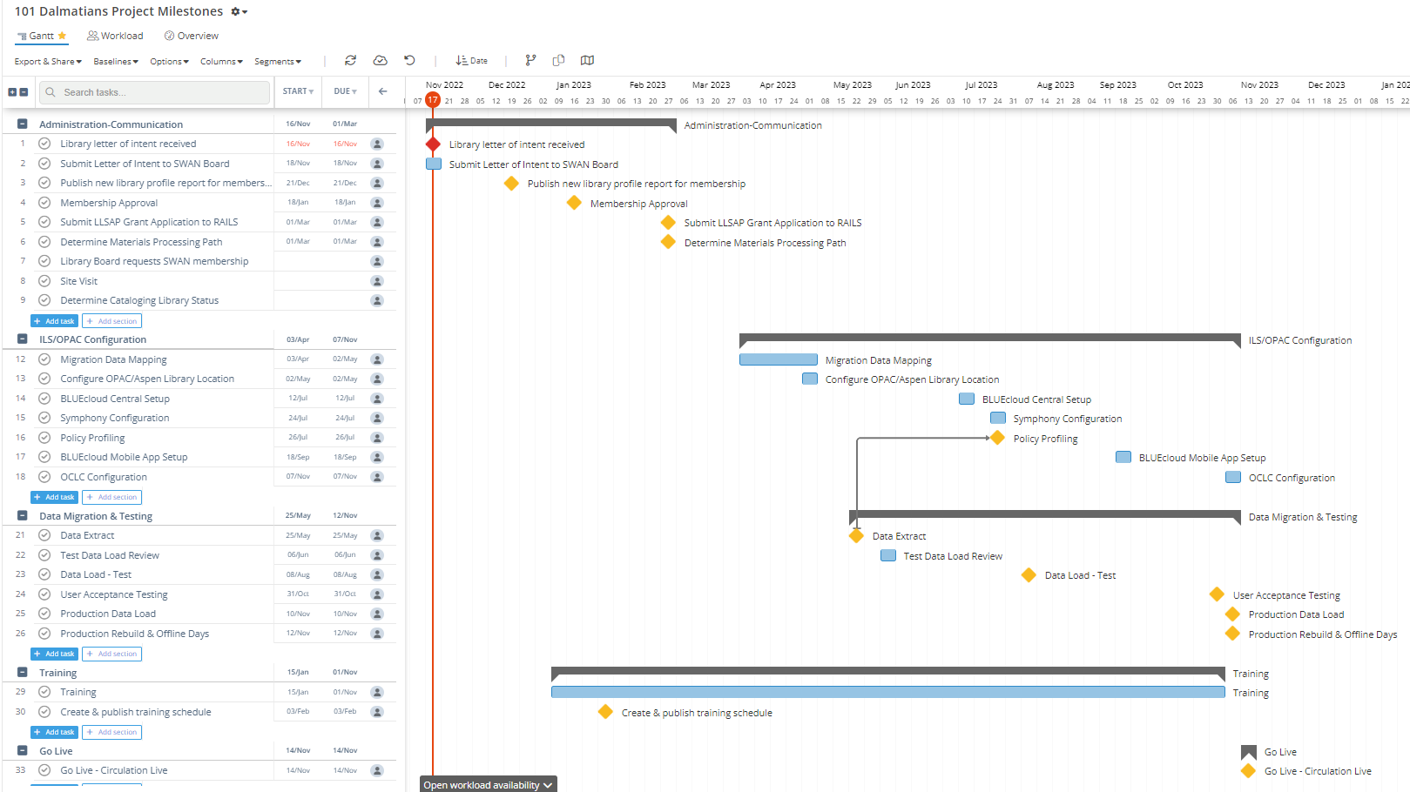
Project timeline: go-live November 2023

Slide 25
SWAN Budget process
Aaron Skog, SWAN

Slide 26
Budget process timeline
DATE | MEETING TYPE | ACTION ITEMS
September 1 - 30, 2022 | Executive Director | Collect county tax data, submit FOIA to Cook County Treasurer for tax data.
Friday, October 21, 2022 | Regular SWAN Board Meeting | Aaron begins work on budget, brings questions to SWAN Board if needed.
November 10, 2022 | Finance Committee | Aaron Skog and Treasurer review Budget; SWAN potential policies are reviewed.
Friday, November 18, 2022 | Regular SWAN Board Meeting | Board accepts financial audit. Aaron to bring budget draft; Board discuss Fees and determines next steps.
Thursday, December 1, 2022 | Quarterly | Announce budget process
Friday, December 16, 2022 | Regular SWAN Board Meeting | Review of budget draft. Approve RAILS LLSAP grant agreement
Sunday, January 1, 2023 |  | Signed LLSAP grant agreements due to RAILS
Friday, January 20, 2023 | Regular SWAN Board Meeting | Review and recommend draft of SWAN Budget for Membership presentation. Set COW date for February for membership review.
 |  | Recommend Draft of SWAN Budget for Membership Presentation. Set Budget Meeting date for February for membership review.
January 2023 [TBD] | SWANcom | Board present draft budget to membership.
 | SWANcom | Aaron Skog/Board announcement of draft budget to membership. Set February COW date and possible location of meeting.
February 2023 [TBD] | Membership Meeting | Meeting to discuss budget, fees, and reserves worksheet.
Friday, February 17, 2023 | Regular SWAN Board Meeting | Incorporate changes, suggestions to SWAN budget. Create recommendation to membership.
Thursday, March 2, 2023 | Quarterly | Roll call vote to approve SWAN budget.

Slide 27
Data visualization in GIS maps
Scott Brandwein, SWAN

Slide 28

Datasets showing:
Who – Who are our patrons?
What – What do they check out?
Where – Where do they check out from?
This Photo by Unknown Author is licensed under CC BY-NC

Slide 29
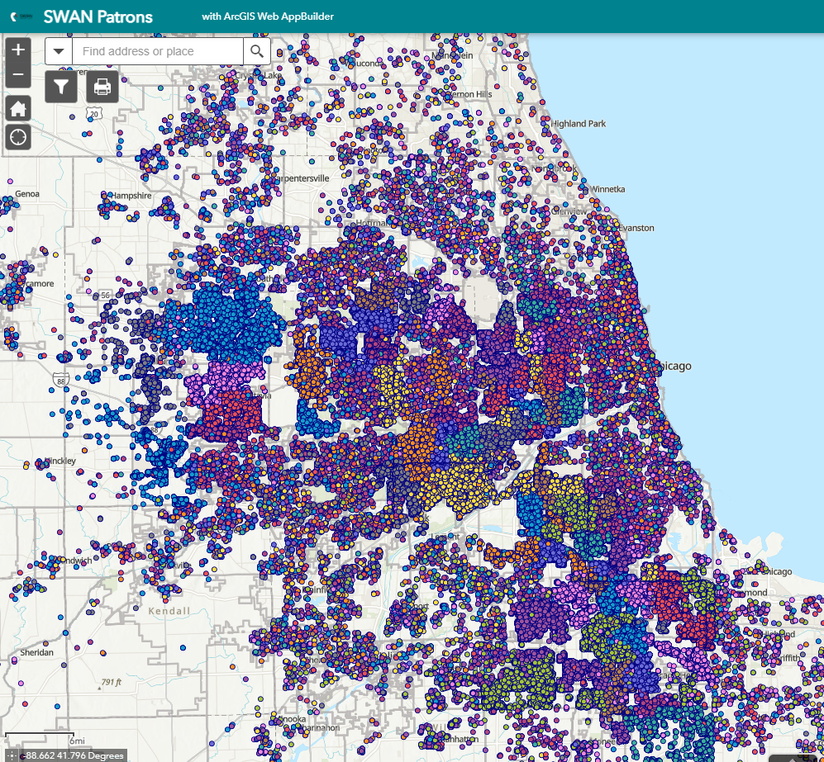
Who – All SWAN Patrons
Color code by Home Library
Filter by:
  Status
  Profile
  Last Activity Year
  Last Activity Date
  Age (Category)

Slide 30
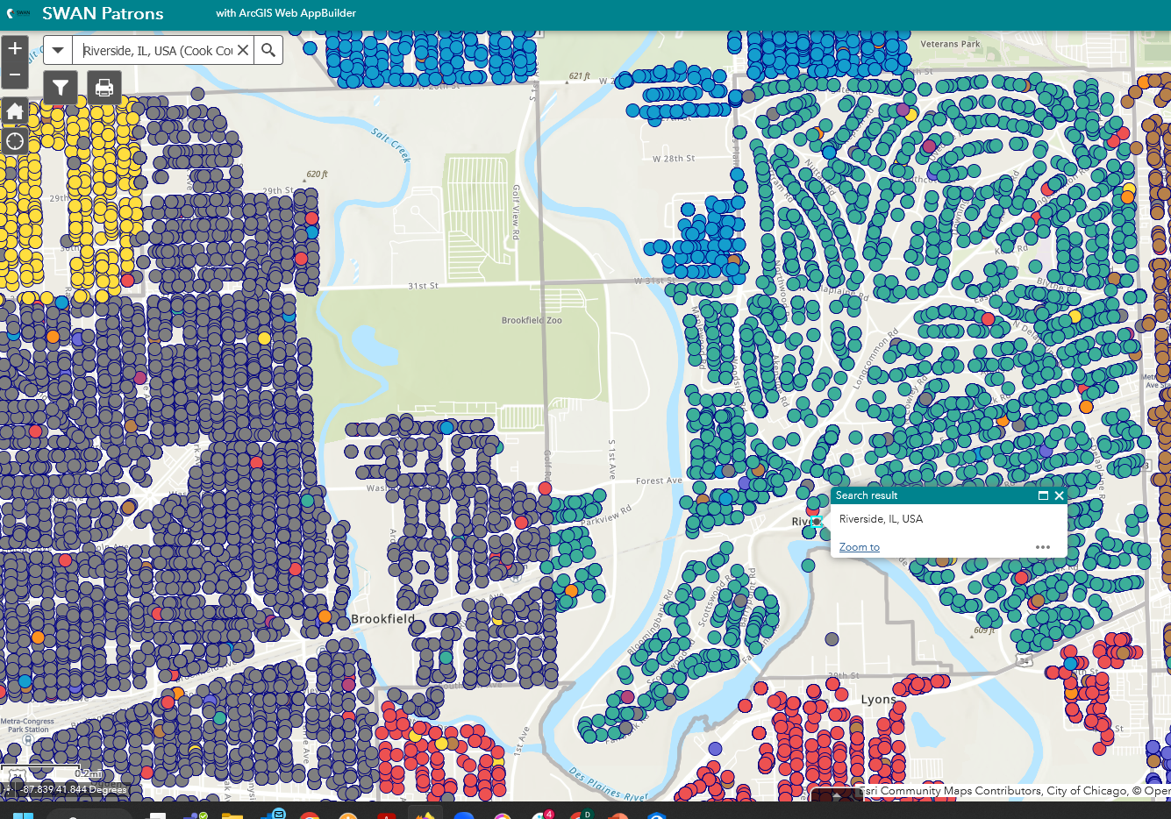
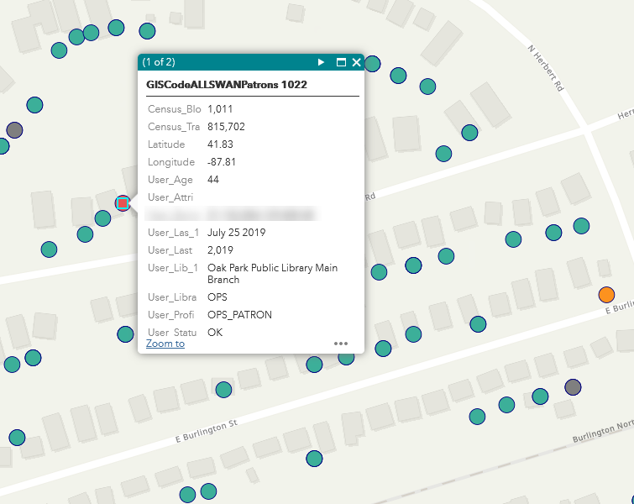
Search, Zoom in, Click on dot for details

Slide 31
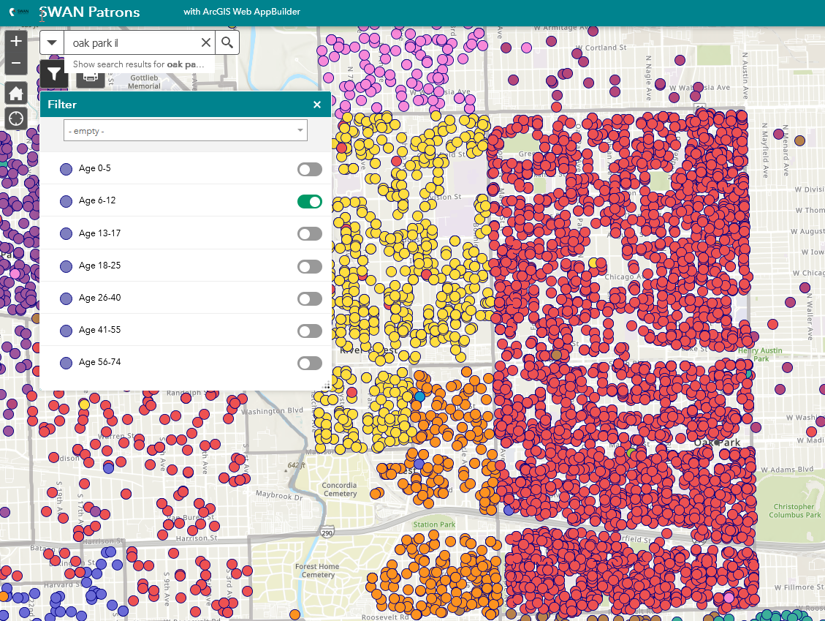
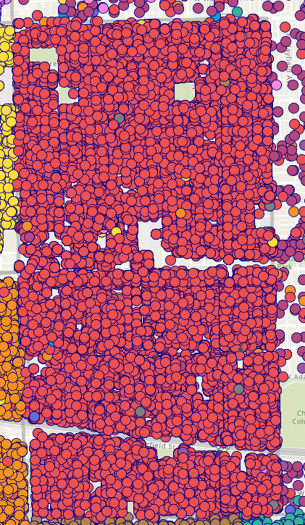
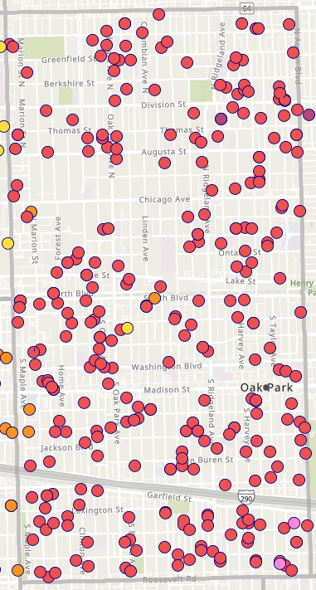
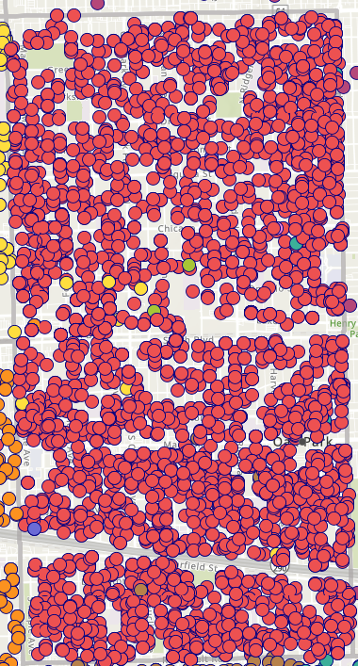
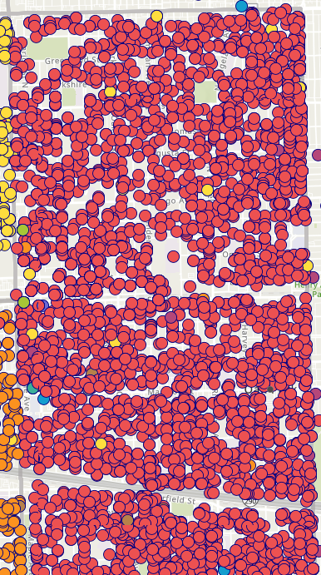
Filter (e.g., age range)
All Patrons
0-5
6-12
13-17
18-25

Slide 32
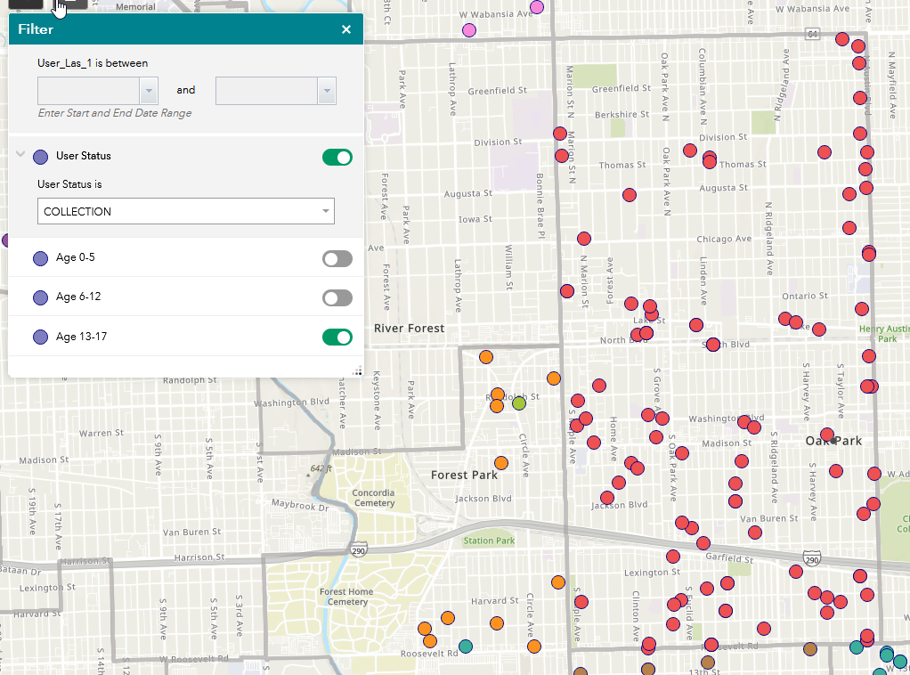
Helps visualize data anomalies
13-17 year olds in collection status
Filters use Boolean AND to connect terms

Slide 33
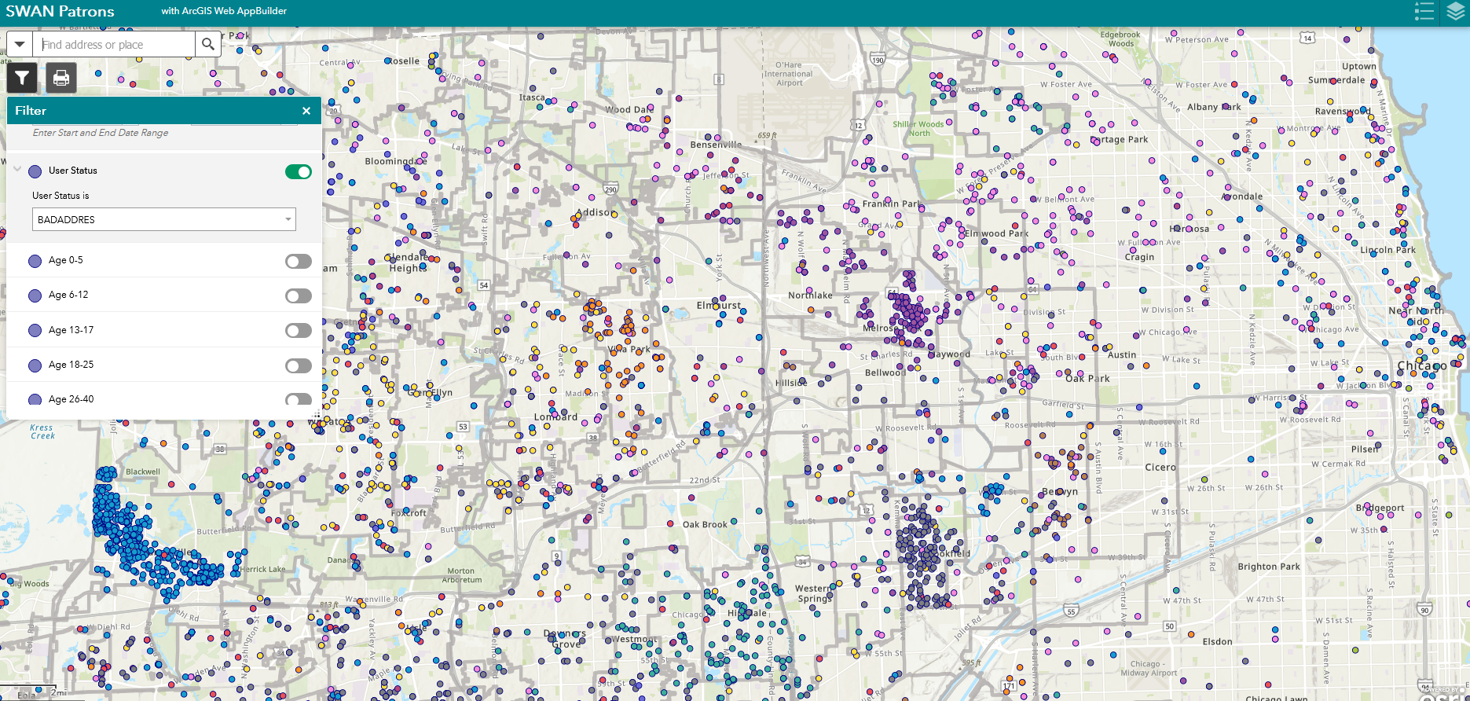
User Status filter (e.g., BADADDRES)
Community clusters represent library local practice in updating status from NCOA

Slide 34
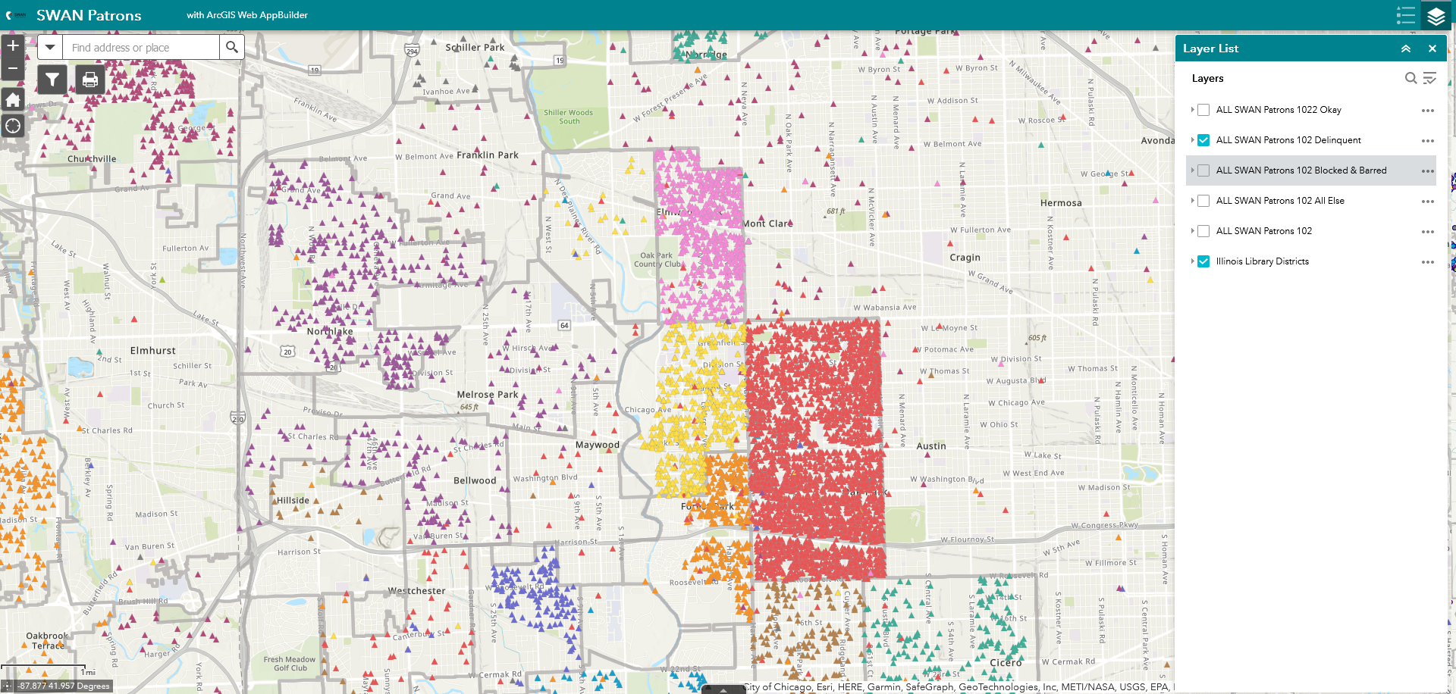
Change visible layer (e.g., Delinquent)
High concentration of delinquent doesn’t necessarily indicate a problem.
Fine-free libraries expect a short period of delinquency, without penalty to patron.

Slide 35
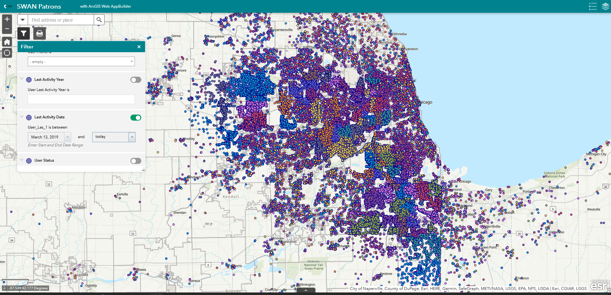
Last Activity Date > Start of Pandemic

Slide 36
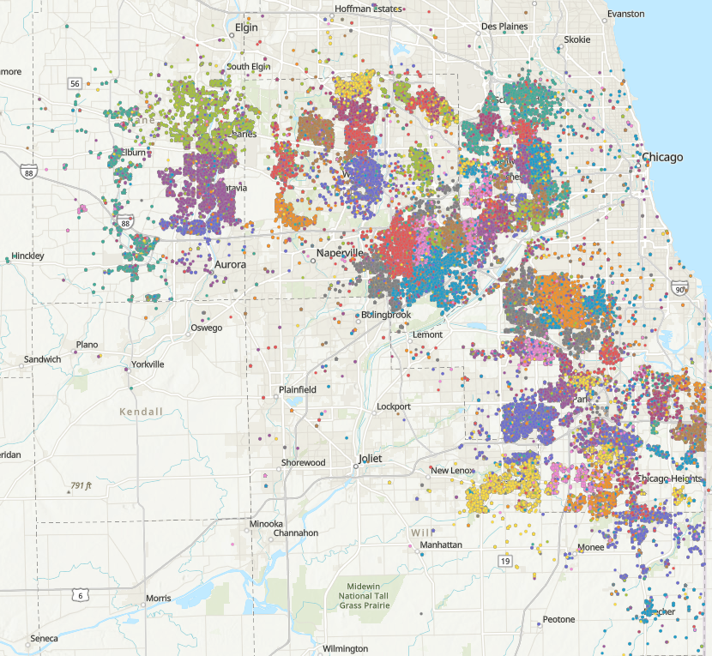
What – Items circulated in last month
Color code by Item Library
Filter by:
  Item Type
  Item Category 1
  User Library
  Age (Category)

Slide 37
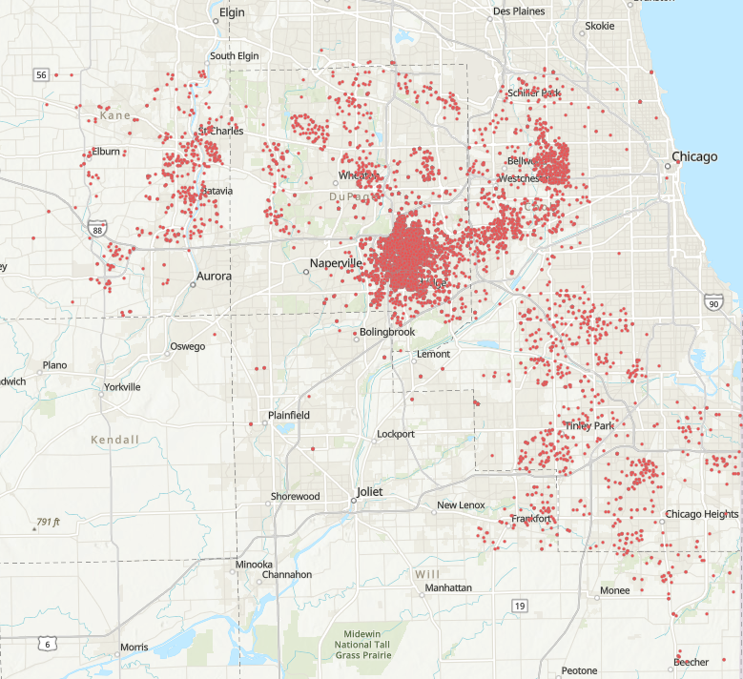
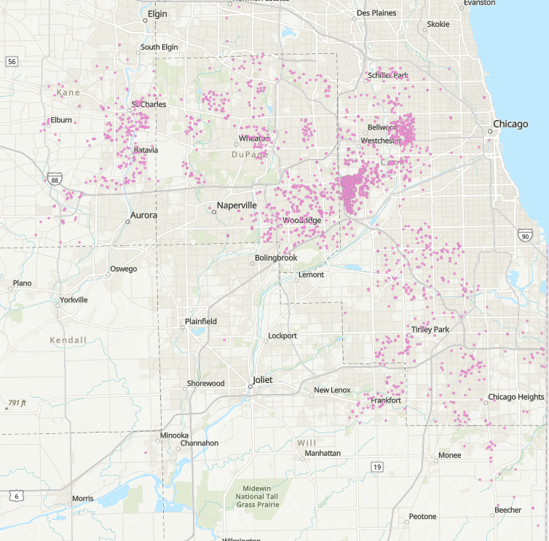
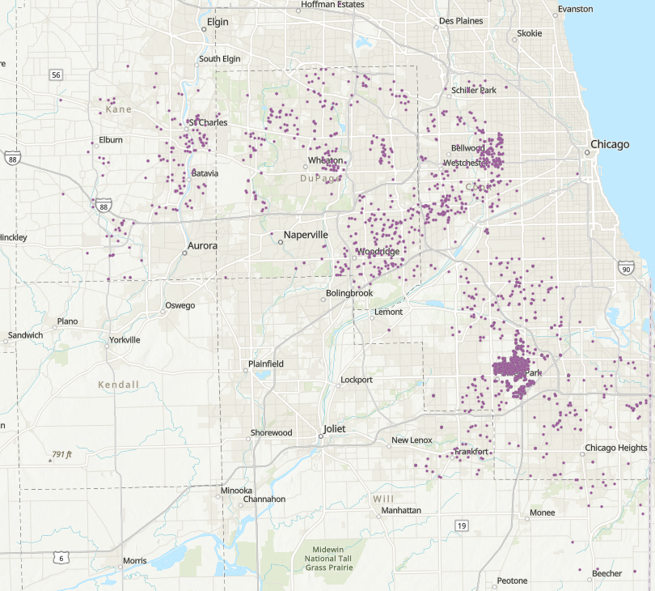
What items from my library circulated?
Every library shares resources throughout the SWAN region. Pattern is similar for all.
Cluster around my home library location, but items travel far and wide.

Slide 38
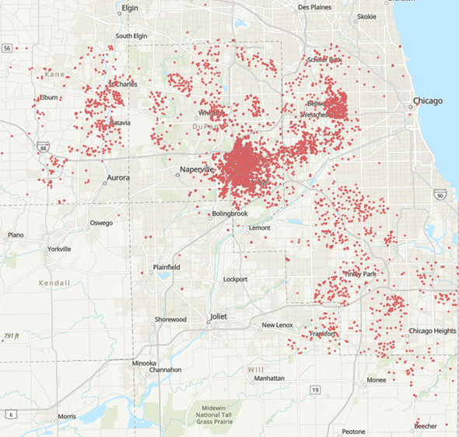
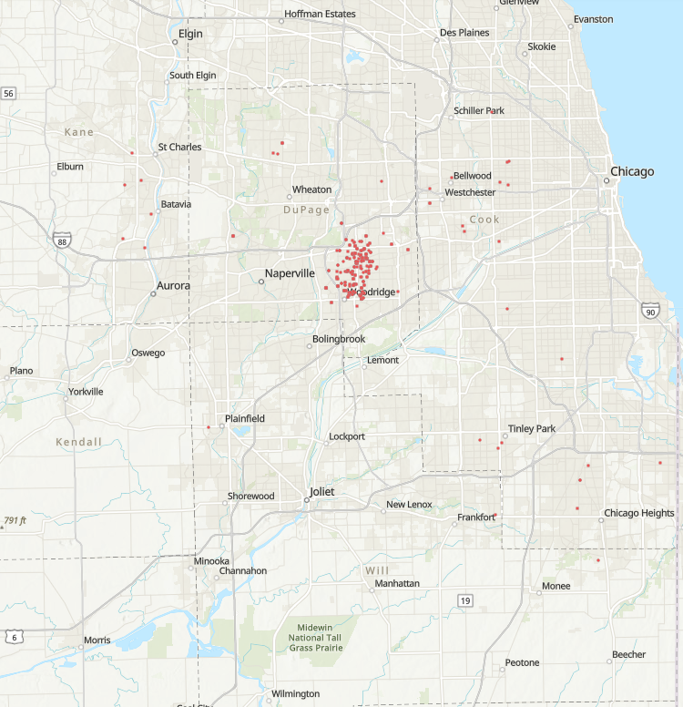
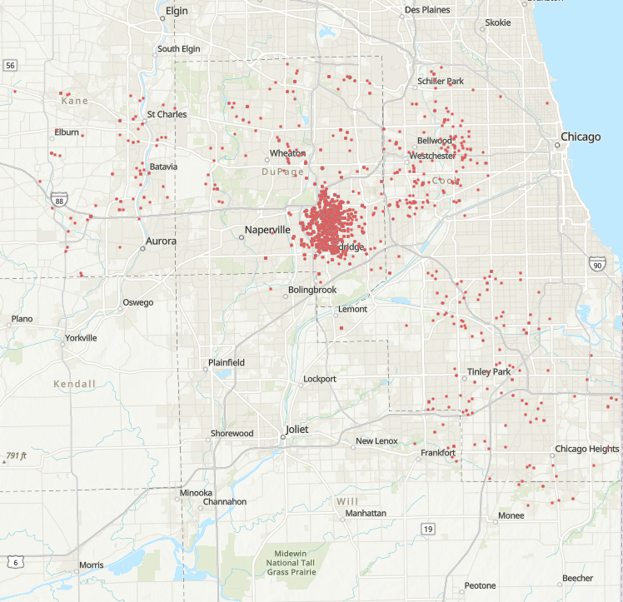
What about item type? (Item Cat 1)
All
Console Games
Video

Slide 39
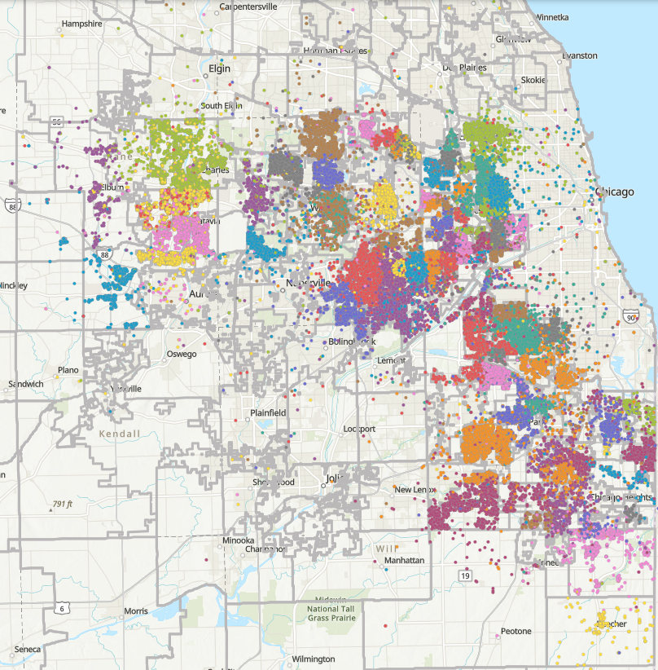
Where – Checkouts from which library
Color code by Station Library
Filter by:
  User Library
  User Attribute Category 8 (Non-SWAN home library)
  Age (Category)
  Checkout, renewals, total thresholds

Slide 40
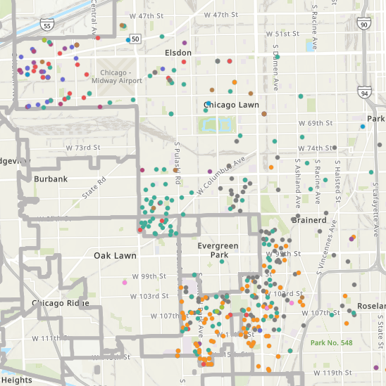
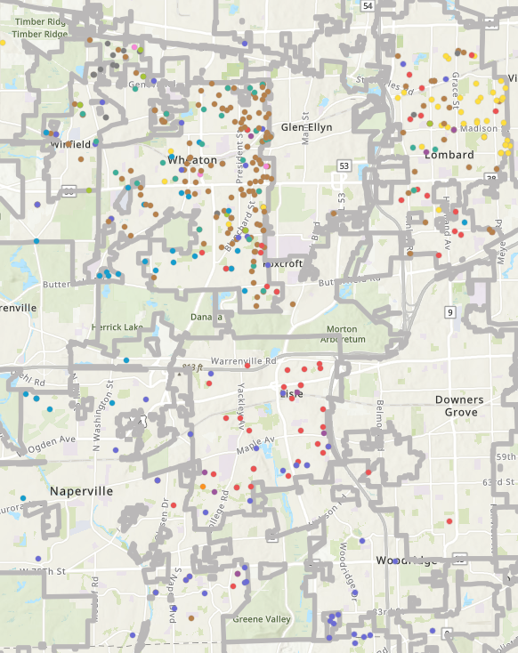
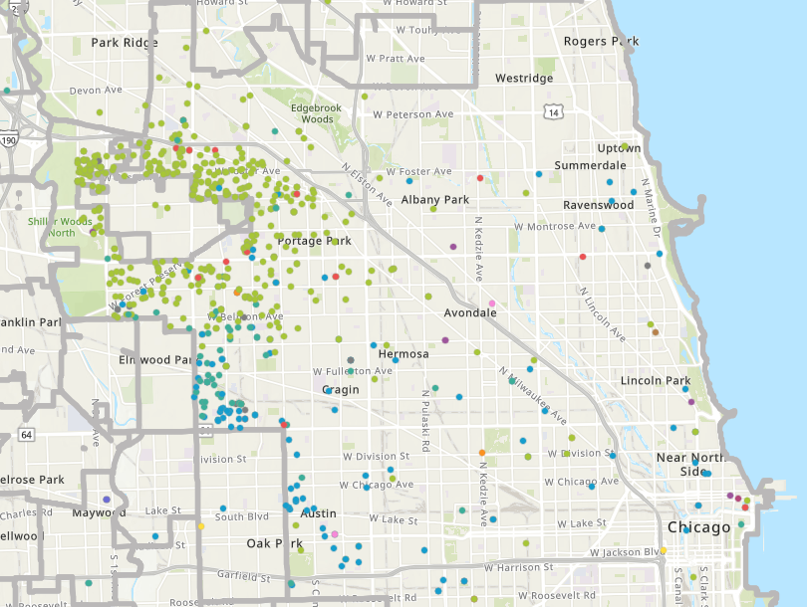
Where do Non-SWAN RBPs go?
Where do we see clusters of checkouts?
Geography greatly impacts our libraries with respect to RBPs

Slide 41
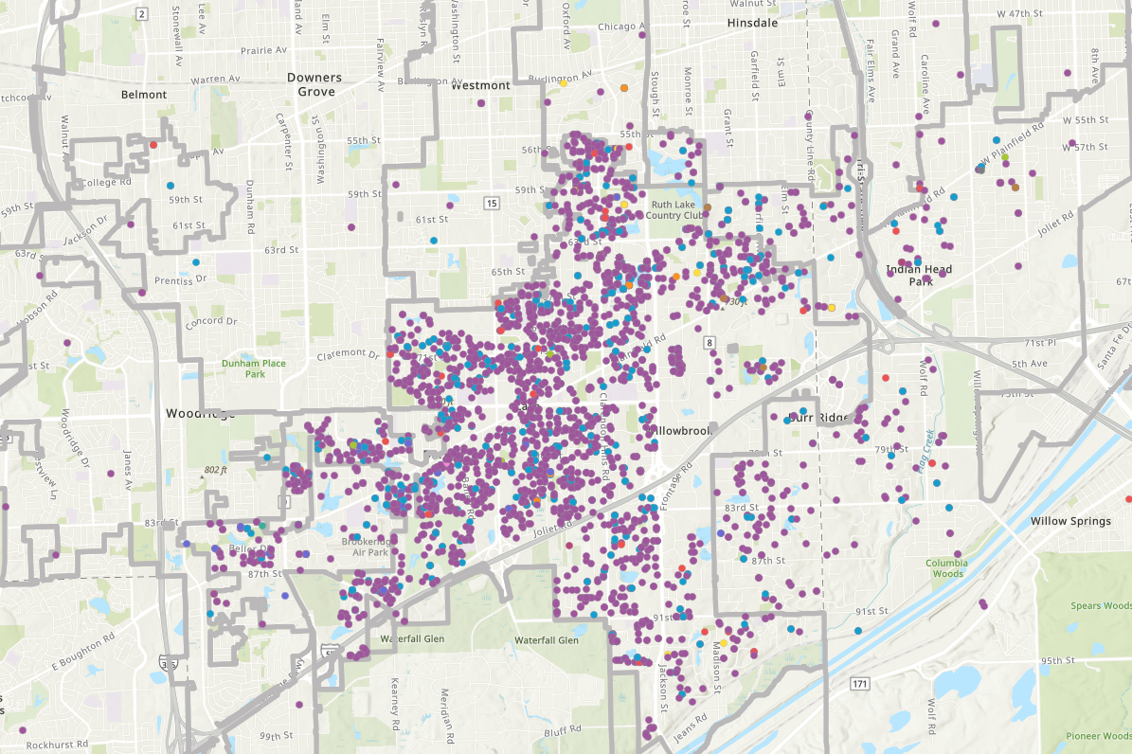
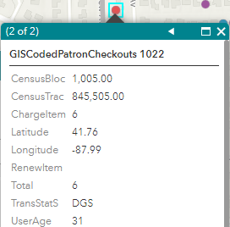
Where do drive-up users live?
Checkout Library example:
Purple – Main
Blue – Drive-up
Red – neighboring library
Some patrons or households, use multiple

Slide 42
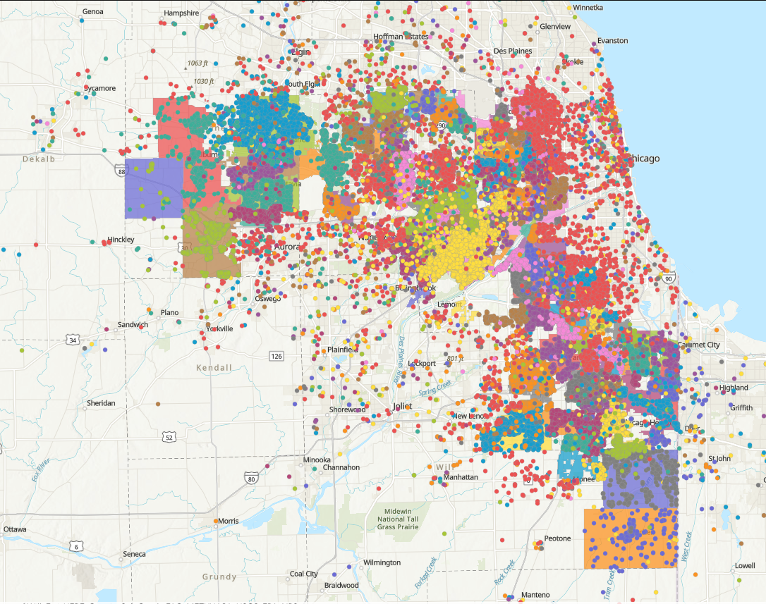
Patrons Active in Past 3 Months

Slide 43
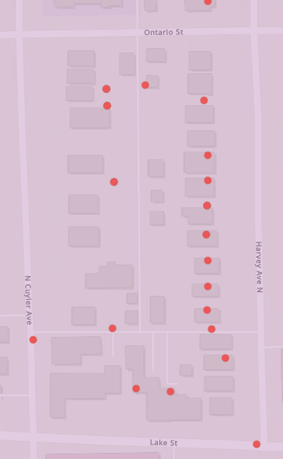
Monthly Data Extracts
Patrons Active in Past 3 Months
  Goal is to provide time progression of active patrons
Item Checkouts
  Libraries will be able to see where their material was checked out
Patron Checkouts
  Libraries will be able to see where their patrons checked out material

Slide 44
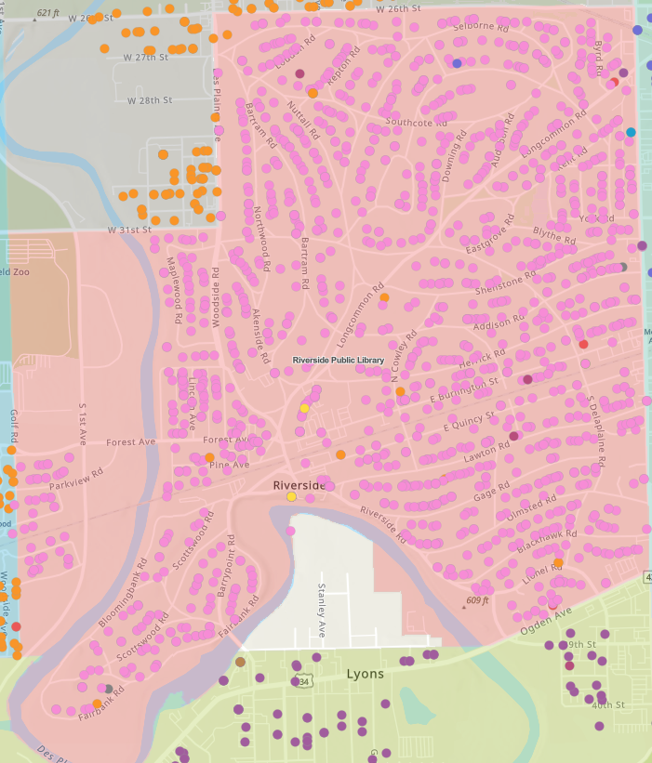
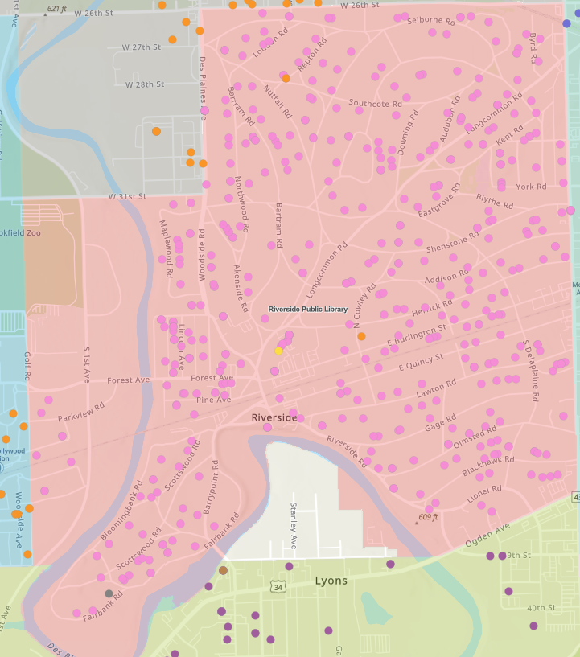
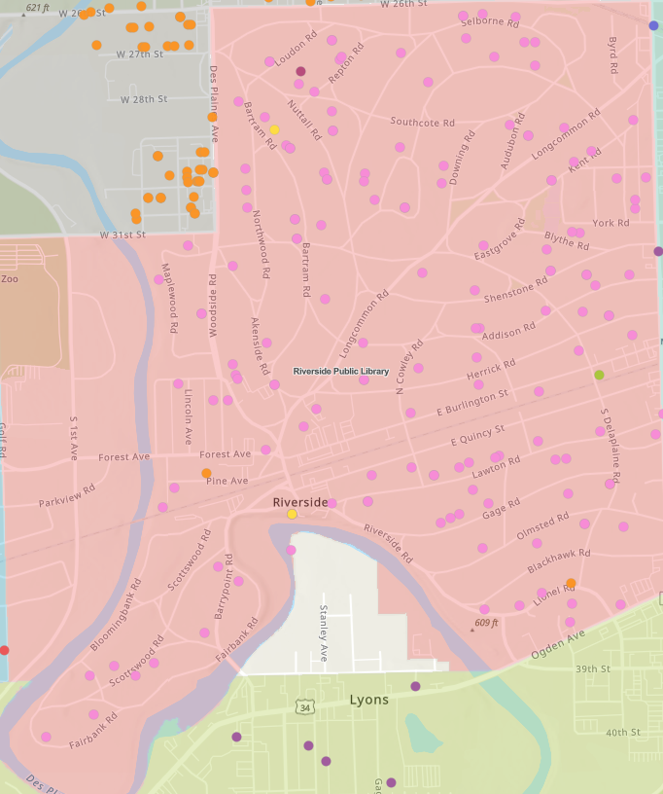
Comparison of Population
All patrons active – 3 months
60 and over
10 and under

Slide 45
Holds & Aspen: time to fill & impact of Aspen Discovery
Tara Wood, SWAN

Slide 46
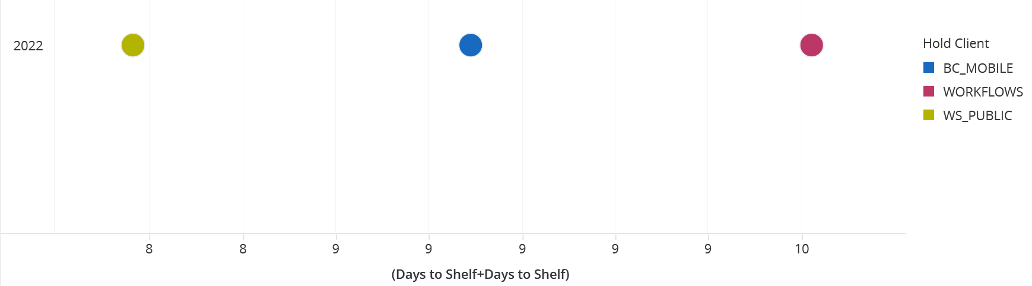
Holds Total Days to Shelf
May 1 – October 31, 2022
Holds placed through Aspen average less time to fill (8 days) than BLUEcloud Mobile (9 days) or Workflows (10 days)

Slide 47
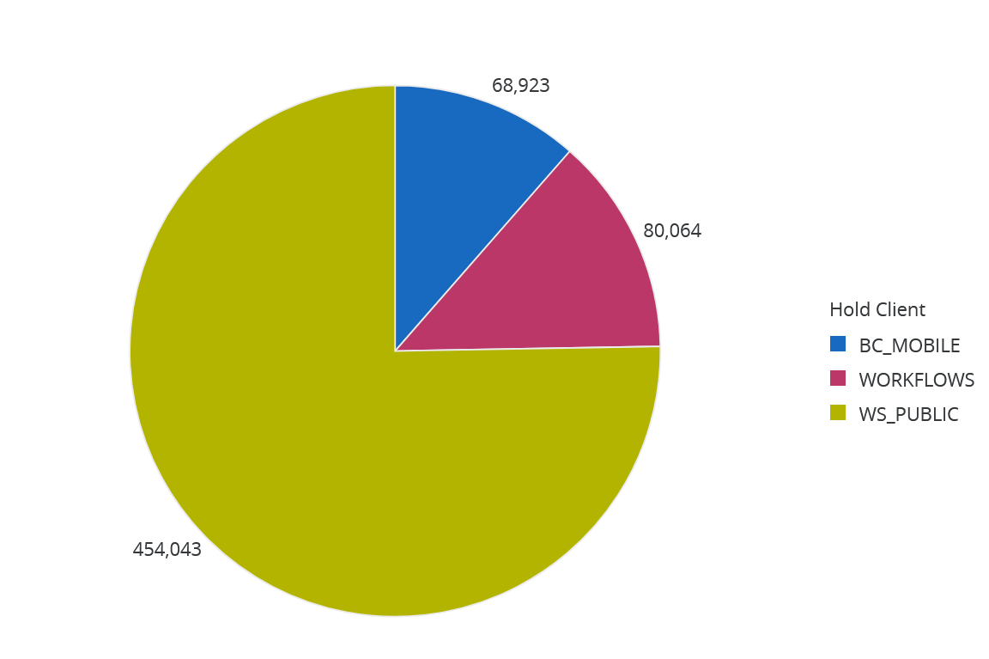
Hold Volume by Client
May 1 – October 31, 2022
Hold volume is much higher in Aspen (75%) than in BLUEcloud Mobile or WorkFlows (25%), so overall time to fill is lower.

Slide 48

Give or take a day or two – no big deal, right?
1 day wait time saved on 450,000 holds placed in Aspen
450,000/365 = 1,233 Years of time saved.
For ~34,000 patrons placing holds, that represents almost a 2-week time savings per patron in a 6-month period!
Like pennies in the bank, it adds up!

Slide 49
Announcements & Questions

