Slide 1
SWAN Fiscal Year 2024 Budget
February 7, 2022
Committee of the Whole Meeting

Slide 2
SWAN Budget Overview
Fiscal Year 2024: July 1, 2023 through June 30, 2024

Slide 3
Timeline
Board review Nov, Dec, Jan
Budget documents posted for membership
COW February 7, 2023 presentation & feedback gathered
SWAN board meeting February 17, 2023
Vote for approval March 2, 2023 at Oak Brook Public Library

Slide 4
Budget priorities
MessageBee
Security initiative: complying with security audit
  Hosting & support
  Monitoring, detection, & response
Addison addition to SWAN
Preparation & research
SirsiDynix annual subscription
  Year-3 of 5-year contract
  1.9% increase
OCLC annual subscription
  Factored 3% increase

Slide 5
Budget Highlights
100 Libraries strong
Addison Public Library add-on
Aspen Discovery catalog hosting & Support site hosting
Security initiative expenses
SWAN Expo August 2023
Revenue
  Increased interest income
  Lower RAILS funding from prior years
  Membership fees increase 1%
Expenses
  Overall, 0.5% increase
  Added MessageBee

Slide 6

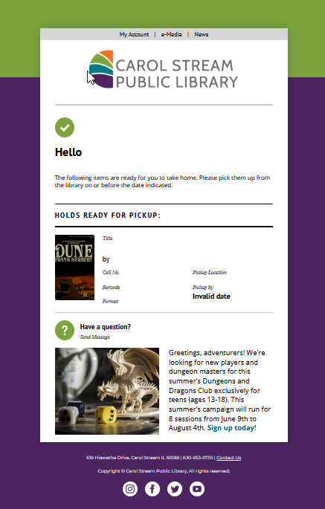
MessageBee
Additional expense for 100 libraries
MessageBee portal for each library
  Email
  SMS
  Voice
Budget $76,686 based on contract with Unique Management

Slide 7
Information Security
Expenses shifting
SWAN infrastructure-as-a-service Microsoft Azure expenses lower
Transitioned Aspen, Support to vendor solutions so new expenses added
ByWater Solutions hosting
Pantheon IO hosting
Additional services & changes planned
“Manage Detect Response” security service
Support site upgrade & redesign

Slide 8
Addison Public Library
Revenue
Expenses
Additional revenue
Membership fees January 2024 – June 2024 (6 months)
  $35,183 Membership Fees
  $70,367 Membership Fee in FY25
One-time migration costs
Addition to services
  OCLC membership
  EBSCO services add-on
  SirsiDynix maintenance add-on

Slide 9
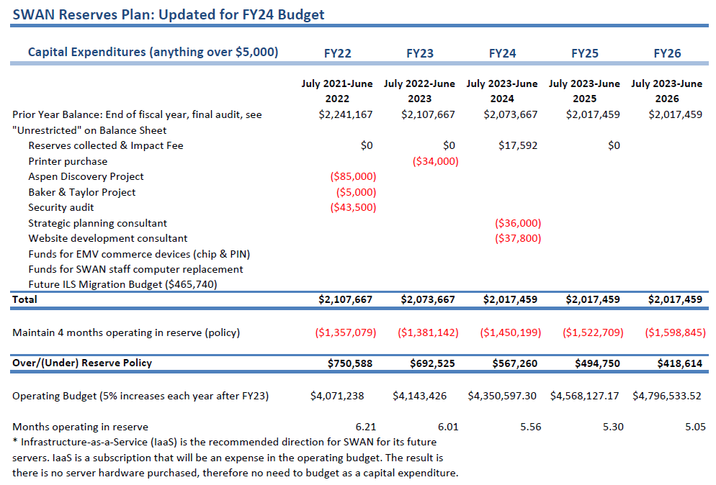
SWAN Reserves
Impact fee revenue $17,592 from Addison
One-time expenses:
strategic planning consulting
Support site migration

Slide 10
Revenue budget

Slide 11
Revenue
Membership Fees, Grant Revenue, Investment & Interest
Pass through: Group-purchase, Reimbursements for Losses,
RAILS LLSAP Support revenue
  $498,388 FY24
  -$28,933 reduction
Interest income budget increased from $1,000 to $20,800
Membership fee budget line increases 1% (varies per public library)
Annual conference fees (offset the food & beverage expenses at rental MVCC)
E-commerce transactions budget line (offset by #5940 expense)
EBSCO group purchase fees (offset by #5990 expense)

Slide 12
Expense budget 0.5% increase FY24

Slide 13
Expenses
Salaries & Wages
Personnel Benefits
5th year no increase in budget
Positions eliminated via attrition, retirement, & elimination
Part-time staff added to Bibliographic Services in December 2022
Reduction in benefits for health, dental, life
Open enrollment completed January 1, 2023

Slide 14
Expenses
Buildings & Grounds
Professional Development
Increase 4.2%
Facility lease increase (per contact)
Utilities expense increase
Reduced expenses based on actual end of June 30, 2022
Conference travel budget $6,000 reduction from pre-pandemic $11,000 budget

Slide 15
Expenses
Membership Development
Information & Technology Services
Supports SWAN Expo
  No speaker fees for FY24
Reduced staff travel budget to libraries
Expenses for SWAN Learning Management System is the #5330 Library Professional Development budget line
Transition of SWAN websites hosted by in SWAN infrastructure to vendor solutions
  Decrease for Azure expense #5430
  Increase infrastructure usage with Aspen Discovery hosted with ByWater Solutions
SirsiDynix decrease (SMS service replaced by MessageBee)
OCLC increase 3% (anticipated)
EBSCO increase 3% (anticipated)

Slide 16
Expenses
General Office, Hardware & Equipment, Insurance
Contractual Services
Budget for office supplies, printer maintenance $10,000
Business, D&O, crime, cyber insurance budget increase based on 2022 renewal
Continuing legal, HR Source membership, & accounting services
Addison joining = contractual expenses RAILS Catalog Grant
SWAN Expo MVCC facility expense
Increase to Notification & Collection due to MessageBee expense
Consulting expenses for FY24
  Strategic planning $36,000
  Support website consulting $37,800
  Paid through Reserve Funds

Slide 17
Expenses
Library Materials & Content
Interest & Fees
EBSCO database package group-purchase year-4 renewal 3% increase
Budget line #5940 E-commerce payment transactions added with revenue offset
Bank fees, merchant account ProPay fees flat
Annual conference merchant account fees for credit card processing $300

Slide 18
Revenue: Membership Fees
Separate formula for academic, school, special, and public libraries
Public library formula based on county tax data (Cook, DuPage, Kane, Will)
  Self-reported bond payments, debt service obligations deducted from total tax data
  Completion of debt service payments may increase fees (ex: Downers Grove)
  Details on how SWAN membership fees are calculated
  https://support.swanlibraries.net/about/budget
State funding via RAILS LLSAP is applied as a reduction in membership fees for 95 public libraries

Slide 19
EBSCO database subscription year-4 renewal group-purchase

Slide 20
EBSCO database group-purchase
Year-4 renewal with 84 participating libraries
Pricing posted & in Committee of the Whole meeting packet
Opt-out period ends Friday, February 24th 11:59 p.m.
Libraries opted out will remain out of the year-4 deal
Go to Support > Help > Request Forms > Opt-out EBSCO database group purchase
https://support.swanlibraries.net/forms/80756

Slide 21
Feedback

Slide 22
Membership Meeting
March 2, 2023

Slide 23
Questions & Answers
Feedback from you
Board meeting February 17th
Final budget packet February 27th
March 2, 2023 Directors’ & Administrators’ Quarterly meeting
In-person vote at meeting

