Slide 1
SWAN Quarterly Meeting
March 2, 2023

Slide 2
Agenda
Information Item—MessageBee project update
Action Item – Approval of the fiscal year 2024 budget & membership fees
Information Item— Aspen LiDA mobile app & SWAN evaluation for 2023
Information Item—Addison Public Library joining SWAN
Information Item—SWAN Online Learning update
Announcements and Questions
Next meeting: June 1, 2023
Call to Order and Welcome
Public Comment
Introduction of New Library Directors
Action Item – Approval of the December 1, 2022 Quarterly meeting minutes
Information Item—Board election for 2023
Information Item-- EBSCO group-purchase renewal for 2023

Slide 3
SWAN Board election 2023

Slide 4
Election process & timetable
Election Process Announced | March 2, 2023 (Quarterly)
Online Self-Nominations Accepted | April 3 – 28, 2023
Names of Candidates Released | May 1, 2023
Electronic Ballot | May 8 – May 26, 2023
Results Announced | June 1, 2023
Elected Candidates invited to June SWAN Board Meeting | June 16, 2023
Candidates’ Terms Begin | July 1, 2023
July Board Meeting | July 21, 2023

Slide 5
EBSCO database group-purchase
Olivia Montolin, SWAN Electronic Resources Consultant

Slide 6
EBSCO Renewal Group Purchase
Entering fourth year of group purchase through RAILS
No new opt-outs
3% increase in cost overall
Final cost per library will be available late March
Selection forms will go out in April
New EBSCO selections will be live July 1

Slide 7
EBSCO Renewal Timeline
February 24
April 24
May 12
Libraries opt-out decision
Database selection form will open
Database selection form is closed
May 24
SWAN order details are due to RAILS
June 30
Updated EBSCO links sent to libraries
July 1
Updated EBSCO selections are live

Slide 8
EBSCO group purchase cost sharing
The SWAN EBSCO group-purchase cost sharing arrangement is divided into 4 participating library groups.
The goal of the cost sharing is to allow as many public libraries as possible in SWAN to participate in the group-purchase
Some libraries are forgoing a full percentage discount so that other libraries can receive a larger discount
EBSCO “Quartile Group” | Year-4 renewal discount
Group 1 discount | 68%
Group 2 discount | 43%
Group 3 discount | 39%
Group 4 discount | 33%

Slide 9
MessageBee for SWAN
Scott Brandwein, Assistant Director SWAN

Slide 10

MessageBee
SMS & e-mail notification testing to begin March 2023 with "SWS patrons" including SWAN staff and non-SWAN RB
Template development still in the works
Aiming to start statistics/dashboard training in April

Slide 11
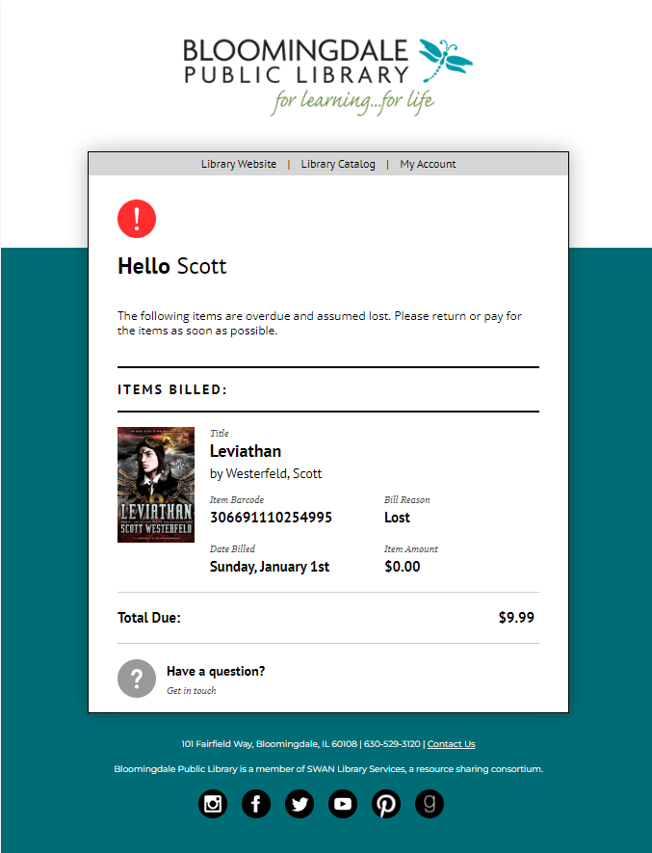
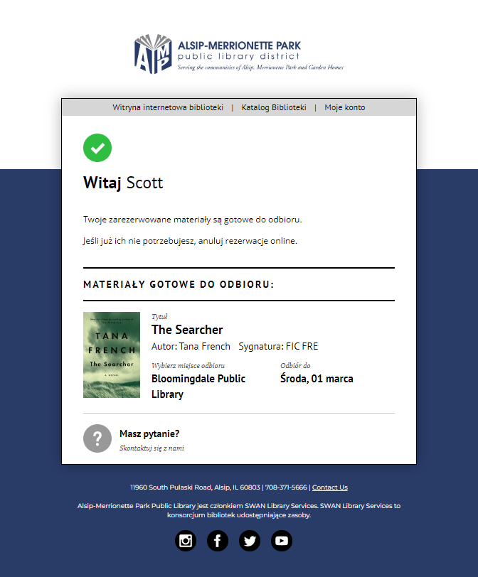

Slide 12
SWAN Budget approval
Aaron Skog, SWAN

Slide 13
Budget process timeline
DATE | MEETING TYPE | ACTION ITEMS
September 1 - 30, 2022 | Executive Director | Collect county tax data, submit FOIA to Cook County Treasurer for tax data.
Friday, October 21, 2022 | Regular SWAN Board Meeting | Aaron begins work on budget, brings questions to SWAN Board if needed.
November 10, 2022 | Finance Committee | Aaron Skog and Treasurer review Budget; SWAN potential policies are reviewed.
Friday, November 18, 2022 | Regular SWAN Board Meeting | Board accepts financial audit. Aaron to bring budget draft; Board discuss Fees and determines next steps.
Thursday, December 1, 2022 | Quarterly | Announce budget process
Friday, December 16, 2022 | Regular SWAN Board Meeting | Review of budget draft. Approve RAILS LLSAP grant agreement
Sunday, January 1, 2023 |  | Signed LLSAP grant agreements due to RAILS
Friday, January 20, 2023 | Regular SWAN Board Meeting | Review and recommend draft of SWAN Budget for Membership presentation. Set COW date for February for membership review.
 |  | Recommend Draft of SWAN Budget for Membership Presentation. Set Budget Meeting date for February for membership review.
January 2023 [TBD] | SWANcom | Board present draft budget to membership.
 | SWANcom | Aaron Skog/Board announcement of draft budget to membership. Set February COW date and possible location of meeting.
February 2023 [TBD] | Membership Meeting | Meeting to discuss budget, fees, and reserves worksheet.
Friday, February 17, 2023 | Regular SWAN Board Meeting | Incorporate changes, suggestions to SWAN budget. Create recommendation to membership.
Thursday, March 2, 2023 | Quarterly | Roll call vote to approve SWAN budget.

Slide 14
Budget priorities
MessageBee
Security initiative: complying with security audit
  Hosting & support
  Monitoring, detection, & response
Addison addition to SWAN
Preparation & research
SirsiDynix annual subscription
  Year-3 of 5-year contract
  1.9% increase
OCLC annual subscription
  Factored 3% increase

Slide 15
Budget Highlights
100 Libraries strong
Addison Public Library add-on
Aspen Discovery catalog hosting & Support site hosting
Security initiative expenses
SWAN Expo August 2023
Revenue
  Increased interest income
  Lower RAILS funding from prior years
  Membership fees increase 1%
Expenses
  Overall, 0.5% increase
  Added MessageBee

Slide 16
Information Security
Expenses shifting
SWAN infrastructure-as-a-service Microsoft Azure expenses lower
Transitioned Aspen, Support to vendor solutions so new expenses added
ByWater Solutions hosting
Pantheon IO hosting
Additional services & changes planned
“Manage Detect Response” security service
Support site upgrade & redesign

Slide 17
Addison Public Library
Revenue
Expenses
Additional revenue
Membership fees January 2024 – June 2024 (6 months)
  $35,183 Membership Fees
  $70,367 Membership Fee in FY25
One-time migration costs
Addition to services
  OCLC membership
  EBSCO services add-on
  SirsiDynix maintenance add-on

Slide 18
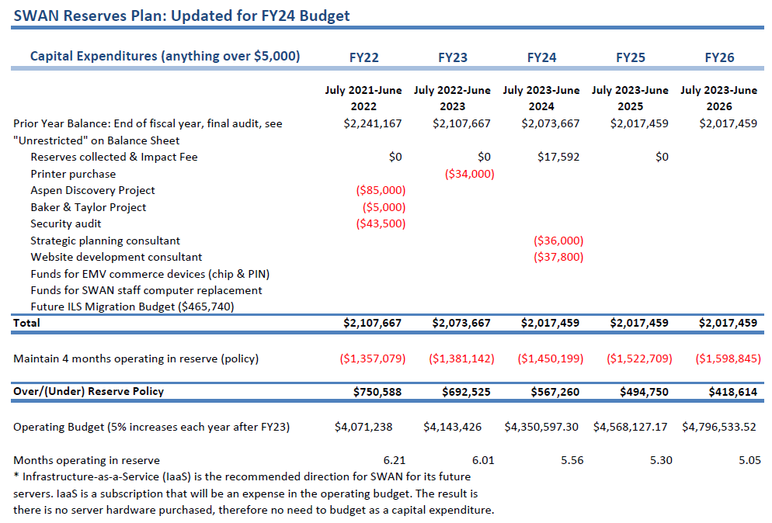
SWAN Reserves
Impact fee revenue $17,592 from Addison
One-time expenses:
strategic planning consulting
Support site migration

Slide 19
Budget approval
Discussion
Motion to accept the SWAN budget for fiscal year 2024 as presented
Roll-call required

Slide 20
Aspen LiDA App
Tara Wood, SWAN

Slide 21
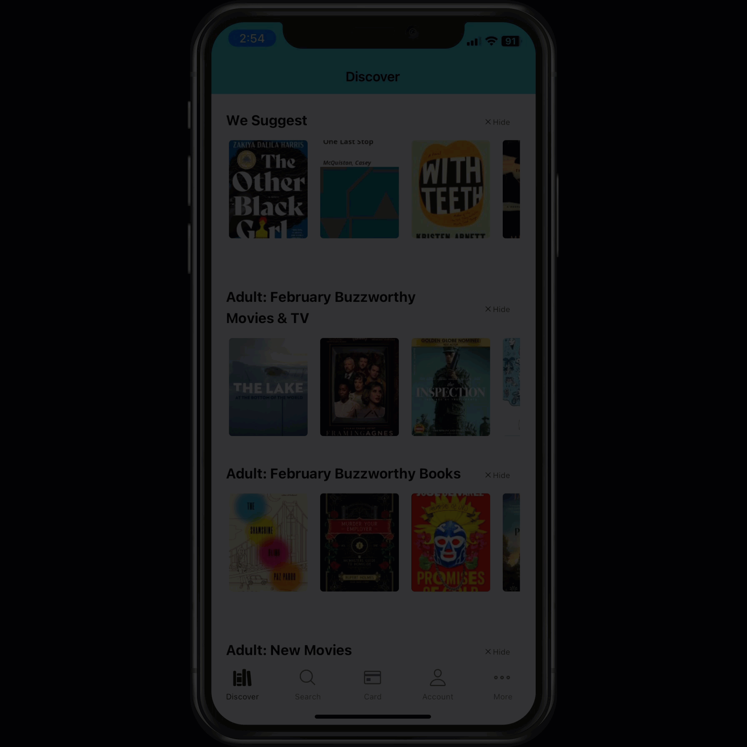
Aspen LiDA Overview
Offers a consistent experience between the Aspen web version and the app
  Searching
  Holds
  Accounts
  Linked cards
In development since October 2021
Can use the generic LiDA or custom branded version(s)
Notes:
Aspen Library Discovery App
Top priorities for DUX from our January 2022 survey:
Consistent keyword search results between the app and the catalog
A consistent holds experience between the app and the catalog (holds on grouped records)
A consistent account experience between the app and the catalog
Linked cards (store multiple library cards in the app)
Consistent search facets between the app and the catalog (subject, availability, etc.)

Slide 22
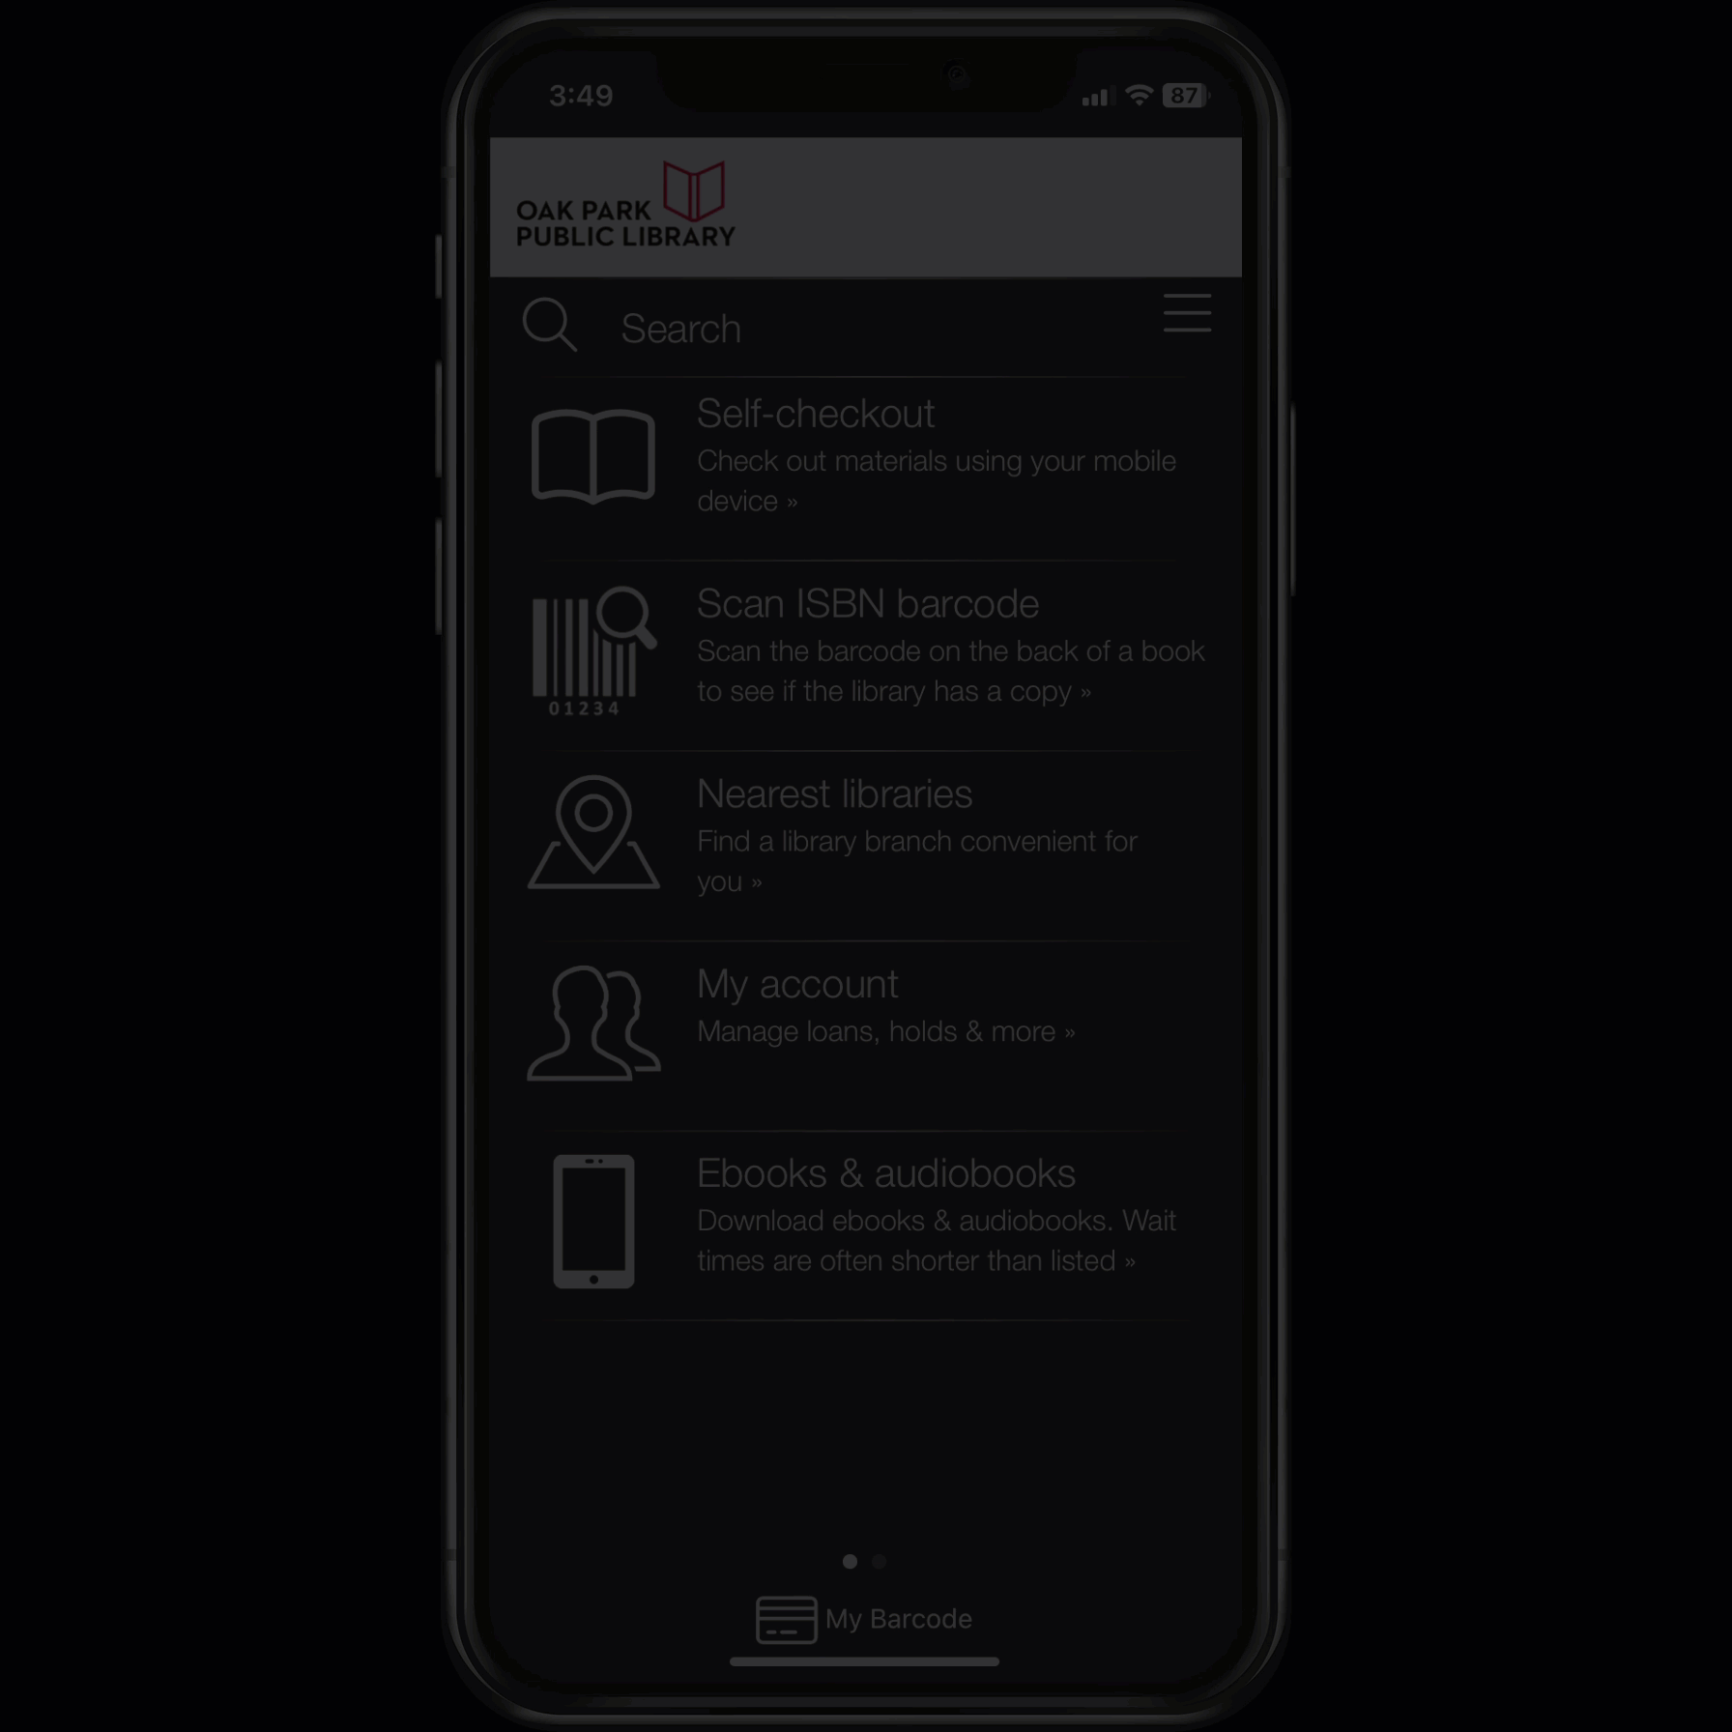
Current App: BLUEcloud Mobile
Inconsistency between the Aspen catalog and the app
  Searching
  Holds
  Accounts
  Linked cards
SWAN live since 2019
Features include self check

Slide 23
Evaluation Process
Phase 1
Monitor development and performance enhancements
Phase 2
DUX evaluation
Phase 3
Pilot
Phase 4
Rollout decisions
Phase 5
Implementation
No firm timelines until Phase 3: Pilot.
Currently in Phase 1 and moving to Phase 2.
Questions to consider before moving to a pilot phase:
What issues are early adopters encountering?
What immediate features, performance enhancements, or usability improvements are needed before a pilot?
Are libraries ready to support this app on an ongoing basis?
Notes:
Phase 1: testing among SWAN staff
Phase 2: Testing with DUX members, feature comparisons between both apps, possible usability testing on provided device
Phase 3: Pilot effectively means this app is live to the pilot libraries' patrons, hard to take away something once offered so we have to be ready. In this phase we could do usability testing with patrons on their own devices, surveys, adoption rate analysis
Phase 4: At this time we'd need to make some decisions about our current BC mobile app, how individual library instances would work
Phase 5: Communications, training, app customization, coordinate BC Mobile retirement if planned

Slide 24
LiDA: Recent Features
Significant performance improvements
Addition of linked account barcodes
Group-level holds
Holds management
Lists management
Search filters
Dark mode
Push notices
Over the past few releases, we've seen several major improvements that will help us move closer to a possible pilot.
Notes:
When DUX previously looked at the app in 2022, we had enough performance issues that most people couldn't complete the testing tasks.
At our most recent DUX meeting, we still had one instance of the app crashing, but the testers were much happier with what they were seeing and could complete all of the testing tasks.

Slide 25
Practical Considerations
BLUEcloud Mobile contract annual renewal (May 1st)
Cost comparisons
Logistics of offering two apps simultaneously
SWAN app vs. Individual library apps
What will the consortium have to consider to offer LiDA to patrons?
Notes:
BC Mobile contract renews in May of each year.
Aspen LiDA is free, but custom branding is not.
It is not possible to have two same-named apps in the app store, so we'll have to think about how we rollout our pilot
SWAN app would be centrally managed, with individual library customizations. Individual instances would require libraries to have their own developer accounts, accept licensing agreements with the app stores, and manage the apps largely on their own – plus there is a cost to your own instance.

Slide 26
Addison Public Library
Aaron Skog, Executive Director

Slide 27
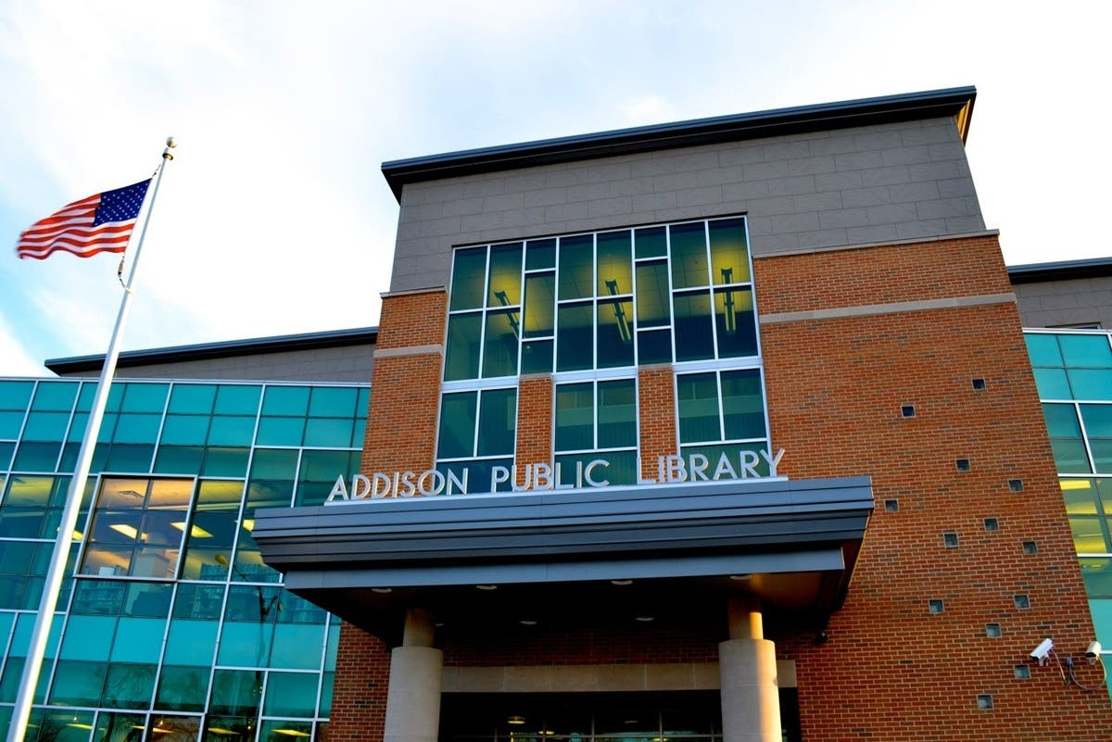
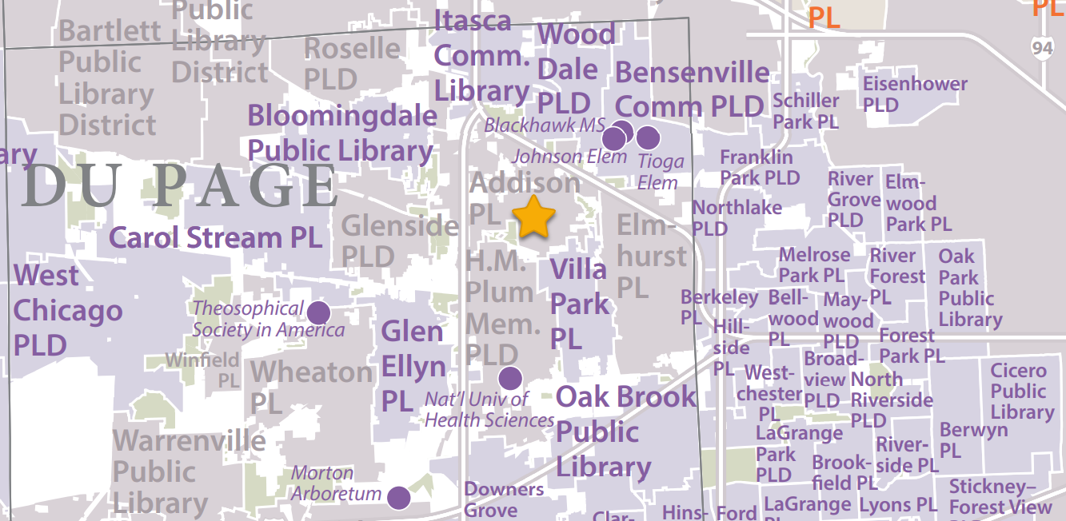
Addison Public Library
Library service pop 36,000
Membership fee est. $70,367
  5th highest in SWAN
Initial meeting took place October 2022
SWAN received a letter of intent to join (incl. in meeting packet)

Slide 28
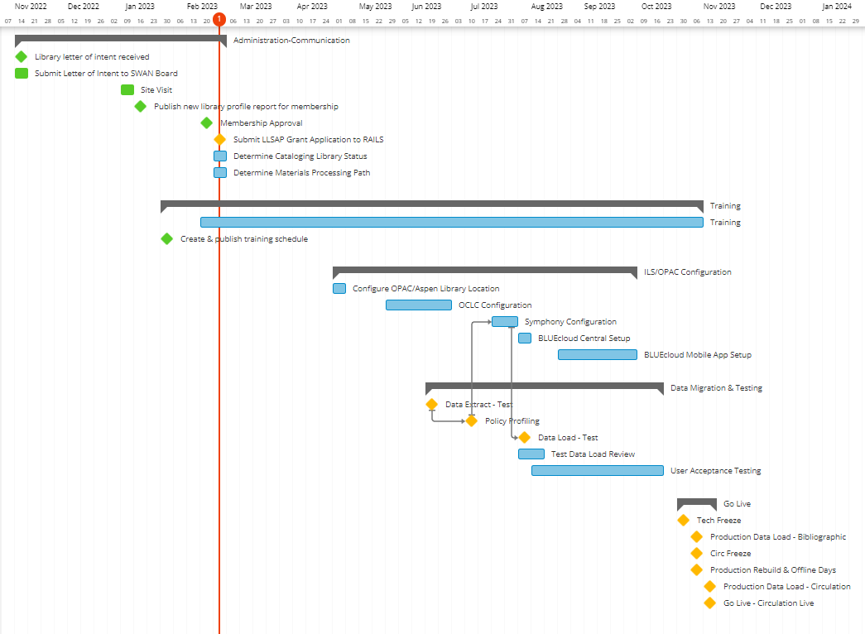
Project timeline: Go-live November 2023

Slide 29
Information security update
Aaron Skog, Executive Director

Slide 30
Hosting
Secure connections
Monitoring
Incident response

Slide 31
SWAN Online Learning update
Crystal Vela, UX Consultant SWAN

Slide 32

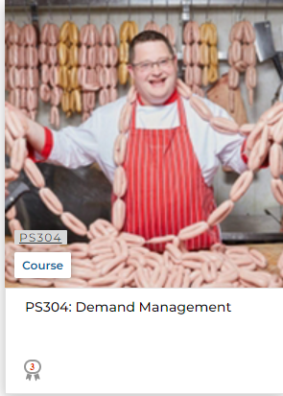
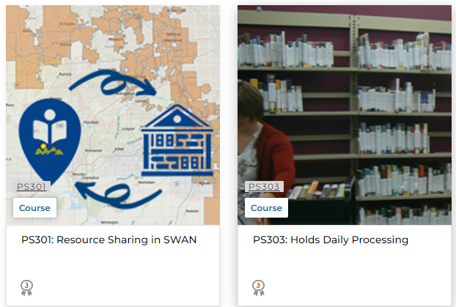
New Courses
Online Learning
Three new courses on holds
PS301: Resource Sharing in SWAN
PS303: Holds Daily Processing
PS304: Demand Management
Notes:
We have 3 new courses for you or your library staff to take.
We have course on Resource Sharing in SWAN. The course will go through the differences between interlibrary loan and reciprocal borrowing. Staff will be able to identify models of sharing within SWAN and outside of the consortium.
We have also created a course on how to process daily holds. This course takes staff through the day to day duties. In addition to trapping holds as items are checked in through the course of the day, staff will be walked through when and how to pull items from the shelf that holds. They will understand how scheduling and timing impact holds efficiency. We also give scenarios on managing the hold shelf, including some special cases.
Now the Demand Management Course covers how holds are created and filled within our system. This is a deep dive into our holds process. It goes through how our policies like item types and our hold and circulation maps impact how holds are filled. Staff will learn the difference between the title and copy level holds. Also the course explains how to use grouped records and place hold actions in Aspen.

Slide 33
Library leadership changes 2021 - 2022
Bensenville Community Public Library District
Broadview Public Library District
Calumet City Public Library
Calumet Park Public Library
Chicago Heights Public Library
Crete Public Library District
Elmwood Park Public Library
Evergreen Park Public Library
Forest Park Public Library
Frankfort Public Library District
Harvey Public Library District
Hillside Public Library
Indian Prairie Public Library District
Itasca Community Library
La Grange Park Public Library District
La Grange Public Library
Lansing Public Library
Markham Public Library
Matteson Area Public Library District
Maywood Public Library District
Messenger Public Library of North Aurora
Oak Lawn Public Library
Oak Park Public Library
Prairie State College
River Forest Public Library
River Grove Public Library District
Riverdale Public Library
Schiller Park Public Library
St Charles Public Library District
Stickney-Forest View Library District
Sugar Grove Public Library District
Thornton Public Library
Warrenville Public Library District
Wood Dale Public Library District
Worth Public Library District

Slide 34
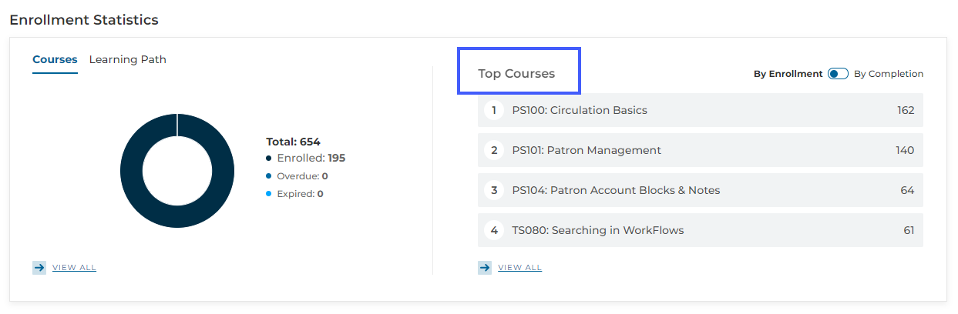
Online Learning via SWAN Learning Management System (LMS)
Currently have 654 users on the LMS and 195 enrollments in courses
The top enrollments are Circulation Basics, Patron Management, Patron Account Blocks & Notes, and Searching in WorkFlows
Notes:
We have seen lots of growth this past month with new users creating accounts on the LMS.

Slide 35
Announcements & Questions

