Slide 1
SWAN Quarterly Meeting
June 1, 2023

Slide 2
Agenda
Information Item—MessageBee project update
Information Item – Addison Public Library joining SWAN project update
Discussion Item—SWAN Decennial Act Statement and the cost-benefit analysis of membership in a library consortium
Information Item – SWAN Expo August 18th Announcements and Questions
Next meeting: September 7, 2023
Call to Order and Welcome
Public Comment
Introduction of New Library Directors
Action Item – Approval of the Quarterly meeting minutes
Information Item—Board election for 2023

Slide 3
SWAN Board election 2023

Slide 4

Board Election Update
Two seats on 7 member SWAN governing board
Election e-ballot completed Friday, May 26th
Elected representatives
  Jennifer Cottrill, Library Director, Midlothian Public Library
  Samantha Johnson, Executive Director, Roselle Public Library

Slide 5
Addison Public Library
Scott Brandwein, Assistant Director

Slide 6
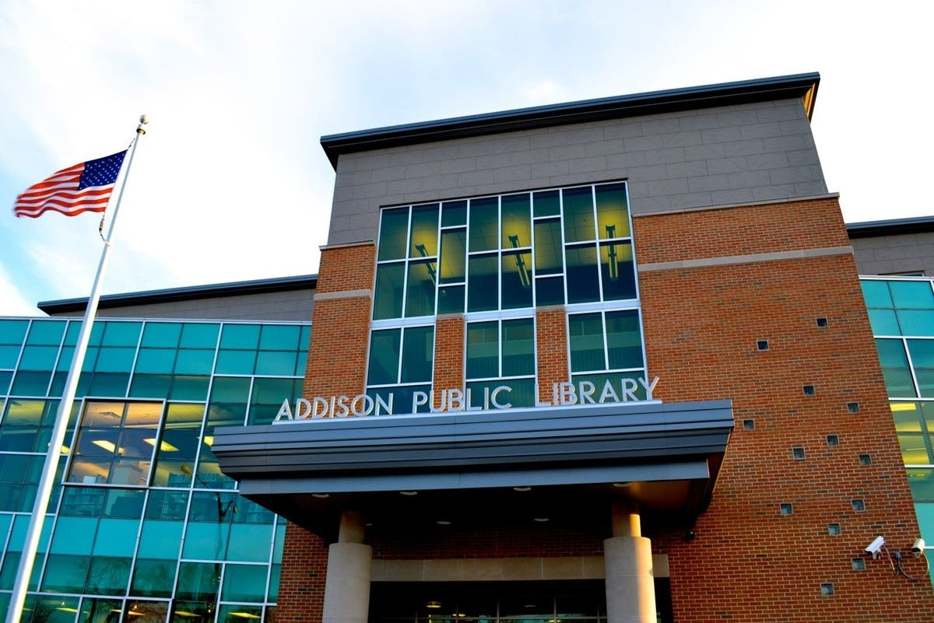
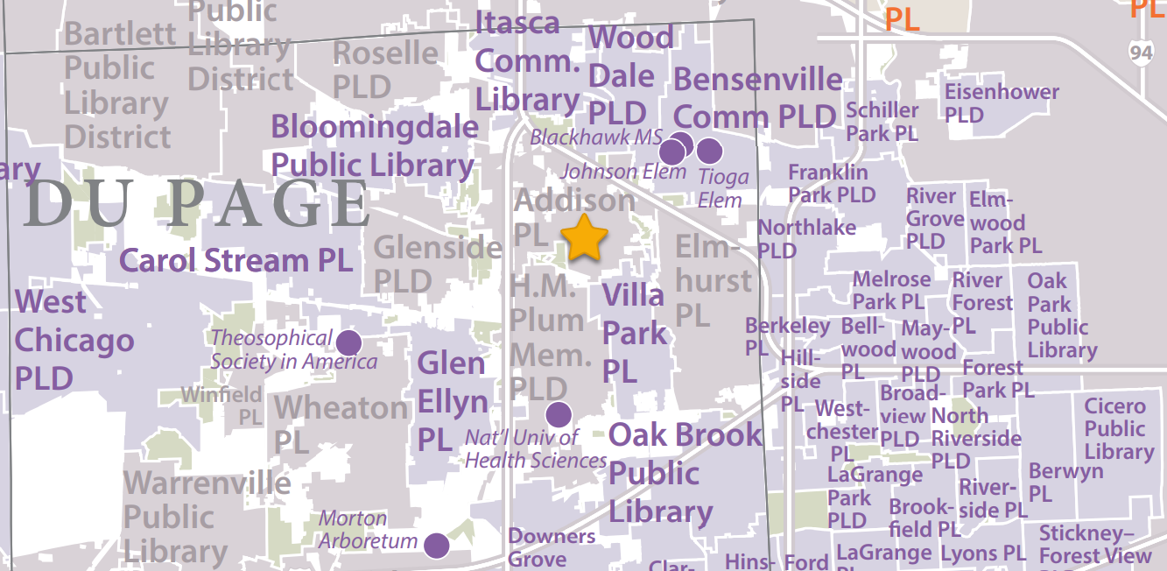
Addison Public Library

Slide 7
SWAN Project Team
Scott Brandwein (Assistant Director)
Olivia Montolin (eResources Consultant)
Ahren Sievers (Systems Administrator)
Samantha Dietel (Bibliographic Services Consultant)
Cynthia Romanowski (Bibliographic Services Manager)

Slide 8
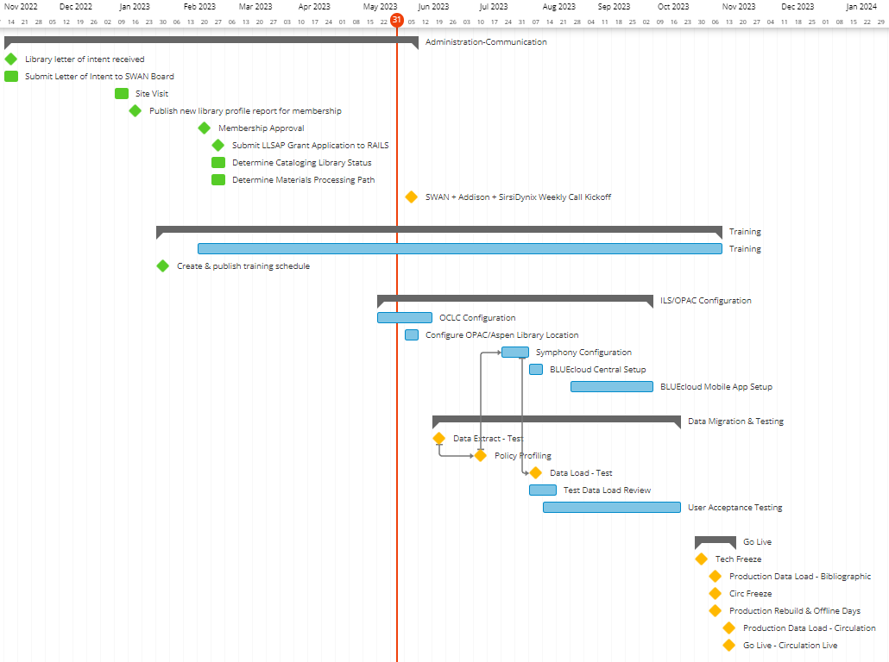
Project Timeline
Go-live: Nov. 17, 2023

Slide 9
MessageBee for SWAN
Scott Brandwein, Assistant Director SWAN

Slide 10
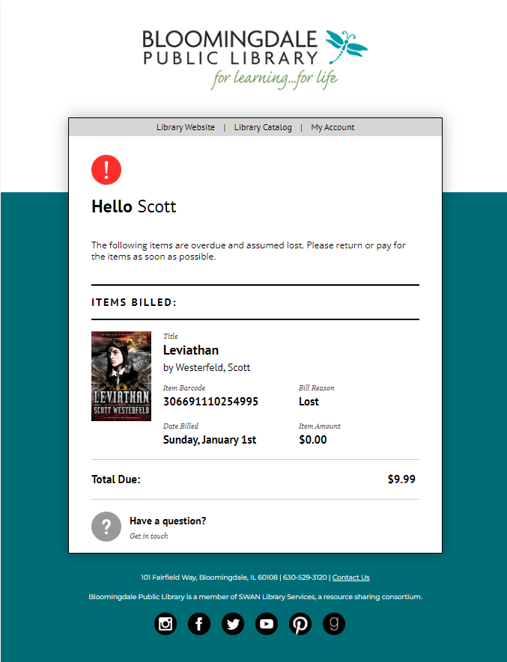
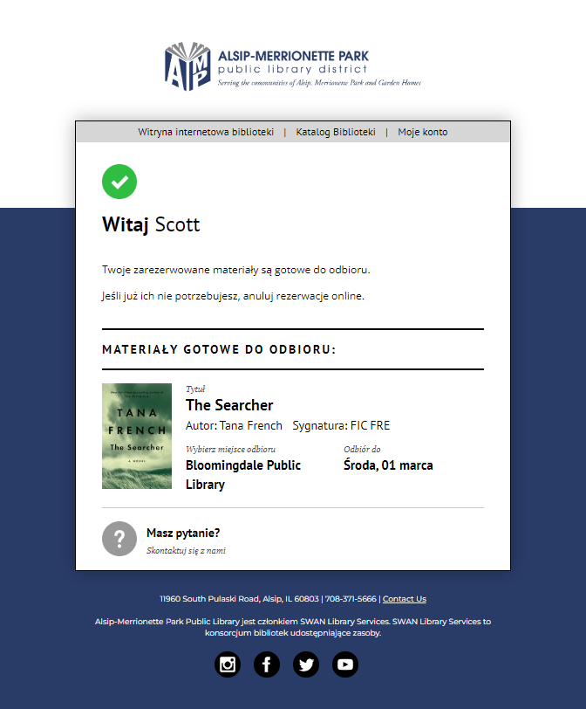

Slide 11
MessageBee Training, Release, Office Hours
Training Recording Available:
MessageBee Rollout and Training
Office Hours
  Wednesdays at 11:00
  June 7th
  June 21st
  July 5th
Email Go-Live Tuesday, June 27th

Slide 12

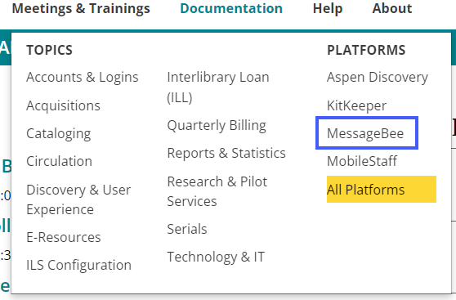
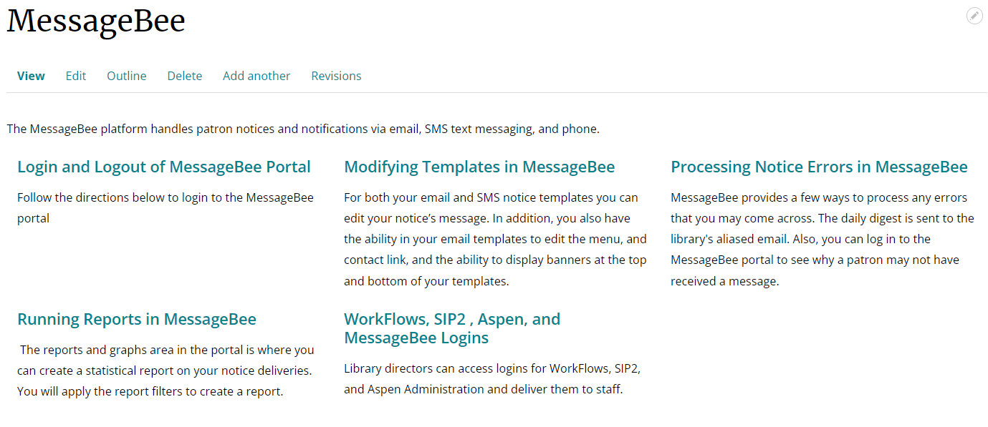
MessageBee Documentation
MessageBee documentation is now live and available!

Slide 13
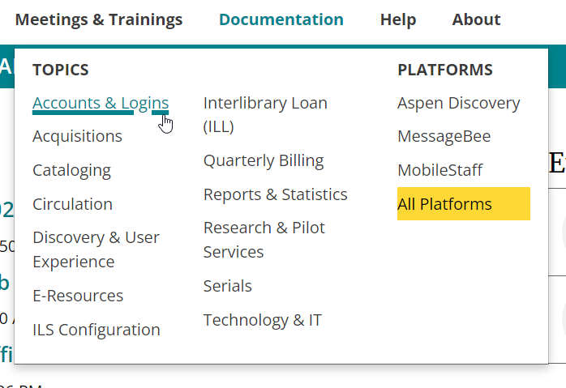
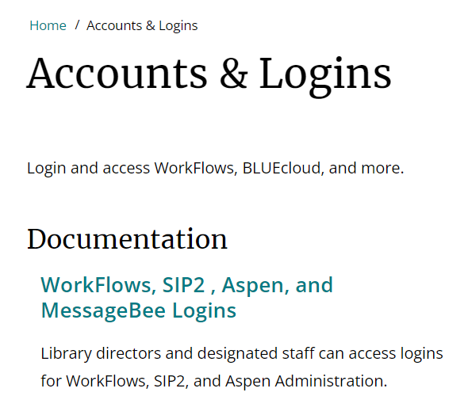
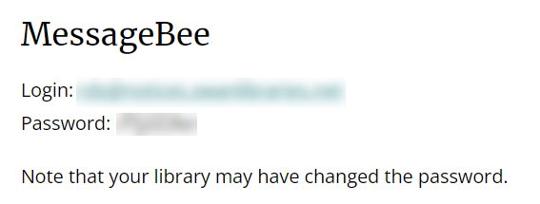
Dashboard Access
Documentation > Accounts & Logins

Slide 14
Cost savings of SWAN membership or
Suggestions on what to include the Decennial Act Report
Aaron Skog, SWAN Executive Director

Slide 15
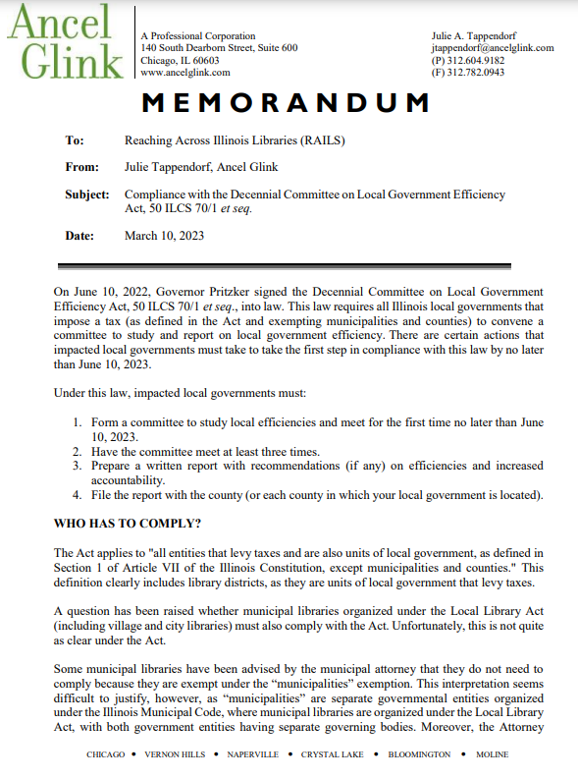
Decennial Act
RAILS requested Ancel Glink to provide guidance and sample report

Slide 16
Decennial Act
Acorn Public Library District | LaGrange Park Public Library District
Alsip-Merrionette Park Public Library District | Matteson Area Public Library District
Batavia Public Library District | Maywood Public Library District
Bedford Park Public Library District | McCook Public Library District
Beecher Community Library District | Nancy L. McConathy Public Library District
Bensenville Community Public Library District | North Riverside Public Library District
Broadview Public Library District | Northlake Public Library District
Crestwood Public Library District | Prairie Trails Public Library District
Crete Public Library District | Richton Park Public Library District
Dolton Public Library District | River Grove Public Library District
Eisenhower Public Library District | Riverdale Public Library District
Frankfort Public Library District | Roselle Public Library District
Franklin Park Public Library District | Saint Charles Public Library District
Geneva Public Library District | Steger-South Chicago Heights Public Library District
Glenside Public Library District | Stickney-Forest View Public Library District
Glenwood-Lynwood Public Library District | Sugar Grove Public Library District
Grande Prairie Public Library District | Summit Public Library District
Green Hills Public Library District | Town and Country Public Library District
Harvey Public Library District | University Park Public Library District
Hodgkins Public Library District | Warrenville Public Library District
Homewood Public Library District | West Chicago Public Library District
Indian Prairie Public Library District | William Leonard Public Library District
Justice Public Library District | Wood Dale Public Library District
Kaneville Public Library District | Worth Public Library District
48 Public Library Districts in SWAN

Slide 17
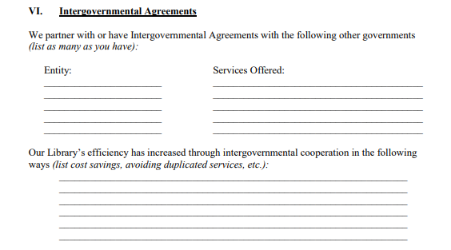
Decennial Act
Sample report
Section 6

Slide 18
Some Definitions
Cost savings versus Cost avoidance
Because much of what consortia do is about generating financial savings and efficiencies for member libraries, it is helpful to understand the difference between the terms cost savings and cost avoidance.
Cost savings are derived by reducing what a library is already paying for something.
Cost avoidance refers to activities that help libraries avoid unnecessary spending in the future. This can be difficult to measure because it is generally hypothetical.

Slide 19
Direct cost savings analysis
Library Expenses: these would be included in SWAN annual membership fee
Library Vendor Annual Maintenance (Innovative Polaris, Sierra, SirsiDynix, etc.)
Hosting/SaaS of Library Services Platform
Enhanced Content Subscription (Content Café, Syndetic, etc.)
OCLC annual subscription
Authority Service Updates (MARCIVE, vendor, etc.)
EBSCO Discovery Service
EBSCO Novelist Select
Proxy Service (OCLC Ezproxy, OpenAthens, etc.)
Mobile app (Capira, Boopsie, library vendor provided, etc.)
Server Licensing (on-premise server support maintenance, warranty, etc.)
Notice printing cost (postage, Unique Management MessageBee, local supplies, etc.)
Patron notification via Text (Shoutbomb, etc.)
Patron notification via Automated Telephony (local on-premise, Unique Management service, etc.)
Library staff supporting ILS (salary, benefits, etc.)
Cost spent attending vendor user event (Innovative Users Group, COSUGI, etc.)
Other
Library Expenses Total
Library districts as standalone
Roselle
Glenside
Warrenville

Slide 20
Direct cost savings analysis
Public library savings
$54,254 annually

Slide 21
Library resource sharing consortia cost-avoidance
Collection Cost
Reciprocal Borrowing
The SWAN consortium of libraries through its collective effort has succeeded in building an online collection of 8 million items.
The combined cost of the 100 library’s collection is $168.5 million
Calculated one fiscal-year of your library’s patrons activity at your library and at member libraries
Access to neighboring libraries
Ease of use, shared user database within SWAN

Slide 22
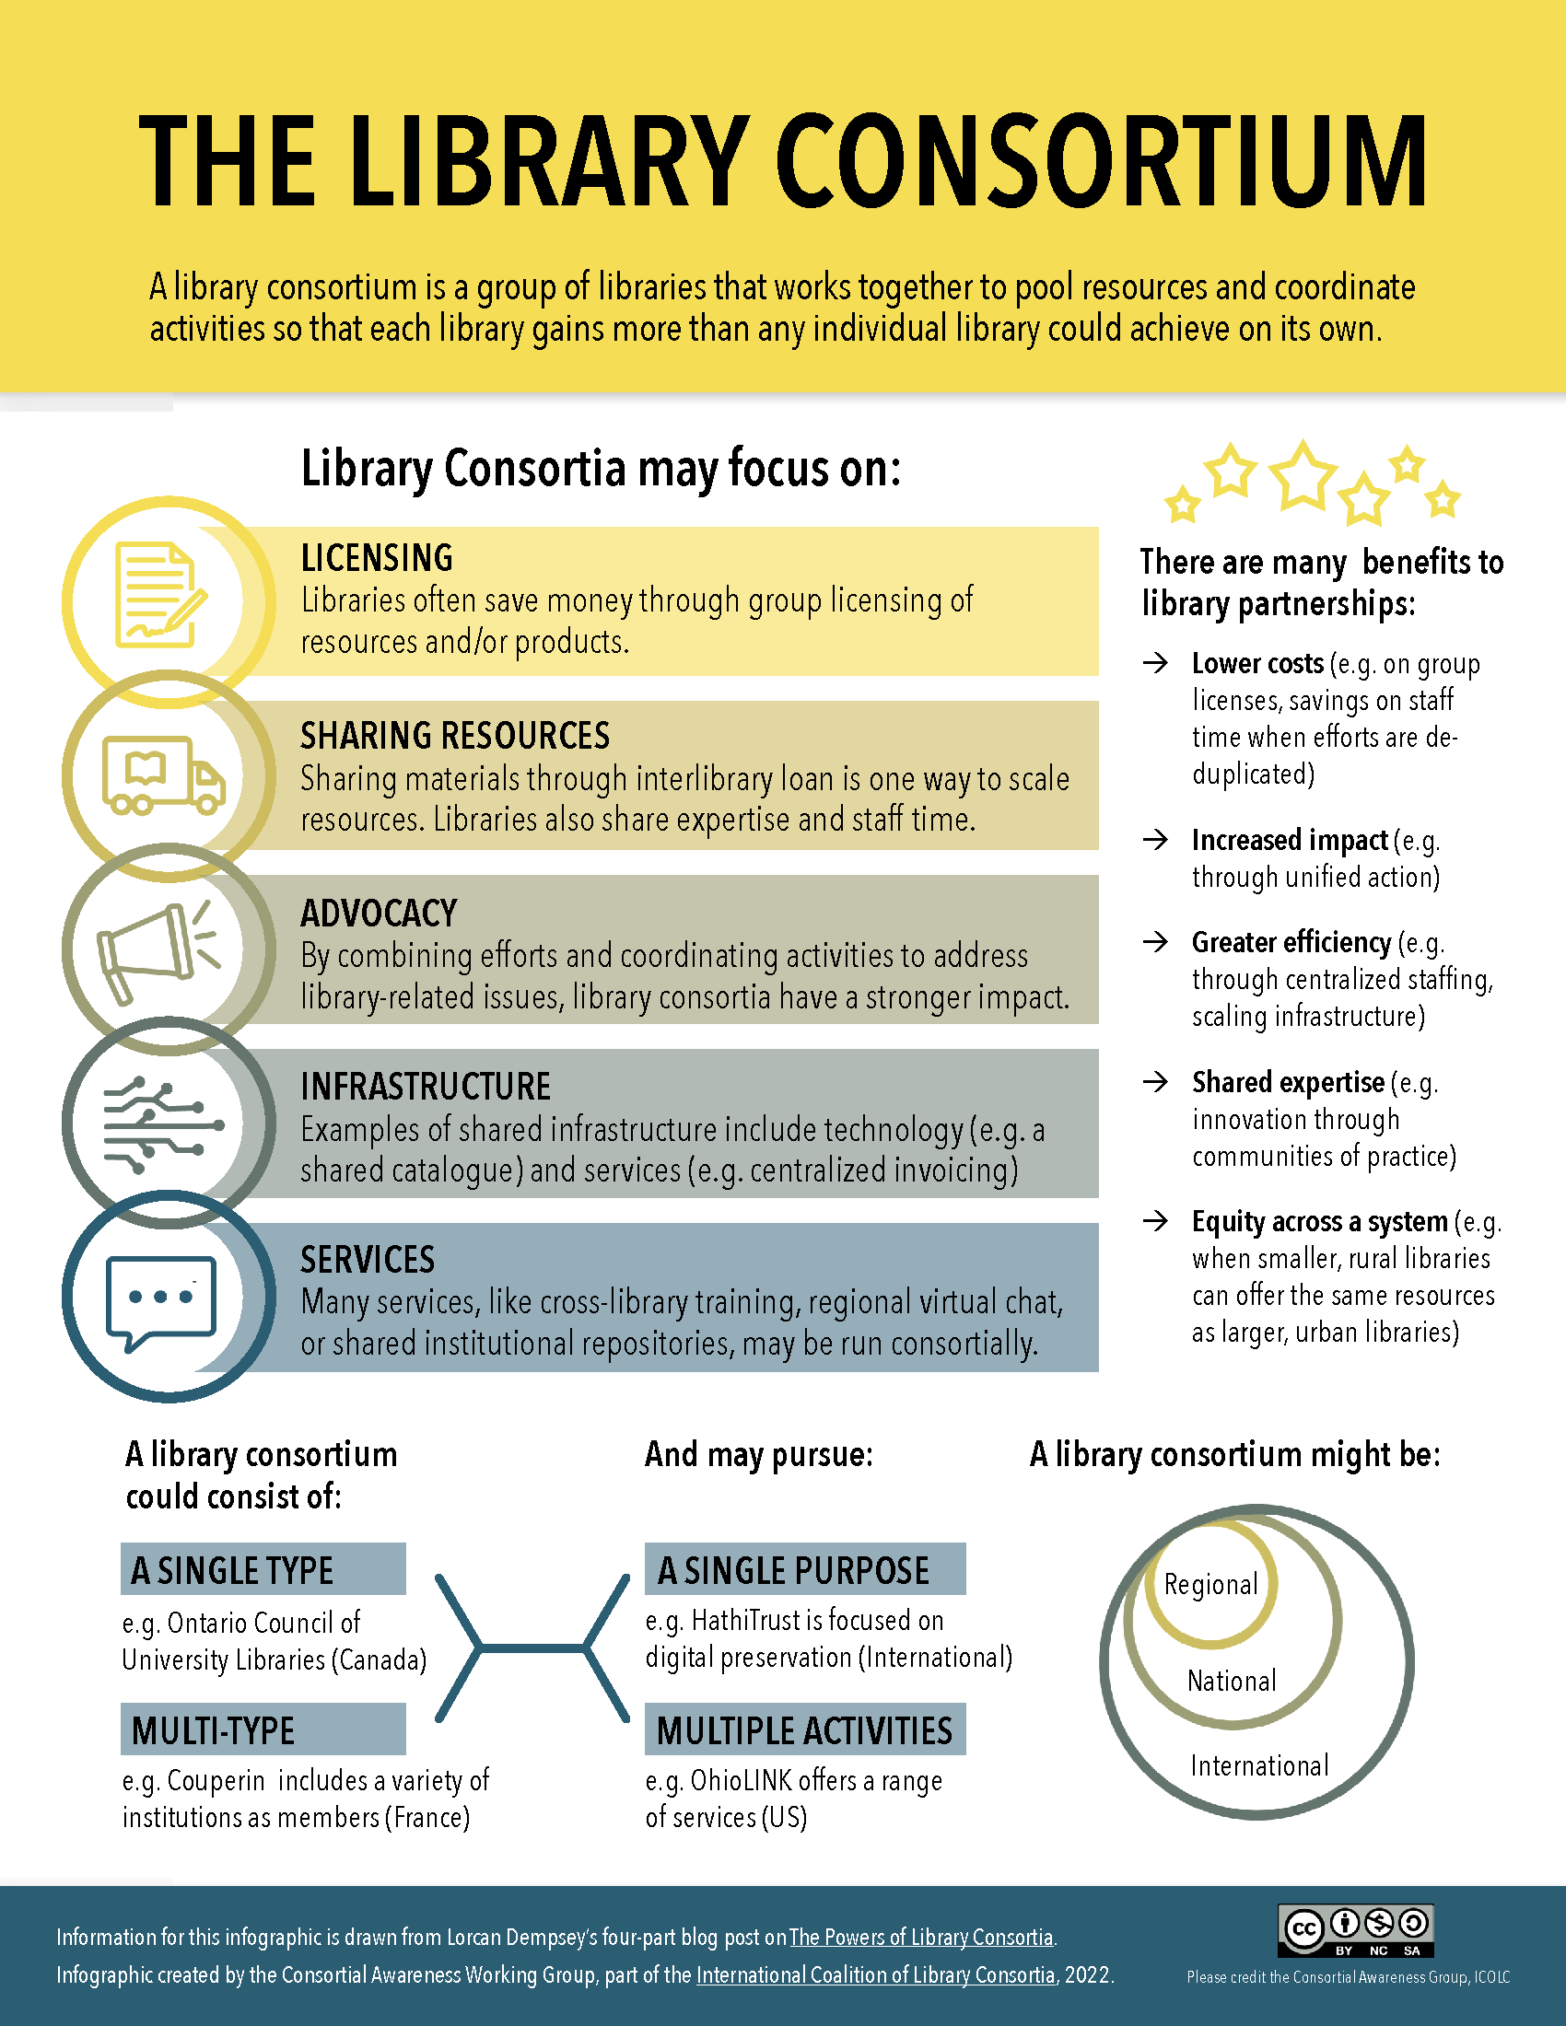
International Coalition of Library Consortia
ROI template
Examples provided for library consortia benefits

Slide 23
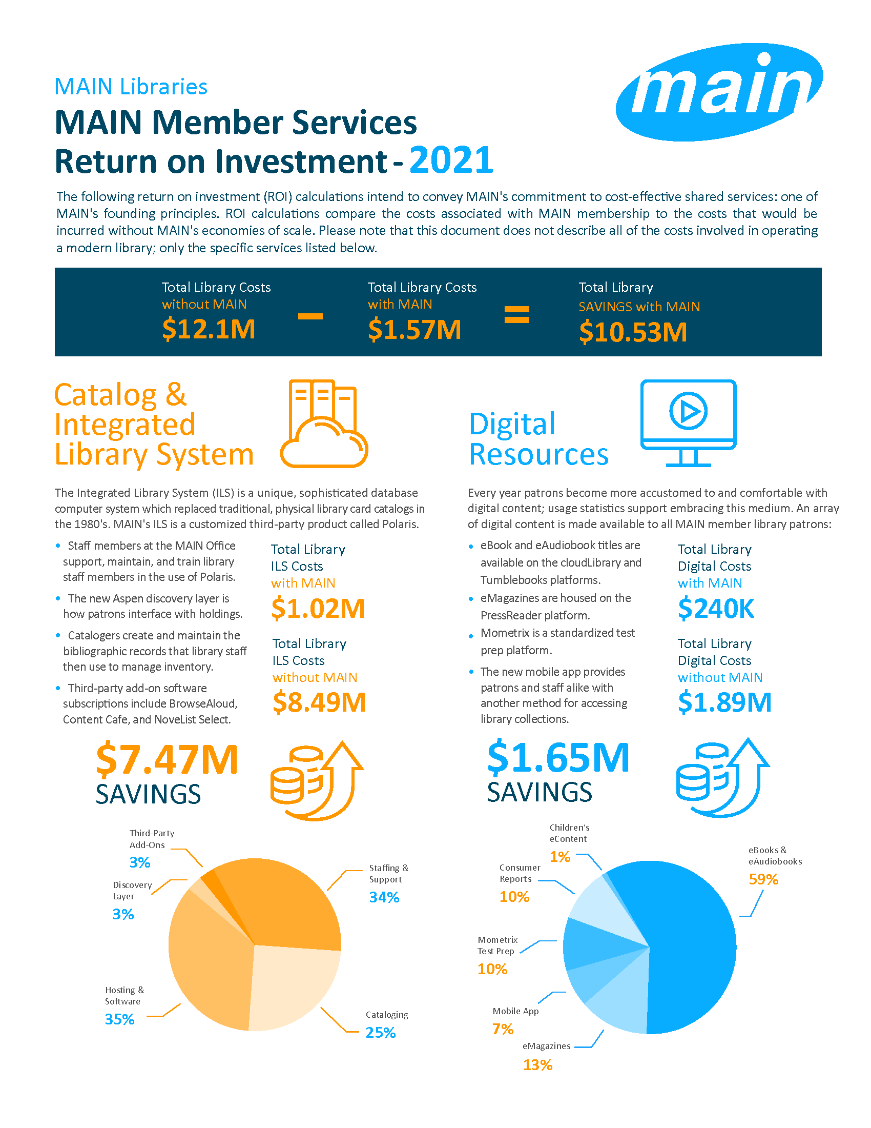
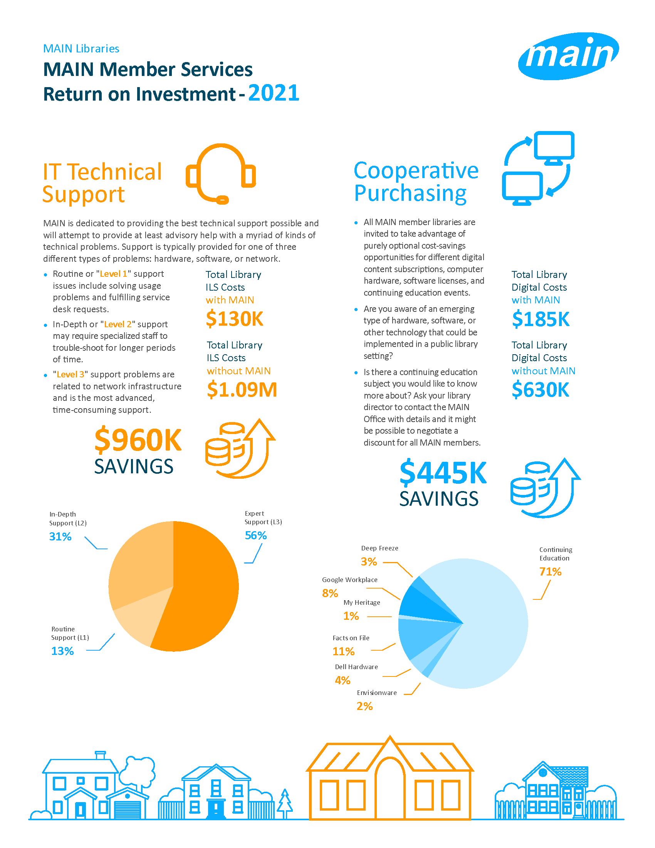

Slide 24
Feedback & Discussion
Would a benefits of consortia membership be worthwhile providing annually?
Who is the audience for a 1-2 page document?
Would a SWAN provided “benefits” document be for public library stakeholders, e.g., trustees?
Do technology services based on comparative cost savings resonate?
Are the benefits of resource sharing via combined collection cost and access via reciprocal borrowing helpful to see on an individual library basis?

Slide 25
SWAN Expo 2023
Aaron Skog, Executive Director

Slide 26
SWAN Expo
When: Friday, August 18th, 2023
Where: Moraine Valley Community College Business & Conference Center (Palos Hills)
Cost: $35/attendee
Session Previews & Registration:
SWAN Expo 2023

Slide 27
Expo Sessions
Aspen for Power Users (Grouped Works & Metadata)
Dealing with the Unexpected: Book Banning, Protests, Incivility in Libraries
Getting Started with Digital Archives
Information Security in Libraries
Library Staff Mental Health and Wellbeing
MessageBee in Practice at Libraries
Roundtable: Collection Management / Vendors / etc.
Roundtable: Programming
Roundtable: Hiring, Staffing, Retention
SWAN Support: Pulling Back the Curtain
User Groups: What We Do & What We Did the Past Year
August 18, 2023
Moraine Valley Community College Business & Conference Center (Palos Hills)

Slide 28
Announcements & Questions

