Slide 1
SWAN Quarterly Meeting
September 7, 2023

Slide 2
Agenda
Call to Order and Welcome
Public Comment
Approval of June 1, 2023 minutes
Strategic planning process
Overview of SirsiDynix agreement with SWAN
MessageBee future development
EBSCO group-purchase year-3 usage metrics
Announcements & Questions

Slide 3
Strategic Planning: Overview of prior processes
Aaron Skog, Executive Director

Slide 4
Overview of strategic planning processes
Plan 2013 - 2015
Plan 2019 - 2023
RFP issued
Selected consultant
“Technology of Practice”
2 Focus groups
Board & SWAN staff 2-day summit
Presentation at Quarterly
RFP issued
Selected consultant
Consulting Within Reach
Discovery phase
Mission, Identity, Vision
Plan presentation to membership

Slide 5

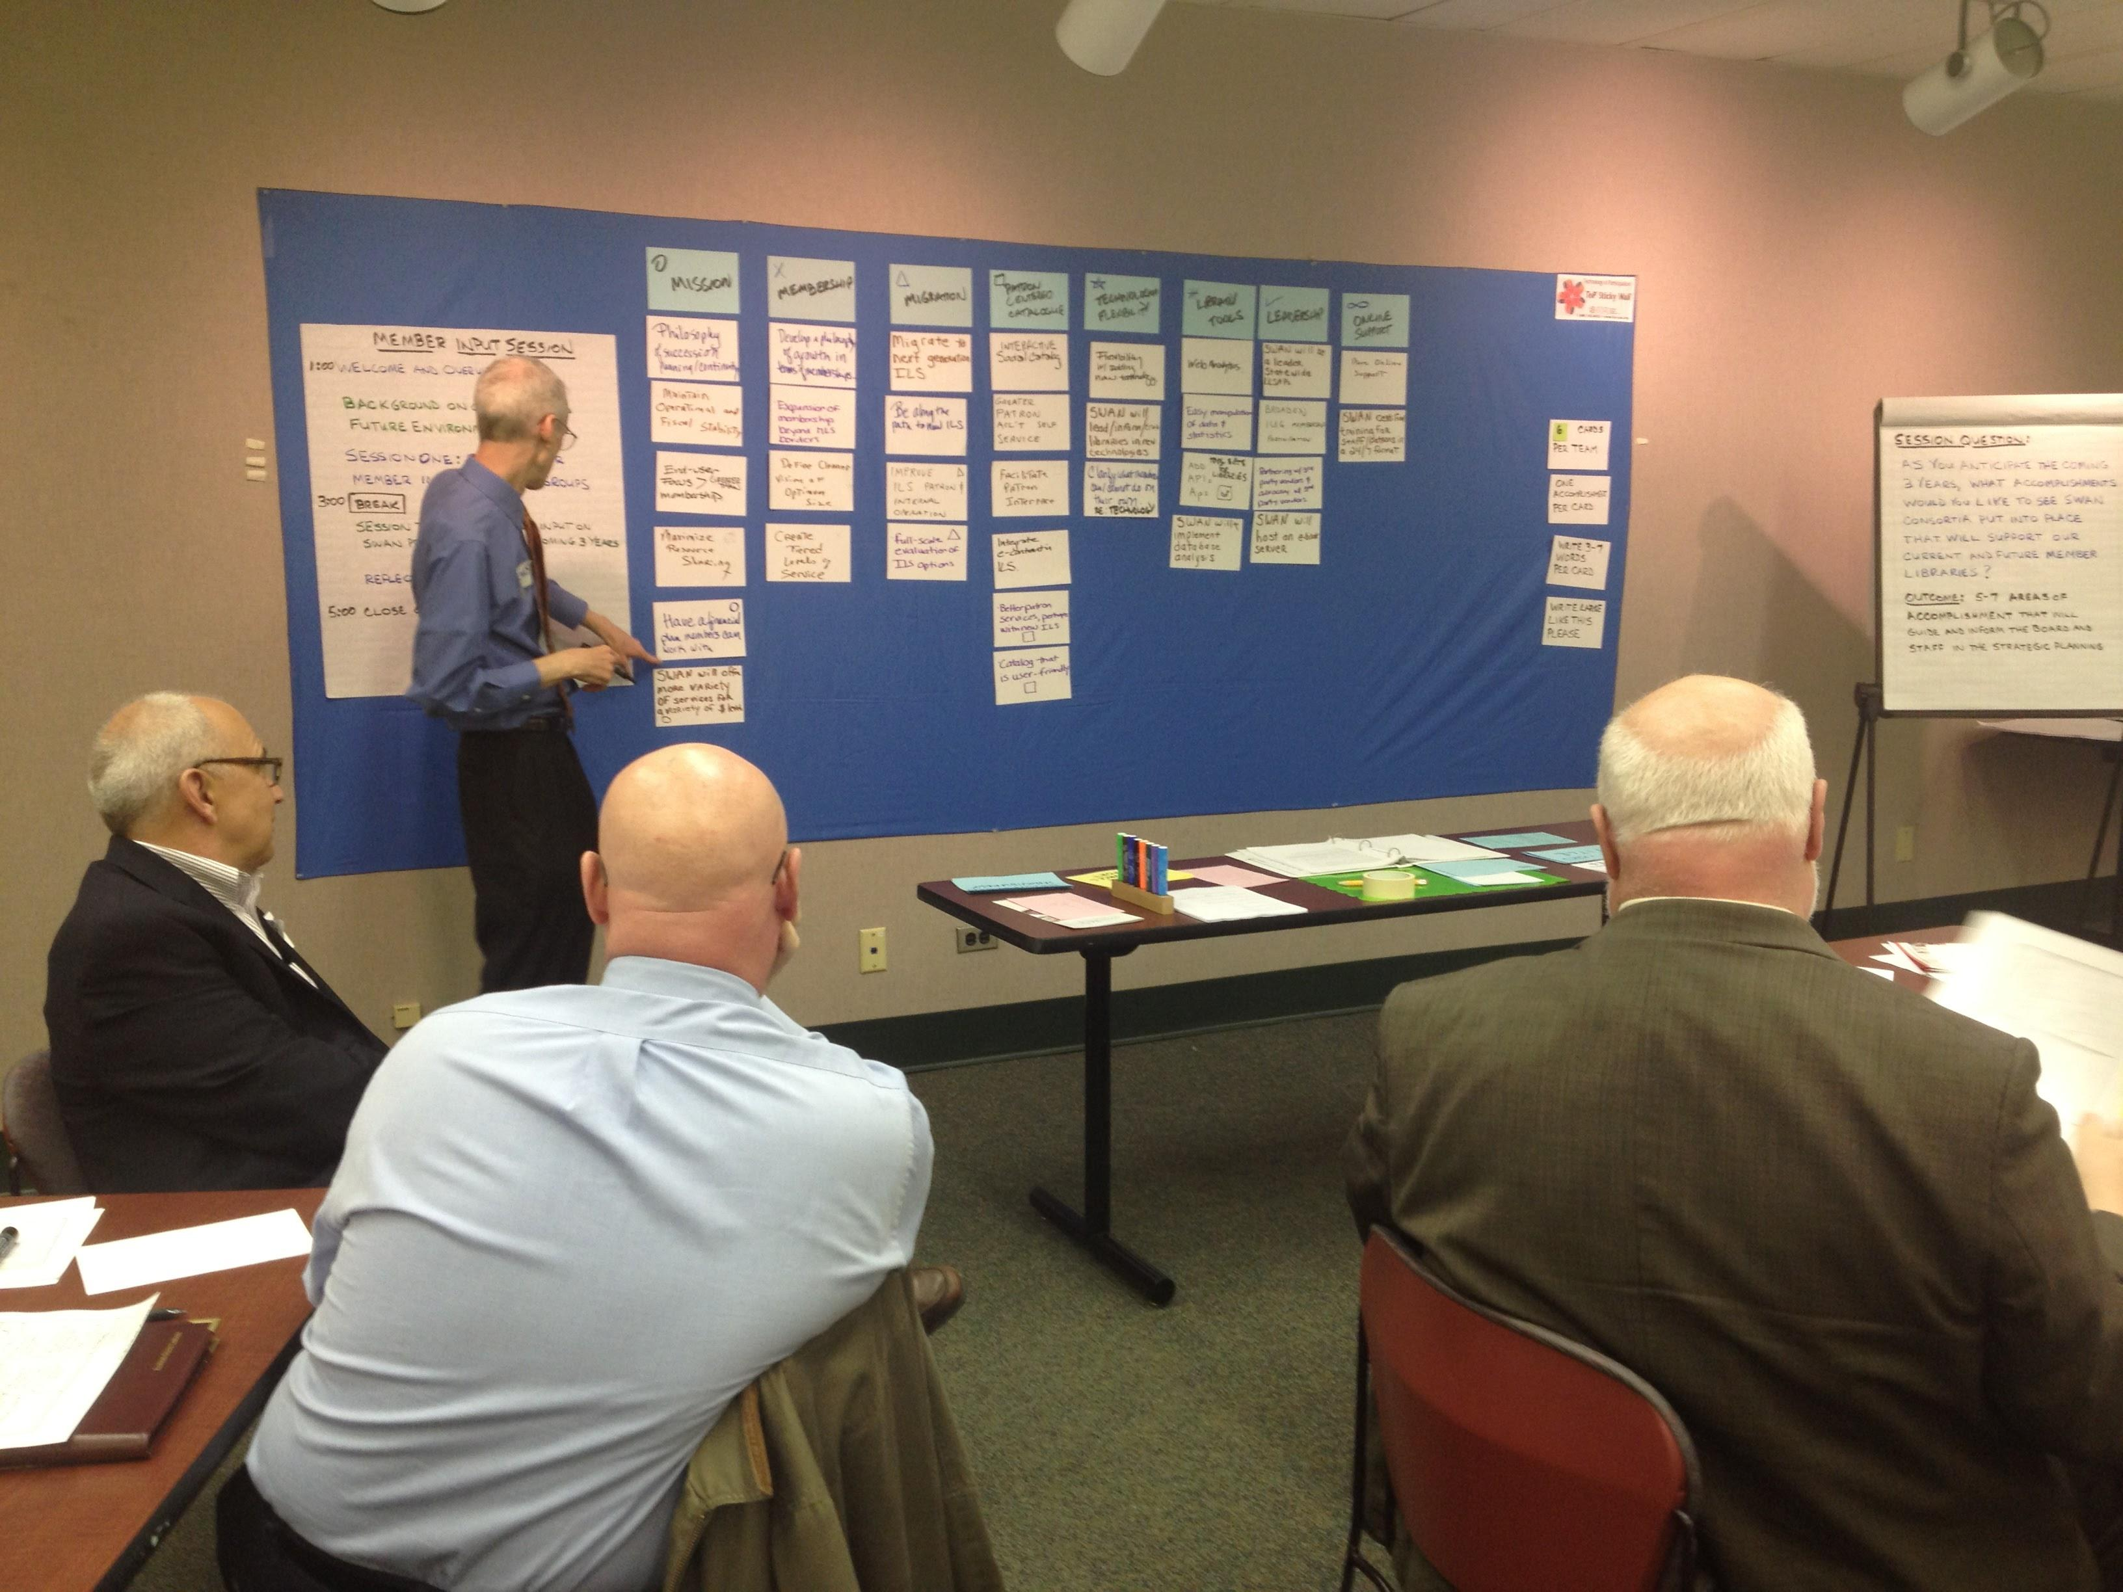
2012 Strategic Planning Process
“Technology of Practice”
2 Focus groups
Focus question:
“As you anticipate the coming 3 years, what accomplishments would you like to see the SWAN Consortium put into place that will support our current and future member libraries?”

Slide 6
Two focus groups, 27 participants
Jim Casey (Oak Lawn)
Tammy Clausen (Berwyn)
Pierre Gregoire (Frankfort)
Karen Keefe (Hinsdale)
Anne Kozak (Thomas Ford)
Doug Losey (Hillside)
Susan McNeil-Marshall (Woodridge)
Andrew Murgas (Matteson)
Cindy Rauch (Homewood)
Shawn Strecker (Elmwood Park)
Stacy Wittmann (Eisenhower)
Rich Wolff (Tinley)
Jeanne Dilger-Hill (LaGrange)
Rick Ashton (Downers)
Dee Brennan (Oak Park)
Jamie Bukovac (Indian Prairie)
Sarah Cottonaro (Stickney-Forest View)
Melissa Gardner (Broadview)
Meg Klinkow Hartmann (South Holland)
Christine Kuhn (Westmont)
Kathy McSwain (Chicago Ridge)
Meg Millen (Flossmoor)
Kathy Parker (Glenwood-Lynwood)
Elaine Savage (Palos Heights)
Kristin Schultz (Bellwood)
Sheila Sosnicki (Palos Park)
Vickie Totton (Cicero)

Slide 7
Group 1: “As you anticipate the coming 3 years, what accomplishments would you like to see the SWAN Consortium put into place that will support our current and future member libraries?”
PROVIDE STATE-OF-THE-ART ILS THAT IS USER-ORIENTED, INTUITIVE AND FLEXIBLE | EXPAND MEMBERSHIP SERVICES AND OPTIONS | EXPAND MEMBERSHIP TRAINING | NIMBLE ORGANIZATIONAL DECISION MAKING | IMPLEMENT INTEGRATED E-STRATEGIES | IMPLEMENT UNIFORM STANDARDS | USE TECHNOLOGY FOR IMPROVED COMMUNICATION | PLAN FOR SWAN’S FUTURE
Migrate to a more modern interface and platform | A la carte member options | More member driven groups – CE modeled after Circ du SWAN | Quick decision making process - proactive rather than reactive | SWAN’s own e-content consortium | Uniform best practices everywhere | SWAN member website overhaul | Developing a plan for technological growth
New ILS platform | Add new members | Member ambassadors | Acknowledgement of binding board decisions – can act more nimbly | Integrated e-content strategy | Implementing best practices: circ rules, reimbursement | Redo member services website to communicate existing services better | Plan for life after RAILS
Improve OPAC | New IT consultant
Plan, direction contract for new ILS | Maintain competitive pricing | Online training for members
Investigate migration to accomplish within 3 years | Centralized services: collection development, cataloging and ILL | Multi-level training | Less cumbersome decision making with stronger board and staff structure | Coordinate group purchases of e-products | Uniformity for patrons | Responsive communication from SWAN staff | Bring back E.T.C (Emerging Technology Committee)
Minimal downtime | Tiered services to enable expanded membership with more resources | Educating members on new trends | Be agile, be nimble, be quick
Add suggestion box to SWAN for patrons
Google-like search with Amazon-like Interface (FRBR that users recognize) |  | Create orientation for directors and department heads | Lead the way

Slide 8
Group 2: “As you anticipate the coming 3 years, what accomplishments would you like to see the SWAN Consortium put into place that will support our current and future member libraries?”
BE A LIBRARY TECHNOLOGY VISIONARY | OFFER INTERACTIVE PATRON-CENTRIC CATALOG | CONTINUE A HEALTHY VIBRANT ORGANIZATION | CREATE A FLEXIBLE MEMBERSHIP MODEL | MIGRATE | FREE OUR DATA | DEVELOP & PROVIDE VIRTUAL SERVICE
SWAN will be a leader of statewide LLSAPs | Interactive social catalog | Philosophy of succession planning/ continuity | Develop a philosophy of growth in terms of membership | Migrate to next generation ILS | Web analytics | SWAN will implement database analysis
Broaden IUG membership participation | Greater patron acc’t self service | Maintain operational & fiscal stability | Expansion of membership beyond MLS borders | Be along the path to new ILS | Easy manipulation of data & statistics | More online support (paperless, virtual mtgs, online training)
Flexibility w/adding new technology | Facilitate patron interface (social media interaction, accommodate physical & virtual formats, interactive community | End-user focus greater than membership | SWAN will offer more variety of services for a variety of & levels | Improve ILS patron & internal operation | Add APIs APs - tool sets for libraries | SWAN certified training for staff & patrons in a 24/7 format
SWAN will host an e-book server | Integrate e-content in ILS | Maximize resource sharing | Create tiered levels of service | Full-scale evaluation of ILS options
Partnering w/3rd party vendors & advocacy w/3rd party vendors | Better patron services, perhaps with new ILS | Have a financial plan members can work with | Define clearer vision of optimum size
SWAN will lead/ inform/train libraries in new technologies | Catalog that is user-friendly
Clarify what member can/cannot do on their own re: technology

Slide 9
“Technology of Practice” Board & Staff retreat
Assessing Our Current and Future Environment
Create Our Practical Vision for the Coming 3 Years
Identify the Underlying Contradictions that Block Our Vision
    Identifying the major barriers that we will need to address in order move toward our Practical Vision. In this session the group will identify the key barriers that stand in the way of their vision so that they can move forward with strategic responses. These barriers provide a doorway of opportunity toward the future.
Develop Our Strategic Directions for the Coming 3 years
Strategic Directions Activity to Further Understand Our Strategic Directions
    Using the SMART Framework: Specific Measurable Action-Oriented Realistic and Time Bound

Slide 10
Assessment of Our Current & Future Environment 2012
About us | Accomplishments | Trends | Advantages
Tumultuous environment for the past 3 years Striving for local control/central control/patron empowerment SWAN service is dealing with various aspects of libraries, providing steady service and keeping up with technology – not being stagnant | Despite personnel loss, there have been an amazing amount of accomplishments under SWAN ED Features staff have worked hard on to deliver to members Print notices were moved into electronic arena Organizational decision-making has come a long way in the past couple of years (Council to Board changeover) Responsive phone service, communication in general/transparency Upgrades are done well and proceed smoothly Herd cats well SWAN offers effective training Minimal downtime | Smooth, moderate growth Electronic resource changes – has become a statewide issue Web-based data analysis tools The cloud Proliferation of mobile devices Next generation ILS | Independence of organization – secure service in light of changes across regional library systems Participation from members and collaboration with RAILS Member input session data showed that the membership supported board decisions being made top down Bridge to best practices among libraries

Slide 11
PRACTICAL VISION: SWAN is a Leader for Illinois Libraries
I We All are Empowered Users | II Before the Curve | III Stewardship that Promotes Sustainability | IV A Patron-centric Culture | V Strong, Smart Growth | VI Build Positive Engagement | VII EZ E-Access | VIII User-friendly, Flexible Intuitive ILS
CE for Everyone New Director Orientation Cross training of SWAN Staff Knowledgeable Staff Enhance Patron Experience | Integrated Notification for Patrons Mobile App OPAC Dynamic, Interactive Website that facilitates communication | Centralized Services e.g. Cataloging, ILL Saving the Small Libraries Seek New Revenue Stream (entrepreneurial) | Proven Best Practices Positive, Uniform Patron Experience Patron-Centered Product | Expand Membership and Connect with other LLSAPs Philosophy of Membership Development Grow SWAN through Flexible Membership | Realistic Goals for Member Participation New Director “Culturalization” Greater Member Participation and Engagement | E-Resource integration provides simplicity and enhanced collection | Migrate to a visionary ILS User-friendly Flexible Intuitive ILS

Slide 12
The Underlying Contradictions: “What is blocking SWAN from moving toward our vision?”
Current ILS Platform Limits Customization & Flexibility & Innovation which Prevents Offering Optional Service to our Patrons. Vendor Business Plans Fragments the Way Libraries Purchase Products & Prevents Seamless Integration within the Catalog and an Easy Patron/Staff Experience
Multiple Conflicting Priorities Make it Difficult to Focus our Resources Effectively and Prevents Forward Progress
Failure to Understand & Buy-in to Interconnectedness Limits Agreement on Best Practices & Hinders Efficiency, Economy & Patron Satisfaction
Structure of Library Governance Funding in Illinois Thru Over-reliance on Local Property Tax & Minimal State Funding Results in Inequitable Allocation of Resources, Underserved Communities & Poor Service to Patrons
Geographical Boundaries & Scalability of ILS and Conflict of Priorities Leads to Inability to Add New Members in Order to Grow which Prevents Sustainability & Capacity to Grow & Adjust
No Organized Promotion & Advocacy Leads to no Public Recognition of SWAN & Public Misconception of Libraries' Collaboration Blocks our Ability to Get Public Appreciation, Support & Funding

Slide 13
Strategic direction & goals 2013 - 2015
Use technology to provide the best patron experience
  Recommend direction for SWAN ILS platform
  Utilize new SWAN R&D staffing position to allow SWAN to investigate new features & services
  Build a robust infrastructure for integrated access to electronic content, resources, and providers
Create a sustainable model
  SWAN will research & analyze the current environment to make recommendations on a new model. We will build a coalition for change across the state.
  SWAN will have completed a cost-benefit analysis of member needs resulting in the development & implementation of centralized consortia services.
Create engagement with SWAN: to make all SWAN members fully engaged participants
  Encourage library director & administrator participation
  Create outreach program
  Enhance patrons use of SWAN & support of SWAN
  Develop library staff expertise in using SWAN to enhance patron experience

Slide 14
2018 Strategic Planning Process
Board Strategic Planning Committee
  Ted Bodewes, Director Thomas Ford Memorial Library
  Jamie Bukovac, Director Indian Prairie Public Library District
  Julie Milavec, Director Downers Grove Public Library
  Aaron Skog, Executive Director SWAN
Issued RFP: April 9, 2018 deadline
Evaluated 12 Proposals: April 20 Committee meeting
Recommendation of Consulting Within Reach (CWR)

Slide 15
Consulting Within Reach
Background Research
Discovery Interviews
Identity, Mission, and Vision Clarification
Assessment
Strategic Plan
Tactical Plan
Process sequence

Slide 16
2018 CWR background research
“Many Faces of Digital Visitor and Residents: Facets of Online Engagement” OCLC report 2017
Lorcan Dempsey blog article series on “Power of Consortia”
Communication in Library Consortia
U.S. Library Consortia: A Snapshot of Priorities & Perspectives
Perceptions 2017: An International Survey of Library Automation
Library Systems Report 2017: Competing visions for technology, openness, and workflow
Library Systems Report: Operationalizing innovation
Chicago Tribune articles
Consultant was provided
  Bylaws
  Membership
  Budget
  Fee formula committee recommendation
  Financial stability plan 2018
  History of SWAN
  Strategic plan
  ILS Committee report & recommendation
  White paper on “New 19” joining SWAN
  SWAN executive director reports April 2017, May 2017, June 2017, April 2018

Slide 17
CWR discovery interviews phase
12 library directors interviewed
  Includes 7 SWAN board representatives
6 SWAN staff interviewed
8 external interviews
  RAILS
  ALA Center for Future of Libraries
  Dominican University Library School
  EBSCO
  SirsiDynix
  OCLC
  Old Colony Network
  NOBLE
2 town hall meetings: Oak Brook Public Library & Tinley Park Public Library
  15 attended Oak Brook
1 SWAN staff meeting
Membership survey

Slide 18
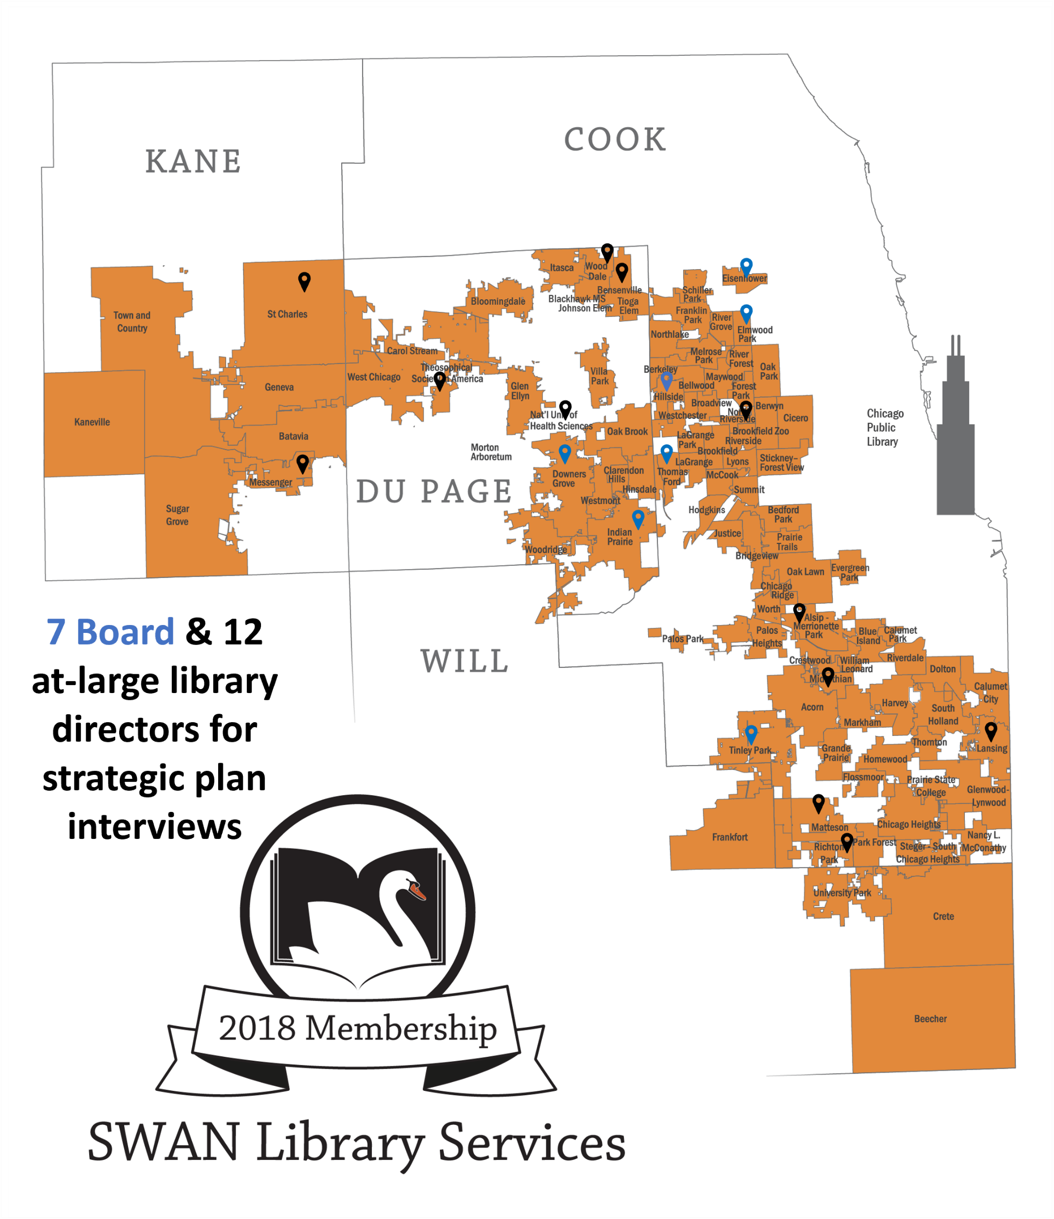
Interviews: representation & region
Counts |  | Library Type
10 |  | Public
1 |  | Academic
1 |  | Special
Counts |  | SWAN Region
5 |  | North (Cook, above I55)
6 |  | South (Cook, below I55)
8 |  | West (DuPage)
19

Slide 19
Membership interviews
Library Director | Board | Hillside Public Library
Library Director | Board (President) | Thomas Ford Memorial Library
Library Director | Board (Secretary) | Elmwood Park Public Library
Library Director | Board (VP) | Eisenhower Public Library District
Library Director | Board (Treasurer) | Indian Prairie Public Library District
Library Director | Board (Strat Plan Comm) | Downers Grove Public Library
Library Director | Internal Interview | Tinley Park Public Library
Library Director | Internal Interview | Bensenville Community Public Library District
Library Director | Internal Interview | Theosophical Society in America
Library Director | Internal Interview | National University of Health Sciences
Library Director | Internal Interview | North Riverside Public Library District
Library Director | Internal Interview | Richton Park Public Library District
Library Director | Internal Interview | Midlothian Public Library
Library Director | Internal Interview | Messenger Public Library of North Aurora
Library Director | Internal Interview | Wood Dale Public Library District
Library Director | Internal Interview | Lansing Public Library
Library Director | Internal Interview | Matteson Area Public Library District
Library Director | Internal Interview | Saint Charles Public Library District

Slide 20
External interviews
Dee Brennan | RAILS Executive Director | Reaching Across Illinois Library System (RAILS)
Berit Nelson | SirsiDynix Chief Product Officer | SirsiDynix
Miguel Figueroa | Director of the ALA Center for the Future of Libraries | American Library Association (ALA)
Karen Brown | Professor, School of Information Studies | Dominican University Library School
David Slater | Executive Director Old Colony Network | Old Colony Library Network (OCLN)
Neil Block | Vice President, Global Open Source Innovation | EBSCO
Andrew Pace & Katie Birch | Executive Director for Technical Research (Andrew), Executive Director, Resource Sharing (Katie) | OCLC
Elizabeth Thomsen | Member Services Manager | North of Boston Library Exchange (NOBLE)

Slide 21
2018 Strategic Planning Activity
Two Membership Meetings Held in August 2018
Interviews with SWAN staff & SWAN board in August 2018
Individual library director interviews August 2018
Interviews as part of the environmental scan
CWR Membership Survey

Slide 22
Consulting Within Reach (CWR) plan overview
Strategic plan is intended as a guide for the SWAN Board and Executive Director over the five years between 2019 – 2023. The tactical plan will be updated each year.
Identity: Defines how decisions are made
Mission: Defines the problem in society the organization is trying to solve
Vision: What is the organization’s solution?
Purposes of this Strategic Plan
Sets high level strategic objectives (where you are trying to go)
Articulates the underlying rationale (why you are trying to go there)
Establishes agreed upon markers (how you will know you are making progress)
Provides guiding principles for execution (what is the right path)

Slide 23
CWR assessment phase: four clarification issues
Identity: How do you make decisions?
  Direct Democracy vs. Representative Democracy
  Member-centric vs. Mission-centric
Mission: What is the problem you are trying to solve?
  3. “Public Utility” problem vs. “Climate Change” problem
Vision: What does your solution look like?
  4. Software as End Product vs. Software as Transformative Platform
CWR presentation to SWAN Board: assessment (89 slides)

Slide 24
Identity, Mission, Vision
Identity
SWAN provides resources and services to member libraries and the constituencies they serve and is governed as a representative democracy of elected Board members who represent the entire membership. Decision making is driven on the patron experience, patron rights, and security.
Mission Statement
SWAN seeks to improve patron ease of access to information, resources, and services through serving our member libraries. SWAN is dedicated to supporting our community of member libraries by sharing resources, technology, and encouraging individual and collective growth.
Vision Statement
SWAN sets the standard of excellence for member and patron experience. We are the catalyst in creating and nurturing an ecosystem of ingenuity and collaboration. We engage in open dialogue with our membership and use purposeful communication in our community. We utilize careful planning of our key resources and are ready to seize opportunities as they arise.

Slide 25
2018 Strategic Planning Activity
Sep. 2018
Presentation of Identify, Mission, Vision & Assessment by Consulting Within Reach to SWAN Board
Oct. 2018
Survey results reviewed SWAN Board meeting October 2018
Dec. 2018
Presentation of draft to membership December 2018 Quarterly meeting
Jan. 2019
Plan adopted by SWAN Board January 2019

Slide 26
6 Objectives of Plan 2019 - 2023
Develop a Shared and Accurate Diagnosis of Member Dissatisfaction Around the Existing ILS and OPAC (Staff Interface and Online Catalog)
Deliver on the Solutions that Can Be Readily Implemented, While Focusing on Long Term Solutions
Reconstitute as a Mission Driven 501c3 with Clear Representative Governance Practices
Increase Presence of the Patron Perspective
Strengthen the Collective Identity
Seek External Funding Options to Support the Research & Development Initiatives of SWAN
Each of the objectives has
Rationale
Markers
Guiding principles

Slide 27
Objective 1: Develop a Shared and Accurate Diagnosis of Member Dissatisfaction Around the Existing ILS and OPAC (Staff Interface and Online Catalog)
Report divided into two parts:
  Part 1 is the "Issues Identified, Responsibility, Corrective Action, and Strategic Direction“
  Part 2 is an overview of the research activities of the Task Force which gathered information directly from library staff using SWAN's software, e.g. Enterprise, WorkFlows, Analytics, etc.
The report identifies 5 important issues, and in its conclusion makes some "big picture" recommendations for SWAN and its libraries to focus on over the next few years.
Holds
New OPAC & desired features
Acquisitions processing & BLUEcloud Acquisitions
Reports & statistical analysis
Support, Communications, documentation, & training
Formed Clarity Task Force April 2019
  Kerry Halter, Technical Services Manager, Batavia Public Library District
  Kristina Howard, Adult Services Manager, Tinley Park Public Library
  Michelle Kurczak, Head of Youth and Teen Services, Messenger Public Library of North Aurora
  Amy Prechel, Head of Access Services, Downers Grove Public Library
  Angela Romano, Fiction and Reference Librarian, Oak Lawn Public Library
  Ahren Sievers, Technology Librarian, Elmwood Park Public Library
  Colleen White, Cataloging Librarian, Oak Park Public Library
Report issued November 2019
Membership presentation December 5, 2019
SWAN Shared Diagnosis: Clarity Task Force report

Slide 28
Strategic planning process
Questions & discussion about next planning process

Slide 29
SirsiDynix & SWAN agreement

Slide 30

SWAN Membership includes
Library Services Platform
SWAN Provided Services
Aspen Discovery
BLUEcloud Analytics
BLUEcloud Commerce
BLUEcloud Mobile
BLUEcloud Staff
EBSCO Discovery Service
eResource Central
MobileStaff
EBSCO Novelist Select
Eduserv OpenAthens
OCLC WorldCat Discovery, ILL
Symphony ILS
Symphony Web Services
Symphony WorkFlows
Unique Management MessageBee
Virtual Private Network
Centralized notification
Centralized billing
Centralized cataloging
Centralized e-commerce
Centralized OCLC configurations
Training & support

Slide 31
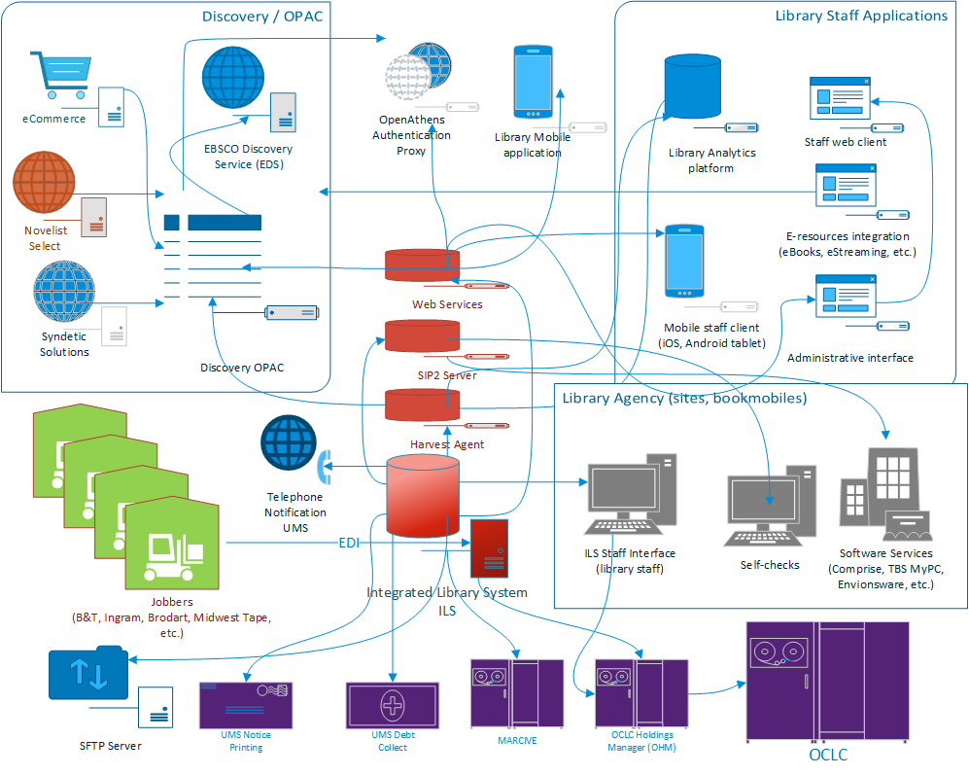

Slide 32
2012: Board appoints ILS Committee
#1 goal of strategic plan 2013 – 2015: Recommend direction for SWAN ILS platform
Phase 1: Request for Info
Phase 2: Official RFP
ILS Committee
  Formed November 2012
  Board rep co-chair with SWAN Executive Director
  4 library staff (circulation manager, technology librarian, assistant director), 1 library director, 3 SWAN staff
Conducted research & issued membership survey
  Sierra, Innovative Interfaces Inc.
  Virtua, VTLS
  Polaris, Polaris
  Alma, ExLibris
  WorldShare, OCLC
  Symphony, SirsiDynix
  Evergreen (open-source), Equinox Software
  Koha (open-source), ByWater Solutions
  Kuali OLE (open-source)
Hired consultant for RFP
Visited vendors ALA Conference 2013 Chicago
Issued RFP July 2013
5 proposals received
  Sierra, Innovative Interfaces Inc.
  Virtua, VTLS
  Polaris, Polaris
  Symphony, SirsiDynix
  Evergreen (open-source), Equinox Software
Scored proposals
Customers interviewed
Software demonstrations for all member libraries
7 Library staff task force formed & attended demos
Final recommendation from ILS Committee after round 2 scoring

Slide 33
5-year contract: 2015 - 2019
Contract negotiations with SWAN’s hired consultant, Board president, Executive Director, & SirsiDynix reps
Agreement set total price
No maintenance increases for 5 years
Added 19 riders/schedules to agreement
Defined add-on costs & migration fees for new libraries

Slide 34
E-content integration with SirsiDynix
BLUEcloud eResource Central
  eBooks appearing in catalog via API
  Discontinued batch loading MARC data
Enterprise profiles per library
Enterprise + EBSCO Discovery search integration & OpenAthens remote authentication
  Keyword search of subscription research databases
  Single authentication against ILS account
2013-2015 Strategic Goal: “Build a robust infrastructure for integrated access to electronic content, resources, and providers”

Slide 35
Agreement extended 5 years: 2020-2024
Year 1 | May 1, 2015 | 0%
Year 2 | May 1, 2016 | 0%
Year 3 | May 1, 2017 | 0%
Year 4 | May 1, 2018 | 0%
Year 5 | May 1, 2019 | 0%
Year 6 | May 1, 2020 | 0%
Year 7 | May 1, 2021 | 0%
Year 8 | May 1, 2022 | 0%
Year 9 | May 1, 2023 | 1.9%
Year 10 | May 1, 2024 | 1.9%
Renewal | May 1, 2025
Escalation 0% years 1 - 8
Set escalation 1.9% years 9 & 10
Set price for SaaS hosting option
Add-on libraries set cost continues
Option to remove
  Enterprise $58K
  SMS notification service $13K
  eResource Central $25K
  BLUEcloud Mobile $72K
Current 2023 total $442K

Slide 36
SWAN & SirsiDynix support structure
Support Center Cases
  253 opened & closed in 2021
  175 opened & closed in 2022
Library Relations Manager: monthly meetings
  Escalate cases, resolve issues
SureSailing: monthly SirsiDynix consulting meeting with SWAN staff
Platinum Premier: consulting hours replenish annually

Slide 37
SWAN & SirsiDynix support structure
Adding libraries via project migration & consulting team
Project manager
SD consultant
Data loader
SWAN migration team
Establish timeline
Data test load
Data review
Final data load
Go-live

Slide 38
SWAN growth: add-on libraries 2016 - 2023
  Lansing Public Library
  Franklin Park Public Library
  Batavia Public Library District
  Oak Brook Public Library
  Bensenville Community Public Library District
  Bensenville Elementary School District #2
  Saint Charles Public Library District
  Bloomingdale Public Library
  Carol Stream Public Library
  Sugar Grove Public Library District
  Geneva Public Library District
  Theosophical Society in America
  Glen Ellyn Public Library
  Town and Country Public Library District
Itasca Community Library
Villa Park Public Library
Kaneville Public Library District
West Chicago Public Library District
Messenger Public Library of North Aurora
Wheaton Academy
National University of Health Sciences
Wood Dale Public Library District
Green Hills Public Library District
Glenside Public Library District
Roselle Public Library District
Warrenville Public Library District
Addison Public Library

Slide 39
SWAN & SirsiDynix feedback structure
Annual Executive Survey (NPS: net promoter score)
Strategic Partner Program (SPP): utilizes project/product feedback via Basecamp
Monthly BLUEcloud sprints
COSUGI: Customers of SirsiDynix User Group, Inc.
  Annual meetings
  Customer Q&A with SirsiDynix leadership
Consortia Special Interest Group
  Annual meetings
  Attended by SirsiDynix CEO & chief officers, managers

Slide 40
BLUEcloud Central & BLUEcloud Staff
BLUEcloud “Central” deployed as 2015 go-live requirement
BLUEcloud “Staff” releases (no additional SWAN cost)
  Monthly & globally
  SWAN BLUEcloud R&D team formed as part of Clarity Task Force
  Circulation Advisory evaluation of BLUEcloud Circulation
  SirsiDynix monthly sprint meeting with SAPLN & SWAN
  Usability tests
BLUEcloud Acquisitions currently used by
  Glenside
  Roselle
  Warrenville

Slide 41
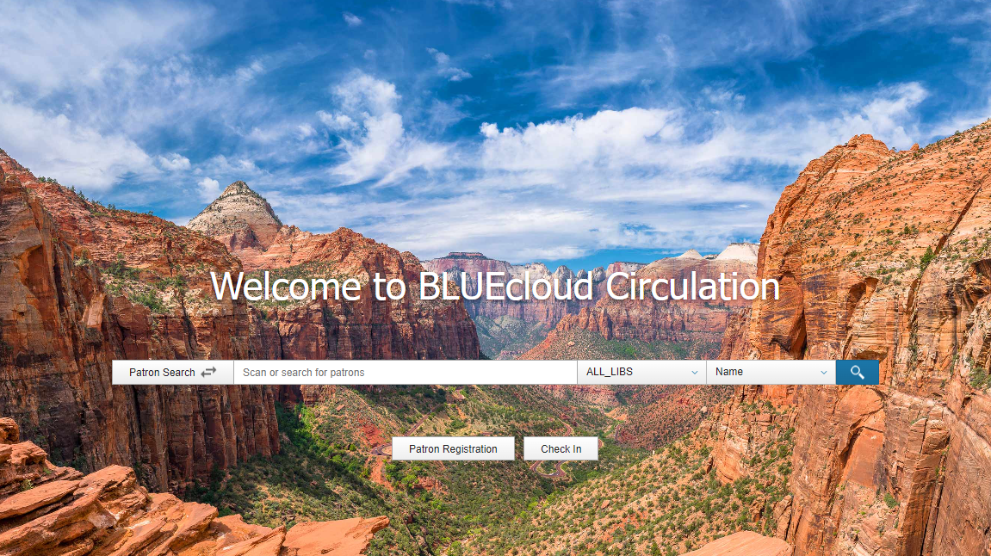

Slide 42
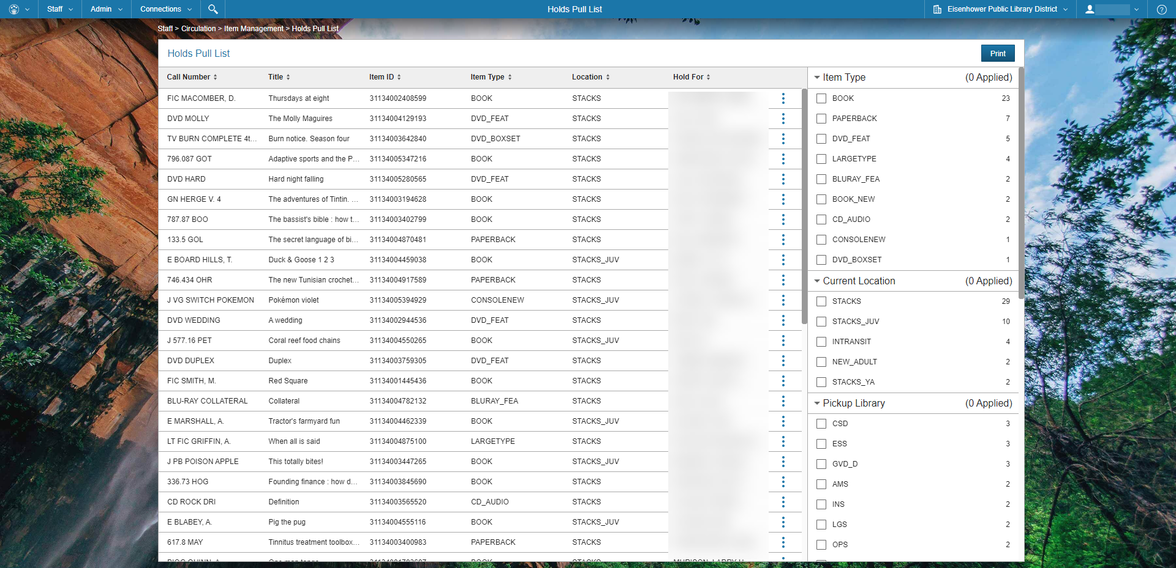

Slide 43
BLUEcloud Circulation evaluation
Alsip-Merrionette Park Public Library District
Batavia Public Library District
Carol Stream Public Library
Eisenhower Public Library District
Elmwood Park Public Library
Glenside Public Library
Homewood Public Library
Matteson Area Public Library District
River Forest Public Library
BLUEcloud Circulation is a web-based tool that covers very basic circulation tasks
SWAN conducted a study with a small team of SWAN members to identify key functionality that needs to be developed in BLUEcloud Circulation
Findings are shared with SirsiDynix through their Strategic Partnership Program (SPP)
2022 Expo panel session “BLUEcloud Circulation: Lessons from the Field”

Slide 44
SirsiDynix Executive Survey: December 2022
Considering your overall experience with SirsiDynix, how well do SirsiDynix products meet the needs of your library? 6/10
What do you like about your experience with SirsiDynix?
The company’s support team, project management, and consulting continue to be standouts. The LRM assigned to SWAN, Nicole Romyak, has been great.
This is the third year of our five-year extension of the agreement with SirsiDynix. The negotiated agreement allows SWAN to remove specific SirsiDynix services if we at some point find that we need to do so. The suite of library software and services SirsiDynix provides has allowed SWAN to provide its libraries with a comprehensive solution for its operations. That said, SWAN has had to move away from some of the solutions SirsiDynix provides in favor of ones that match our complex needs. SWAN has moved away from Enterprise in favor of Aspen Discovery, and we discontinued SVA for phone notifications for MessageBee from Unique Management. We are now in the process of migrating our notifications for email and SMS away from SirsiDynix into MessageBee. This means we will drop from the SirsiDynix maintenance the $13,000 SMS package.

Slide 45
SirsiDynix Executive Survey: December 2022
How could SirsiDynix better meet your needs?
SWAN is working closely with the BLUEcloud SPP to ensure its circulation functions are prioritized. There is an aspect to being involved now with the SirsiDynix developers sprint meetings of “seeing the sausage being made” which is good but also bad, with the bad being software development is not often pretty or smooth. … While understanding the sprint process of product functionality review can be helpful, it highlights lack of progress and some concern over development team confidence in demonstrating their own product.
SWAN has submitted through the SPP enhancements and usability requests which are requirements before we can adopt BLUEcloud Circulation other than as a R&D activity for a select set of our members. Performance is a major barrier in adoption.
SWAN will likely undertake a strategic planning process in 2023, so I would anticipate some discussion about the SirsiDynix agreement and if SWAN should take some step like an environmental scan to see if there should be an RFP in the near future.

Slide 46
Questions & Discussion

Slide 47
MessageBee for SWAN
Scott Brandwein, SWAN Assistant Director

Slide 48
“Phase 2” Development
Account access tiers (Reports only)
Phone notification reports & statistics migration
2-Way SMS Messaging rollout

Slide 49
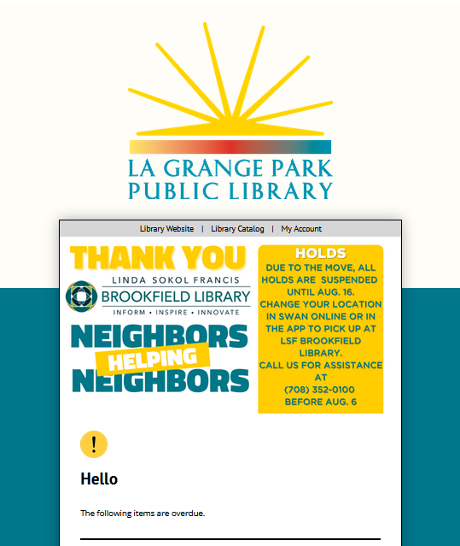
SWAN Expo Showcase
Slides for all Expo sessions available on the SWAN Support Site.
SWAN Expo Presentation Archive

Slide 50
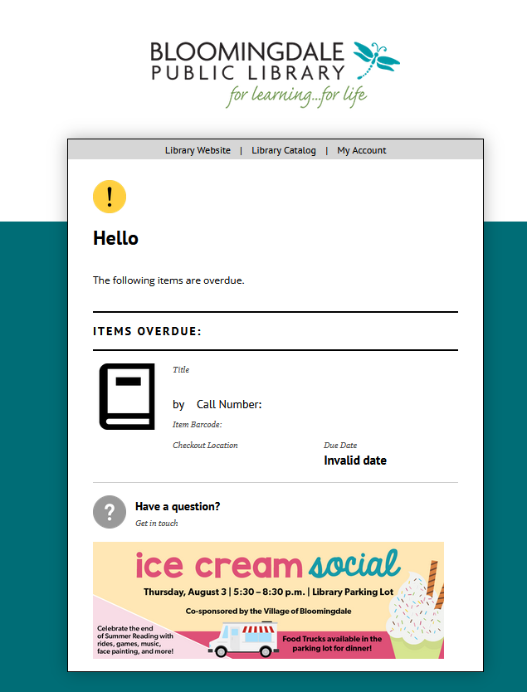
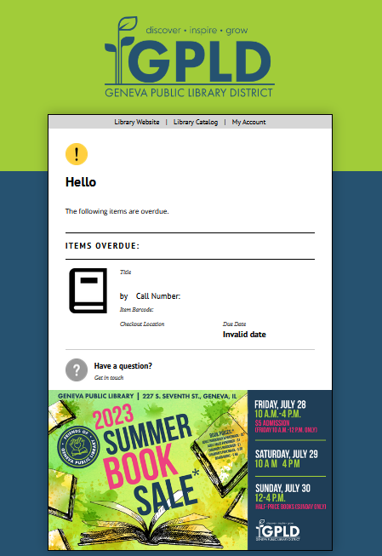

Slide 51
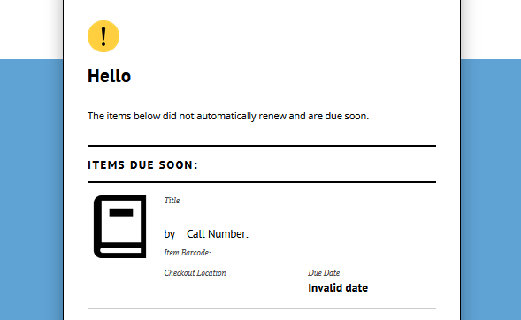

Slide 52
Up Next…
Evaluating List Communications
Audience Lists
Dynamic Lists
Organizing demo and pilot
Autorenewals
Insufficient feedback to move forward
Opportunities for further discussion
DUX (September)
Circulation Users (October)
Circulation Advisory (November)

Slide 53
EBSCO usage statistics
Olivia Montolin, E-Resources Consultant

Slide 54
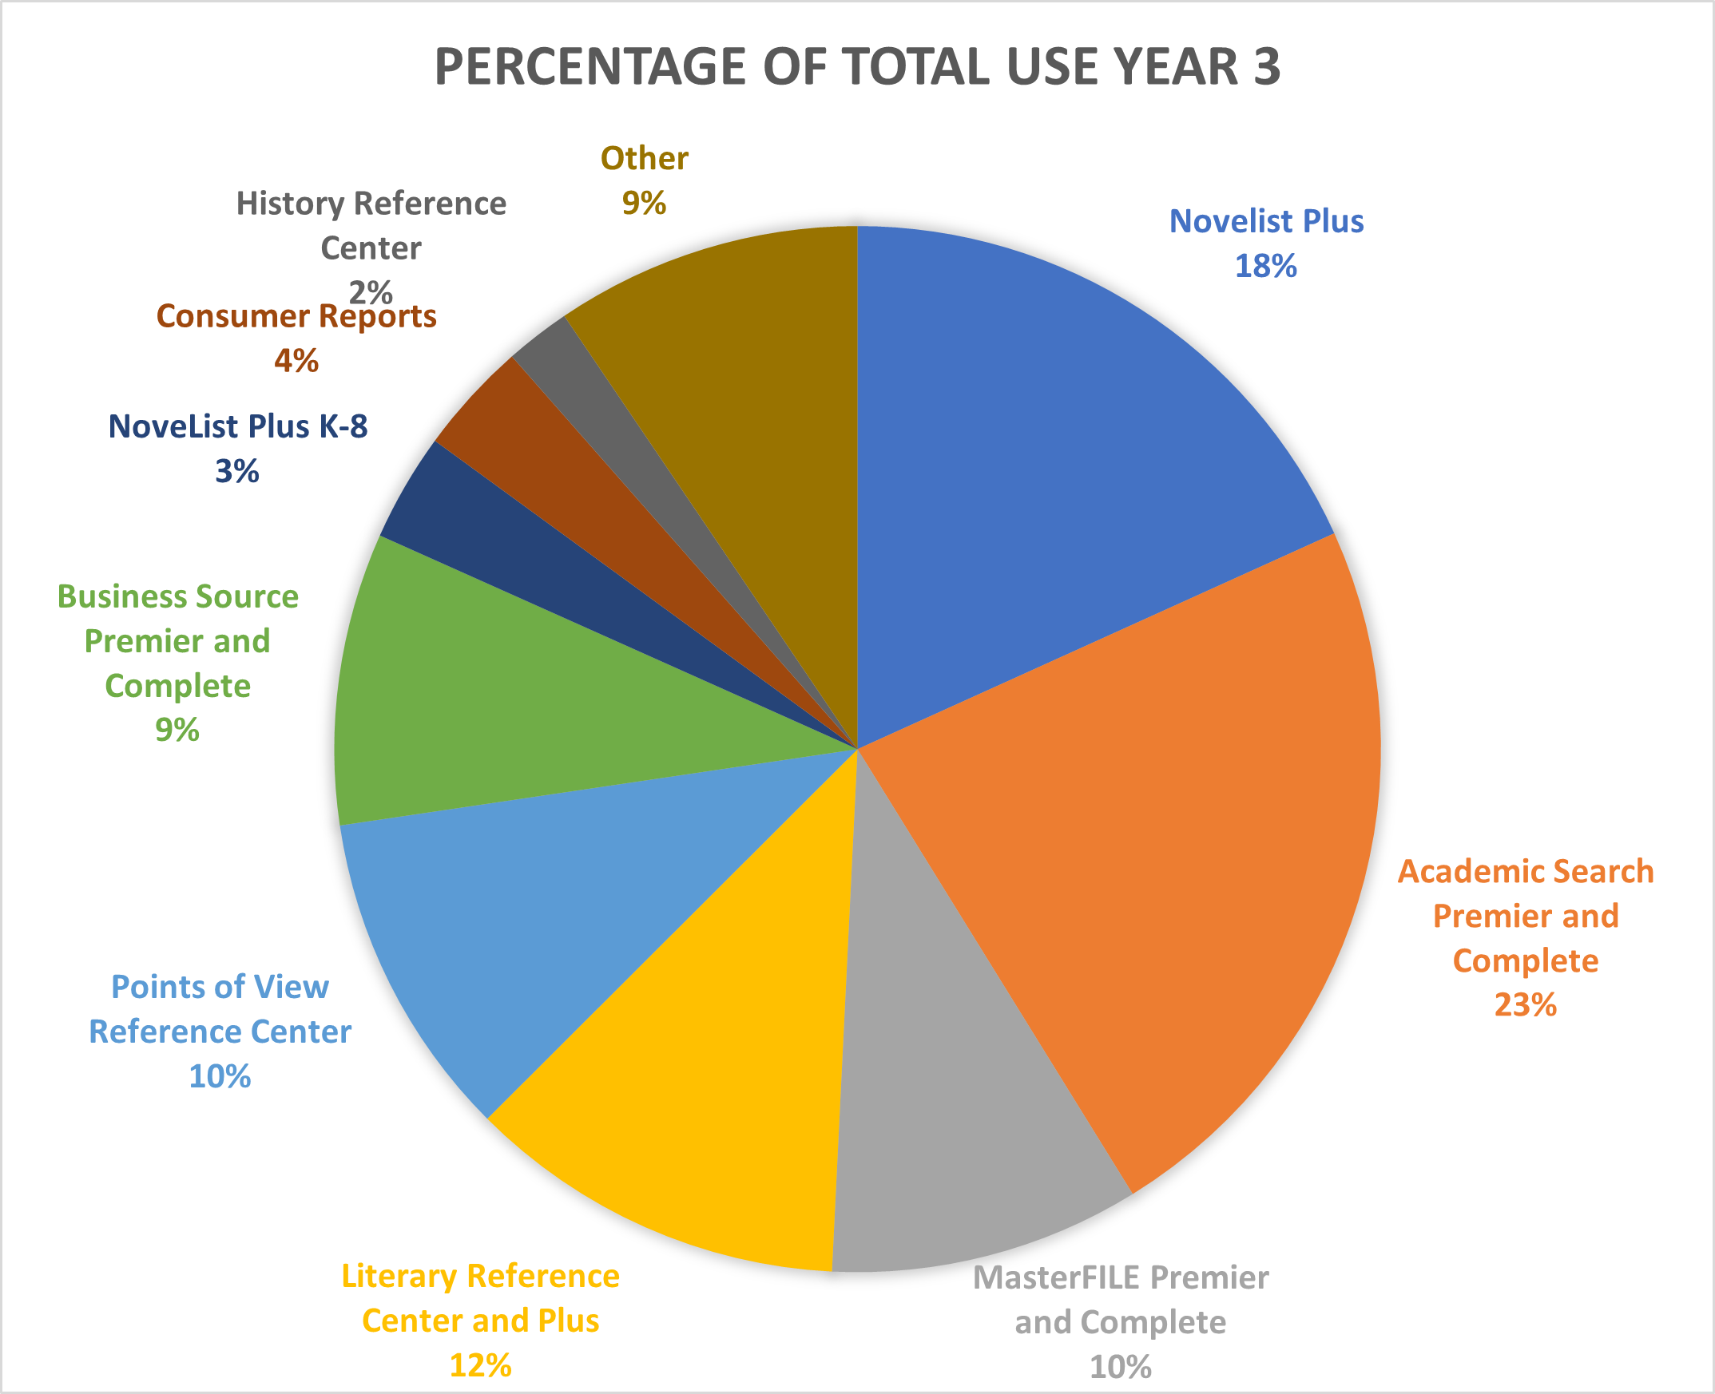
EBSCO Database Usage
Database usage saw a 32% increase in Year 3, with an overall increase of 51% from Year 1
Use of research and niche databases is growing
  Academic Search Premier and Complete 23% overall usage
"Big deal" allows access to more databases for about the cost of Novelist, Consumer Reports

Slide 55
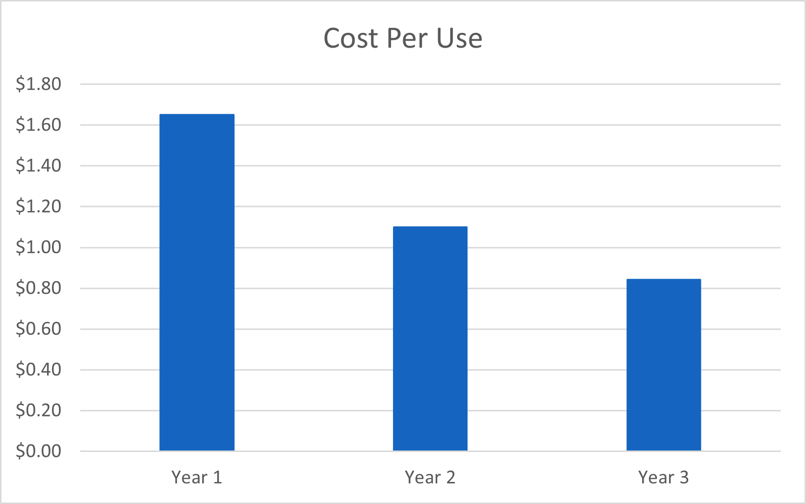
EBSCO Database Cost-Per-Use
Cost per use continues to go down
  Year 1 = $1.65
    95 libraries
  Year 2 = $1.09
    84 libraries
  Year 3 = $0.84
    84 libraries

Slide 56
EBSCO Year 5 Renewal
Conversations with RAILS & EBSCO will start in the coming months
In Year 3, EBSCO proposed opted out libraries requesting to rejoin must do so at the full RAILS package B price.
Anticipate pricing will be available by February 2024

Slide 57
Announcements & Questions
Jennifer Cottrill, SWAN Board President
Library Director Midlothian Public Library

