Slide 1
SWAN Quarterly Meeting
December 7, 2023

Slide 2
Agenda
Call to Order and Welcome
Public Comment
Approval of September 7, 2023 minutes
Future of SWAN mobile app
Overview of SWAN & OCLC services
Reports on projects
Next year’s SWAN budget & timeline
Illinois State Library Advisory Committee (ISLAC) update
Announcements & Questions

Slide 3
Future of SWAN mobile app
Aaron Skog, Executive Director
Tara Wood, User Experience Manager

Slide 4
BLUEcloud Mobile outage timeline
26 Nov.
Solus shut down the backend of BLUEcloud Mobile on Nov. 26
27 Nov.
Announcement of outage
29 Nov.
Announcement that SirsiDynix and Solus, the vendor that provided BLUEcloud Mobile support, were unable to come to an agreement.
1 Dec.
SWAN requested for the SWAN instance of BLUEcloud Mobile to be removed in app stores.
Work began on SWAN instance of Aspen LiDA.
BLUEcloud Mobile no longer operational.
SWAN provided templates for patron announcements.

Slide 5
BLUEcloud Mobile outage
SirsiDynix will refund SWAN for the loss of the app
  Day pro-rated costs since outage & cancellation (Nov 26, 2023 – April 30, 2024)
  Refund total ($40,850.03)
  To be applied on the May 1, 2024 renewal of SirsiDynix maintenance agreement
SWAN’s BLUEcloud Mobile is no longer in the app stores for download
  No way to remove apps already downloaded – patrons may still see outdated account data

Slide 6
Work-to-date on future mobile app
Feature | Score
Consistent keyword search results between the app and the catalog | 85%
A consistent holds experience between the app and the catalog (holds on grouped records) | 83%
A consistent account experience between the app and the catalog | 81%
Linked cards (store multiple library cards in the app) | 81%
Consistent search facets between the app and the catalog (subject, availability, etc.) | 79%
Consistent display of record details between the app and the catalog | 73%
Library specific links (to your website, events, etc.) | 71%
Library specific branding (customize logos, colors, etc.) | 69%
Fines payment in the app | 69%
Alerts (e.g. holiday closings) | 67%
Access to eBooks and streaming content in the app | 67%
Push notifications for hold pickup, etc. | 60%
Consistent display of my library's browse categories in the app and the catalog | 54%
Calendar integration | 52%
Self checkout in the app | 42%
My library's name on the app in the app stores (Google Play, Apple App Store) | 42%
Novelist and supplemental content in the app | 38%
These are the priorities set by the Discovery & User Experience Advisory group (DUX) in March 2022.
SWAN has been monitoring development progress for Aspen LiDA and the Solus Aspen integration, given the priority of consistency with the catalog. BLUEcloud Mobile contract renewal was set for May 2024.

Slide 7
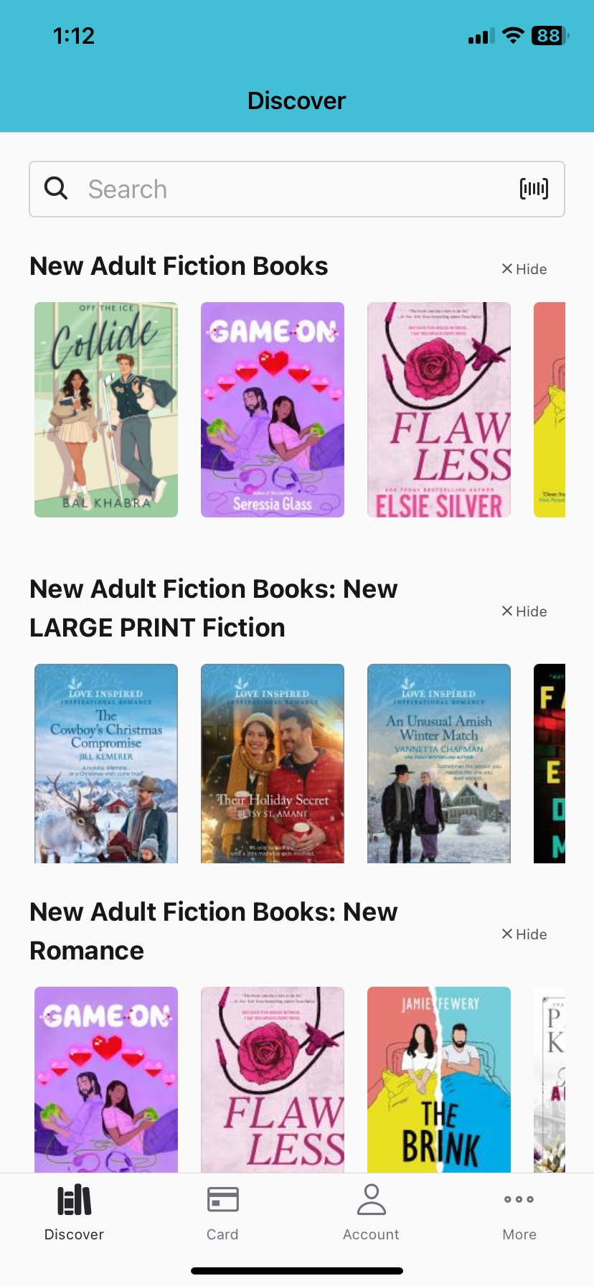
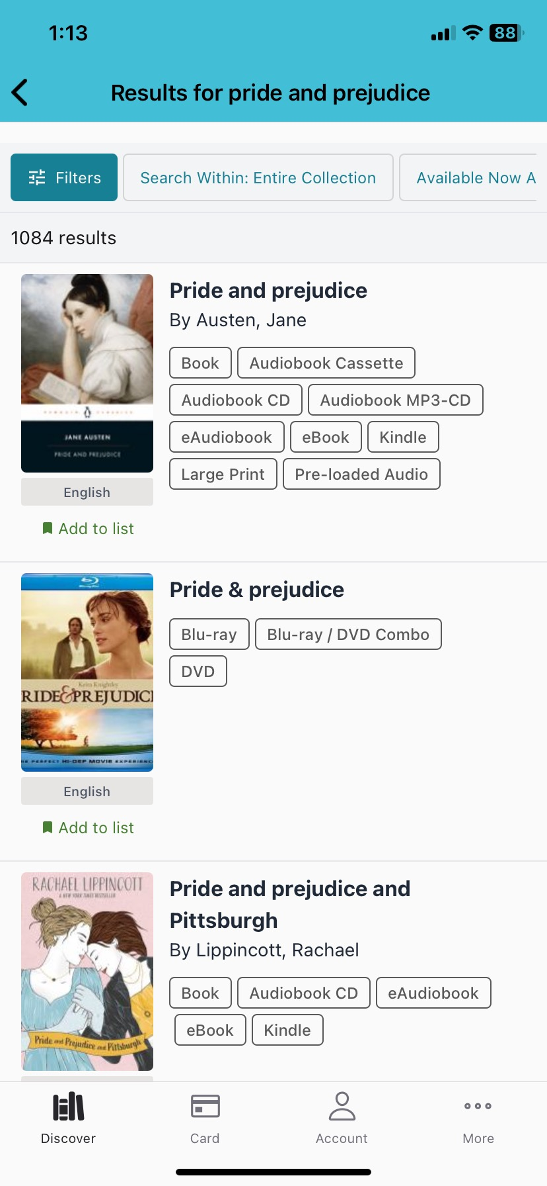
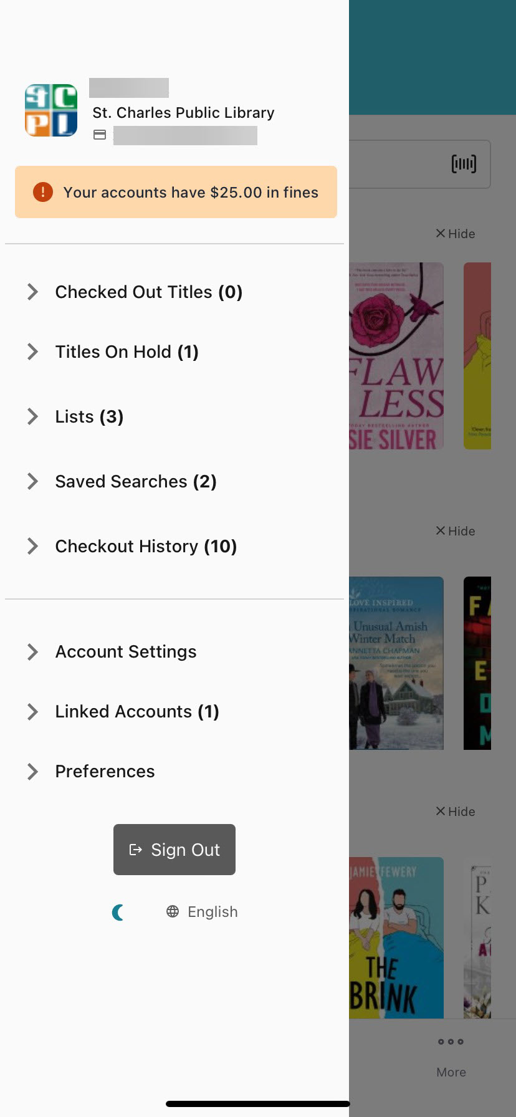
Aspen LiDA

Slide 8
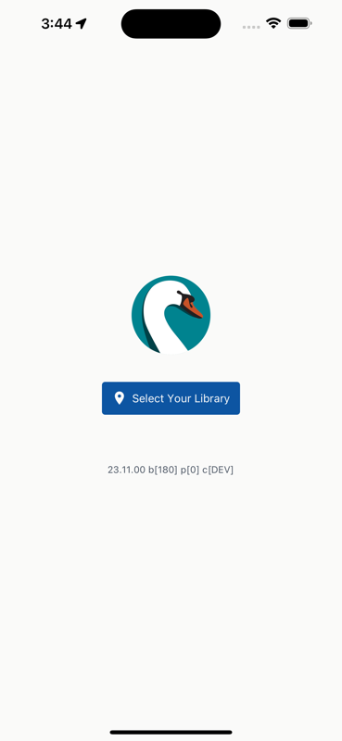
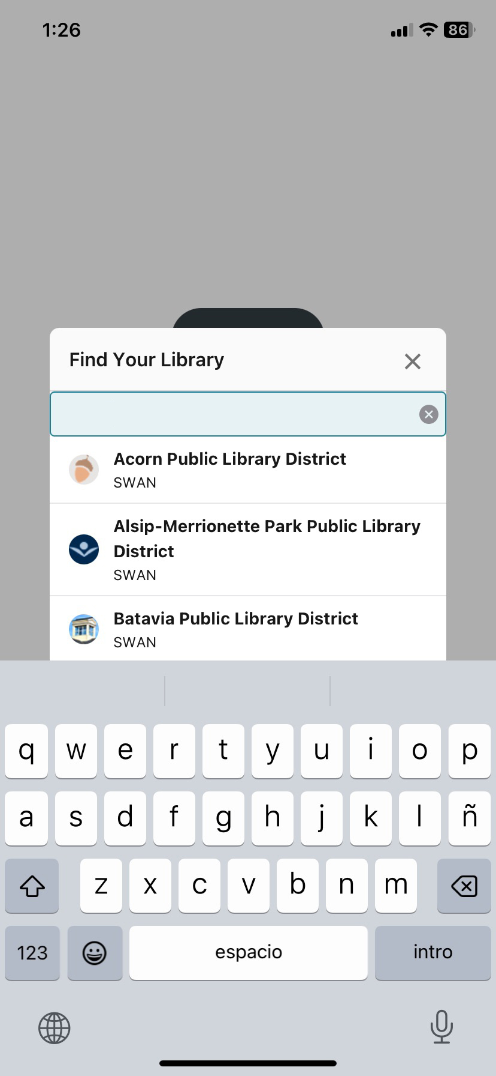
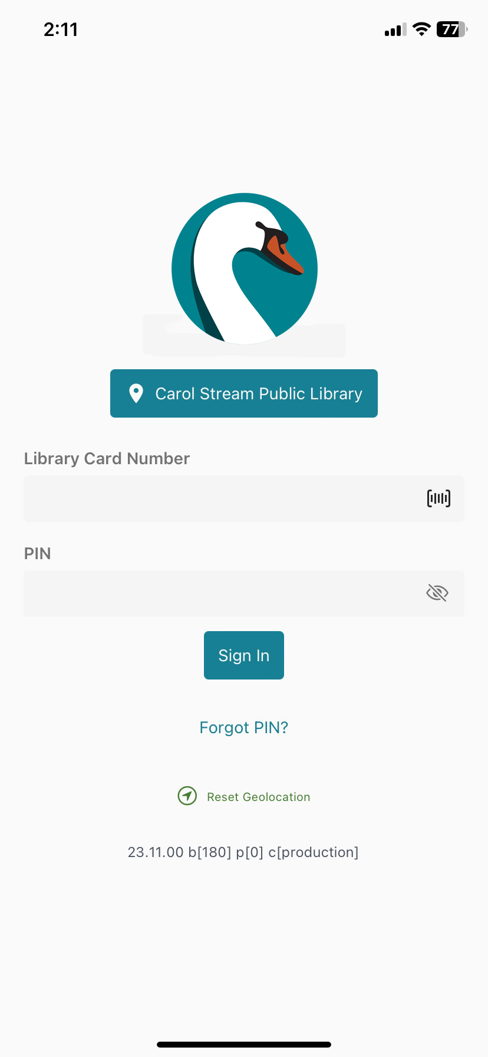
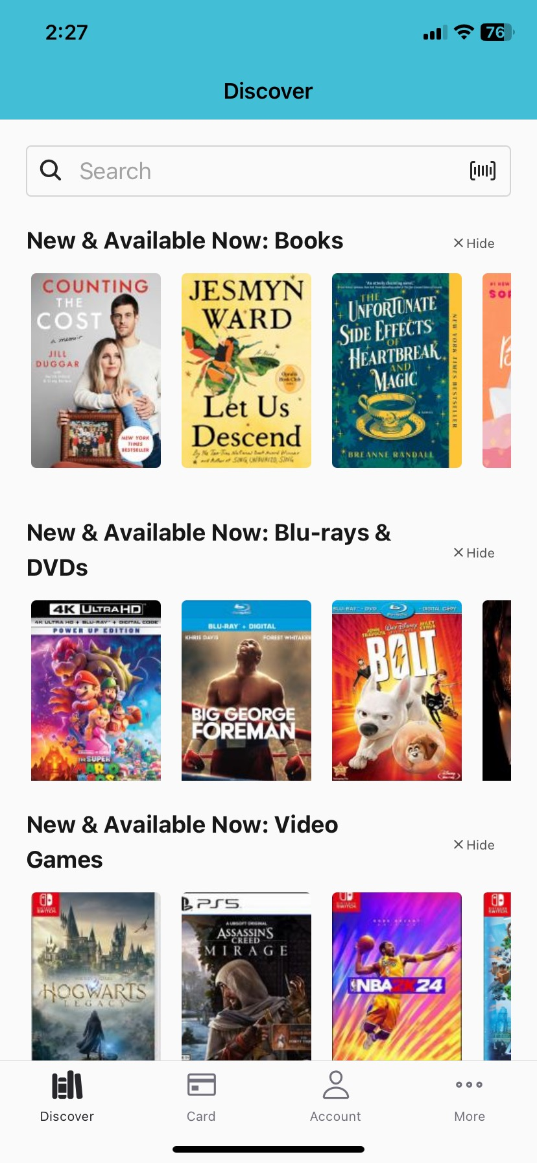
Aspen LiDA supports library consortia

Slide 9
Aspen LiDA: Patron Experience
LiDA is built upon our existing Aspen Discovery
Patrons will have a consistent experience with the catalog
  Browse categories
  Grouped records
  Holds logic
  Account features
    Linked accounts
    Checkout history
  Searching and filtering
  E-content integration
    OverDrive
    Hoopla
    Sideloads
  Accessibility features, such as dark mode
Future development
  Fines payment
  Self checkout limited by geolocation

Slide 10
Aspen LiDA: Staff Administration
Staff will administer Aspen LiDA through the same Aspen Administration interface
No need for new accounts or making updates in two places – everything syncs between web and app
  Browse categories
  Themes and logos
  System messages
  Contact information
Manual push notifications
Future development
  Usage statistics
  Push notification enhancements (holds)

Slide 11
Aspen LiDA: Implementation
ByWater Solutions is the hosting & support provider for Aspen Discovery
LiDA will be added to the existing ByWater agreement with SWAN
  Payment is due May 1, 2024
Information and assets have been provided to ByWater Solutions to start the implementation process
Apps have been submitted to the app stores for approval and will go live pending membership and app store approval
Notes:
Developer accounts, graphics, information for app stores was already ready to go.

Slide 12
Aspen LiDA costs
 | BLUEcloud Mobile | Aspen LiDA
Annual cost
Mobile | $71,930 | $4,600
E-content integration | $23,200 | included
Total | $95,130 | $4,600
Refund applied to May 1, 2024 renewal | ($40,850) | (not applicable)
One-time cost | (Not applicable) | $1,917
Costs May 1, 2024 at renewal | ($95,130) | $6,517
 | SWAN cancels SirsiDynix BLUEcloud Mobile & eResource Central
Renewals for ByWater & SirsiDynix occur May 1, 2024
ByWater agreed to defer all costs until May 1, 2024
Annual savings: ($90,530)
Notes:
Aspen already includes the administration portal and connections to our ILS, so that saves both cost and effort.
E-resource integrations are already in place through Aspen.

Slide 13
Aspen LiDA:
Go Live Timeline
Dec. 7th
approval
App store submission
ASAP
App appears in app store
As soon as mid-December
Webinars for library staff
December/January
Recommended go live/public announcement date
January
Libraries notified app is available to begin downloading and testing
As soon as mid-December
You can choose when to start promoting to your patrons – so effectively there’s a soft launch built in.
The app will appear in app stores as SWAN Libraries +

Slide 14
Aspen LiDA:
Go Live Resources
Patron instructions at www.swanlibraries.net
Web graphics for you to use on social media and your library websites
Webinar dates for staff
  TBA – plan to offer both December and January dates

Slide 15
Aspen LiDA: Future Developments
Individual library apps
  Libraries would need Apple and Google Developer Accounts
  Provide graphics and app store assets
  Additional cost of $500/year
Fines payment
Usage statistics
Enhancements to self checkout
Push notifications

Slide 16
Conclusion
Notes:
What questions do you have?
What is better for your libraries – get the app out ASAP, or wait until the new year?

Slide 17
Membership Satisfaction Survey
Aaron Skog, Executive Director
Jennifer Cottrill, Board President

Slide 18
Membership satisfaction survey
Goal of survey
Will be open to 100 library directors to complete
Confer with library staff/management team
Rate the satisfaction of products
Background
Two strategic plans for SWAN has surfaced dissatisfaction with ILS/staff work interface
  Millennium
  Symphony WorkFlows
Why wait for the next strategic plan?
Why not issue the survey annually?

Slide 19
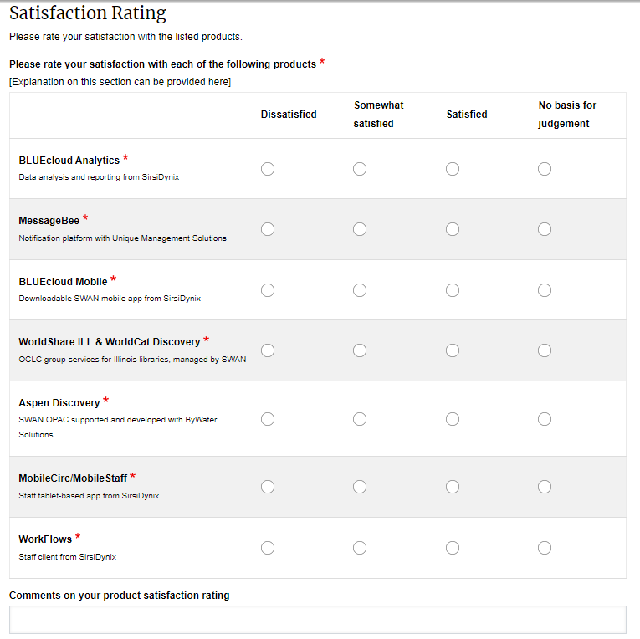
Satisfaction with software products & platform: Question 1
Q1. Please rate your satisfaction with each of the following products.
WorkFlows by SirsiDynix
BLUECloud Analytics by SirsiDynix
BLUECloud Mobile app by SirsiDynix
MobileCirc/MobileStaff by SirsiDynix
Aspen Discovery
MessageBee by Unique Management
OCLC WorldShare

Slide 20
Satisfaction with software products & platform: Question 2
Q2. Considering your overall experience with the above platforms, how well do the currently provided products meet the needs of your library?
0=poorly
10=extremely well

Slide 21
Satisfaction with software products & platform: Questions 3 & 4
Q3: For the products for which you indicated satisfaction, please provide detailed feedback on which features of which products you appreciate.
Q4: For the products for which you indicated dissatisfaction, please provide detailed feedback on which features of which products you find problematic. Where appropriate, please attach screenshots and share attempted solutions.

Slide 22
Survey timeline
Introduction at SWAN Quarterly December 7, 2023
Email directors directly with survey link December 11. 2023
News post about the survey with background & introduction
Reminders via SWANcom
Survey close January 31, 2024

Slide 23
SWAN integration with OCLC services
Aaron Skog, Executive Director
Scott Brandwein, Assistant Director
Helen Pinder, Resource Sharing Consultant

Slide 24
SWAN & OCLC background
OCLC membership included in SWAN membership
Illinois “group services contract” arranged by Illinois State Library
SWAN standardized setup for membership
SWAN has ability to make updates on your behalf, but respects existing access and choices made by library
We will show some examples of what can be done
Notes:
Aaron introduction

Slide 25


Maximize our OCLC Services
Database and discovery tools
Cloud-based library services platform
Notes:
Scott & Helen

Slide 26
Maximize our OCLC Services: WorldCat
WorldCat Discovery
Public facing & library staff facing discovery engine
Scoped for SWAN holdings & individual libraries
Auto "No" by item OPAC status availability
WorldCat API
Developer tools to build tools to interact with WorldCat data
Used to maintain SWAN holdings
WorldCat.org
Web portal to WorldCat database, but lacks library/consortium scoping
Includes WorldCat Digital Collection Gateway – article citations from popular databases

Slide 27
Maximize our OCLC Services: WorldShare
WorldShare ILL
Resource Sharing/ ILL
Staff interface only
Custom holdings groups and paths for targeted borrowing
IFM for sending and receiving fees
Article Exchange
Collection Manager
Maintaining holdings for physical and e-content collections
Record Manager
Cataloging functions in cloud environment
Record editing, export
Maintenance of holdings and Local Holdings Records

Slide 28
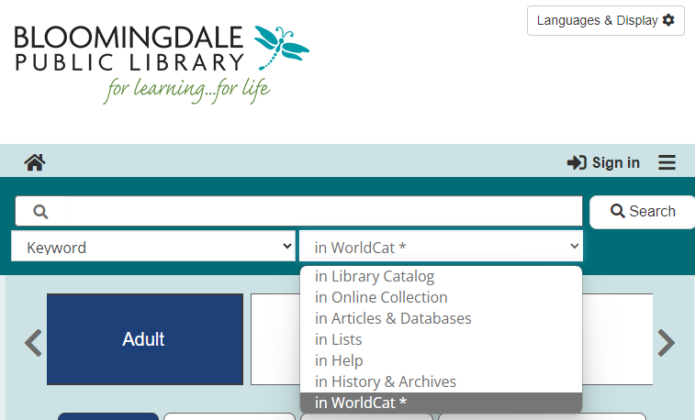
WorldCat Integration with Aspen Discovery
Implemented for all SWAN members in Aspen
Aspen search dovetails with WorldCat Discovery
Patrons empowered to place their own ILL requests
Patron authentication required to initiate requests using user barcode & PIN (via OpenAthens)

Slide 29
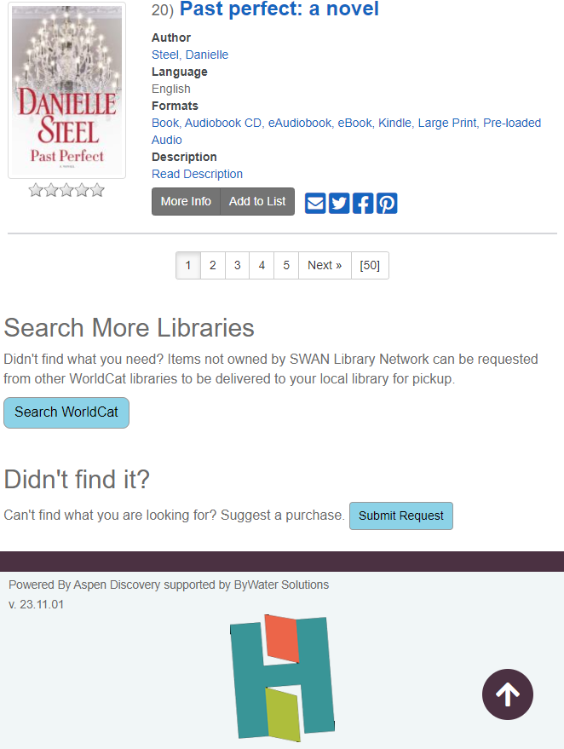
WorldCat Integration with Aspen Discovery
New option!
Add “Search WorldCat” button to your Aspen catalog at the end of a search results list
Aspen Discovery feature enhanced in November release carries over search terms
Users can continue their own search in WorldCat Discovery

Slide 30
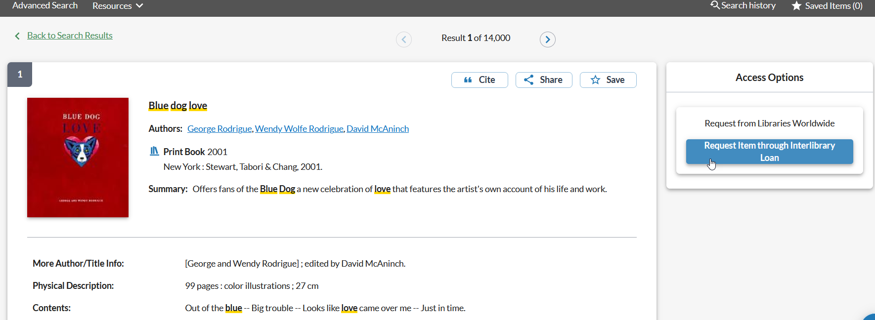
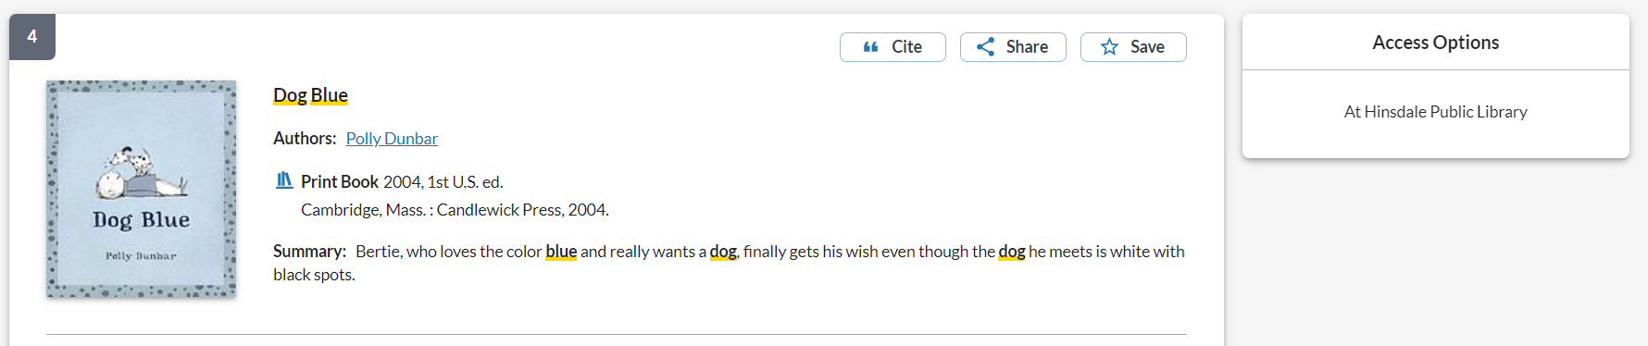
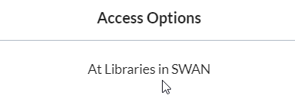
WorldCat Discovery: empower your patrons
Button presented/suppressed by scoped holdings:
Will not appear where SWAN holdings exist:

Slide 31
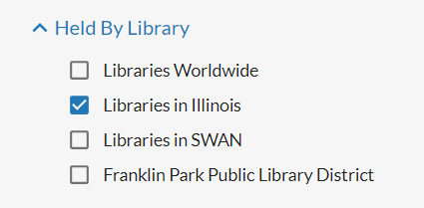
WorldCat Holdings for Illinois Libraries
SWAN centrally processes WorldCat holdings for 100 members monthly
Built process using WorldShare APIs
OCLC Holdings Manager (OHM) is a SWAN-developed tool to maintain holdings throughout the state

Slide 32
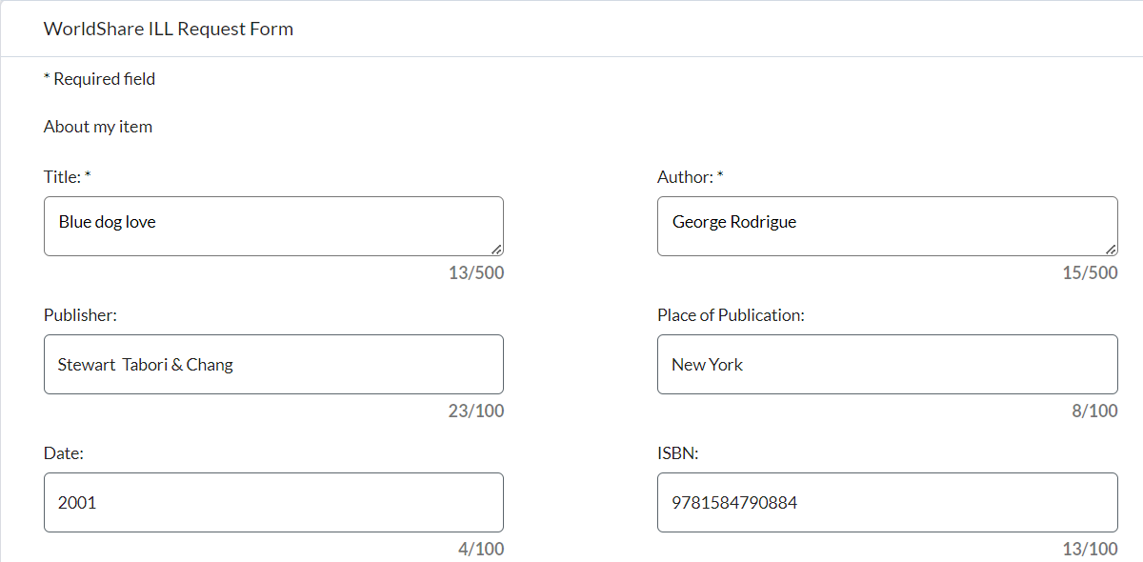
WorldCat Discovery: patron request
Request form populates from bib record
ILL Staff approve/deny requests

Slide 33
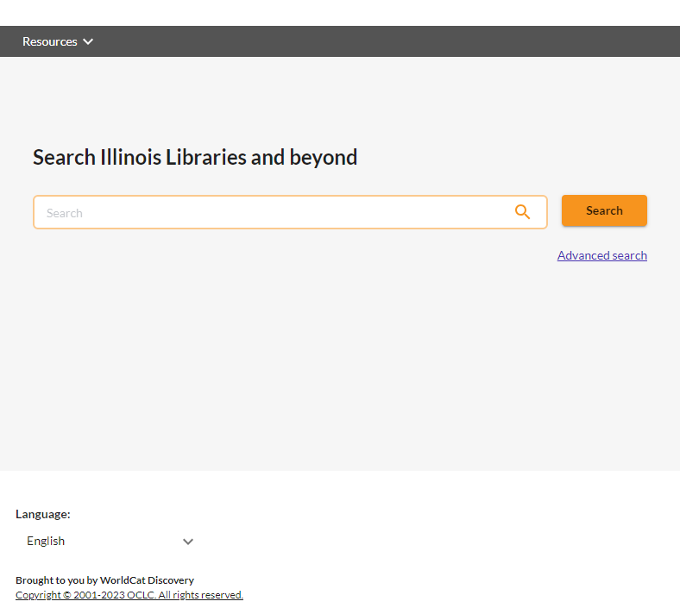
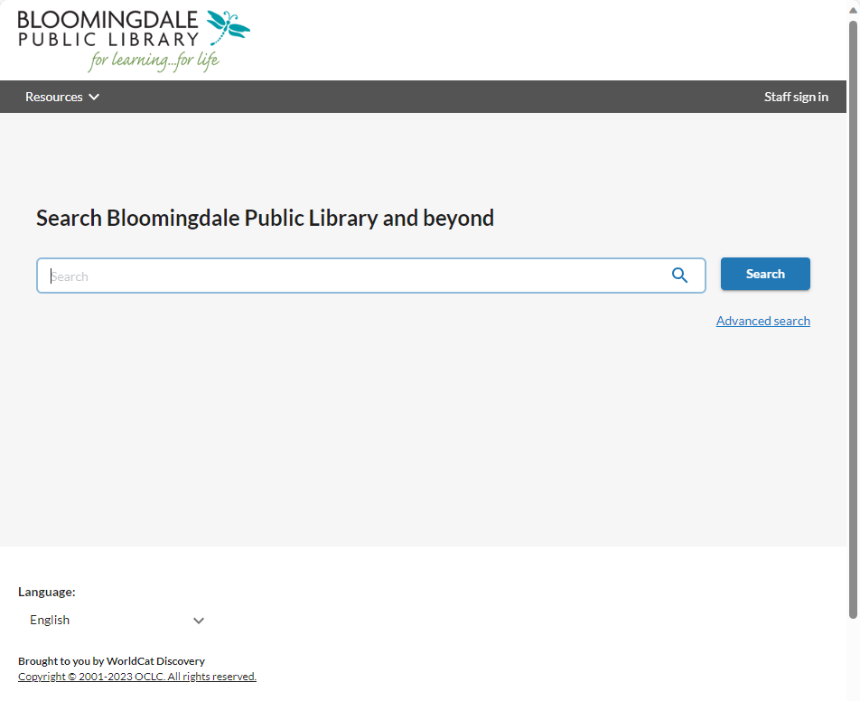
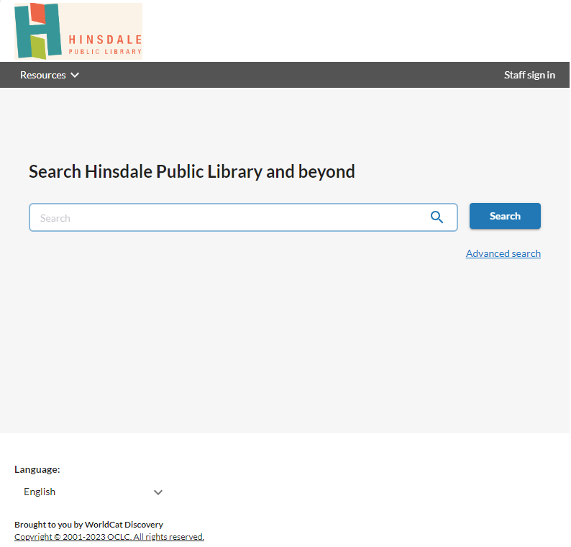
WorldCat Discovery instances: Illinois Statewide Catalog & individual libraries
Illinois Statewide Catalog:
https://illinois.on.worldcat.org
Individual library WorldCat Discovery instance
https://hinsdalepl.on.worldcat.org
Notes:
Illinois Statewide Catalog:
https://illinois.on.worldcat.org/discovery
Individual library WorldCat Discovery instance
https://hinsdalepl.on.worldcat.org/

Slide 34
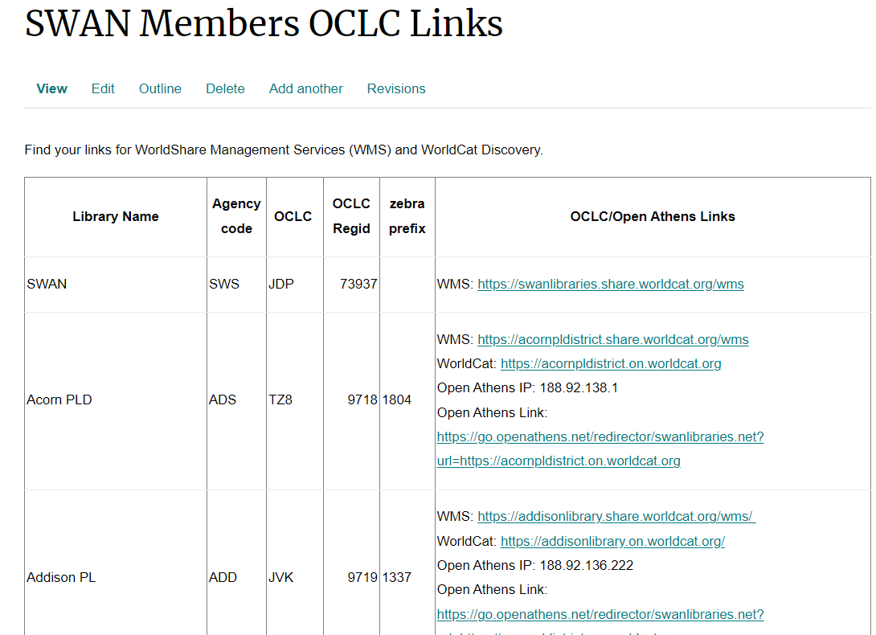
SWAN Support website: access URLs
WorldShare Management Services
WorldCat Discovery
Open Athens IP
Open Athens Link

Slide 35
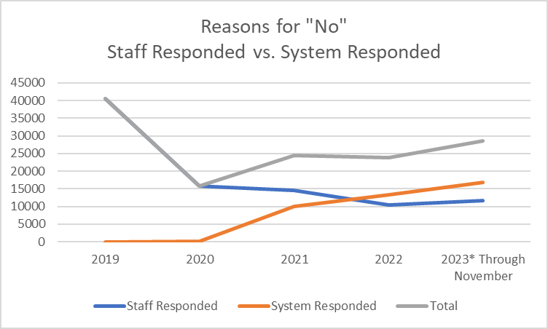
Real-time availability: “Auto No”
2020 SWAN libraries went non-supplier in March
2021 RTA piloted
2022 General* “unavailable” statuses applied group-wide
2023 More libraries populating availability statuses!
 | 2019 | 2020 | 2021 | 2022 | 2023
Staff Responded | 40,513 | 15,756 | 14,453 | 10,476 | 11,676
System Responded | - | 15 | 9,990 | 13,355 | 16,803
Totals | 40,513 | 15,771 | 24,443 | 23,831 | 28,479
*Checked Out, On-Hold, On-Order, In-Transit, Missing

Slide 36
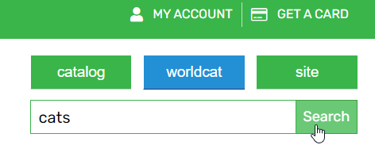
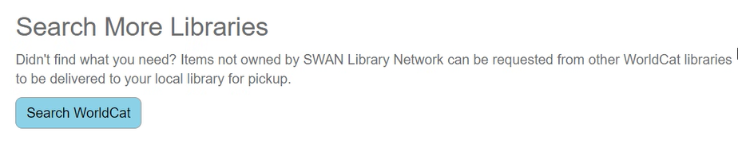

Three things you can do today!
Embed a WorldCat Discovery search option on your library home page
Add a link in Aspen to WorldCat Discovery to empower patrons to continue their own search
Review the locations of your collection to see where Auto-No can work better

Slide 37
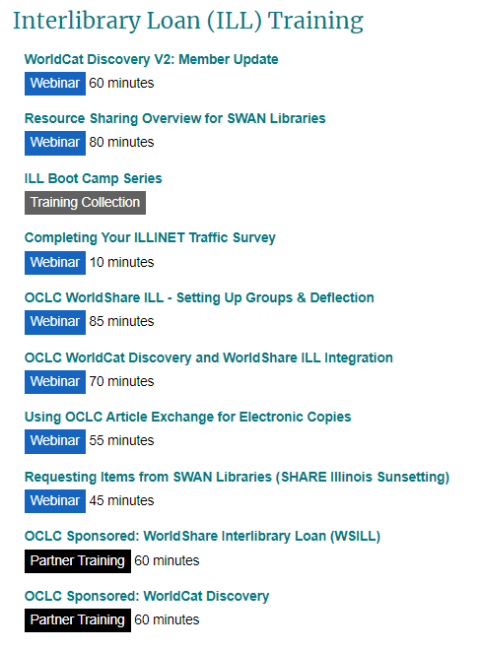
Where you can find more
SWAN Support
Home > Meetings & Trainings > Tutorials & Training Resources
SWAN recorded trainings
OCLC webinars
Notes:
SWAN Support
Home > Meetings & Trainings > Tutorials & Training Resources

Slide 38
Conclusion

Slide 39
Reports on SWAN Projects
Scott Brandwein, SWAN Assistant Director

Slide 40
SWAN projects
Prairie State College exit
Mobile app
SWAN office search
Helpdesk system research
MessageBee portal & lists
December 2023 – March 2024

Slide 41
Budget Update
Aaron Skog, Executive Director

Slide 42
SWAN budget process timeline
DATE | MEETING TYPE | ACTION ITEMS
Thursday, December 7, 2023 | Quarterly | Announce budget process timeline
Friday, December 15, 2023 | Regular SWAN Board Meeting | Review of budget draft. Board accepts FY23 financial audit.
Friday, January 19, 2024 | Regular SWAN Board Meeting | Review and recommend draft of SWAN Budget for Membership presentation.
January 2024 [TBD] | SWANcom | Share draft budget to membership. Set February COW date and possible location of meeting.
Tuesday, February 6, 2024 | Committee of the Whole Membership Meeting | Meeting to discuss budget, fees, and reserves worksheet.
Friday, February 16, 2024 | Regular SWAN Board Meeting | Incorporate changes and suggestions to SWAN budget. Create recommendation to membership.
Thursday, March 7, 2024 | Quarterly | Roll call vote to approve SWAN budget.
Save the date
Committee of the Whole meeting Tuesday, February 6, 2024
  Virtual presentation of proposed budget to library directors
Quarterly meeting Thursday, March 7, 2024
  Budget vote

Slide 43
ISLAC Update: Illinois State Library Advisory Committee

Slide 44
Thank you!

