Slide 1
SWAN Quarterly Meeting
March 7, 2024

Slide 2
Agenda
Call to Order and Welcome
Public Comment
Approval of minutes
Board election
EBSCO group-purchase renewal
Approval of FY25 budget
Amend current FY24 budget
Platform survey results
SWAN consulting overview
Announcements & Questions

Slide 3
SWAN Board election 2024

Slide 4
Election process & timetable
Election Process Announced | March 7, 2024 (Quarterly)
Online Self-Nominations Accepted | April 1 – 26, 2024
Names of Candidates Released | May 1, 2024
Electronic Ballot | May 6 – May 24, 2024
Results Announced | June 1, 2024
Elected Candidates invited to June SWAN Board Meeting | June 21, 2024
Candidates’ Terms Begin | July 1, 2024
July Board Meeting | July 19, 2024

Slide 5
EBSCO database subscription year-5 renewal group-purchase

Slide 6
EBSCO database group-purchase
Renewal with 84 participating libraries
Preview pricing at February 6th Committee of the Whole meeting
Opt-out period ended Friday, February 23rd 11:59 p.m.
  1 library opted out: Wood Dale
  1 library joined: Addison
Updated pricing within March 7th meeting packet

Slide 7
Renewal timeline
February 23, 2024 | Libraries opt-out decision
April 22, 2024 | Database selection form will open
May 10, 2024 | Database selection form is closed
May 30, 2024 | SWAN order details are due to RAILS
June 30, 2024 | Updated EBSCO links sent to libraries
July 1, 2024 | Updated EBSCO selections are live

Slide 8
FY2025 budget
Aaron Skog, Executive Director

Slide 9
SWAN budget process timeline
DATE | MEETING TYPE | ACTION ITEMS
Thursday, December 7, 2023 | Quarterly | Announce budget process timeline
Friday, December 15, 2023 | Regular SWAN Board Meeting | Review of budget draft. Board accepts FY23 financial audit.
Friday, January 19, 2024 | Regular SWAN Board Meeting | Review and recommend draft of SWAN Budget for Membership presentation.
January 2024 [TBD] | SWANcom | Share draft budget to membership. Set February COW date and possible location of meeting.
Tuesday, February 6, 2024 | Committee of the Whole Membership Meeting | Meeting to discuss budget, fees, and reserves worksheet.
Friday, February 16, 2024 | Regular SWAN Board Meeting | Incorporate changes and suggestions to SWAN budget. Create recommendation to membership.
Thursday, March 7, 2024 | Quarterly | Roll call vote to approve SWAN budget.
Today
Quarterly meeting Thursday, March 7, 2024
Budget vote

Slide 10
Budget priorities
Helpdesk platform
Single sign-on (SSO)
Downsizing office space
Membership changes
Preparation & research
SirsiDynix annual subscription
  Year-5 of 5-year contract
  Removed BLUEcloud Mobile & eResource Central expense $95,130
OCLC annual subscription
  Factored 3% increase

Slide 11
Budget Highlights
100 Libraries strong
  Addison Public Library full member
  Prairie State College exits
Year 2 Aspen Discovery catalog hosting & Support site hosting
Full year security initiative expenses: MDR
SWAN Expo August 2024: 50th anniversary of SWAN (1974-2024)
Revenue
  Increase interest income
  Small RAILS funding increase from prior years
  Membership fees decrease -6%
Expenses
  Overall, decrease -3.4%
  Added SSO & helpdesk system

Slide 12
FY25 budget: Helpdesk platform
Replacement for OTRS ticketing system and user portal including improved analytics
Customer Relations Manager
Possible additional features
  Knowledge Base
  Forum integration
Candidates
  Zendesk
  Zoho Desk
  Freshdesk
Budget line #5470 Support Services Subscription
$20,000 annual subscription in FY25 budget
Expense has a small offset with decommission of existing ticketing system

Slide 13

What is Single Sign-On?
Streamlined experience for member library and SWAN staff
Unify all SWAN’s services/accounts under single login
  Sign in once and access all services
Leverage existing L2 account
  No need to create new account or migrate credentials
Flexible framework – Easy to add new services going forward
Single sign-on is an authentication schema that allows a user to log in with a single ID to any of several related, yet independent, software systems.
Notes:
What is Single Sign-On?
Who does this effect? (SWAN Staff, Member Library Staff, not patrons)

Slide 14
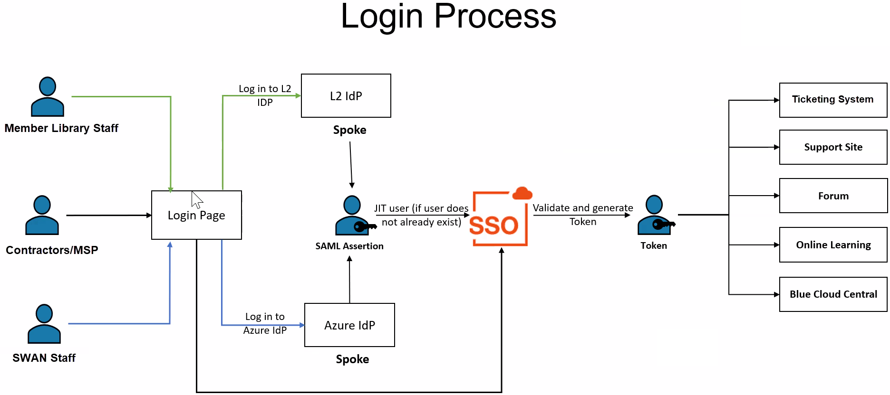
How will SSO work?

Slide 15
FY25: SSO project & budget expense
Subscription based on annual active users
  1,000 to 1,200 library staff estimated
SWAN researched in-house, self-maintained, and SaaS options 2022-2023
Ping/HiQuest selected as vendor
  Vendors (Okta/Auth.0/etc.) unable to meet our requirements
  Ping offers bespoke implementation
  Seamless integration with Support Site
Future proof our next library staff client
  BLUEcloud Staff
  Alternate option requirement
Budget line #5430 Server Infrastructure
$26,890 annual subscription
One-time setup & configuration costs $35,000
Amend existing SWAN budget for FY24 to allow project to begin
Resolution to amend SWAN budget at March 7, 2024 Quarterly membership meeting after budget approval
Notes:
In-house options required significant staff involvement to both implement and maintain.
Ping’s solution is designed to work in conjunction with our existing Drupal Support Site and use L2 as the Identity provider

Slide 16
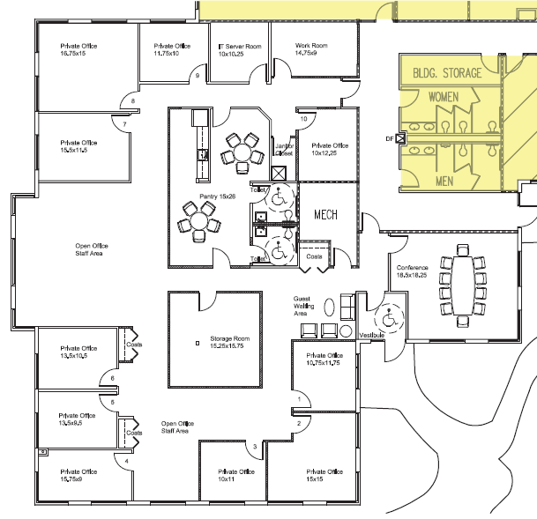
FY25: Office relocation
FY25 budget $32,100 expense reduction
  Current space July – Dec 2024
  New space Jan – June 2025
Reduction in square footage
  Current 5, 621 sq ft
  Anticipated 2,800 sq ft
Commercial lease length unknown
Moving November 2024
Current floor plan

Slide 17
Membership changes: Addison Public Library & Prairie State College
Addison Public Library: full year
Revenue - Membership Fee | $70,367
Expenses (licensing add-ons) | -$27,410
 | $42,957
Prairie State College: exit
Revenue - Membership Fee | -$18,333
Net | $24,624

Slide 18
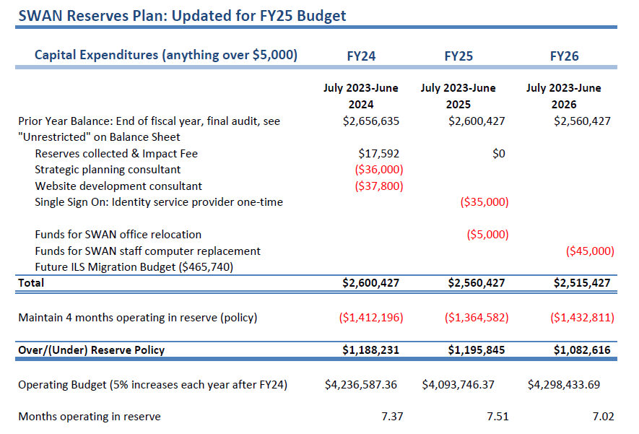
SWAN Reserves
Updated with FY23 audit
Impact fee revenue $17,592 from Addison
One-time expenses:
SSO one-time costs
Office relocation expenses

Slide 19
FY25 Revenue budget

Slide 20
Revenue
Membership Fees, Grant Revenue, Investment & Interest
Pass through: Group-purchase, Reimbursements for Losses,
RAILS LLSAP Support revenue
  $500,616 FY25
  $2,228 increase
Interest income budget increased from $20,800 to $83,328
Membership fee budget line decreases $196,245
Overall decrease 6% (mileage varies per public library)
Annual conference fees (offset the food & beverage expenses at rental MVCC)
E-commerce transactions budget line (offset by #5940 expense)
EBSCO group purchase fees (offset by #5990 expense)

Slide 21
Expense budget 3.4% decrease FY25

Slide 22
Expenses
Salaries & Wages
Personnel Benefits
2% increase in budget
First increase in 5 years
Held static FY20 – FY24
Positions consolidated via retirement & attrition
2 part-time staff added to Bibliographic Services in December 2022
  Increasing complexity with Aspen grouped records
  FRBR display of book editions, large type, eBooks, eAudiobooks
FY25 budget benefits for health, dental, & life insurance
Based on open enrollment completed January 1, 2023
Reduction compared to prior year based on usage

Slide 23
Expenses
Buildings & Grounds
Professional Development
Decrease -24.8%
Facility lease ends November 2024
New location with planned reduction in square footage
Utilities expense unchanged
Reduced expenses based on actual end of June 30, 2023
Conference travel budget $6,000 reduction from pre-pandemic $11,000 budget

Slide 24
Expenses
Membership Development
Information & Technology Services
Supports SWAN Expo
SWAN 50th anniversary
Reduced staff travel budget to libraries
Expenses for SWAN Learning Management System is the #5330 Library Professional Development budget line
Full year transition of SWAN websites hosted by in SWAN infrastructure to vendor solutions
  Decrease for Azure expense #5430
SirsiDynix decrease (BLUEcloud Mobile & eResource Central service replaced by LiDA)
OCLC increase 3% (anticipated)
EBSCO increase 3% (anticipated)

Slide 25
Expenses
General Office, Hardware & Equipment, Insurance
Contractual Services
Budget for office supplies includes one-time $10,000 for office relocation needs
Business, D&O, crime, cyber insurance budget increase based on 2023 renewal
Continuing legal, HR Source membership, & accounting services
Addison joining = contractual expenses RAILS Catalog Grant
SWAN Expo MVCC facility expense
Increase to Notification & Collection due to MessageBee expense
Consulting expenses for FY25
  LiDA software development $5,000

Slide 26
Expenses
Library Materials & Content
Interest & Fees
EBSCO database package group-purchase year-5 renewal 3% increase
Budget line #5940 E-commerce payment transactions added with revenue offset
Bank fees, merchant account ProPay fees reduction
Annual conference merchant account fees no longer needed

Slide 27
Revenue: Membership Fees
Separate formula for academic, school, special, and public libraries
Public library formula based on county tax data (Cook, DuPage, Kane, Will)
  Self-reported bond payments, debt service obligations deducted from total tax data
  Completion of debt service payments may increase fees (ex: Downers Grove)
  Details on how SWAN membership fees are calculated
  https://support.swanlibraries.net/about/budget
State funding via RAILS LLSAP is applied as a reduction in membership fees for 96 public libraries

Slide 28
FY25 Revenue
Public library fee formula incorporates tax data
Bond or debit service arrangement will be deducted from tax data
FY25 budget is using 2021 tax & bond data
  Why not current?
  Disbursement completed end of 2022
  Tax reports collected in September 2023
  FY25 SWAN budget work begins October 2023
Bond schedule & SWAN: set it & forget it!
Bond schedule updates

Slide 29
Budget approval
Discussion
Motion to accept the SWAN budget for fiscal year 2025 as presented
Roll-call required

Slide 30
Amend current budget

Slide 31
Amend budget
#5430 Server Software Licensing budget | $18,000
Ping one-time setup costs | $35,000
Ping annual subscription | $26,890
Total budget for FY24 | $79,890
Single sign-on project
Pricing for project negotiated with vendor Ping
After approval, work can begin immediately

Slide 32
Budget vote
RESOLVED, THE SWAN FISCAL YEAR 2024 BUDGET LINE #5430 SERVER SOFTWARE LICENSING WILL BE INCREASED FROM $18,000 TO $79,890 FOR THE IMPLEMENTATION OF SINGLE SING-ON SERVICES TO BE COMPLETED BY JUNE 30, 2024.

Slide 33
Membership Satisfaction Survey Results
Aaron Skog, Executive Director
Jennifer Cottrill, Board President

Slide 34
Membership satisfaction survey
Goal of survey
Open to 100 library directors to complete
Rate the satisfaction of products
Results
75 library responses
6 platform ratings
Valuable written comments
Some clearly conferred with library staff/management team

Slide 35
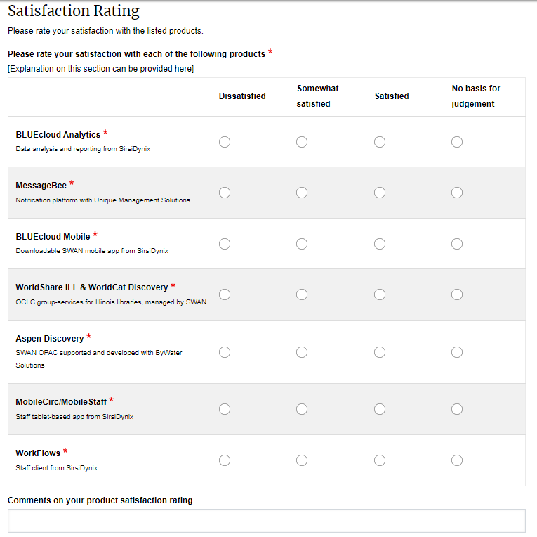
Satisfaction with software products & platform: Question 1
Q1. Please rate your satisfaction with each of the following products.
WorkFlows by SirsiDynix
BLUECloud Analytics by SirsiDynix
MobileCirc/MobileStaff by SirsiDynix
Aspen Discovery
MessageBee by Unique Management
OCLC WorldShare

Slide 36
Satisfaction with software products & platform: Question 2
Q2. Considering your overall experience with the above platforms, how well do the currently provided products meet the needs of your library?
0=poorly
10=extremely well

Slide 44
Satisfaction with software products & platform: Questions 3 & 4
Q3: For the products for which you indicated satisfaction, please provide detailed feedback on which features of which products you appreciate.
Q4: For the products for which you indicated dissatisfaction, please provide detailed feedback on which features of which products you find problematic. Where appropriate, please attach screenshots and share attempted solutions.

Slide 45
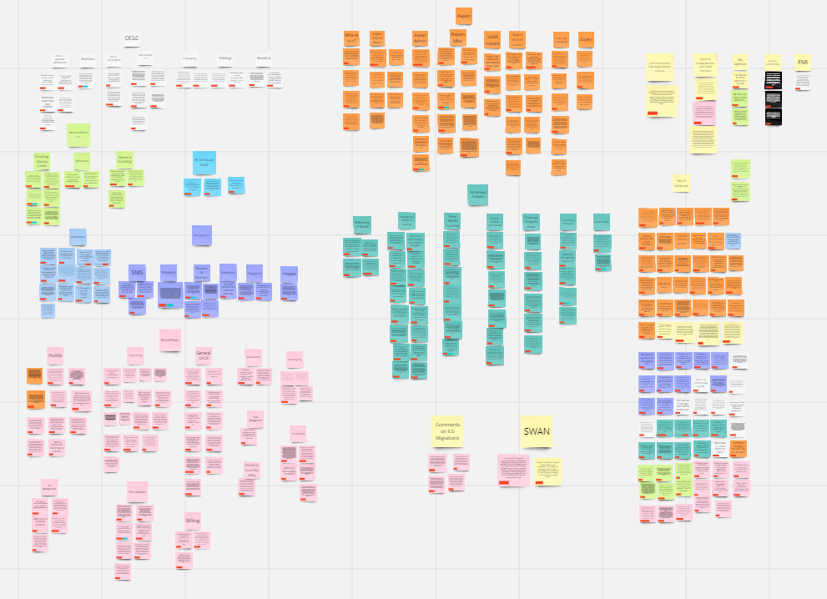
Comment sorting & analysis underway

Slide 46
Next steps
Analysis of the written comments
Sharing results with board & membership
Recommendations
  Contract renewal
  Follow-up investigation
  Opportunities

Slide 47
SWAN 50th anniversary: 1974 -2024

Slide 48

SWAN started in March 1974…
9 libraries sign contract with Suburban Library System
  Alsip
  Dolton
  Eisenhower
  Elmhurst
  Harvey
  Lansing
  Northlake
  Oak Park
  Park Forest
Notes:
Go live was Aslip in June 1975

Slide 49
SWAN Expo 2024
Save the date!
Friday, August 23
Do you have a session you want to present at Expo?
  Individual presentation, co-presenters, panels, and workshop ideas are welcome
  45 minutes length
  Submit your proposal!
  support.swanlibraries.net/expo

Slide 50
On-demand consultations
Scott Brandwein, SWAN Assistant Director

Slide 51
On-demand consultations
Meeting with SWAN staff via Zoom
Choose a topic, tell us what you want to chat about, and schedule time on our calendars
Consultations are 30 minutes, or 60 in select cases

Slide 52
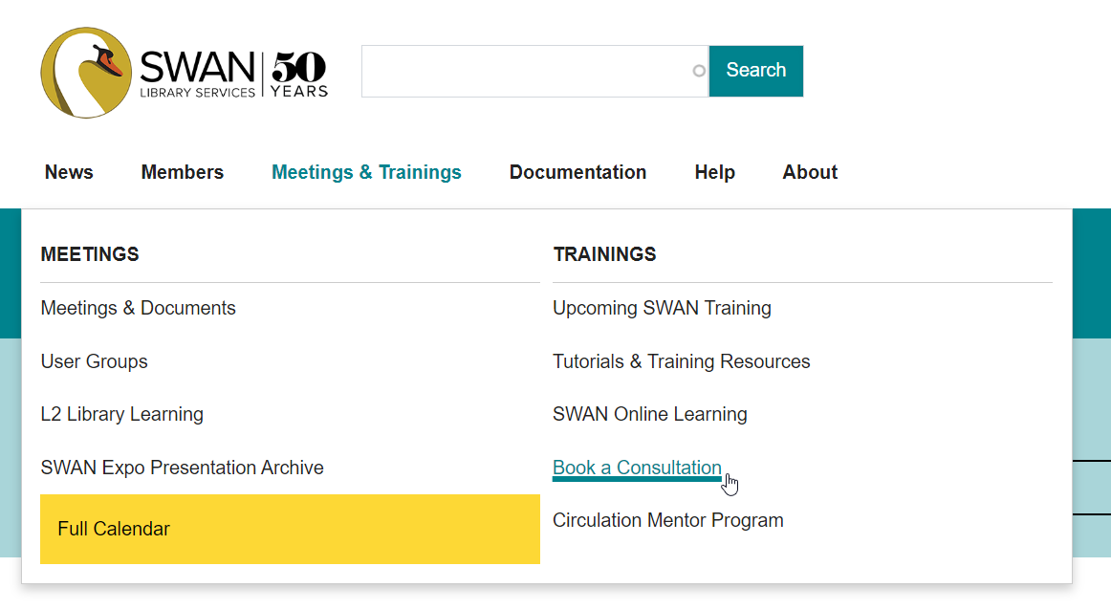
On the support site…

Slide 53
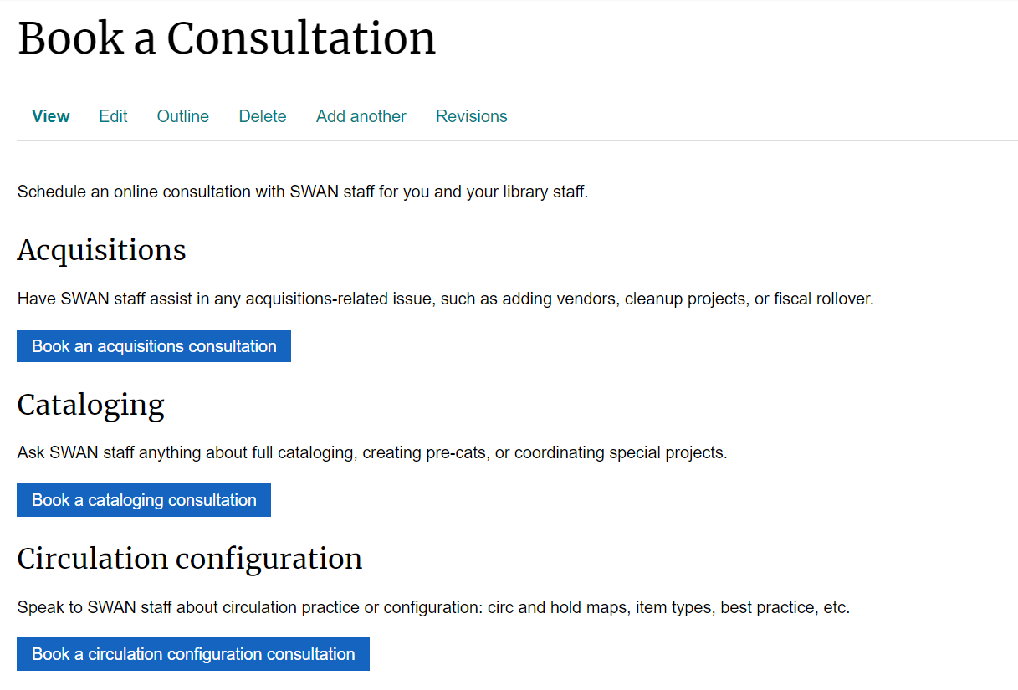
Choose a topic…
Acquisitions
Cataloging
Circulation configuration
Library collection projects
MessageBee
AspenDiscovery/LiDA
Partnerships
Other

Slide 54
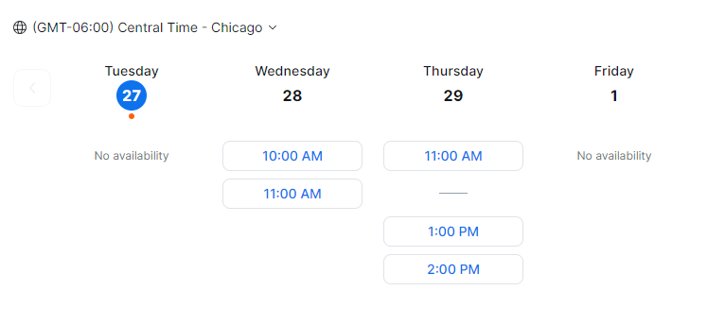
Pick a time slot.

Slide 55

Ticket submission form
Submit a ticket from our support site
Search results based on ticket subject
E-mail ticketing still an option

Slide 56
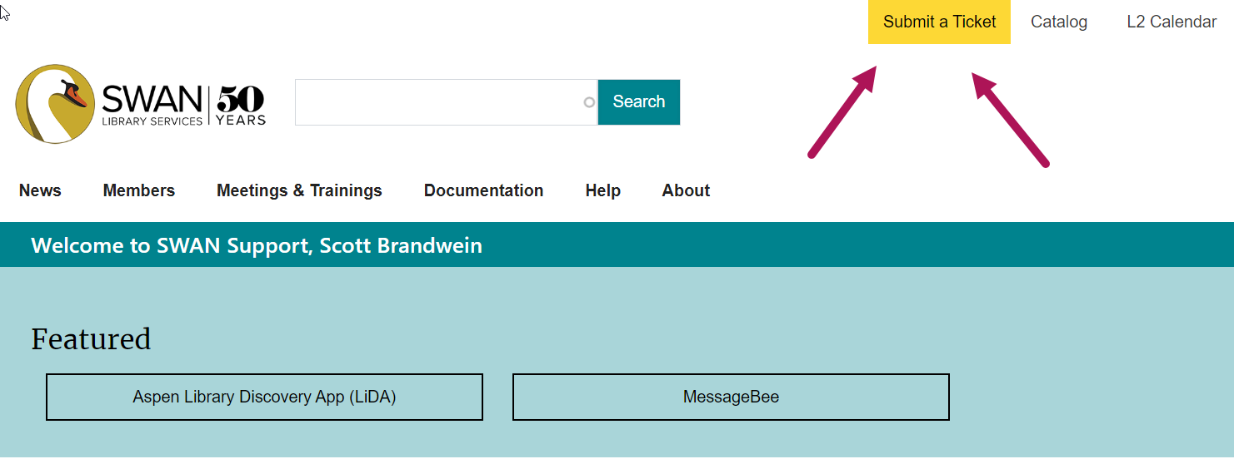
On the support site…

Slide 57
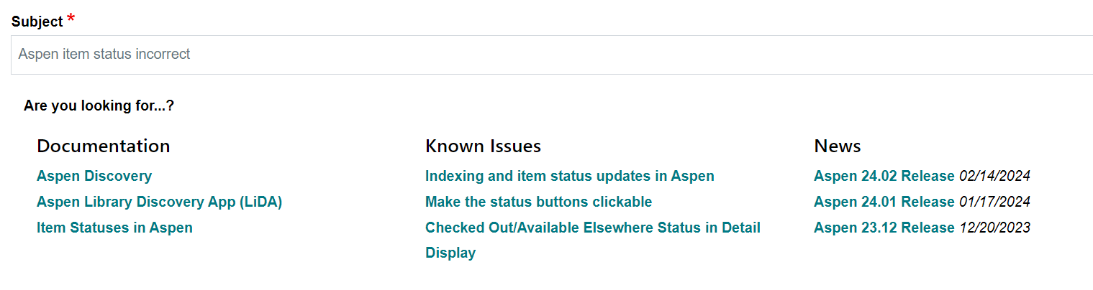
Results example

Slide 58
Thank you!

