Slide 1
SWAN Quarterly Meeting
June 6, 2024

Slide 2
Agenda
Call to Order and Welcome
Public Comment
Approval of minutes
Board election
Illinois State Library e-Resource Program & future of SWAN EBSCO deal
Website accessibility challenges for public libraries & SWAN’s role
Comics Plus SWAN deal
Symphony 4.1 upgrade
Software platform survey results
Banking with ACH: SWAN payments & deposits
Announcements & Questions

Slide 3
SWAN Board election 2024

Slide 4
New Board representatives
SWAN Board Member | Library | Term Expires
Dawn Bussey | Glen Ellyn Public Library | July 1, 2027
Zach Musil | Tinley Park Public Library | July 1, 2027
Anna Wassenaar | Blue Island Public Library | July 1, 2025
Colleen Waltman | Homewood Public Library | July 1, 2025
Jesse Blazek | Palos Heights Public Library | July 1, 2025
Samantha Johnson | Roselle Public Library | July 1, 2026
Jennifer Cottrill | Midlothian Public Library | July 1, 2026
Thank you!
Ridgeway Burns, Itasca Community Library
Natalie Starosta, North Riverside Public Library

Slide 5
Illinois State Library e-Resource Program & future of SWAN EBSCO deal

Slide 6
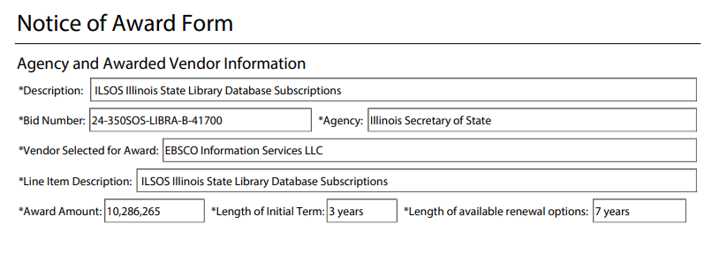
Illinois State Library E-Resource Program
What is it?
What does this mean?
The Illinois State Library will administer a program for an e-resource package available to all communities in Illinois.
What will we get?
A robust package of full-text databases provided from the state library through EBSCO.
Through our current SWAN-RAILS EBSCO Package, many of the databases will overlap in content.
The goal is to work with EBSCO & RAILS to negotiate a package that makes sense for our SWAN members.
Publicly available information from:
State of Illinois - General Services - Bid Solicitation

Slide 7
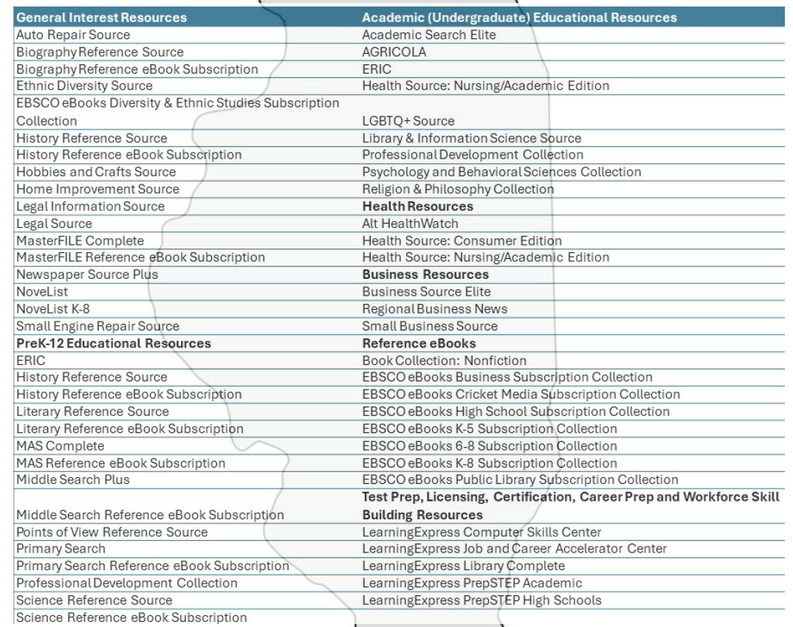
Illinois E-Resource Program
General interest
PreK-12 educational resources
Academic (undergraduate) educational resources
Health resources
Business resources
Reference eBooks
Test prep, licensing, certification, career prep and workforce skill building resources
Notes:
Novelist only includes fiction titles, Novelist Plus includes both fiction and non-fiction titles
LearningExpress Computer Skills: Fundamentals of computers, the internet and popular software applications
LearningExpress Job and Career Accelerator Center: Provides job seekers with tools to explore careers, find open positions, apply for jobs and get hired.
LearningExpress Library Complete: Includes academic skill-building, test prep and career-related resources all-in-one
LearningExpress PrepSTEP Academic:
LearningExpress PrepSTEP High Schools: Whether planning to attend college, join the military, or enter the workforce, students can achieve their goals using targeted learning centers.
Academic Search Elite:

Slide 8
SWAN support for statewide e-resource program
All public libraries & schools will be supported with SWAN platform integration
This includes libraries that opted out of the SWAN EBSCO deal
SWAN will aim for July 1, 2024
OpenAthens links for posting
Integration within Aspen library profiles
Provides keyword searching across databases

Slide 9



The SWAN EBSCO deal: three paths forward
New SWAN brokered deal with EBSCO: all inclusive package
Gale & others have approached SWAN
RAILS EBSCO package “A” (smaller than our current package “B”) with a SWAN discount
Libraries purchase resources individually with EBSCO

Slide 10
Introduction to EBSCO nomenclature
Academic Search Ultimate
(9,982 full text journals)
Academic Search Premier
Academic Search Elite
(1,357 full text journals)
Ultimate (largest)
Premier/Complete
Elite (smallest)

Slide 11
What are some of the differences?
Statewide deal
SWAN EBSCO current deal (RAILS EBSCO package B)
Novelist & Novelist K-8
  Fiction only
Academic Search “Elite”
  Smaller full-text
Business Source “Elite”
Novelist Plus & Novelist Plus K-8
  Fiction & all non-fiction
Academic Search “Premier”
  Option to upgrade to Academic Search “Complete”
Business Source “Premier”
  Option to upgrade to Business Source “Complete”
Consumer Reports

Slide 12
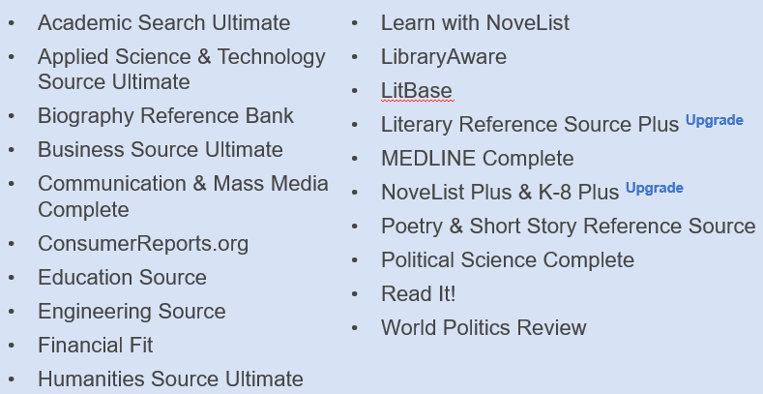
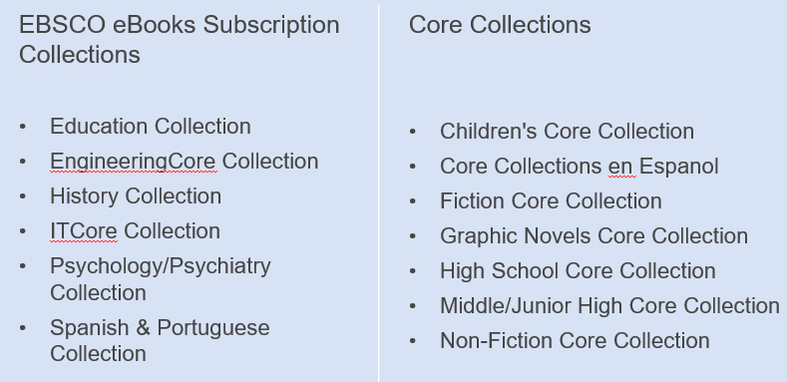
Proposed SWAN “All-Inclusive” Package
New EBSCO proposal to SWAN
July 1, 2024, start date
Total invoice price expected at $419K (previous proposal was $475K)
  If libraries drop-out of deal, individual library price is expected to increase
Participating libraries will have access to all resources listed on this slide
No more picking every year! One set package
Notes:
LibraryAware: Helps libraries raise awareness and engage their community. Use templates and tools to create emails, newsletters, bookmarks, shelf talkers, flyers, social and digital displays, and more for promoting books and resources throughout the library and beyond.
Highlights include: No limits on users, subscribers, or sends.

Slide 13
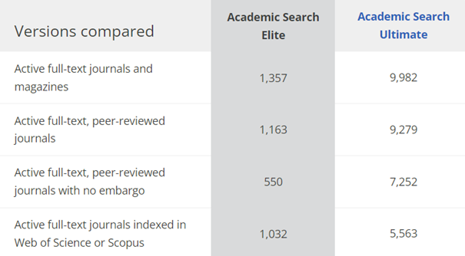
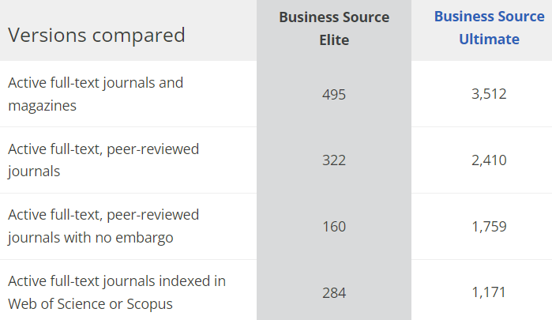
Upgrades Available with NEW SWAN all-inclusive package
Statewide EBSCO deal
Academic Search Elite
Business Source Elite
NoveList
NoveList K-8
Proposed new SWAN package
Academic Search Ultimate
Business Source Ultimate
NoveList Plus
NoveList K-8 Plus

Slide 14
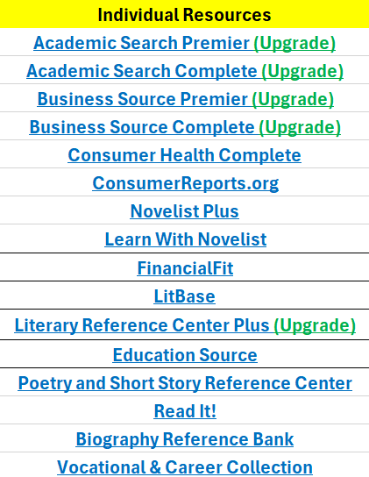

RAILS Package A
Another possible SWAN package
July 1, 2024, start date
Pricing based on service population + SWAN discount
  Dependent on how many libraries participate in this package, price may increase
  ConsumerReports.org + NoveList Plus / K-8 Plus + 6 from pick list

Slide 15
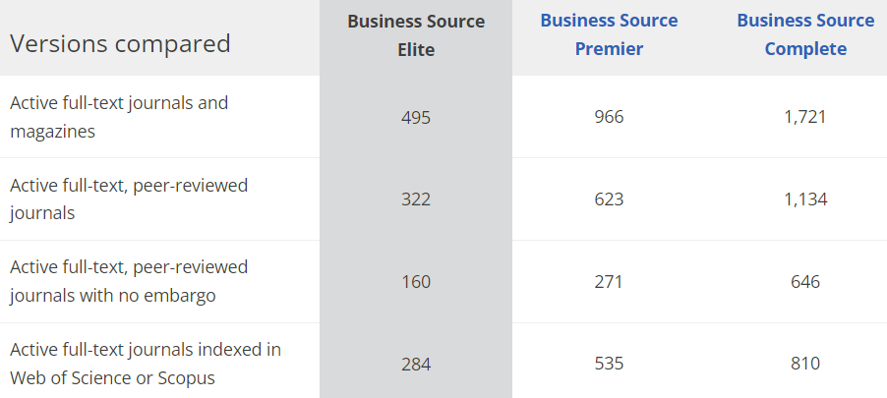
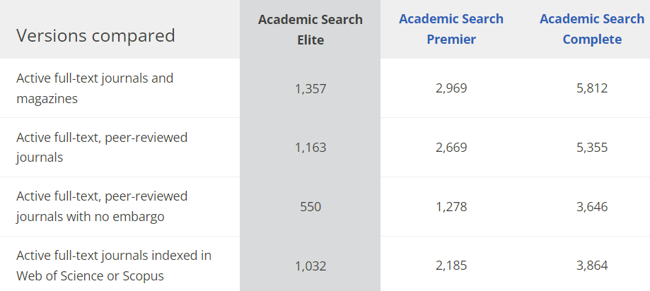
Upgrades Available with RAILS Package
Statewide
Academic Search Elite
Business Source Elite
NoveList
NoveList K-8
New RAILS Package
Academic Search Premier / Complete
Business Source Premier / Complete
NoveList Plus
NoveList K-8 Plus

Slide 16
Highlights from each package
SWAN All-Inclusive Package
RAILS Package
One set package
NoveList Plus + ConsumerReports.org continuation
LibraryAware
Core Collections including Core Collections en Espanol
Core databases + pick list model
NoveList Plus + ConsumerReports.org continuation
Core Collections can be added for an additional price – not in pick list

Slide 17
Year 4 does not include June 2024

Slide 18



Other Options - Gale
Gale – Peterson’s Test Prep, Udemy, and Chilton Library
  Choose standalone product
  Udemy + 1
  All three
Initial proposal includes a deep discount for all SWAN member libraries
Final pricing is dependent on the number of interested libraries
The more products bundled, the deeper the discount

Slide 19
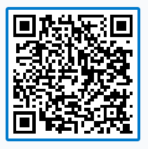
Polls! https://pollev.com/aaronskog656
Based on what we know about the statewide research databases deal, will you retain your CURRENT budget used for online resources?

Slide 20



Pricing for renewing libraries and new libraries available under SWAN Group Discounts for E-Resources.
New library pricing is set to expire on June 30, 2024 – take advantage while you can!
For existing Comics Plus libraries with a subscription set to expire June 30, 2024. Intent to renew form available now on our SWAN Support Site.

Slide 21
Website accessibility challenges for public libraries & SWAN’s role

Slide 22
Background
Who brings the accessibility challenge?
What does it look like?
What is a VPAT?
What guidance is there for Illinois public libraries?
What is SWAN’s role within website accessibility?

Slide 23
Who brings the accessibility challenge?
Library patron files complaint with Office Civil Rights of the US Department of Education
Public libraries fall under the definition of a “public entity” and are subject to regulations of ADA
Complaint alleges discrimination to persons with disabilities, including website accessibility
RAILS provided memo outlining the complain process, investigation, and resolution of complaints

Slide 24
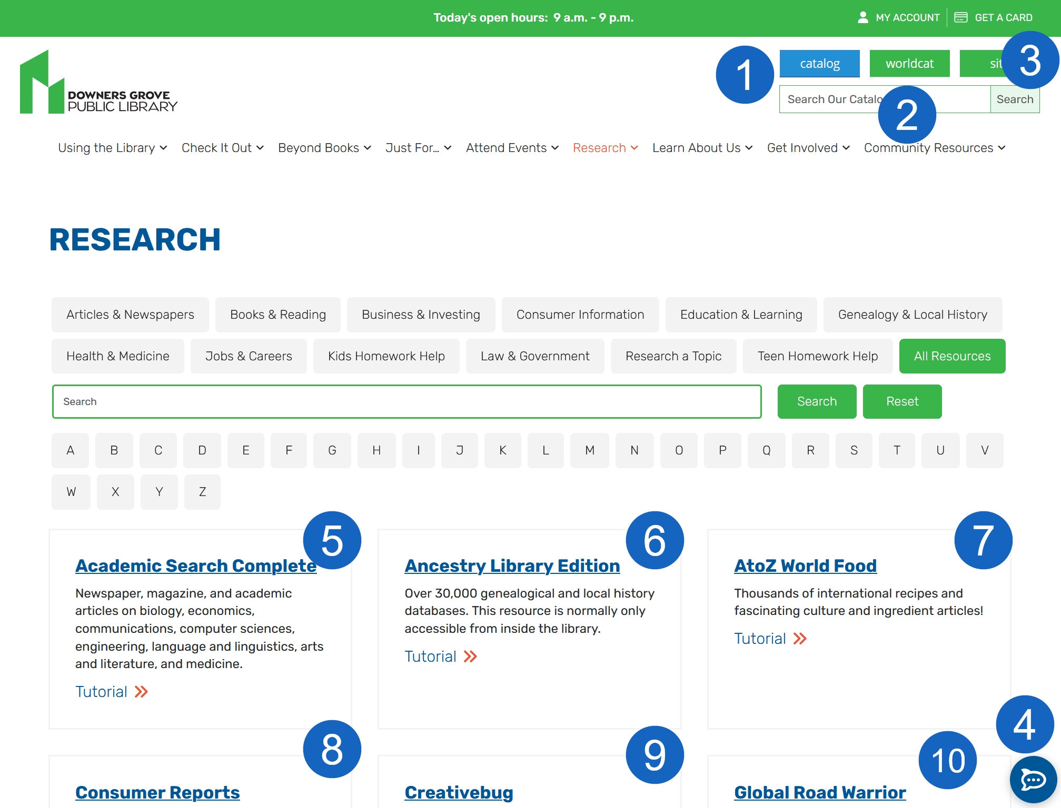
Public library website & online digital presence
It’s complicated!
  Your library website
  SWAN catalog with integrated e-content (eBooks, online resources)
  E-content vendors (Illinois Digital Archive/ContentDM, mobile app, etc.)
  3rd party vendors (events calendars, card registration)
10 different sites represented on this screenshot, not including the library website itself

Slide 25
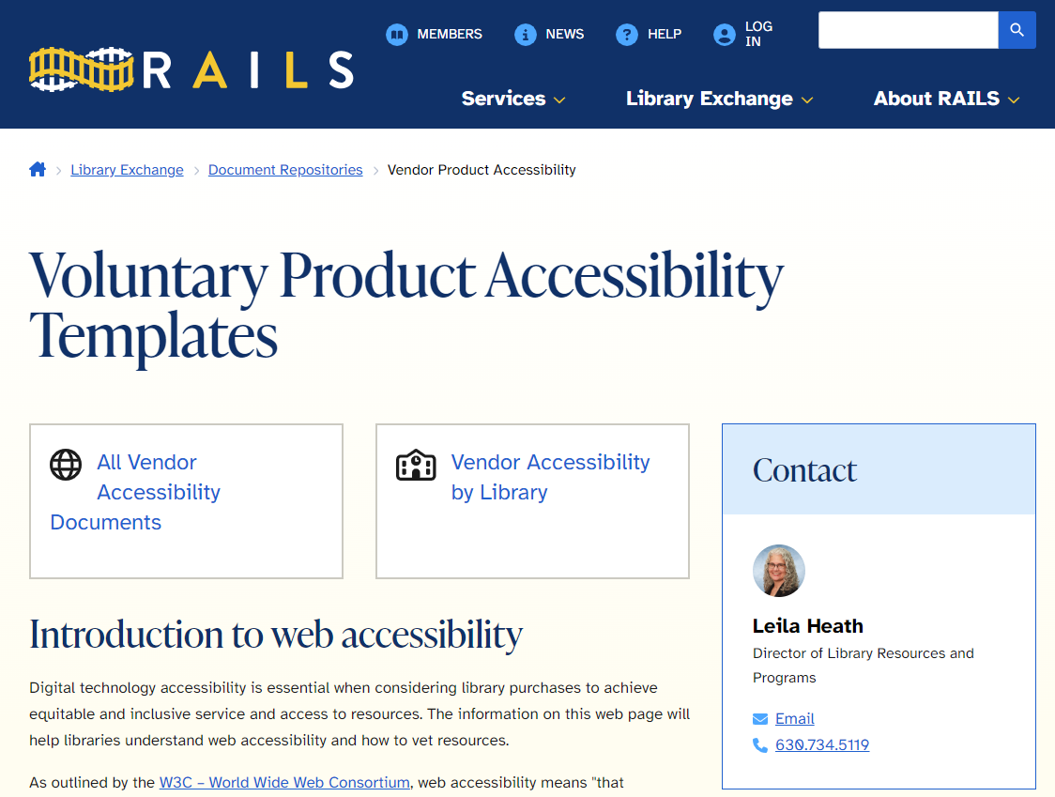
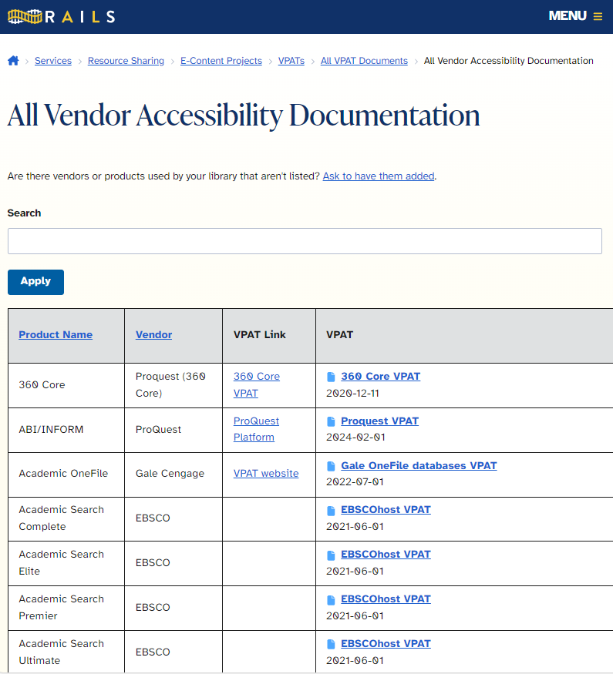
What is a VPAT?
A VPAT is a form provided by Information Technology Industry Council that vendors use to create an Accessibility Conformance Report
Although the ACR is the completed VPAT, vendors and manufacturers commonly refer to both as VPAT
Vendors provide VPAT including:
Communico
EBSCO
Gale
ProQuest
Etc
Use the RAILS database to search & assign your library profile

Slide 26
Aspen Discovery needs a VPAT
Deque Service Description | Aspen Discovery web | Aspen LiDA (SWAN libraries + app)
Comprehensive Assessment - Web 31 Pages WCAG 2.1 AA testing standard Chrome Browser/NVDA Assistive Technology Written Executive Summary Report Online view-only access to the Web Assessment Results | $26,350 | $34,800
Voluntary Product Accessibility Template (VPAT) | $10,500 | Unknown
Total | $36,850 | $34,800
Deque quote for SWAN Aspen Discovery & LiDA app

Slide 27
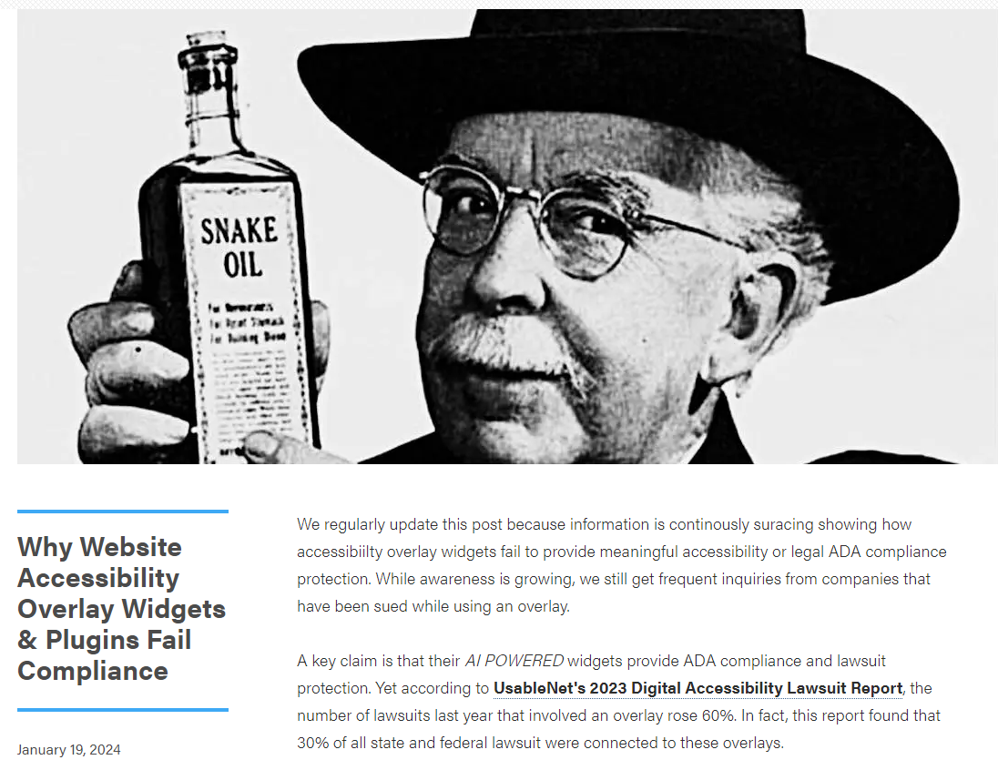
Can’t we just use overlays & widgets?
“What these overlay "solutions" do is add a layer of code over the site that masks errors but only addresses the basic accessibility issues it can detect. This is like putting a bandaid over a shark bite and calling it a day.”
https://www.accessibility.works/blog/avoid-accessibility-overlay-tools-toolbar-plugins/

Slide 28
Next steps
SWAN
  Deque consultation: SWAN Board decide Aspen web only or expand to LiDA
  SWAN: explore Aspen Discovery community cost-sharing
Libraries
  Obtain your own accessibility assessment for your organization website
  Review the RAILS VPAT database & assign your library to vendors you are using
Per RAILS memo: DOJ deadline 2027

Slide 29
Membership Satisfaction Survey Results
Aaron Skog, Executive Director

Slide 30
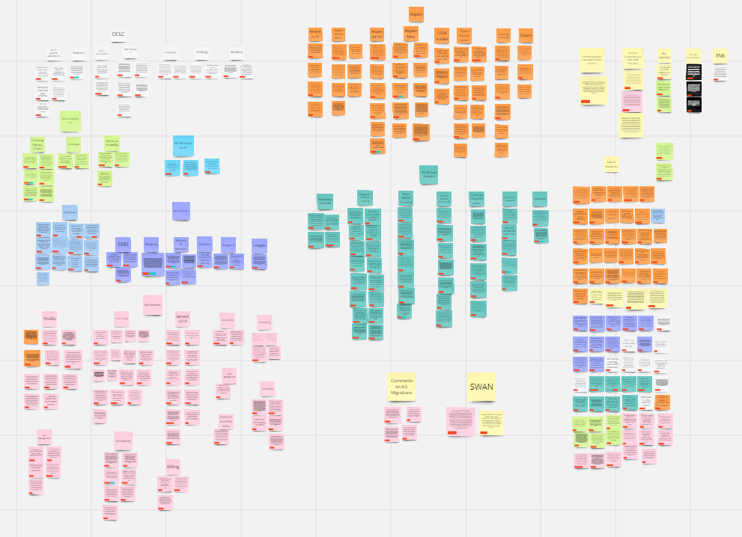
Comment sorting & analysis
Used affinity diagram
Completed by SWAN Management Team
Full report presented to SWAN Board in April

Slide 31
Summary & Follow up
WorkFlows unintuitive UI
MobileStaff problematic outside the library
Analytics learning curve
Aspen filters, record grouping, artwork
MessageBee UI improvements needed
Explore a trial of SymphonyWeb
Researching Analytics option Privacy Suite for UI improvements
Expo workshops & future classes
SirsiDynix contract extension
SWAN Board Environmental Scan Task Force

Slide 32
SWAN Business administration: ACH vs checks

Slide 33
Let’s discuss! Cost of transactions: bank ACH vs checks
Current arrangement with checks vs. possible arrangement with ACH replacing checks
Summary of fees | Current arrangement using checks | Proposed ACH only scenario
Bank fees | $162.26 | $162.26
Check fees | $370.42
ACH fees | $9.12 | $38.40
Postage | $56.44
Subtotal | $598.24 | $200.66
 | Monthly savings | $397.58
 | Annual savings | $4,770.96
Are libraries interested in having SWAN send payments for monthly online fines reimbursements?
Would libraries be willing to pay SWAN for quarterly invoices using ACH instead of by check?

Slide 34
SWAN Projects

Slide 35
Symphony Upgrade: Release Features
Features
Bugfixes
Item Categories 6-10
  Integrated into Configuration, Reports, API, 949 bib loading, and SIP2
Reporting security failures on RFID checkouts
BLUEcloud Single Sign-On for Workflows
Many updates to SymphonyWeb
Copy User does not honor Charge History rule
Trap Holds incorrectly handles in-transit items with canceled hold
Serials call numbers with extra spaces in analytics

Slide 36
Symphony Upgrade: What to Expect
June 17th
June 18th
Download WorkFlows 4.1 installer from SWAN Support Site and update staff workstations
Upgrade takes place overnight
  System will be offline beginning around 11:30PM
WebServices and SIP2 services are unavailable during upgrade
  No access to ‘My Account’ features in Aspen Catalog | E-Resources | SIP2
Downtime for library staff/use of Offline Mode not anticipated
Wait for ‘All-Clear’ SWANcom
Go live on Symphony 4.1!
Watch for any client/server mismatch errors
Open a support ticket to report unexpected behavior/errors
  Provide as much detail as possible

Slide 37
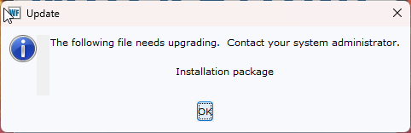
Installing WorkFlows 4.1
Installation packages for WorkFlows will be available on Support Site by June 10th
  Standard installer (with prompts, for most installations)
  Silent installer (non-interactive, best option for automated deployment)
  Automatically removes v3.7.1 prior to installing 4.1
  Will not affect settings stored in user profile (printers, preferences, etc.)
    Libraries using custom sig-pad language should backup any modified files prior to installation
Clients are not required to be updated prior to June 18th
  New features unavailable until client is and server version matches
  Client/Server mismatch errors to be expected until after go-live

Slide 38

SWAN Expo
Registration open!
https://support.swanlibraries.net/expo
The full session schedule will include roundtables, workshops, and presentations - we will announce the full schedule soon!
Workshops and presentations
  Aspen for library staff
  BLUEcloud Analytics
  Circulation best practices
  Collection management: weeding, storage, renovation
  MobileStaff hands-on
  Navigating copyright
  Power searching in Symphony
  RAILS delivery
  WorldCat Discovery
Roundtables
  Mindfulness and self care
  Staff development and team building
  Difficult service scenarios
Save the date! August 23rd

Slide 39
Thank you!

