Slide 1
SWAN Quarterly Meeting
September 5, 2024

Slide 2
Agenda
Call to Order and Welcome
Public Comment
Introductions
Approval of minutes
SWAN Board Environmental Scan Task Force update
Gale proposal for subscription e-resources
Revision to SWAN networking & working groups
Online patron registration options for SWAN libraries
SWAN Expo recap
Announcements & Questions

Slide 3
SWAN Board: Environmental Scan Task Force update

Slide 4
Environmental Scan Task Force
Reviewed potential library consortia & systems to contact
Created online survey
  Inquired about ILS & OPAC in use
  Strengths & weaknesses of both
  If a platform change took place within last 3 years
8 responses received to-date
Will review responses & decide on additional online interviews with selected library consortia & systems
Software vendors will be contacted for interviews on selected areas important to SWAN
  Based on platform survey
  Likely to include Innovative (Polaris), ByWater (Koha), and SirsiDynix (BLUEcloud)
Final recommendation & report will be brought to SWAN Board & membership

Slide 5
Gale proposal for subscription e-resources
Tara Wood, SWAN User Experience Manager

Slide 6
Gale Presents: Udemy
NEW RAILS Udemy offer
  Previous discount was 25%
  SWAN + RAILS worked with Gale to negotiate a deeper discount
  New discount is 50% off Udemy list price – we need 75 RAILS libraries
New subscription period: 1/1/25-12/31/25
Current Udemy subscribers will be adjusted to get on the1/1/25 period and will receive a credit for the remaining length of their subscription
RAILS will handle all subscription requests
Notes:
RAILS + SWAN worked closely with Gale to put together the following offer.
We do not yet have the information on how to sign up for RAILS; want to share pricing and information for your consideration, and stay tuned for more information about how to join the deal.

Slide 7
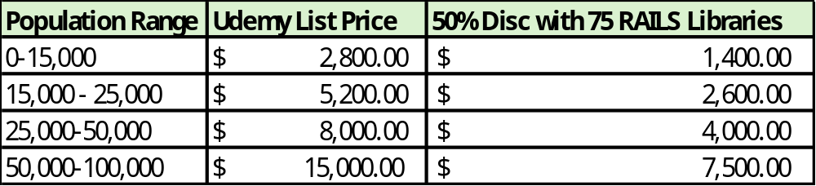
Preview at pricing for SWAN

Slide 8
Important dates
Webinar #2 @ 10:00AM
Library decision deadline
January 1
Subscription starts
October
Udemy trial site available
October 1
Webinar #1 @ 2:00 PM
November 6
November 30

Slide 9
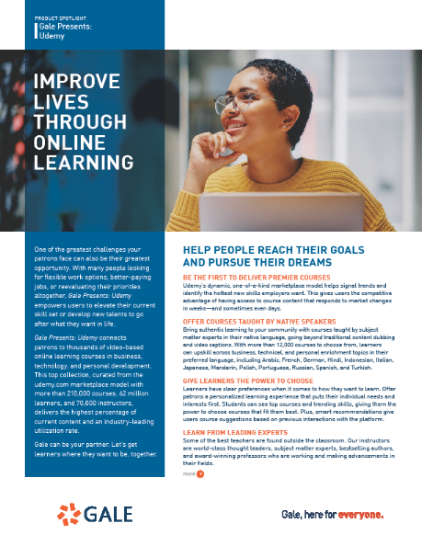
Details
Gale Presents: Udemy one sheet
Information sessions hosted by Gale:
RAILS – sign up
List of SWAN libraries
#1 October 1 @ 2:00 PM: Registration link
Coming soon!
Udemy list price
#2 November 6 @ 10:00 AM: Registration link
Price with 50% discount
support.swanlibraries.net/deals

Slide 10
Reminder: Database links
Links for the Illinois State Library EBSCO package are available.
support.swanlibraries.net/EBSCOdatabases
There is no need to contact EBSCO or the State Library to start using your databases.
Upcoming Illinois State Library webinars:
https://librarylearning.org/event/2024-09-05/statewide-database-package-training-public-libraries
Notes:
Big thanks to Olivia Montolin, E-Resources Consultant, for assembling the links for SWAN libraries in July.

Slide 11
Revision to SWAN networking & working groups
Scott Brandwein, SWAN Assistant Director

Slide 12
Types of groups
Working Groups
Networking Groups
Formerly “Advisory Groups”
Emphasis on collaboration, tasks, assignments, outreach, and decision-making
Membership set in fall and committed to attendance
Formerly “User Groups”
Emphasis on discussion, networking, Q&A, connecting with SWAN staff and fellow members
One in-person meeting/event per year

Slide 13
Networking and working groups
Meeting Type | Recorded | Notes | Agenda | Calendar | Chair | In-person
Working Group | No | Yes | Created by SWAN staff, shared with participants only | Personal invitations sent to participants. | SWAN Staff | Chair’s/group’s discretion
Networking Group | Yes | No | Created by member staff chair(s) with input from membership | L2/Zoom | Member Staff with SWAN facilitator | Once a year
SWAN Update | Yes | No | Created by SWAN staff, shared publicly | L2/Zoom | SWAN Staff | No

Slide 14
2025 Groups
Networking Groups
  Acquisitions and Cataloging
  Circulation
  Aspen
Working Groups
  Circulation
  Cataloging
  Discovery & User Experience

Slide 15
Defunct groups
Groups ending in 2024 include
  ILL Users
  RFID Users
  Book Club Users
  Technology Update
Instead, we will plan individual events and work on a series of topical sessions throughout 2025.

Slide 16
Next steps
“Getting Involved” informational session on Zoom
  September 18th at 10:00 a.m.
  Covers information provided here + information about each group
SWAN reworking charges and descriptions
Scheduling to take place in October

Slide 17
Online patron registration
Tara Wood, SWAN User Experience Manager

Slide 18
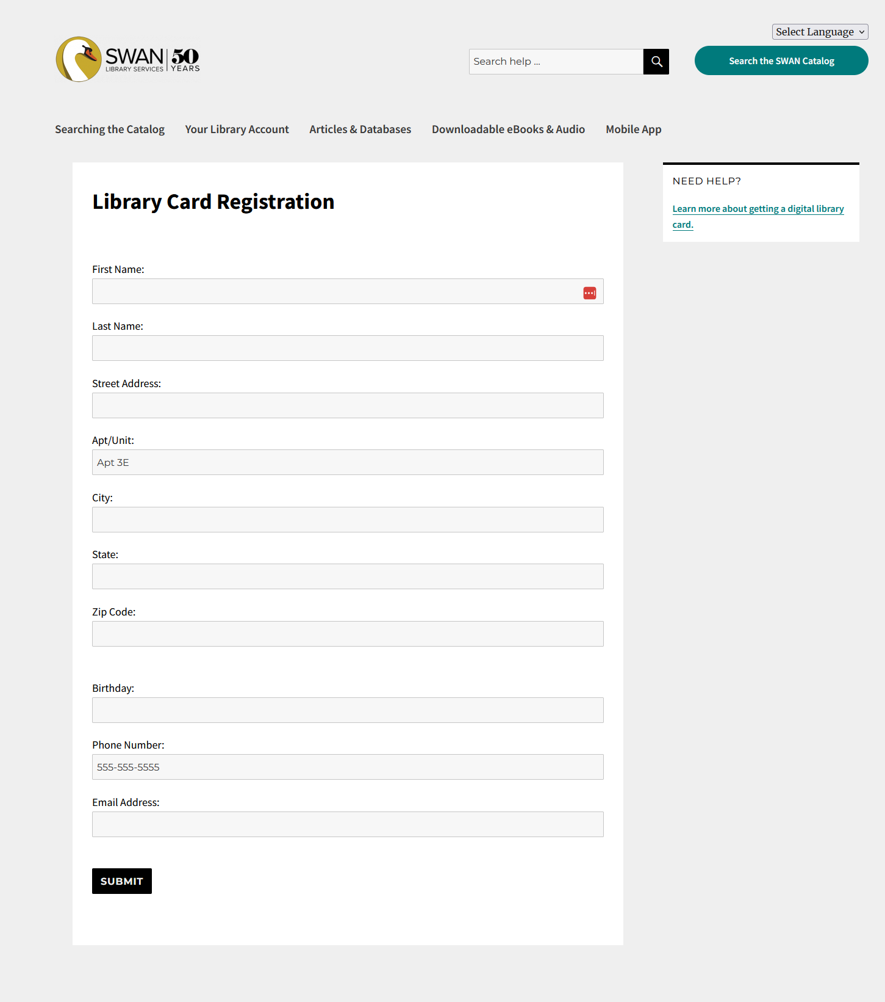
Current
63 libraries use the SWAN Online Patron Registration tool, through the SWAN patron site
No address validation
No verification of identity or address within library district
Notes:
Home grown solution with limited support – we are the only ones using it. SWAN is looking to the future of this tool and investigating better supported and fuller featured solutions.

Slide 19
Features to consider for a new tool
Registration forms
Welcome emails
Address verification
Identity verification
Duplicate checking
Provisional cards and non-residents
Minor registrations

Slide 20
Registration forms
The registration form would collect all necessary information from the patron at the time of registration. Features to consider with registration forms include:
Customization: Can the form be customized on a per-library basis versus a shared form across the consortium, can we add custom fields (e.g. for notice preference).
Home library assignment: Can the form automatically assign the users home library based on address verification, or does the user need to select a home library.
Format standardization i.e. correcting information entered by the patron before it is passed to the ILS.
Statement of responsibility: An agreement page the user must complete to apply for a card, either customized on a per-library basis or shared across the consortium.
Languages: Form can be offered in more than one language.

Slide 21
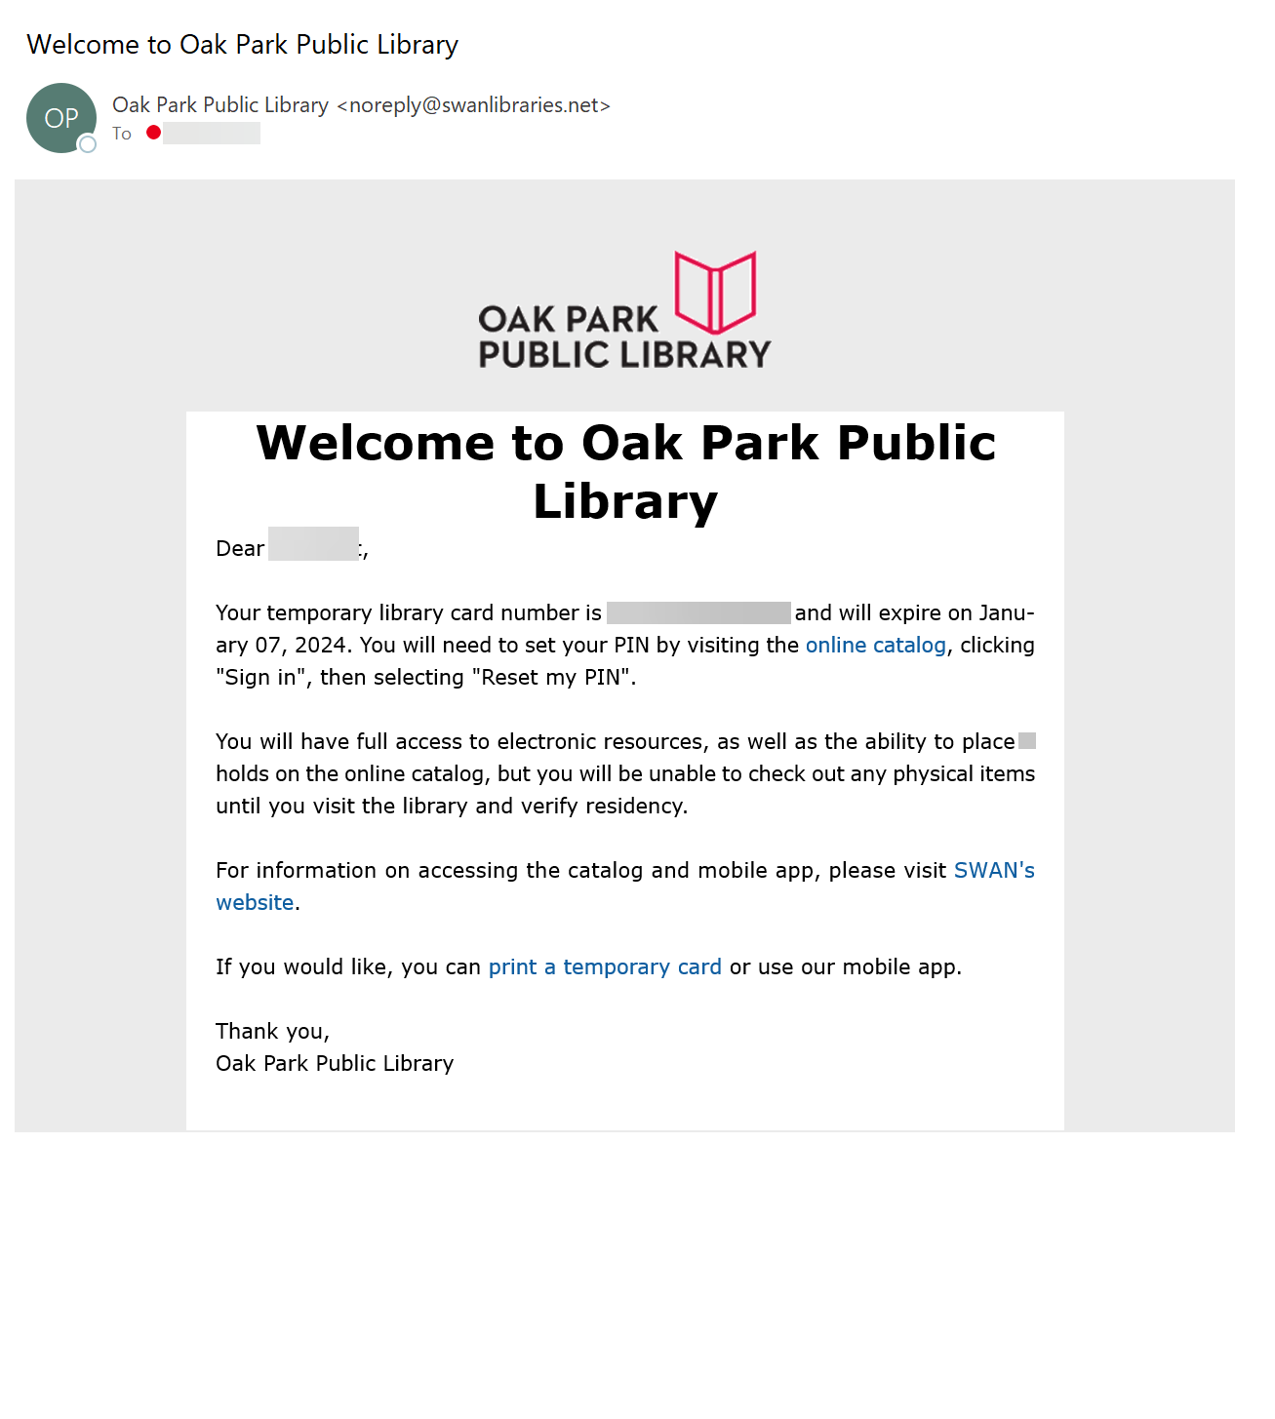
Welcome emails
Welcome emails are delivered to the patron after a successful registration, with details about their account and information about the library. Features to consider with welcome emails include:
Customization: Can the emails be customized on a per library basis, or is one email template shared across the consortium with library details dynamically populated (e.g. library name, contact information, etc.).

Slide 22

Address & GIS verification
Address verification checks the patron’s entered address and confirms it is a valid address.
At the most basic level, a tool can verify that the address is a valid USPS address. At a more advanced level, a tool can use a map of the library district in the form of a shape file to verify that the patron lives in the library district.
Notes:
All of the tools we are looking at have better address verification than our current tool.

Slide 23

Identity verification
Some tools will verify that a patron actually lives at the entered address.
Basic verification: Checks USPS Change of Address information and marketing databases; this is not as reliable as advanced verification but comes at a lower cost.
Advanced verification: Through an additional third-party provider, verifies identity against multiple points of data using the same technology banks and credit card companies use; this is more reliable, but comes at a higher cost.
Notes:
With identity verification and in-district address verification, we could issue full access cards to patrons.

Slide 24
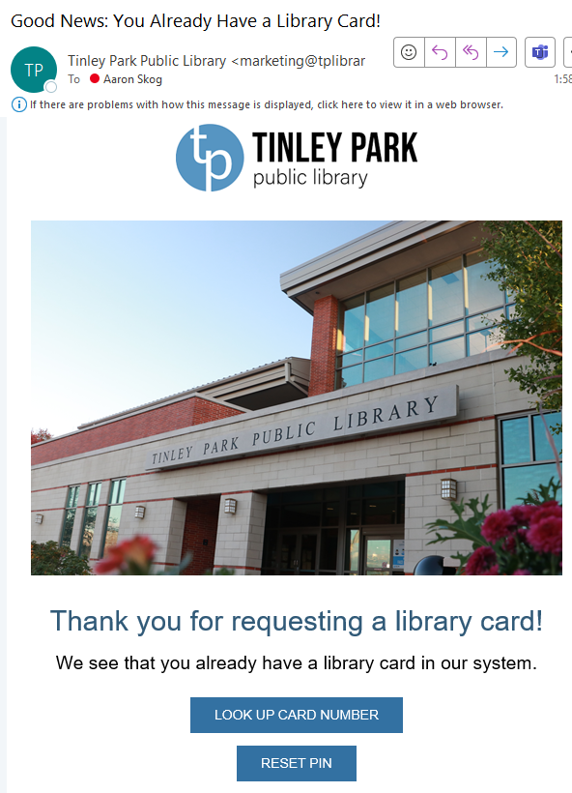
Additional checks & fallbacks
Duplicate checking
A tool may check the ILS to ensure the same patron is not registering multiple times - typically check using name and birth date.
Provisional cards
A tool may provide only a provisional, or temporary card, that requires the patron to come into the library to verify their identity to receive a full access card.
  For example: If they did not pass the automated identity verification in the tool.
Non-resident registration
Tools can redirect to the library's web page for non-resident card application.
Notes:
Note: Our current tool issues provisional cards.

Slide 25

Minor registration
Tools can provide a process for parents or guardians to register cards for minors.
Typically adds additional fields to collect both parent/guardian information and minor information.
Identity verification would be performed against the parent/guardian.

Slide 26
Comparing solutions
Quipu eCard
Patron Point
Route patrons to the correct home library
One form, one welcome email with custom library info
Address & GIS verification
Identity verification (basic and advanced)
Provisional cards, duplicate checking, non-resident application link
Minor registration
Estimated annual cost:
$32,000 for 30k patrons
Route patrons to the correct home library
One form, one welcome email with custom library info
Address & GIS verification
Identity verification (advanced)
Provisional cards, duplicate checking, non-resident application link
Minor registration
Estimated annual cost:
$16,500 for 30k patrons
Notes:
Both options that could issue full access library cards.
These are just preliminary quotes, we would need updated quotes if we proceed

Slide 27
Comparing solutions
Aspen registration does not include: Address, GIS, or ID verification or routing to the correct library.
If a third-party solution isn’t selected, SWAN will move to using Aspen Self-Registration in 2025.
Aspen Self-Registration
Custom registration form per library
Custom welcome email
Address validation (USPS valid address only)
Minor registration
Estimated annual cost:
Included with Aspen
Notes:
Would likely not use Aspen to issue full access cards – would continue to issue provisional cards.

Slide 28
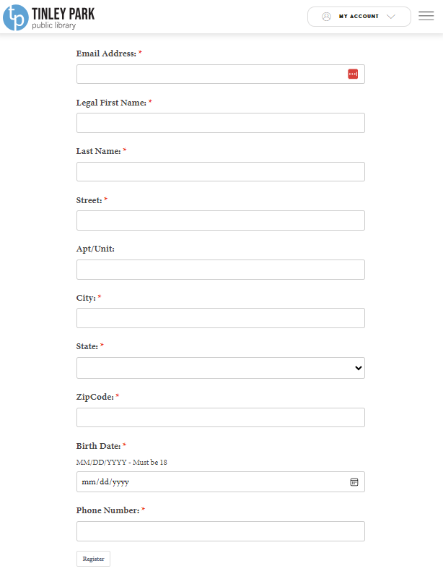
Patron Point
Tinley Park Public Library
Notes:
Two SWAN libraries use Patron Point currently. Quipu forms would look similar – both are embedded into your website and/or Aspen catalog.

Slide 29
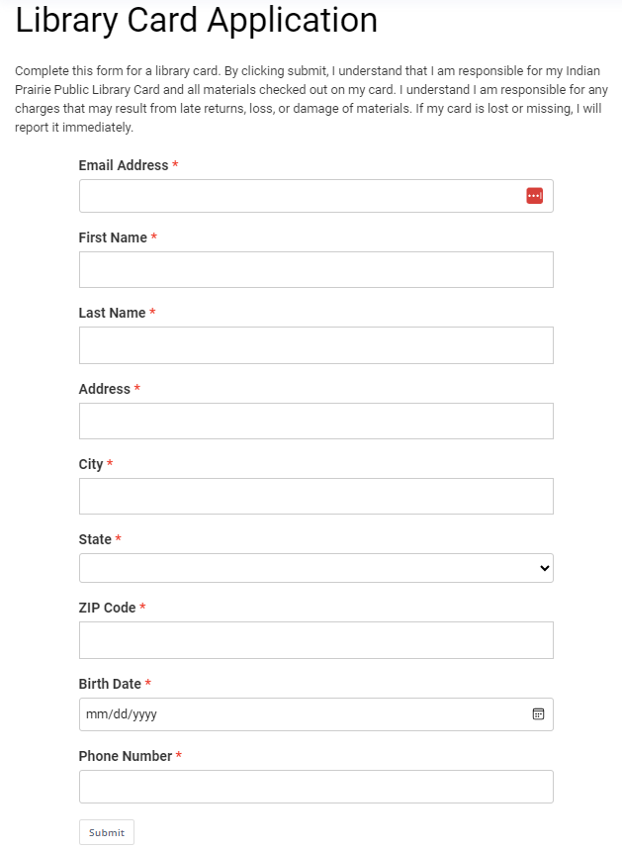
Patron Point
Indian Prairie Public Library District
Notes:
Indian Prairie is using online registration kiosks in the library. This helps to deal with issues of interpreting patron handwriting on paper forms, handling ID documents, or typos manually keying in information into Symphony. They also encourage patrons to use the mobile app for their library card, and few patrons ask for a physical card.

Slide 30
Card renewals
Card renewals presents issues with ongoing cost & security.
Requires storage of patron data outside of the Symphony ILS, so there are additional privacy and security concerns.
Many SWAN libraries use an expiration date of NEVER.
Online registration and card renewal are typically two separate processes and tools.
Notes:
34 libraries using NEVER

Slide 31
Discussion

Slide 32
SWAN Expo recap
Aaron Skog, SWAN Executive Director

Slide 33
SWAN Expo
Workshops and presentations
  From Confusion to Confidence: Improving Mental Health Crisis Intervention
  Keynote: State of SWAN
  NAMI consultation session
  MobileStaff consultation: bring your library device or learn about how to enhance your tablet experience
  BLUEcloud Analytics Q&A for public services
  Crisis plans from an HR perspective
  School partnerships: Issuing student cards
  BLUEcloud Analytics Q&A for technical services
  Basic copyright for library staff
  Utilizing the Illinois Digital Archives
  Local records management
  BLUEcloud Analytics basics
  Aspen for library staff
  Collection management: Weeding, storage, renovations
  Library newcomers & the immigrant experience
  Circulation best practices: Moments at the service desk
  Be a WorkFlows detective: Following clues to unravel confusing service scenarios
  RAILS delivery: Bins, bags, and beyond!
Roundtables
  Roundtable: Staff development, library in-service days, & what libraries do for fun
  Roundtable: Self Care in the Balance of Work & Life (NAMI)
  Roundtable: How to deal with difficult service scenarios

Slide 34
52 attending libraries, 227 staff
Acorn Public Library District | 3
Addison Public Library | 9
Alsip-Merrionette Park Public Library District | 5
Batavia Public Library District | 3
Bedford Park Public Library District | 1
Bensenville Community Public Library District | 2
Berkeley Public Library | 1
Berwyn Public Library | 9
Bloomingdale Public Library | 3
Blue Island Public Library | 5
Broadview Public Library District | 2
Carol Stream Public Library | 5
Chicago Heights Public Library | 2
Crestwood Public Library District | 6
Crete Public Library District | 3
Dolton Public Library District | 5
Downers Grove Public Library | 10
Eisenhower Public Library District | 4
Evergreen Park Public Library | 6
Forest Park Public Library | 3
Frankfort Public Library District | 2
Geneva Public Library District | 8
Glen Ellyn Public Library | 3
Hinsdale Public Library | 3
Homewood Public Library District | 1
Indian Prairie Public Library District | 4
Justice Public Library District | 2
LaGrange Public Library | 8
Linda Sokol Francis Brookfield Library | 3
Lyons Public Library | 1
Markham Public Library | 1
Matteson Area Public Library District | 8
Messenger Public Library of North Aurora | 1
Midlothian Public Library | 3
Oak Brook Public Library | 3
Oak Lawn Public Library | 8
Oak Park Public Library | 7
Palos Heights Public Library | 22
Park Forest Public Library | 3
Prairie Trails Public Library | 2
Riverside Public Library | 2
Saint Charles Public Library District | 2
South Holland Public Library | 1
Sugar Grove Public Library District | 4
Summit Public Library District | 2
Tinley Park Public Library | 3
Villa Park Public Library | 5
Warrenville Public Library District | 1
West Chicago Public Library District | 6
Wood Dale Public Library District | 2
Woodridge Public Library | 17
Worth Public Library District | 2

Slide 35
“I think opportunities to meet and speak with folks from other libraries are really valuable! Especially when your position requires you to connect with them in other contexts (circ staff across libraries needing to collaborate bc of shared patrons or items). I like that it's not just vendors trying to sell services and products to attendees. I will share information from the key note speaker with my library staff.”
“The hands on workshops were most beneficial!”
“Knowing that we are part something that is so large and every expanding was very encouraging. Seeing that many support systems are available if you are in need of them was cool.”
2024
Feedback
“After the MobileStaff demo on the iPad, I felt more confident ordering a new Socket Mobile scanner.”
“I loved hearing the last session I attended where they talked about how CPL is helping migrants. It made me realize that there is always more we can do to help.”

Slide 36
Announcements?

