Slide 1
SWAN Quarterly Meeting
March 6, 2025

Slide 2
Agenda
Call to Order and Welcome
Public Comment
Introduction of new directors
Approval of minutes Sept
Approval of minutes Dec
Board election
Enhanced online patron registration
Approval of budget
Environmental Scan Task Force report
2025 Platform survey
Overview of new helpdesk
Announcements

Slide 3
SWAN Board election 2025

Slide 4
Election process & timetable
Election Process Announced | March 6, 2025 (Quarterly)
Online Self-Nominations Accepted | April 1 – 25, 2025
Names of Candidates Released | May 1, 2025
Electronic Ballot | May 5 – May 23, 2025
Results Announced | June 2, 2025
Elected Candidates invited to June SWAN Board Meeting | June 20, 2025
Candidates’ Terms Begin | July 1, 2025
July Board Meeting | July 18, 2025

Slide 5
Online patron registration
Tara Wood, SWAN User Experience Manager

Slide 6
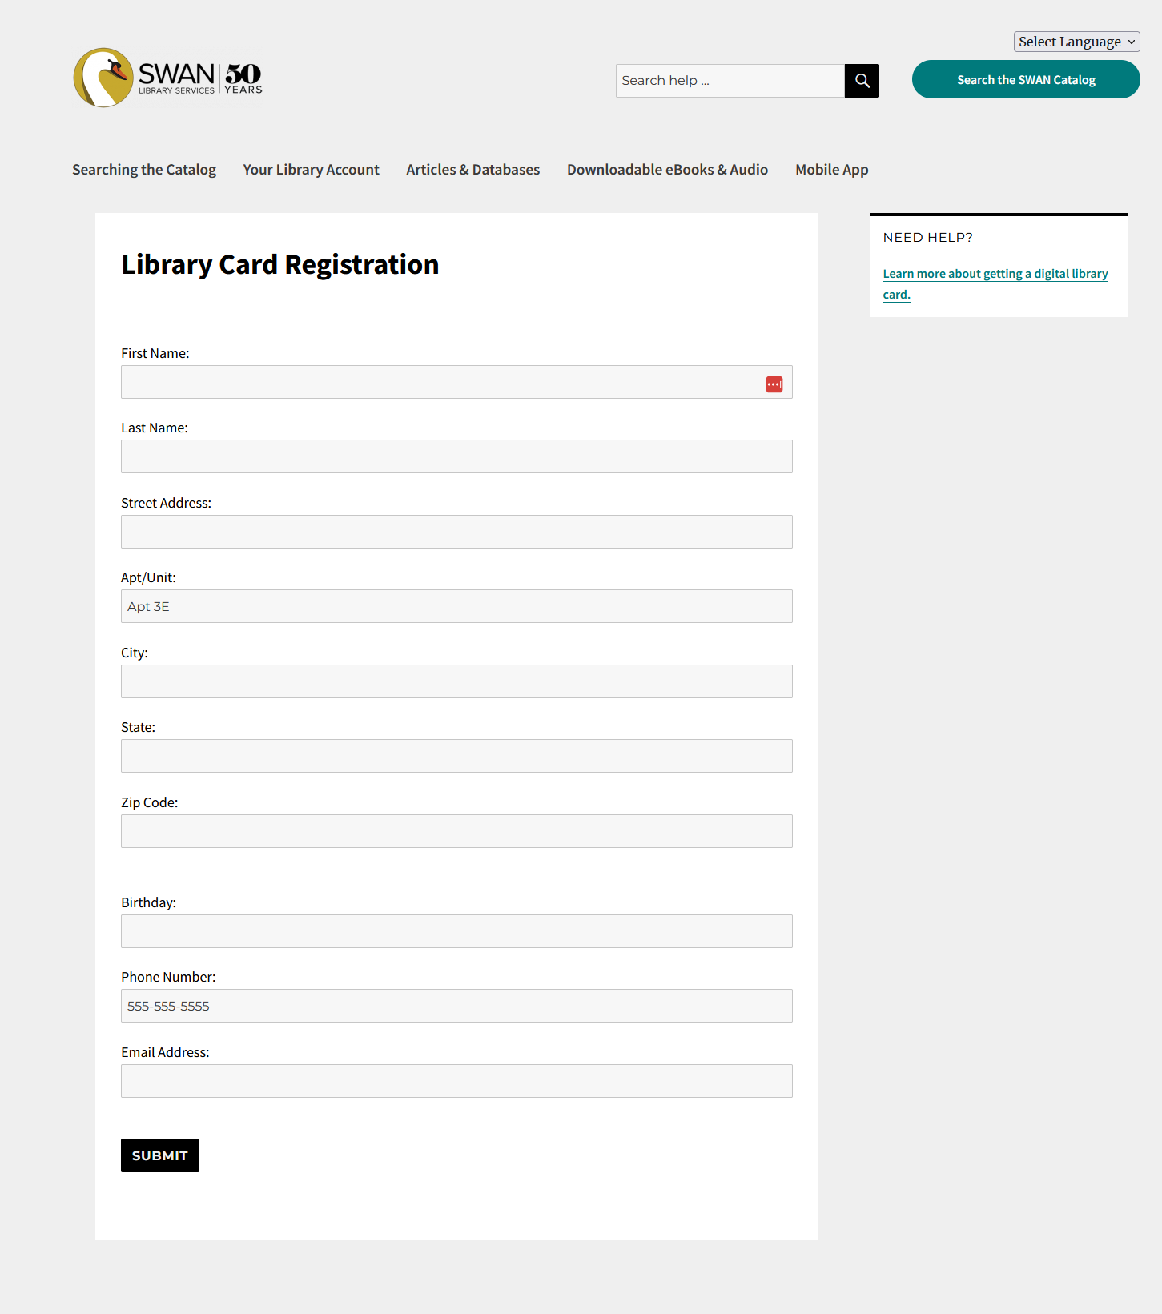
Current
63 libraries use the SWAN Online Patron Registration tool, through the SWAN patron site
No address validation
No verification of identity or address within library district
Notes:
Home grown solution with limited support – we are the only ones using it. SWAN is looking to the future of this tool and investigating better supported and fuller featured solutions.

Slide 7
Features to consider for a new tool
Registration forms
Welcome emails
Address verification
Identity verification
Duplicate checking
Provisional cards and non-residents
Minor registrations

Slide 8
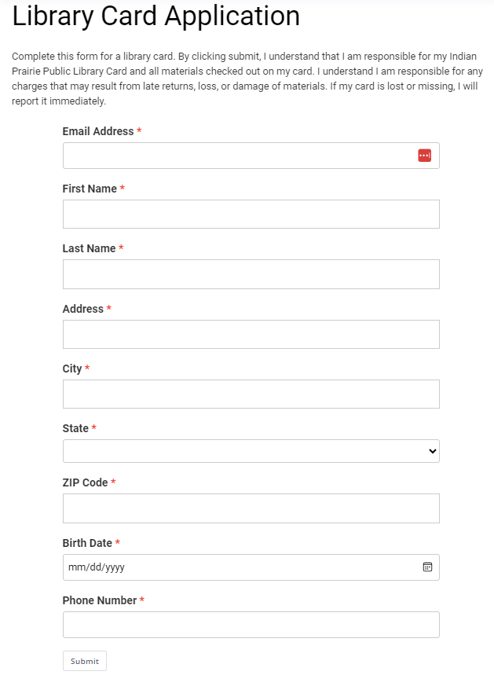
Comparing solutions
Patron Point
Route patrons to the correct home library
One form, one welcome email with custom library info
Address & GIS verification
Identity verification – can issue full access cards online
Provisional cards, duplicate checking, non-resident application link
Minor registration
Estimated annual cost:
$17k for 30k registrations
Notes:
Both options that could issue full access library cards.
These are just preliminary quotes, we would need updated quotes if we proceed

Slide 9
Comparing solutions
Aspen registration does not include: Address, GIS, or ID verification or routing to the correct library.
If a third-party solution isn’t selected, SWAN will move to using Aspen Self-Registration in 2025.
Aspen Self-Registration
Custom registration form per library
Custom welcome email
Address validation (USPS valid address only)
Minor registration
Estimated annual cost:
Included with Aspen
Notes:
Would likely not use Aspen to issue full access cards – would continue to issue provisional cards.

Slide 10
Summary
SWAN recommends pursuing Patron Point to provide full access cards through online registration.
This tool would not include card renewals, though libraries could add renewals on a per-library basis.

Slide 11
Discussion

Slide 12
FY2026 budget
Aaron Skog, Executive Director

Slide 13
SWAN budget process timeline
DATE | MEETING TYPE | ACTION ITEMS
Thursday, December 5, 2024 | Quarterly | Announce budget process timeline
Friday, December 20, 2024 | Regular SWAN Board Meeting | Review of budget draft.
Friday, January 24, 2025 | Regular SWAN Board Meeting | Review and recommend draft of SWAN Budget for Membership presentation.
January 2024 | SWANcom | Share draft budget to membership. Set February COW date and possible location of meeting.
Tuesday, February 4, 2025 | Committee of the Whole Membership Meeting | Meeting to discuss budget, fees, and reserves worksheet.
Friday, February 21, 2025 | Regular SWAN Board Meeting | Incorporate changes and suggestions to SWAN budget. Create recommendation to membership. Board accepts FY24 financial audit.
Thursday, March 6, 2025 | Quarterly | Roll call vote to approve SWAN budget.
Today
Quarterly meeting Thursday, March 6, 2025
Budget vote

Slide 14
Budget priorities
Includes new service Enhanced online patron registration cost $16.5K
Subscription to Novelist Select cancelled ($59K)
Savings realized in SWAN office ($95K)
Preparation & research
Presented Enhanced online patron registration September 2024 Quarterly meeting
Researched & replaced Novelist Select integration with Syndetics Unbound
Completed office search & move in December 2024

Slide 15
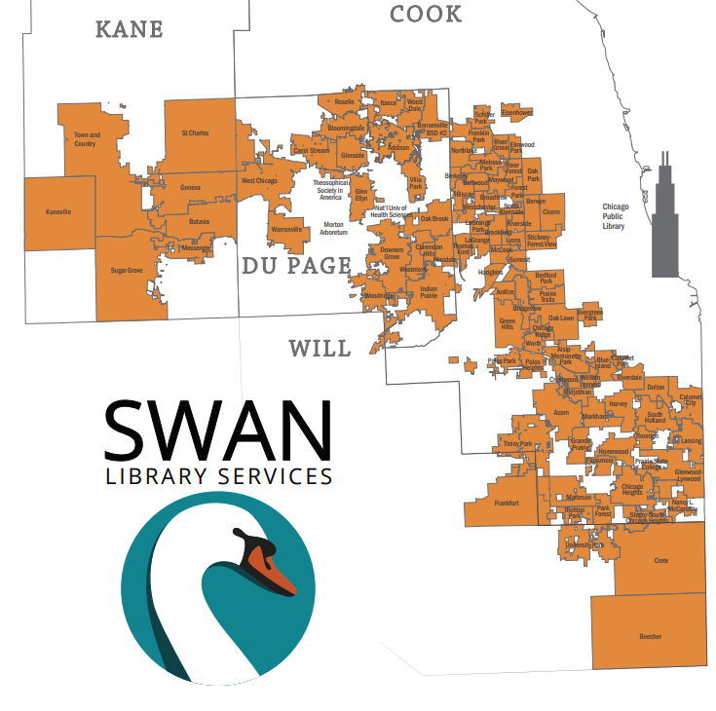
FY25 budget: online patron registration
Features
Registration forms
Welcome emails
Address verification
Identity verification
Duplicate checking
Provisional cards and non-residents
Minor registrations

Slide 16
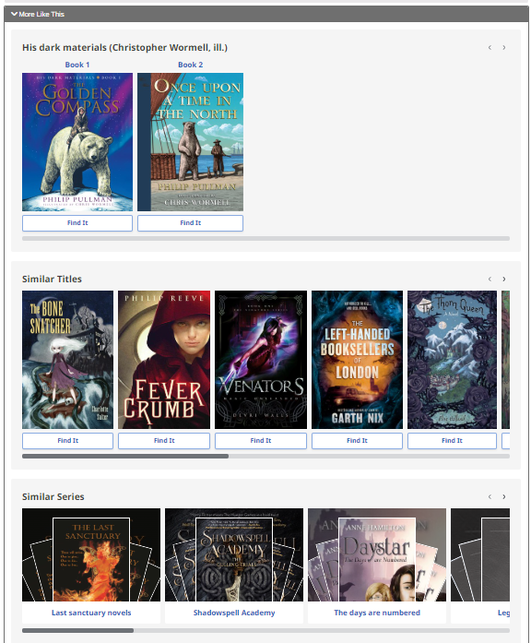
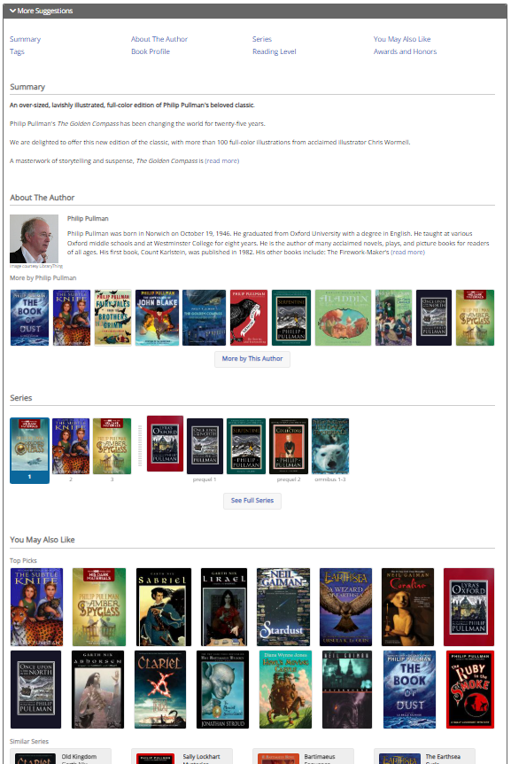
“More like this” in Aspen
Novelist Select
Syndetics Unbound

Slide 17
Cost of services
Service | 2024 Subscription price | Status
Novelist Select subscription | $59,059 | Ends June 30, 2025
Syndetics Unbound subscription | $19,767 | Renews July 1, 2025
EBSCO Novelist Select
ProQuest Syndetic Unbound

Slide 18
SWAN Reserves
SWAN Reserves Plan: Updated for FY26 Budget
Capital Expenditures | FY25 | FY26 | FY27 | FY28
 | July 2024-June 2025 | July 2025-June 2026 | July 2026-June 2027 | July 2027-June 2028
Prior Year Balance: End of fiscal year, final audit, see "Unrestricted" on Balance Sheet | $2,600,427 | $2,560,427 | $2,515,427 | $2,515,427
Single Sign On: Identity service provider one-time | ($35,000)
Funds for SWAN office relocation | ($5,000)
Funds for SWAN staff computer replacement |  | ($45,000)
Future ILS Migration Budget ($465,740)
Total | $2,560,427 | $2,515,427 | $2,515,427 | $2,515,427
Maintain 4 months operating in reserve (policy) | ($1,364,582) | ($1,326,431) | ($1,392,753) | ($1,462,390)
Over/(Under) Reserve Policy | $1,195,845 | $1,188,996 | $1,122,674 | $1,053,036
Operating Budget (5% increases each year after FY26) | $4,093,746.37 | $3,979,293.38 | $4,178,258.05 | $4,387,170.95
Months operating in reserve | 7.51 | 7.59 | 7.22 | 6.88
FY26 computer replacement $45K
7.5 months operating in reserve
4 months operating required by SWAN Reserve Policy

Slide 19
FY26 Budget
SWAN Budget Summary
SWAN Budget |  | FY25 Budget | FY26 Budget
4000 | Membership Fees | $2,875,427 | $2,936,839
4100 | Membership Reimbursements | $491,375 | $301,600
4200 | Reimbursements | $98,000 | $85,400
4300 | Grant Revenue | $500,616 | $501,394
4400 | Registration & Event Receipts | $5,000 | $6,260
4500 | Investment & Interest | $83,328 | $106,000
4600 | Reserves Funding | $40,000 | $45,000
Total Revenue |  | $4,093,746 | $3,982,493
5000 | Salaries & Wages | $1,577,736 | $1,639,608
5020 | Personnel Benefits | $445,419 | $448,700
5100 | Building & Grounds | $97,410 | $46,560
5200 | Professional Development | $14,700 | $25,501
5300 | Membership Development | $10,750 | $11,494
5400 | Information & Technology Services | $1,206,000 | $1,231,500
5500 | General Office | $12,700 | $4,100
5600 | Hardware & Equipment | $2,000 | $45,000
5700 | Insurance | $11,400 | $10,900
5800 | Contractual Services | $125,760 | $127,460
5900 | Library Materials & Content | $584,375 | $387,000
6000 | Interest & Fees | $2,474 | $2,610
Total Operating Expenses |  | $4,090,724 | $3,980,433
6100 | Asset Management | $2,322 | $1,460
Excess of revenues over (under) estimated expenses |  | $0 | $0

Slide 20
FY26 Revenue budget
RAILS LLSAP Grant $501,394
Membership fees $2,936,839
Investment & interest $106,000

Slide 21
Revenue
Membership Fees, Grant Revenue, Investment & Interest
Pass through: Group-purchase, Reimbursements for Losses,
SWAN membership fees overall increase 2%
  Varies per library due to public library fee formula
  FY26 fees based on 2022 tax data & bond amounts from 2022
Investments in Money Market & IMET Convenience Fund
Reimbursement resource sharing: reconciled & distributed quarterly
E-commerce fines: collected & distributed monthly

Slide 22
Expense budget 3% decrease for FY26

Slide 23
FY26 Expenses
Salaries & Wages
Personnel Benefits
4% increase
18 employees
  4 Administration
  3 User Experience
  5 Bibliographic Services
  3 part-time Bib Services
  6 IT & System Support
Health insurance via LIMRiCC
401a plan via MissionSquare
STD/LTD insurance

Slide 24
FY26 Expenses
Buildings & Grounds
Professional Development
New office 7-year lease
Reduced square footage
$95,658 savings
Bringing conference travel back to pre-pandemic level
Increase in planned conference attendance

Slide 25
FY26 Expenses
Information & Technology Services
SirsiDynix expenses are budgeted for $365,864 with a 2% escalation
OCLC renews at $318,848 with 2.25% escalation
Article Search integration through EBSCO Discovery Services and OpenAthens is $121,621 total
Support from ByWater Solutions for SWAN's Aspen Discovery Services is $102,350 & includes mobile app $4,600 annual hosting
The new subscription for online patron registration is budgeted at $16,500
Membership Development
Subscription expenses for learning management system and online tutorial coursework
Interactive training and within the learning management system, complete courses to master skills in the software systems SWAN provides
Expenses include Articulate Storyline, and Inquisiq
Slight increase from prior year

Slide 26
FY26 Expenses
General Office, Hardware & Equipment, Insurance
Contractual Services
General office decreased $8,600
One-time expense for SWAN employee laptop replacement
Reserve funds
Insurance adjusted for new office coverage
Cyber risk renewal descreased
Small increase
No new libraries joining in FY26
Financial auditor RFP completed
Audit expense increased
Accounting & payroll

Slide 27
Expenses
Library Materials & Content
Interest & Fees
EBSCO RAILS package deal no longer under SWAN e-content formula
RAILS invoices SWAN for participants
Expenses associated with bank fees for stopping checks or other services are recorded in this line
Lock box deposits
ACH services
Check processing

Slide 28
Revenue: Membership Fees
Separate formula for academic, school, special, and public libraries
Public library formula based on county tax data (Cook, DuPage, Kane, Will)
  Self-reported bond payments, debt service obligations deducted from total tax data
  Completion of debt service payments may increase fees (ex: Downers Grove)
  Details on how SWAN membership fees are calculated
  https://support.swanlibraries.net/about/budget
State funding via RAILS LLSAP is applied as a reduction in membership fees for 96 public libraries

Slide 29
FY26 Revenue
Public library fee formula incorporates tax data
Bond or debit service arrangement will be deducted from tax data
FY26 budget is using 2022 tax & bond data
  Why not current?
  Disbursement completed end of 2023
  Tax reports collected in September 2024
  FY26 SWAN budget work begins October 2024
Bond schedule & SWAN: set it & forget it!

Slide 30
Questions & Answers

Slide 31
Budget approval
Discussion
Motion to accept the SWAN budget for fiscal year 2025 as presented
Roll-call required

Slide 32
Environmental Scan Task Force Report
Aaron Skog, SWAN Executive Director

Slide 33
Work completed
Survey of library consortia & systems
Interviews with 5 consortia & systems
Vendor software demonstrations
  Koha with ByWater Solutions
  Polaris with Innovative Interfaces
  BLUEcloud Staff with SirsiDynix

Slide 34
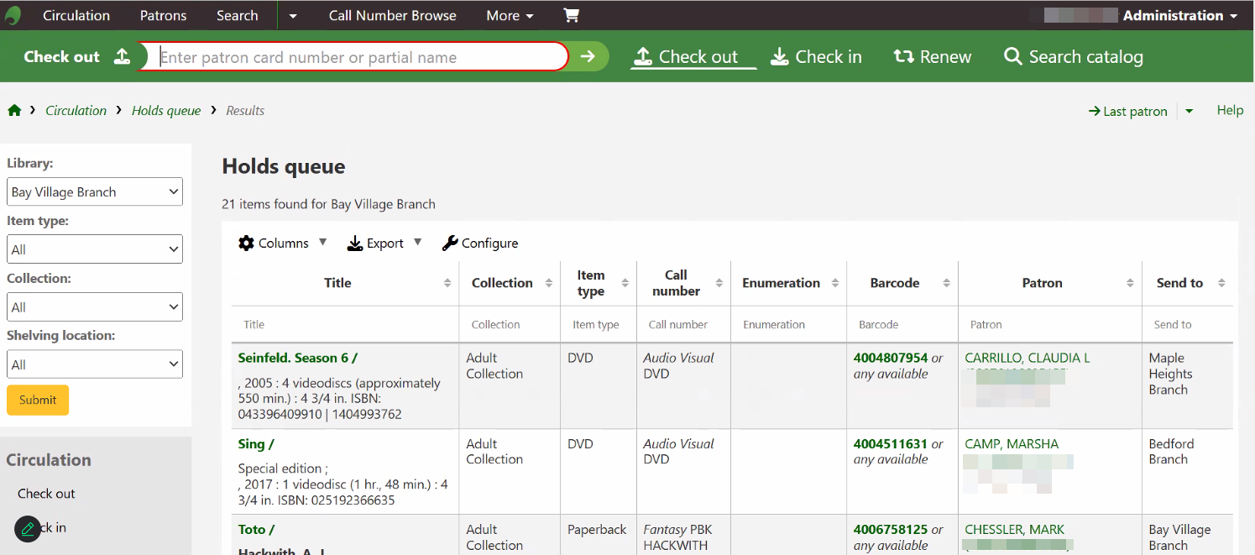
Koha ILS: holds queue example

Slide 35
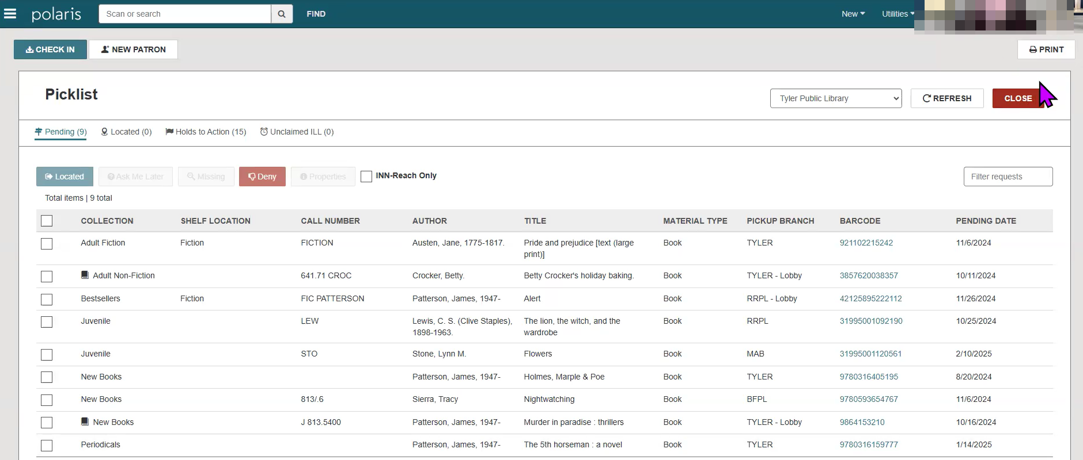
Polaris Leap: holds picklist

Slide 36
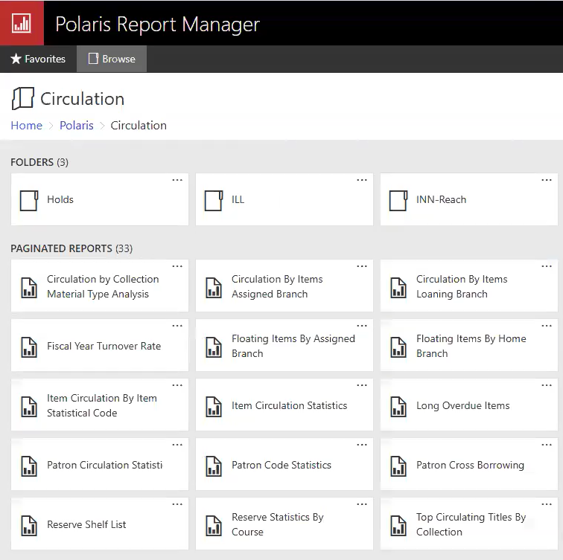
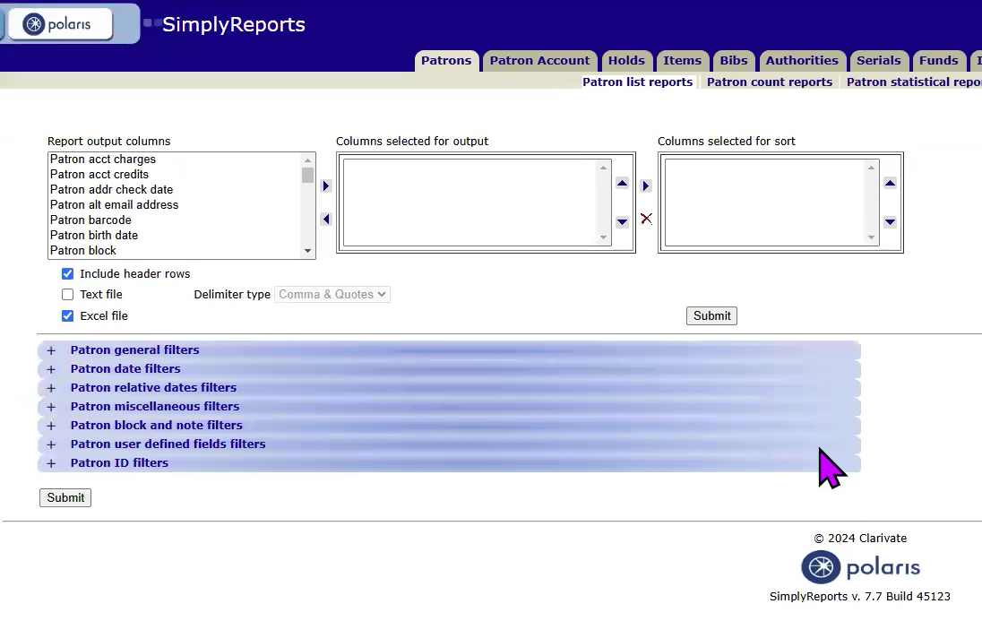
Polaris SimplyReports & Report Manager

Slide 37
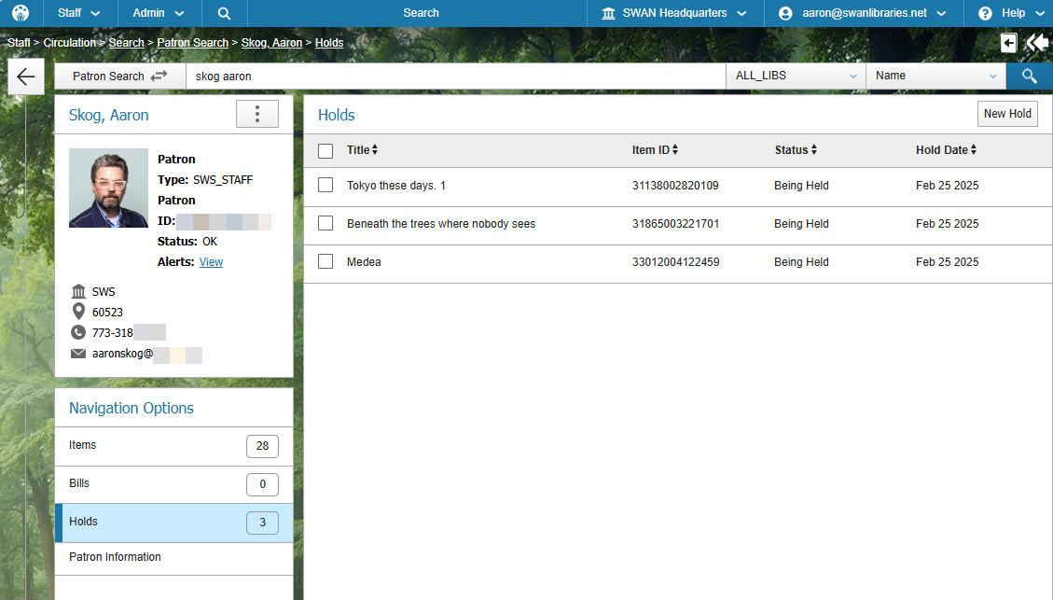
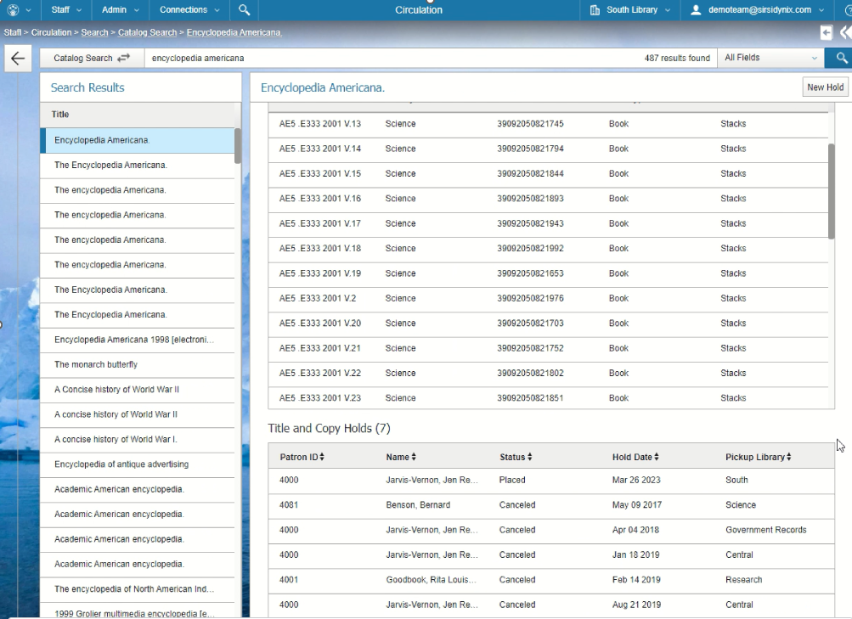
BLUEcloud Staff: viewing title & copy holds

Slide 38
Recommendation
Koha & Polaris Leap are strong alternative staff interfaces for circulation
Koha & Polaris utilize SQL for reports & analytics
Retain flexibility for future decision based on discussion & feedback
Consider year-to-year agreement with SirsiDynix
Potential higher increases vs multi-year agreement

Slide 39
SWAN Board Task Force
Anna Wassenaar, Blue Island Public Library
Jennifer Cottrill, Midlothian Public Library
Jesse Blazek, Palos Heights Public Library
Aaron Skog, SWAN
Environmental Scan Task Force

Slide 40
Membership Satisfaction Survey 2025
Aaron Skog, Executive Director
Jennifer Cottrill, Board President

Slide 41
Membership satisfaction survey
Goal of survey
Open to 100 library directors to complete
Rate the satisfaction of products
Revised rating for 2025
  Very satisfied
  Satisfied
  Neutral
  Dissatisfied
  Very dissatisfied
Platforms
WorkFlows
BLUEcloud Analytics
MobileCirc/MobileStaff
LiDA
Aspen Discovery
MessageBee
WorldShare ILL & WorldCat Discovery

Slide 42
Overview of new helpdesk platform
Scott Brandwein, SWAN Assistant Director

Slide 43
Orientations
Help Desk Interface
E-mailing tickets
Next Steps
Q&A
February 27 & 28

Slide 44
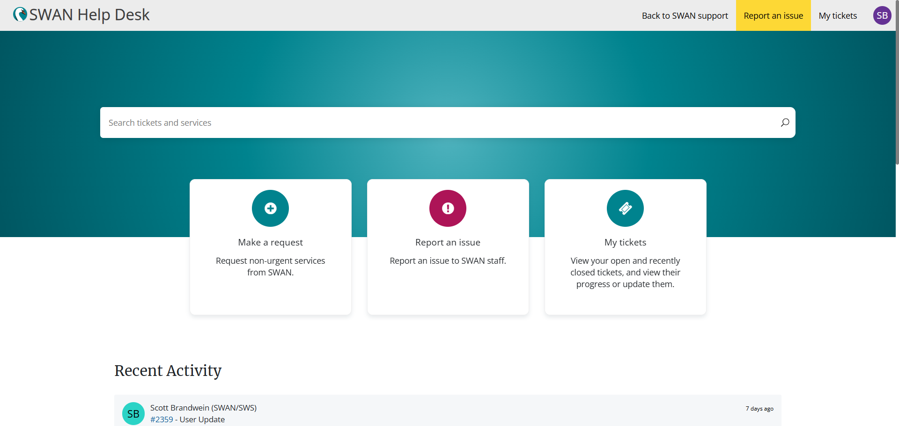

Slide 45
Finding Us
https://help.swanlibraries.net
help@swanlibraries.net

Slide 46
Next Steps
Create support site documentation
Finish single sign-on integration for L2 access
Launch on April 29th
  Member staff will not need to do anything special
  E-mail ticket responses will look different

Slide 47
Announcements & Questions

Slide 48


Aspen server migration
Configuration freeze Tuesday, March 11th – Wednesday, March 26 SWAN will temporarily disable permissions on library staff Aspen accounts
  Pause of staff sideloads of e-resources
  Any new integrations (e-resources, events, etc.)
  Record grouping & ungrouping
  Changes to library themes, locations, system settings
Migration starts Tuesday, March 25th through Wednesday, March 26th morning

Slide 49
Other announcements?

