Slide 1
Cataloging Working Group
October 15, 2026

Slide 2
Agenda
Welcome
Representative from Pre-cat Library
Change in meeting times 2028
Subject heading reminders
590 field and pre-cat formats
130 title field for film remakes
Fields for video games
Title consistency for numeric volumes
RFP Status
Call for April 8th’s In-person meeting location
Open Discussion
Next Zoom Meeting : January 14th, 2027, 9:30-11:00 AM

Slide 3
Welcome

Slide 4
Representative from Pre-Cat Library
Response to July’s meeting
Represents Pre-cat voice
Advisory
Facilitate communication
2-year term
Amy Weiss of Woodridge Public Library

Slide 5
Change in Meeting Times 2028
RFP kept things status quo for 2027
Meeting time change 2028?
  Depends on how RFP goes
  May need to keep same for 2028
  Tentative poll June send out

Slide 6
Subject Heading Reminders
  January meeting
    Forms
      Add back in the form designator (subfield v)
        |vJuvenile fiction
        |vJuvenile literature
        |vFiction
        Genre headings usage
    Large type subject removal
      Reminder to remove even when “controlled” or “greyed”
      Use the genre heading
        655 _7 Large print books.|2lcgft
  Non-English Language subject headings
    Spanish – bidex & qlsp
  https://swanlibraries.net/documentation/64630

Slide 7
590 Field and Pre-Cat formats
Evaluating 590 field and planning its retirement
  Looking at how Aspen assigns all formats
    Identifying Aspen development that could better align with pre-cat record standards
    Updating SWAN pre-cat record templates to align with these standards
    Updating documentation and trainings to convey updated practices

Slide 8
130 Title Field for Film remakes
Reminder for film remakes or live action film versions of animated films – please add a 130 field
  Example for Moana live action
    130 0_ Moana (Motion picture : 2026)
  Keeps different versions of films by the same name from grouping in Aspen
    Very important for holds and discoverability
This and more can be found on the MARC Field Reference – 1xx Fields page
  https://swanlibraries.net/documentation/66743

Slide 9
Fields for Video Games
OLAC recommendations
PlayStation 5
336 $a two-dimensional moving image $b tdi $2 rdacontent
336 $a computer program $b cop $2 rdacontent
337 $a computer $b c $2 rdamedia
338 $a computer disc cartridge $b ce $2 rdacarrier
344 $a digital $2 rdatr
344 _ $b optical $2 rdarm
347 $e region 1 $2 rdare
380 $a Video game.
538 $a System requirements: PlayStation 5 ; PlayStation 5 consoles in the United States; 2 GB minimum storage; Ultra HD Blu-ray.
500 $a 1-2 players.
521 8_ $a ESRB rating: M (Mature 17+; strong language, violence)
500 $a Title from disc label
753 PlayStation 5
https://cornerstone.lib.mnsu.edu/cgi/viewcontent.cgi?article=1017&context=olac-publications

Slide 10
Fields for Video Games Cont’d
Genre Headings for Video Games
655 _7 Video games. |2 lcgft
655 _7 Adventure video games. |2 olacvggt
655 _7 Role playing video games. |2 olacvggt
655 _7 Video games. |2 olacvggt
655 _7 Action adventure video games. |2 olacvggt

Slide 11
Title consistency for numeric volumes
Current Practice
Consistency in numbering
Recommends "volume", "part", and "book" be spelled out in the 245 tag
  Facilitates title sorting and standardization
    WorkFlows
    Aspen Online
  Does not include number, e.g. no.
  SWAN local practice
https://swanlibraries.net/documentation/86457

Slide 12
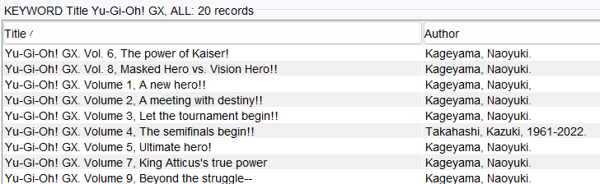
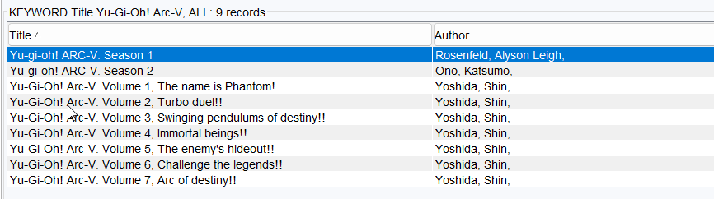
245 spelled out in subfield n
245 has variants for subfield n

Slide 13
RFP Status
IT’S LIVE!!!!!
SWAN ILS Search Information for Vendors | SWAN Library Services

Slide 14
April 8th Location
We need a location for the April 8th in-person meeting
Any volunteers?

Slide 15
Open Discussion

